Slide 1

Towards high-quality and inclusive education for all
Equinet Roundtable
Equality Bodies Enabling Equal Access of Roma People to Education
19 June 2025
Hristina Petkova DG EAC, A1 unit : Strategy and Investment

Slide 2
Overview
EU Roma Strategic framework (EURSF) for equality, inclusion and participation : recap
2023 Eurydice report on Diversity and Inclusion in Schools in Europe
2024 Implementation report on the EU Roma SF
Strategic European Education Area (EEA) initiatives : e.g. Pathways to school success and Basic Skills Action Plan
Trends in education and training : Headline indicators and targets
Mutual learning under the EEA

Slide 3

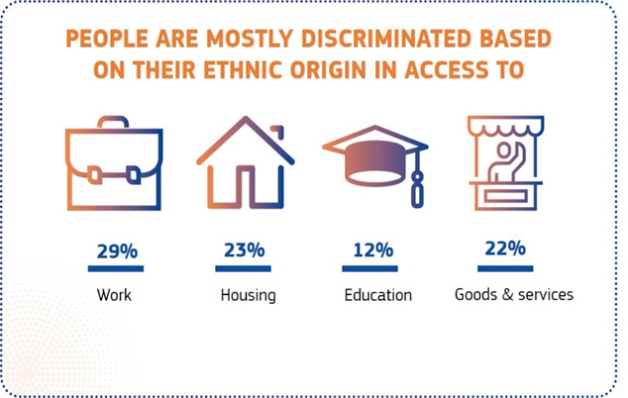
Combating discrimination on the basis of racial or ethnic origin in education : targeted legal and policy tools
EU Treaties, the Charter of Fundamental Rights
Council Directive 2000/43/EC
prohibits discrimination in education but covered only to the extent that the subject matter falls within EU competence.
  Not covered: the organisation of the school system, activities and the content of education courses, including how to organise education for persons with disabilities; Member States may provide for differences in treatment in access to religious educational institutions.
  Covered: C-457/17 Maniero: Scholarships covered if sufficiently close connection between scholarship and the participation in education
  Infringement cases : discrimination of Roma children in education
Directives on standards for equality bodies (May 2024 → June 2026)

Slide 4
Combating discrimination on the basis of racial or ethnic origin in education : targeted legal and policy tools (I)
EU Anti-Racism Action Plan (2020-2025)
EU Roma Strategic Framework for equality, inclusion and participation (2020-2030)
Communication with two annexes:
      Guidance for national strategies and Portfolio of indicators
Council Recommendation with guidance for concrete measures to achieve EU objectives and targets
Staff Working Document outlining the methodological, analytical and contextual basis of the proposal, baseline data from FRA
EU Headline targets in education and issues of equality data availability (FRA surveys)
Cut gap (50.2pps) in participation in early childhood education and care by at least half | to ensure that by 2030 at least 70% of Roma children participate in pre-school
Reduce gap (55.5pps) in upper secondary completion by at least one third | to ensure that by 2030 the majority of Roma youth complete at least upper secondary education
Work towards eliminating segregation by cutting at least in half the proportion of Roma children (44%) attending segregated primary schools (in Member States with significant Roma population) | to ensure that by 2030 less than one in five Roma child attend schools where most or all children are Roma

Slide 5
Combating discrimination on the basis of racial or ethnic origin in education : targeted legal and policy tools (II)
Council recommendation on Roma equality, inclusion and participation
Objectives
Providing stronger guidance to Member States and renewing their commitment to addressing the challenges faced by Roma communities
Setting out concrete measures that Member States should adopt to achieve equality, inclusion and participation of Roma
Five chapters
Horizontal objectives : equality, inclusion and participation
Sectoral objectives: education, employment, health and housing
Partnerships and institutional capacity (EB involvement)
Funding
Monitoring and reporting

Slide 6
Combating discrimination on the basis of racial or ethnic origin in education : targeted legal and policy tools (III)
Council recommendation on Roma equality, inclusion and participation
Chapter 3 : Partnerships and institutional capacity
EB cooperation with NRCPs, CSOs, other public and private institutions, general public
Institutional capacity to :
pursue cases of discrimination, hate speech and hate crimes, and pursue strategic litigation;
address underreporting of discrimination, hate speech and hate crimes, and raise awareness of rights among Roma;
conduct research into and collect data on equality of and discrimination against Roma;
build the capacity of and cooperate with Roma civil society, with a focus on access to justice and enforcing equality legislation;
provide guidance and training to the general public as well as public and private organisations;
Advice on design, monitoring and evaluation of the NRSF, EU funds monitoring committees

Slide 7
About this Eurydice report
Investigates national/top-level policies (reference year 2022/2023)
Focuses on learners at risk of experiencing disadvantage/ discrimination:
Girls/boys, learners from different migrant/refugee, ethnic minorities and religious backgrounds, LGBTIQ+ students, students with SEN/disabilities
Covers 39 European education systems
Report and policy tables available at: https://eurydice.eacea.ec.europa.eu/

Slide 8
Cooperation between top-level education authorities and national equality bodies
Education authorities cooperate with different bodies or organisations to prevent discrimination and promote diversity and inclusion in schools. Nearly all education systems participating in the report confirm ongoing collaborations with national equality bodies.
The main fields of cooperation between top-level education authorities and national equality bodies (see next figure):
  Policy development, e.g. providing recommendations for the development or amendment of regulations concerning equal treatment or inclusive education.
  Monitoring discrimination and disadvantage in schools, including collecting data or investigating cases of discrimination experienced by learners.
  Identifying good practices for preventing and combating discrimination and promoting diversity and inclusion in schools, e.g. sharing experiences, innovative actions or guidelines.
  Providing support to victims of discrimination, e.g. advice and legal assistance for learners who have been treated unfairly in school.
  Policy evaluation, e.g. support for monitoring the implementation of laws and regulations or conducting surveys about equal opportunities in schools.
  Other areas of cooperation, e.g. organising workshops and raising awareness about discrimination in education or organising training for teachers and other pedagogical staff.

Slide 9
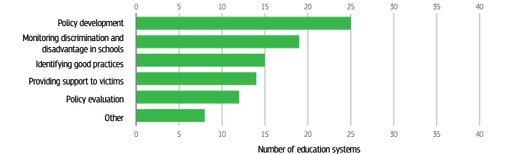
Main fields of cooperation between top-level education authorities and equality bodies, 2022/2023

Slide 10

2024 Report on the implementation of national Roma strategic frameworks
January 2023 : Assessment report on the Member States national Roma strategic frameworks
Main findings of the 2024 report :
  NRCPs: Several MS have strengthened the role of their NRCPs.
  Combatting antigypsyism: Some MS reported positive developments in this area.
  Segregation: Affected MS recognize the urgent need to address both spatial and educational segregation.
  Monitoring, targets and indicators: The EC recognises the efforts undertaken by MS to set targets for the objectives of the EU Roma Framework but better alignment with the EU-level targets is necessary
  Mainstreaming of Roma equality: improvement but more inclusive safeguards at regional and local levels are needed.

Slide 11
Roma Equal Access to Education: Challenges and Progress
Roma children continue to face significant barriers in accessing quality education, including segregation, discrimination, and lack of access to resources. (European Semester Spring package 2025)
These barriers can lead to lower educational outcomes, such as higher dropout rates and lower achievement in basic skills, lower participation in ECEC.
Overall countries focus on improving access to ECEC (pre-school years), employing inter-disciplinary teams or educational mediators, learning support measures, including transition years, free teaching materials, meals, transportation, intercultural training, better involvement of parents in school life.
Segregation in education is a major challenge, with 52% of Roma children aged 6-15 facing segregation in education. (Available online: Mapping Study on School Segregation of Roma Communities: Trends and Pathways Towards Educational Inclusion - Inclusive schools Making a difference for Roma children)
Funding: MS with large Roma populations have allocated a combination of funds to implement their frameworks but often they do not sufficiently cover the scale of the issue or are not used effectively. The EC encourages MS to make more effective use of EU funds (ESF+, ERDF, RRF, TSI).

Slide 12
Leading objectives of the European Education Area in terms of quality inclusive education
Inclusion involves access to and progress in high-quality formal, non-formal and informal education without discrimination.
Decouple attainment and achievement from socio-economic status and other personal characteristics.
Eliminate structural barriers for learners at risk of discrimination, underachievement and early school leaving.
Structural components of inclusive education systems and schools (legislation, implementing guidelines, effective needs identification, professional capacity, resource allocation, curricula and pedagogical approaches, monitoring & evaluation).
Build the capacity of policy-makers, educational institutions and educators to recognise and act against prejudice and discrimination.

Slide 13
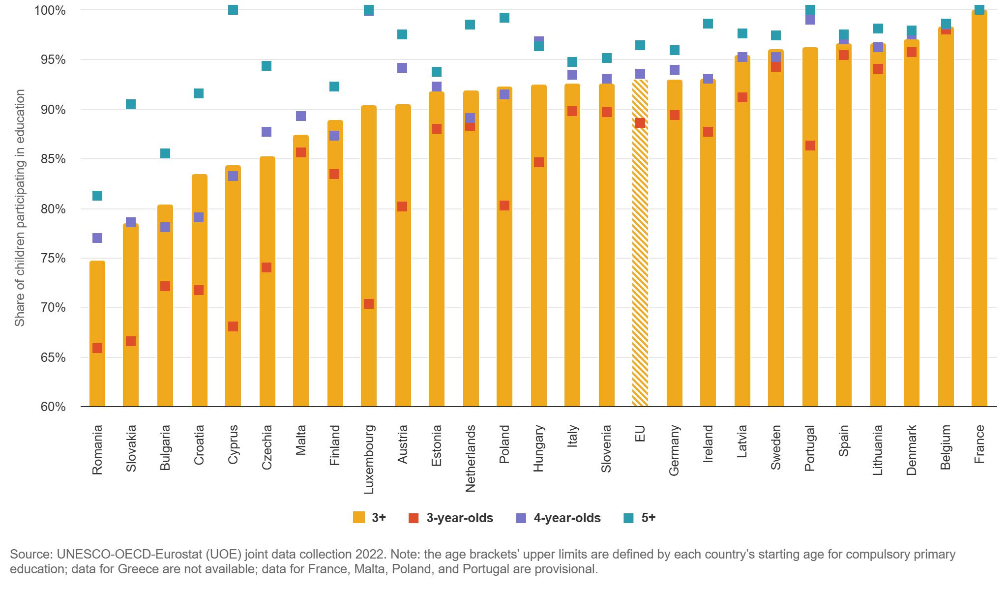
Participation in ECEC

Slide 14
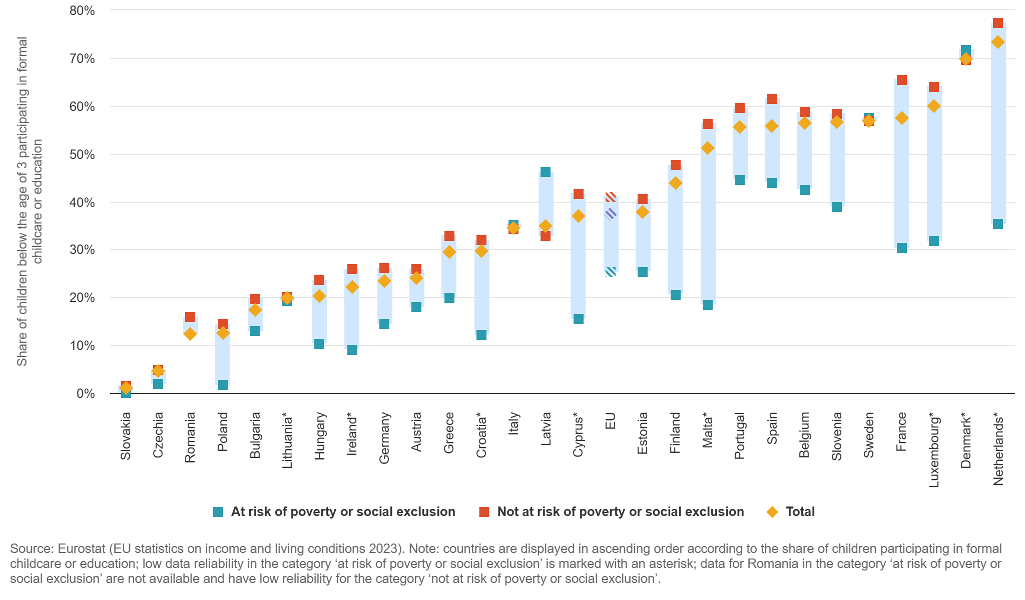
Children at risk of poverty or social exclusion are less likely to participate in formal childcare or education

Slide 15





What are the basic skills?
Literacy Numeracy Science Digital Citizenship
1 in 5 adults in the EU struggle to read and write
30% of 15-year-olds in the EU lack minimum proficiency in mathematics, while around 25% struggle in reading and science; 43% of eighth graders struggle with basic digital literacy; 50% of adults
Foundational (esp. literacy and numeracy) for more complex tasks and competences

Slide 16
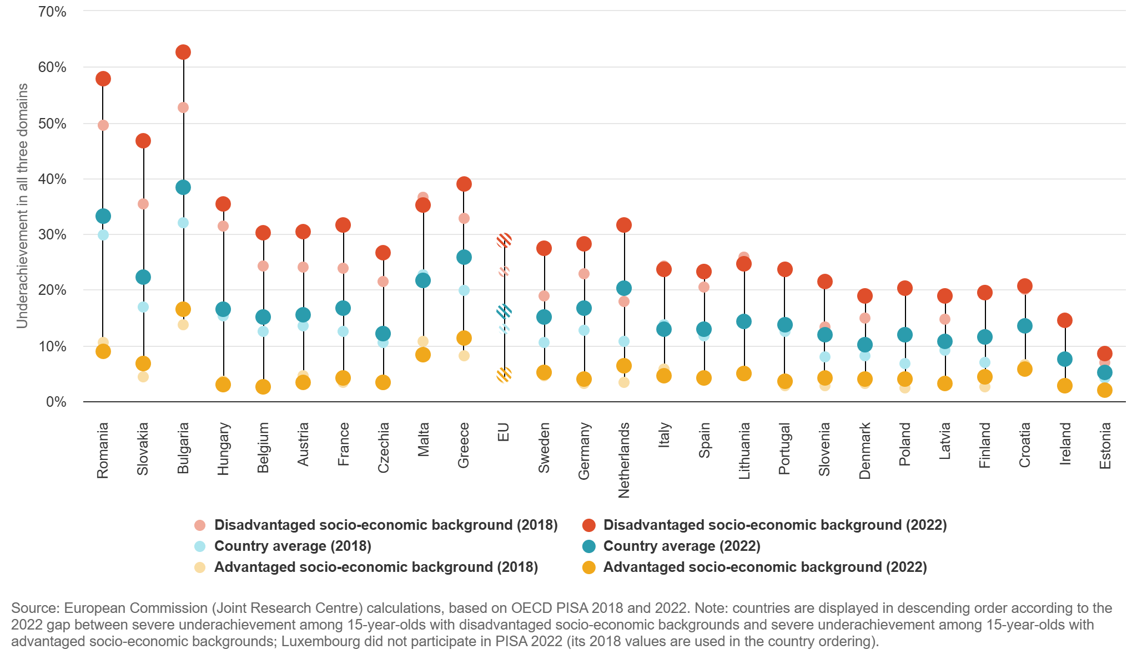
Inequity in learning outcomes has increased in most EU countries

Slide 17
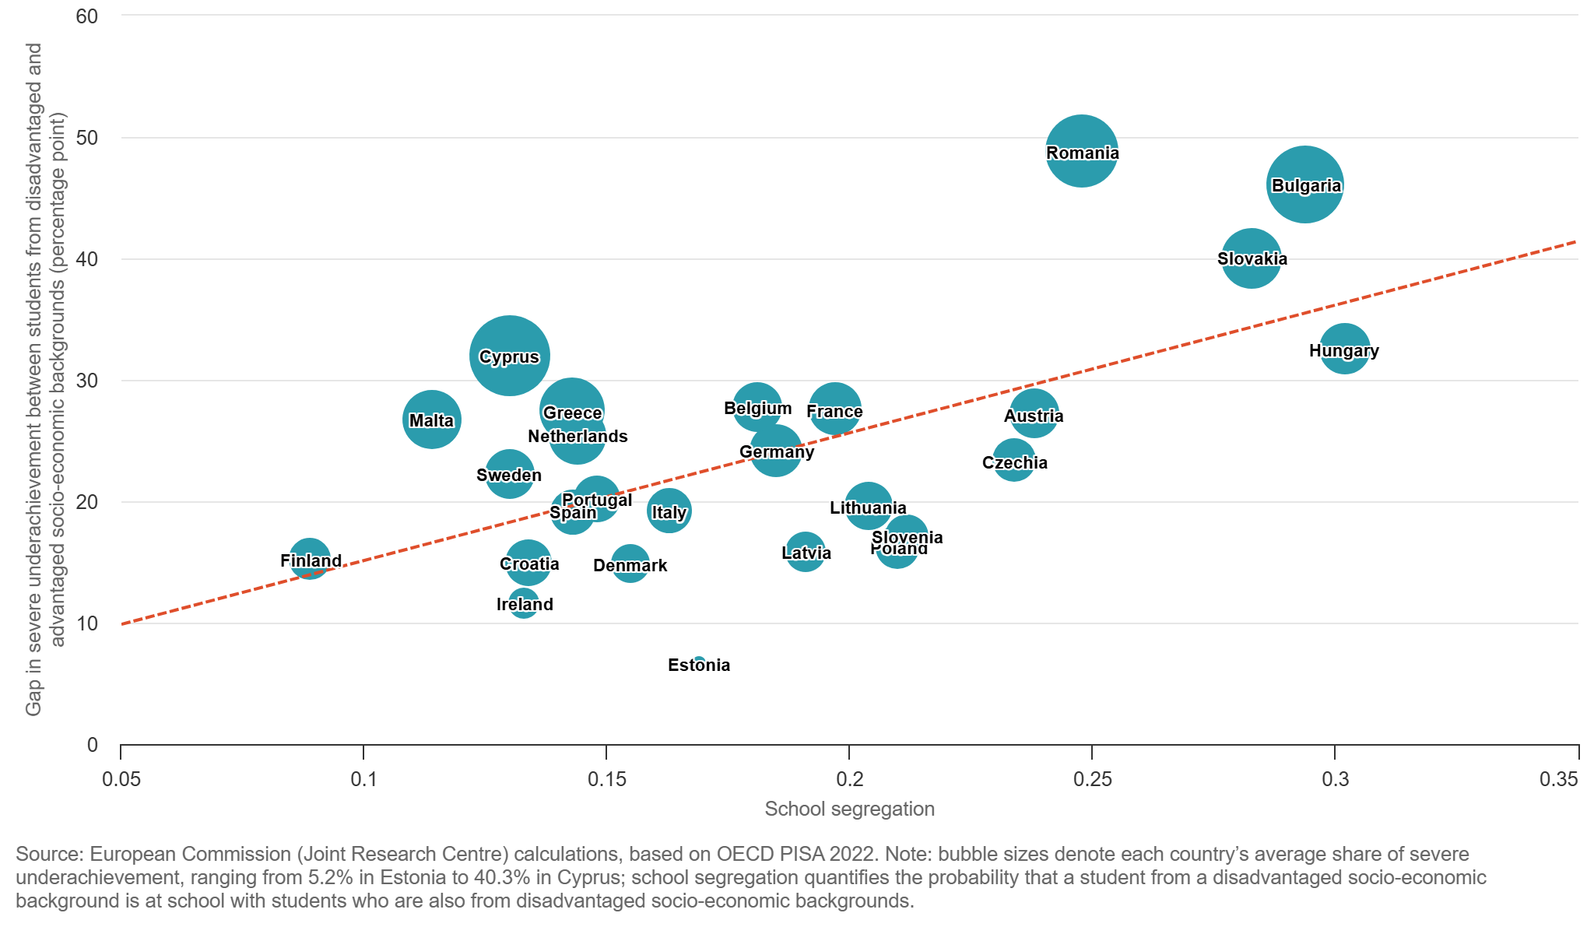
School segregation is associated with higher likelihoods of inequity

Slide 18
European Education Area strategic framework Working Group Equality and Values
Support implementation of the 2018 Council Recommendation on promoting common values, inclusive education, and the European dimension of teaching
Structural reforms to promote inclusion, equality and equity in education and training while building on the common EU values, in particular through citizenship education.
Dual approach of inclusive education for all and targeting specific population groups, i.e. both group-focused approaches (such as gender equality, anti-racism, equality of Roma, people with migrant background, LGBTIQ+ persons and people with disabilities) and cross-cutting issues with societal benefits and of high importance to all discriminated and disadvantaged groups, such as fighting segregation in education, managing diversity and building a sense of belonging in a lifelong learning perspective

Slide 19
EEA strategic framework Working Group Equality and Values
Topics covered so far:
gender equality (2022) Issue paper on gender equality in and through education
anti-discrimination (2023) Issue paper on tackling different forms of discrimination in and through education and training
citizenship education and promoting EU values (2023) Issue paper on citizenship education
special needs education - towards quality, inclusive and accessible education Input paper on Special Educational Needs ? Working towards more flexible systems of support to meet all learners’ needs (EASNIE, PLA); Reflection paper Special Educational Needs: non-physical vulnerabilities
Countering and preventing hatred (hate speech and bullying) Input paper on Confronting Hate Speech in and through Education (2024); Input paper on bullying off and online (2024), Issue paper on addressing hate speech and bullying
Still to come: Citizenship education an EU dimension (2025), Compendium of inspiring practices (end of 2025)

Slide 20


The structure of the tackling different forms of discrimination issue paper
1. Key definitions and concepts
2. Tackling discrimination based on ethnic or racial origin, including discrimination against Roma
3. Tackling discrimination based on religion or belief
4. Tackling discrimination based on disability
5. Tackling discrimination based on sexual orientation (gender identity or expression and sex characteristics)
6. Tackling social and territorial inequalities
7. Tackling multiple discrimination: an intersectional approach
Appendix: References
Notes:
sklgjskgjskljgskl

Slide 21
Tackling prejudice and discrimination based on racial or ethnic origin
Key points for attention:
  Diversity of experiences and voices within minority communities. It thus takes time and effort to allow all voices to be heard. But this inclusive process can improve what takes place in the curriculum and in schools.
  Multi-level strategies are needed to address racism, hate speech and discrimination directed at racial and ethnic minorities. Initiatives to raise awareness (individual and societal level), adjust the curriculum (decolonialisation, diversity of societies), mechanism of reporting racist incidents and discrimination (underreporting, internalisation of racist and discriminatory behaviours and actions), anti-bullying programmes
  Different forms of racism and different histories of persecution and marginalisation. (cooperation with UNESCO/ODIHR)
  Some common solutions : human rights education, socio-emotional learning, media/information literacy and (digital) citizenship education within national teaching and learning curricula to tackle the root causes. Fostering cooperation with civil society organizations, documentation and information centres, museums, history of local communities.
  Prevention of segregation and well-planned desegregation : INSCHOOL project : Inclusive schools making a difference for Roma children (CoE/EU)

Slide 22
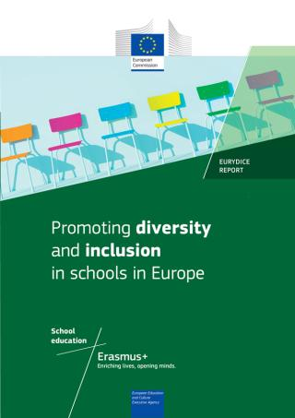
References
Education and Training Monitor
The Issue Paper on tackling prejudice and discrimination full, policy brief
Further EEA WG Equality and Values deliverables are available HERE
Basic skills - European Education Area
More information about all EEA strategic framework working groups is available HERE
Eurydice report on Promoting Diversity and Inclusion in schools in Europe
European Agency for Special Needs and Inclusive Education (EASNIE)
OECD Promoting inclusive education for diverse societies: A conceptual framework
Basic skills - European Education Area

Slide 23


Thank you
© European Union 2020
Unless otherwise noted the reuse of this presentation is authorised under the CC BY 4.0 license. For any use or reproduction of elements that are not owned by the EU, permission may need to be sought directly from the respective right holders

