Slide 1
Report findings:
Equality Bodies Work to Advance Equality for Trans and Intersex People
Miglė Kolinytė (she / her)
The Office of the Equal Opportunities Ombudsperson in Lithuania

Slide 2
Experience of Equality Bodies
Out of the 29 Equinet Members surveyed, more than half have some experience in addressing:
barriers to legal gender recognition
discrimination on the grounds of sex characteristics and gender expression
65,5 %
55 %

Slide 3
Equality Bodies working on trans and intersex rights
Equinet’s Discussion Paper „Equality Bodies working on the rights and discrimination faced by trans and intersex persons“ (2020) noted that protecting intersex persons was still a developing area.
Today, more Equality Bodies are actively engaged in promoting the rights of both trans and intersex persons.

Slide 4
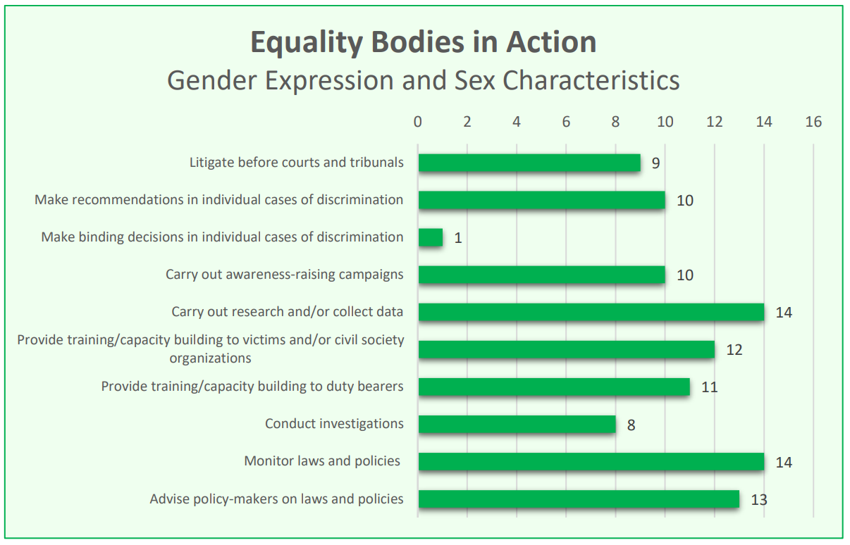
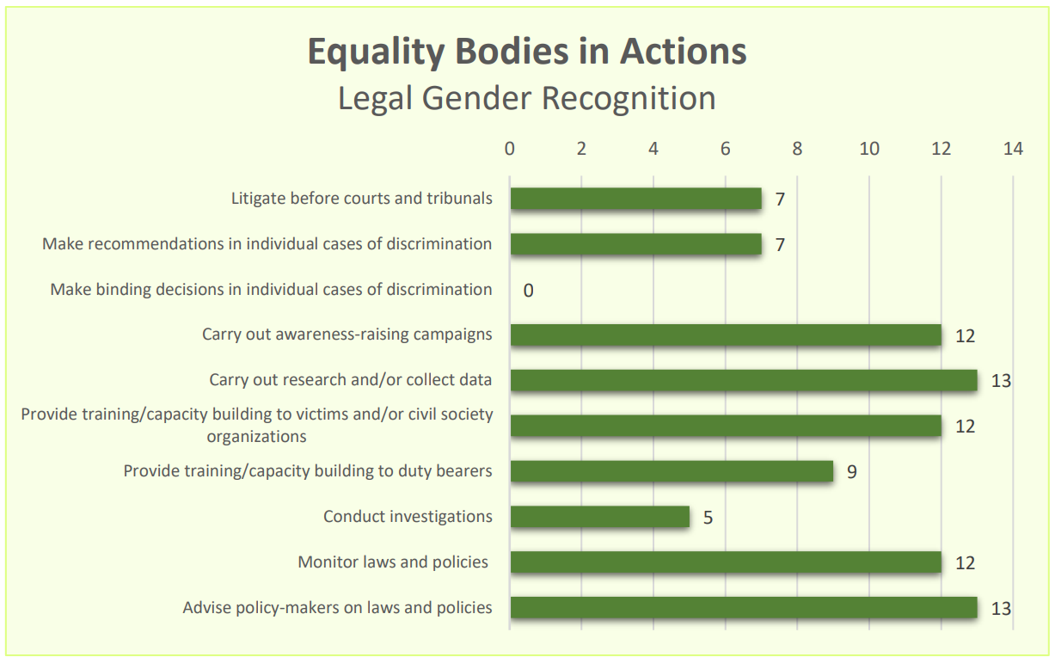
Equality bodies working on gender expression and sex characteristics and on legal gender recognition
Many Equality Bodies go beyond their formal mandates: Even when not explicitly mandated to address issues related to gender identity, gender expression, or sex characteristics, they often still take action to support affected individuals;
Research as a key tool: it’s important to note that many Equality Bodies carry out research and data collection on these grounds, which is a crucial part of tackling discrimination.

Slide 5
Examples: How Equality Bodies Protect the Rights of Trans and
Intersex Persons?
Ombud for Equal Treatment, Austria: Empowering people to inform service providers about their duties
Many Austrian websites still use binary gender forms (Mr./Ms.), excluding non-binary people. The Equal Treatment Commission found this discriminatory under the Equal Treatment Act.
The Ombud for Equal Treatment offers a sample letter for affected individuals to request changes. If companies don’t comply, the Ombud can take action.
They also provide guidance on inclusive forms and gender-sensitive language.

Slide 6
Examples: How Equality Bodies Protect the Rights of Trans and
Intersex Persons? I
Gender Equality Ombudsperson in Croatia: A Win for Trans Healthcare Rights in Croatia
In Croatia, the Gender Equality Ombudsperson supported a trans person denied insurance coverage for a mastectomy. After similar complaints, the Ombud found these refusals discriminatory, as such surgeries had been covered for others.
In one case, the Ombud's expert opinion helped win a 2021 court ruling that ordered the health insurer and hospital to reimburse the claimant.

Slide 7
Examples: How Equality Bodies Protect the Rights of Trans and
Intersex Persons? II
Institute for the Equality of Women and Men, Belgium: supporting parents of intersex children
The Belgian Institute for the Equality of Women and Men has published an information guide for the parents of intersex children.
The guide is handed out to medical professionals, medical teams and other stakeholders across the country to be distribute to and support parents of intersex children.

Slide 8
Examples: How Equality Bodies Protect the Rights of Trans and
Intersex Persons? III
Commissioner for Human Rights of the Republic of Poland: advocating for intersex rights
In recent years, the Polish Commissioner for Human Rights has raised concerns with the Minister of Health, the National Health Fund, and the Commissioner for Patients' Rights about the frequent use of invasive, non-consensual surgeries on intersex individuals.
After consulting medical and legal experts, the Commissioner emphasized that surgeries on atypical genitalia should only be done with the patient’s informed consent, especially when gender identity is uncertain. These efforts aimed to evaluate the treatment of intersex people in Poland and identify rights violations.

