Slide 1
Advancing equality for intersex persons and the role of Equality Bodies
May 2025

Slide 2
Who are intersex people?
Intersex people are people born with variations of sex characteristics, i.e sex characteristics that do not fit the typical definition of male or female. Intersex = an umbrella term for the spectrum of variations of sex characteristics that naturally occur within human species and which acknowledges that people with sex characteristics other than male or female exist.
Being intersex can become apparent at different stages of one’s life.
Intersex people make up 1.7% of the global population.
What are sex characteristics?
Sex characteristics can be primary or secondary
Primary sex characteristics have to do with sexual anatomy, reproductive organs, hormonal structure and/or levels and/or chromosomal patterns.
Secondary sex characteristics have to do with muscle mass, body & facial hair, breast development and stature.

Slide 3
Main challenges faced by intersex people in Europe

Slide 4
IGM
Intersex genital mutilation refers to non-vital, non-consenual surgical intervention, hormonal treatment and other medical interventions on an intersex person’s sex characteristics.
It is often performed without the person’s personal, prior, free and fully informed consent.
FRA LGBTIQ III Survey data:
57% of intersex respondents who were subjected to surgery did not provide – and were not asked for – their own or their parents’ informed consent before their first surgical treatment to modify their sex characteristics.
49% said they did not give informed consent for hormonal treatment.
IGM violates a person’s right to self-determination and bodily integrity.
IGM has been identified as a harmful practice by the European Commission and the European Parliament, the Council of Europe and United Nations Treaty Bodies.

Slide 5
Discrimination and violence
Experiences of discrimination
FRA LGBTIQ III Survey data:
62% of intersex respondents in 2023 felt discriminated against because of being intersex in at least one area of life compared to 61% in 2019 → no improvement.
In some cases, discrimination is seen to be on the rise.
A higher proportion of intersex respondents reported experiencing discrimination
when looking for work in 2023 (31%) than in 2019 (27%)
or when looking for housing to rent or buy in 2023 (28%) than in 2019 (20%)

Slide 6
Legal protection
Lack of explicit legal protection in anti-discrimination legislation
Only 13 Council of Europe Member States, including 8 EU MS have included sex characteristics as a protected ground in at least one area of life.
Lack of reporting and lack of use of existing rights and redress mechanisms
FRA LGBTIQ III Survey data:
62% of intersex respondents were aware of at least one equality body in their country (61 % in 2019),
Only 18% reported the discrimination incidents experienced to any organisation.

Slide 7
Experiences of violence
FRA LGBTIQ III Survey data:
34% of intersex respondents experienced one or more physical or sexual attacks in the five years before the survey in 2023 compared to 22% in 2019.
While in 2023, 5% of all LGBTI respondents said that they had been physically or sexually attacked in the twelve months before the survey, this was 15% for intersex respondents.
73% of intersex respondents experienced hate motivated harassment in daily life in the twelve months before the survey compared to 42% in 2019.

Slide 8
LEGAL PROTECTION
Lack of explicit legal protection
Only 9 Council of Europe Member States and 7 EU MS have legislation in place on hate crime and/or hate speech covering the ground of sex characteristics.
Lack of reporting and use of existing rights and redress mechanisms
FRA LGBTIQ III Survey data:
Only 28% of intersex victims reported the most recent incident of hate-motivated physical or sexual attack experienced to the police, or any organisation or institution.
Reasons for not reporting:
fear of LGBTIQ phobic reactions from the police (43%)
lack of trust in the police (38%)
lack of trust in receiving any kind of redress (39%)

Slide 9
Intersex people are a target of anti-LGBTIQ discourse and the anti-gender movement
Intersexphobia during Paris Olympics 2024, including hate speech in the media from prominent political figures and massive cyberharassment.
Harassment of activists by far-right groups and some governments

Slide 10
Challenges in access to employment, education, healthcare, housing
Lack of access to/difficulty in accessing quality education, employment, housing, healthcare services as a result of:
Experiences of discrimination,
Violence, including bullying from a young age
Trauma

Slide 11
Equality Bodies and intersex rights

Slide 12
EQUALITY BODIES ROLE
Incomplete legal protection from discrimination at national and European level
Alarmingly high levels of discrimination
Most Equality Bodies work on intersex rights, even if the ground of sex characteristics is not explicitly recognised in their mandate
9 out of 29 Equality Bodies surveyed in Equinet’s new report have an explicit mandate on sex characteristics.
18 out of 29 do not have an explicit mandate but address discrimination on sex characteristics through other grounds of discrimination or other competencies.
10 cover the ground under sex/gender
4 cover the ground through the open-ended list of discrimination grounds in the national anti-discrimination legislation

Slide 13
State of play
Legal protection ≠ perceivable improvement in the lives of intersex people.
Latest FRA data does not show lower levels of violence in countries with legal systems more protective of intersex people ( in anti-discrimination and hate crime/speech legislation).
Intersex people are the only group that have not experienced progress when it comes to discrimination between 2019 and 2024.

Slide 14
How to improve this situation?
Equality Bodies can:
Use the transposition of the EB Directive as an opportunity to, as equality bodies, advocate for ambitious national transposition, including explicit mention of the ground of sex characteristics.
Use the explicit mention of sex characteristics in article 6 of the EB Directive to make the case for this at national level.
Advance intersex people’s rights within the scope of your mandate
Issue recommendations, give your opinion on laws relevant for intersex people, ask for data when information about IGM is lacking, etc.

Slide 15
How to improve this situation? (2)
Collaborate more with intersex organisations at national level
Include intersex organisations in CSO consultation fora
Good practice examples in e.g. France, Austria
Conduct awareness raising measures on the existence, role, and mandate of EBs, mentioning the work on intersex.
Foster more understanding of the realities and challenges faced by intersex people
Carry out projects including intersex inclusion as a topic with key stakeholders e.g. trade and employers’ unions, law enforcement.
Adopt an intersectional approach in your work, taking into account the realities of specific sub-groups (intersex people from ethnic minorities and/or migrant backgrounds, intersex people with disabilities, trans and non-binary intersex people).

Slide 16
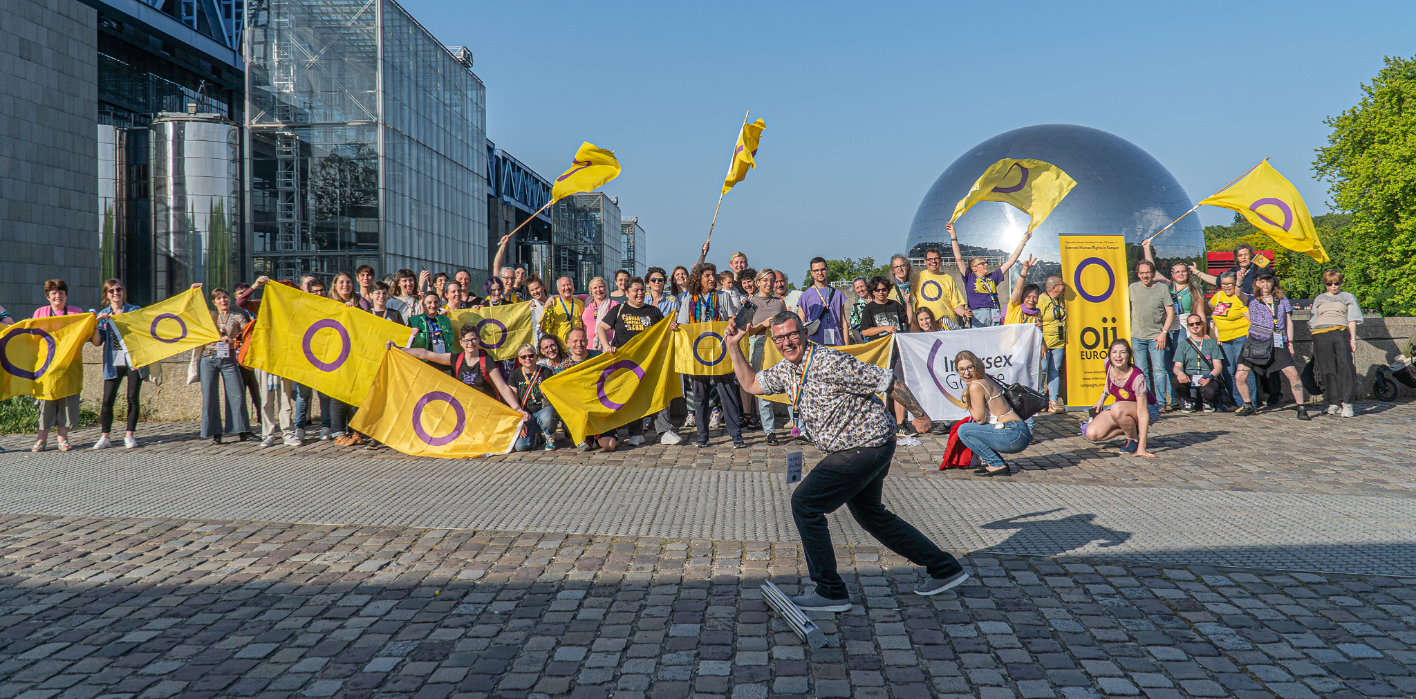
Thank you for your attention!

