Slide 1
The FRA European Union LGBTIQ Survey 2023
MAIN RESULTS
FOCUS on intersectional profiles and life experiences
Miltos Pavlou, EU LGBTIQ Survey project manager

Slide 2

LGBTIQ Equality at a Crossroads
A critical moment between progress and hatred
Signs of slow gradual progress amidst persisting or increasing violence and harassment
The moment to step up and strengthen
our efforts focussing on key areas

Slide 3
EU LGBTIQ SURVEY III 2023
→ Online survey June 15 – August 24, 2023
→ Surveying 100.577 respondents who are:
lesbian
gay
bisexual
pansexual, asexual or other sexual orientation
trans women and trans men
non-binary & gender diverse people
intersex or queer
above 15 years old and living in 30 countries
  the 27 EU Member States, plus, Albania, North Macedonia and Serbia
  Questionnaire with 124 questions in 31 languages
    Albanian, Bulgarian, Catalan, Croatian, Czech, Danish, Dutch, English, Estonian, Finnish, French, German, Greek, Hungarian, Italian, Latvian, Lithuanian, Luxembourgish, Macedonian, Maltese, Polish, Portuguese, Romanian, Russian, Serbian (in both Latin and Cyrillic alphabet), Slovak, Slovenian, Spanish (Castilian), Swedish, Turkish, Ukrainian
    Collected also more than 27 thousands personal stories

Slide 4
The EU LGBTIQ Survey themes
Asks questions about life experiences of LGBTIQ people (in bold new questions):
Discrimination
Violence and harassment
Victim support and reporting
Safety and societal participation
Workplace and education experiences
Homelessness
Freedom of movement
Self-perceived health
Life satisfaction
‘Conversion’ practices
Online hatred
Cancer diagnosis, treatment and prevention, HIV prevention and diagnosis
Mental health and suicidal feelings
Rainbow families and parenthood
Police complaint handling and victim support
Multiple and intersecting identities breakdowns and experiences
Perceived trends and government responses to intolerance and violence

Slide 5

Key findings - openness & discrimination
Openness: 52% of respondents are now open about being LGBTI compared to 46% in 2019.
Fear: 54% avoid holding hands in public with their same-sex partner compared to 61% in 2019.
Discrimination: 36% felt discriminated against in their everyday life in the year before the survey compared to 42% in 2019. Trans and intersex people are most affected.
Reporting: Only 8% of victims reported discrimination to an equality body or any other organisation compared to 9% in 2019.

Slide 6
Discrimination
The proportion of respondents who felt discriminated in at least one area of life in the year before the survey in 2023 survey decreased from 42% in 2019 to 36% in 2023.
One in three trans respondents feels discriminated when looking for a job or at work in 2023 (34%) compared to 41% in 2019.
The responses of intersex respondents shows little progress. For example, the same high proportion reported experiencing discrimination, such as when looking for work or at work (38%) in 2023 compared to 2019 (38%)
The share of LGBTI respondents who say that they reported a discrimination incident to an equality body or any other organisation, remains similar to the previous survey very low (8 % in 2023, 9% in 2019).

Slide 7

Key findings – violence & harassment
Violence: 14% of LGBTIQ people had been physically or sexually attacked in the five years before the survey compared to 11% in 2019. Intersex people face most violence (34% vs 23% in 2019).
Reporting violence: Only 18% of the victims reported it (20% in 2019) to the police or any organisation.
Harassment: 55% experienced hate-motivated harassment in the year before the survey compared to 37% in 2019. Intersex and trans people are most affected.

Slide 8

Key findings – education & health
Education: schools address LGBTIQ issues more often. 35% of 15–17-year-olds say that their school never addressed LGBTIQ issues compared to 47% in 2019.
Bullying: 67% say they suffered bullying, insults and threats at school because they are LGBTIQ compared to 46% in 2019.
Mental health: 37% of respondents considered suicide in the year before the survey last year. This proportion is much higher for pansexual people (59%), trans women (59%), trans men (60%) or non-binary and gender diverse people (55%).

Slide 9

Key findings – governments & inclusive societies
Satisfaction with governments: only 26% now believe their government effectively combats prejudice and intolerance against LGBTIQ people compared to 30% in 2019. The greatest fall in trust is in Malta, Luxembourg and Ireland.
Inclusive societies: LGBTIQ people and in particular intersex and trans respondents suffer disproportionately from homelessness compared to the general population. This is also true for LGBTIQ people with disabilities, in financial hardship or members of ethnic, racial or other minority groups.

Slide 10
Discrimination in employment – Trans Women & Men – EU LGBTIQ Survey III (2023)

Slide 11
Discrimination in employment – Non-Binary & Gender Diverse – EU LGBTIQ Survey III (2023)

Slide 12
Discrimination in employment – Intersex – EU LGBTIQ Survey III (2023)

Slide 13
Background:
A context of hate speech and FIMI campaigns while social acceptance increases
Source: FIMI targeting LGBTIQ+ people: Well-informed analysis to protect human rights and diversity, October 2023
“There is now a robust body of evidence displaying how foreign information manipulation and interference (FIMI), including disinformation, feeds on vulnerabilities and hot-button issues. It twists them to sow divisions and distrust, and to polarise our societies. One of the groups considerably targeted with FIMI is the LGBTIQ+ community.”

Slide 14
Online hatred – themes and frequency

Slide 15
Eurobarometer - same sex marriage acceptance (totally agree+tend to agree), 2006-2015-2019-2023

Slide 16
Main Survey results

Slide 17
Prevalence of hate motivated violence in the last 5 years / by SO-GIE-SC

Slide 18
Prevalence of hate motivated violence in the last 5 years / by minority belonging

Slide 19
Harassment against LGBTIQ respondents in the year before the survey

Slide 20
Respondents who during their time in school, they have been ridiculed, teased, insulted or threatened because they are LGBTIQ

Slide 21
Reporting the most recent hate motivated incident of physical or sexual attack

Slide 22
Life and Dignity
- Homelessness

Slide 23
Life and Dignity
- Mental health

Slide 24
Life and Dignity
- ‘Conversion practices’

Slide 25
Who are the respondents? The universe of SO-GIE-SC

Slide 26
LGBTIQ Survey respondents by SO-GIE-SC

Slide 27
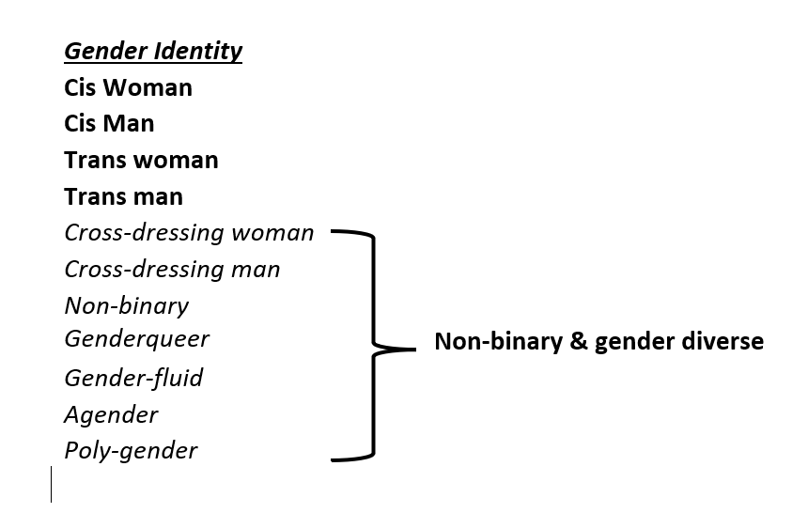
Trans women – trans men and Non-Binary & gender diverse
In the survey analysis and reports we disaggregate trans people under the criterion of binary or non-binary self-identification
→ After consultation with LGBTIQ communities

Slide 28
Intersectional discrimination in EU law?
FRA has addressed intersectional discrimination in its work, and expressed the need for explicit inclusion of intersectional discrimination in EU legislation, see in particular in its FRA OPINION – 1/2021 on Equality in the EU 20 years on from the initial implementation of the equality directives (europa.eu):
FRA OPINION 2
The EU legislator should consider broadening the concept of discrimination to include intersectional discrimination in existing and new legislation in the area of equality and non-discrimination. This would enable the EU and Member States to reinforce legal protection against intersectional discrimination, in particular for women who face discrimination based on the combination of different grounds of discrimination.
(..) The EU and the Member States should acknowledge the multiple and intersecting identities of LGBTIQ people, with respect to their sexual orientation, gender identity and sex characteristics, and ensure that legislation or policy promoting LGBTIQ equality adopts an intersectional approach to reflect the reality and lived experiences of LGBTIQ people.
intersectional discrimination has already been included in the two Directives on Standards for Equality Bodies, in the framework of raising awareness about discrimination

Slide 29

How to advance LGBTIQ equality?
Discrimination: tackle discrimination in all areas of life and empower and properly resource equality bodies so they can better support victims.
Hate crime: enforce a culture of zero tolerance towards violence and harassment of LGBTIQ people.
Online hate: tackle online hatred and disinformation campaigns against LGBTIQ people.
Education: make schools safe and supportive learning environments for all children and tackle bullying.
Healthcare: secure access to quality healthcare, including mental health support. End ‘conversion’ practices and non-vital medical interventions.

Slide 30
Thank you! email: fra-lgbti-survey@fra.europa.eu
FRA – EUROPEAN UNION AGENCY FOR FUNDAMENTAL RIGHTS
Schwarzenbergplatz 11 – 1040 Vienna – Austria
T +43 158030-0 – F +43 158030-699

