Slide 1
European Artificial Intelligence Act
Karolina Iwańska
Digital Rights Advisor, ECNL

Slide 2
EU Artificial Intelligence Act
Context:
Adopted in 2024, entry into effect starting in February 2025
Directly applicable in all EU Member States, aimed to harmonise internal market on AI while protecting fundamental rights

Slide 3
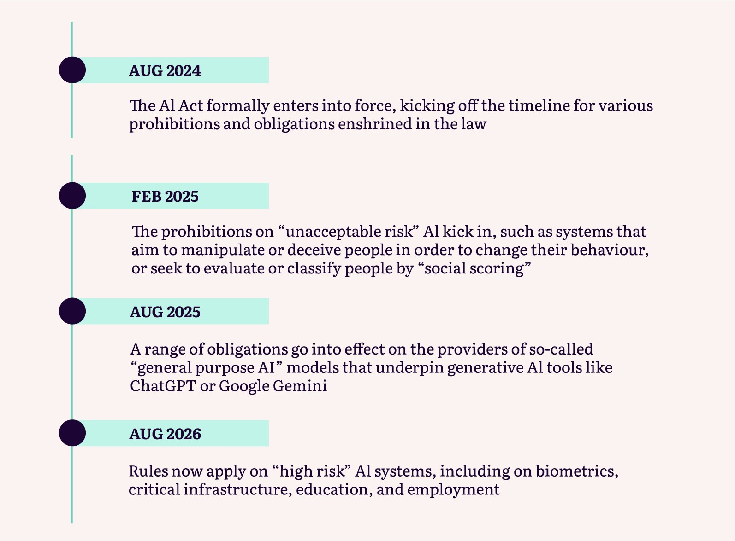
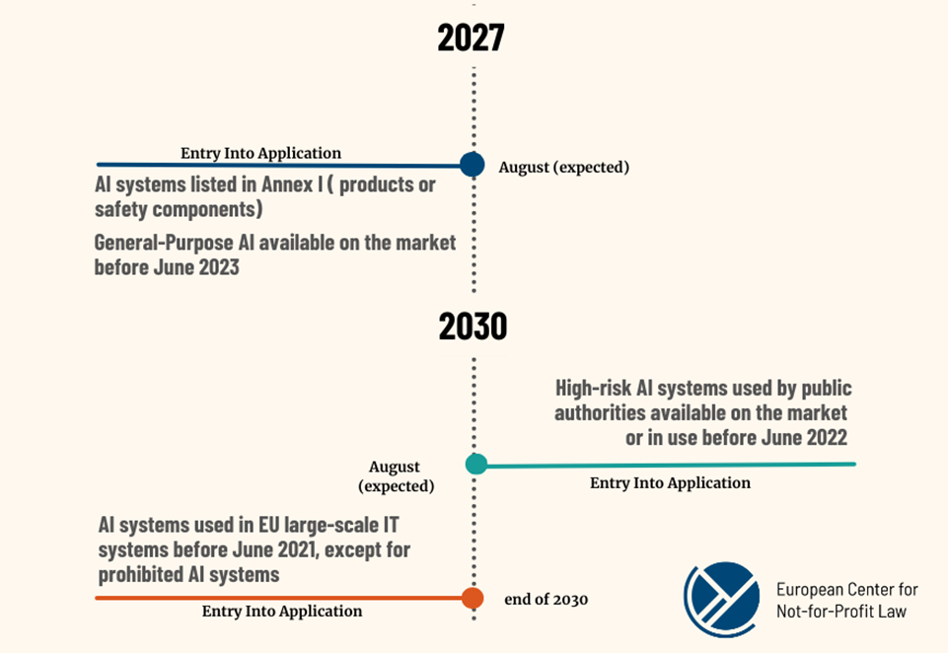
The AI Act is adopted, what happens now?

Slide 4
Risk-based approach
Notes:
How will the AI Act address identified problems:
How it feeds the current narrative → appetite to limit what is high-risk

Slide 5
AI Act fundamentals: AI providers vs AI deployers
AI provider: individual, company, public authority that develops an AI system or a GPAI moder, or that commissions it, and makes it available on the EU market for sale or for use under its own name
AI deployer: individual, company, public authority putting the AI system into use under its authority

Slide 6
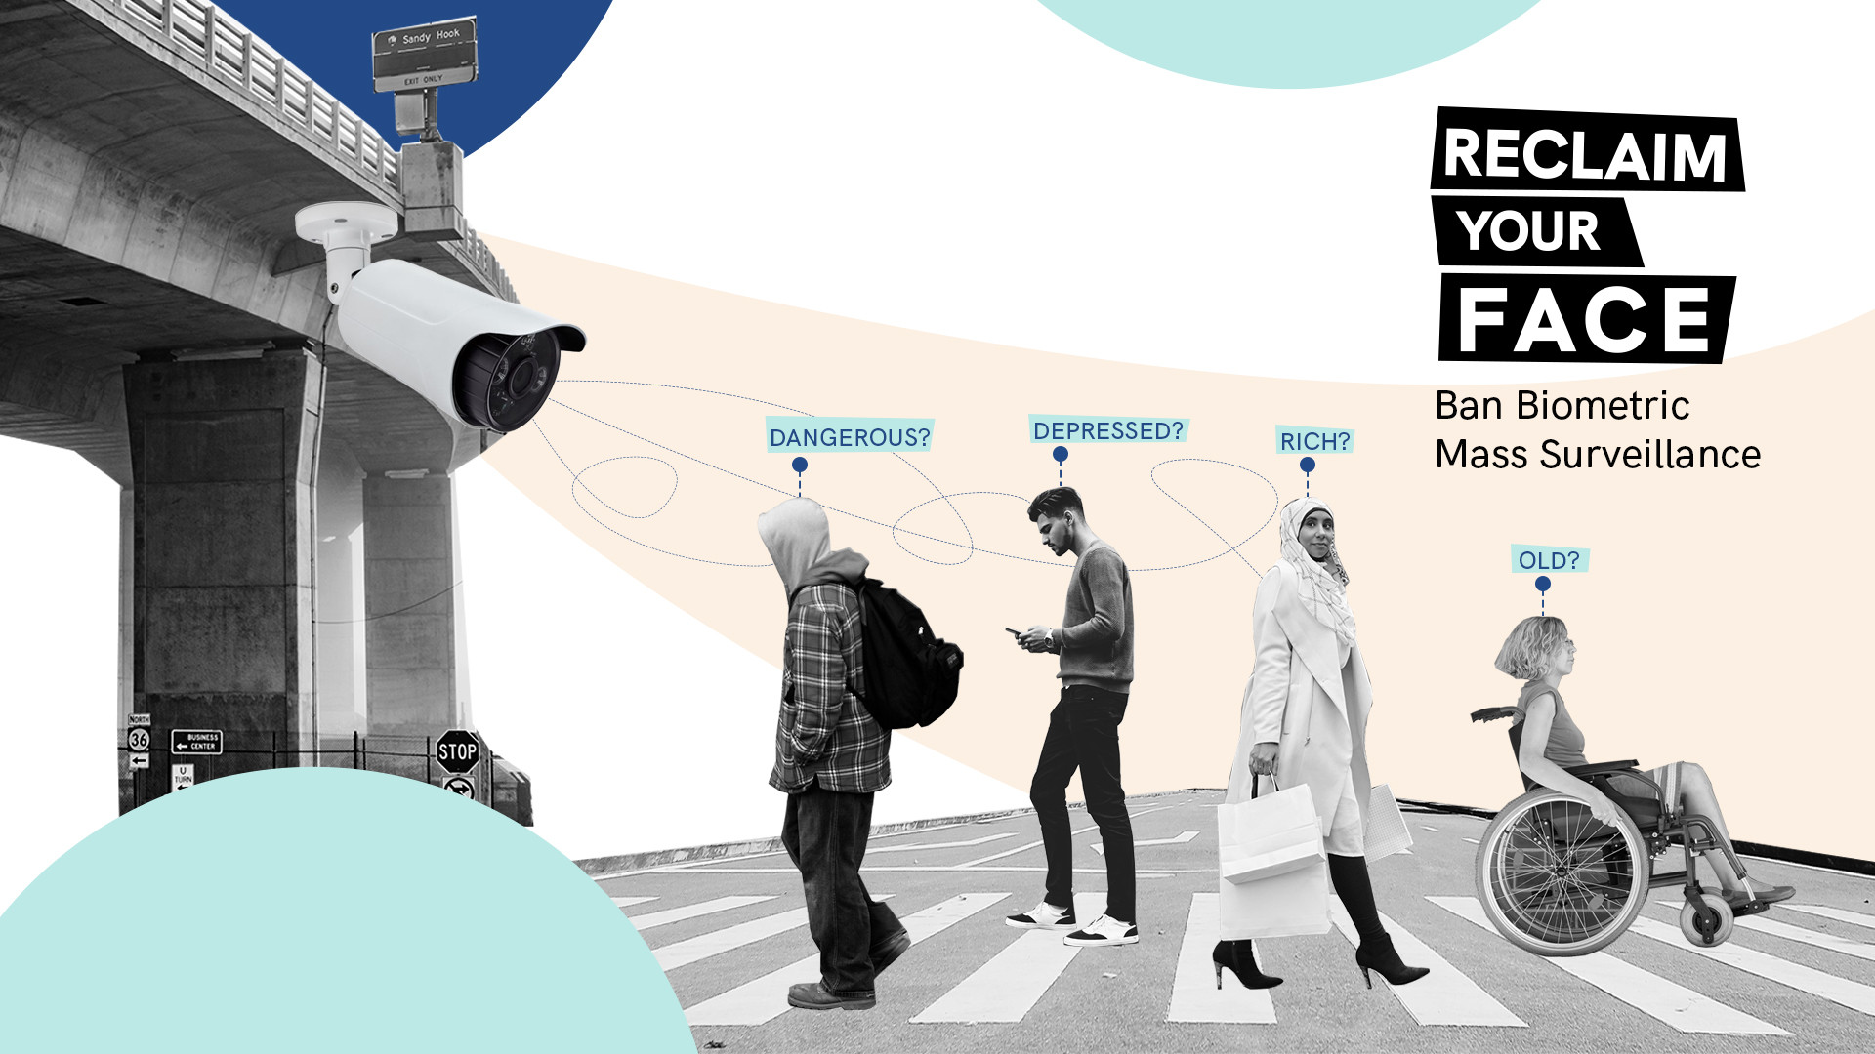
Prohibited AI systems (art. 5) (1)
‘Real-time’ remote biometric identification (RBI) systems in publicly accessible spaces for the purpose of law enforcement, unless the targeted search of victims of crime, prevention of a terrorist attack, search of the perpetrator of a crime.
Emotion recognition in the area of workplace and education
Predicitve policing involving profiling of individuals
Biometric categorisation based on sensitive characteristics
Social scoring: evaluation of “trustworthiness” by public authorities, leading to unjustified, disproportionate or detrimental treatment
The use of subliminal/manipulative techniques aimed to distort a person’s behaviour and likely to lead to harm
AI systems which exploit vulnerabilities linked to age, disability or social or economic situation, aimed to distort a person’s behaviour and likely to lead to harm
Human rights-based concerns:
Far-reaching exceptions
No full prohibition of biometric surveillance
No prohibitions in the politicised area of migration
Broad national security exemption

Slide 7
Prohibited AI systems (art. 5) (2)
Modification of the list of prohibitions:
Only through amendment of the AI Act (new legislative procedure)
The Commission has to assess the need for amending the list yearly but they cannot do it themselves
Evidence for the review can be provided to the Commission
Implementation timeline
Will start applying in February 2025
The Commission is consulting guidelines to be finalised before February
Potential enforcement gap until August 2025

Slide 8
High-risk AI systems (1)
Strict regulatory safeguards only for high-risk AI
Providers: conformity self-assessment:
risk assessment and mitigation system;
checks for data quality and accuracy, bias prevention;
technical documentation;
human oversight;
accuracy, robustness and security;
will be standardised by CEN/CENELEC.
Deployers: fundamental rights impact assessment
Transparency register
Post-market surveillance by an authority
Biometric and emotion recognition systems;
Education - access to education, evaluation or monitoing of students;
Welfare - access to and enjoyment of public benefits;
Law enforcement – geographic predictive policing, risk assessments, polygraphs;
Migration, asylum and border management – individual risk assessments, visa and asylum assessments, polygraphs;
Justice and democracy – researching laws, influencing the outcome of elections;
Employment - recruitment systems, worker managment;
Credit scoring and assessment of insurance premiums.

Slide 9
High-risk AI systems (2)
Who decides that an AI system is high-risk?
Exhaustive list of high-risk systems included in Annex III
Annex III is to be reviewed yearly by the Commission who can add/remove systems from the list based on the list of high-risk criteria in Art. 7
Big loophole: providers can self-assess that their system is not high-risk, despite falling under Annex III, where it “does not pose significant risk of harm to health, safety or fundamental rights”, e.g. when the system:
Performs a narrow procedural task
Improves the result of a previously completed human activity
Detect decision-making patterns;
Perform a preparatory task to an assessment.
Biometric and emotion recognition systems;
Education - access to education, evaluation or monitoing of students;
Welfare - access to and enjoyment of public benefits;
Law enforcement – geographic predictive policing, risk assessments, polygraphs;
Migration, asylum and border management – individual risk assessments, visa and asylum assessments, polygraphs;
Justice and democracy – researching laws, influencing the outcome of elections;
Employment - recruitment systems, worker managment;
Credit scoring and assessment of insurance premiums.

Slide 10
General Purpose AI Systems
All GPAI models:
Maintain technical documentation
Implement a copyright policy
Publish information about content used for training
Make information available to downstream deployers
GPAI models posing „systemic risks”:
Identify and mitigate systemic risks
Document and report serious incidents, e.g. Infringement of fundamental rights, damage to people’s health or to the environment;
Ensure cybersecurity.

Slide 11
Public transparency: EU database
Transparency database
However....
EU-wide, publicly accessible
Will include information about high-risk AI systems:
Technical information about the system
In which Member States the system has been made available and put into use
For public sector deployers: results of Fundamental Rights Impact Assessments
No public access to information about AI systems in the area of law enforcement and migration
Unclear if art. 77 authorities will have access to the database

Slide 12
Redress and individual transparency
Individual notification and right to explanation
The right to complain
Possibility to flag infringements to the supervisory authority, but no “traditional” complaint procedure
Collective redress to protect consumer rights (e.g., against banks or insurance companies, generative AI)
Individuals need to be notified when they are subject to a high-risk AI system (no clarity what information)
They can also receive an explanation of the outcomes of the system (even if the system only assisted a human decision)
However, might not apply to law enforcement if countries decide so
Workers should be informed before using a high-risk AI system

Slide 13
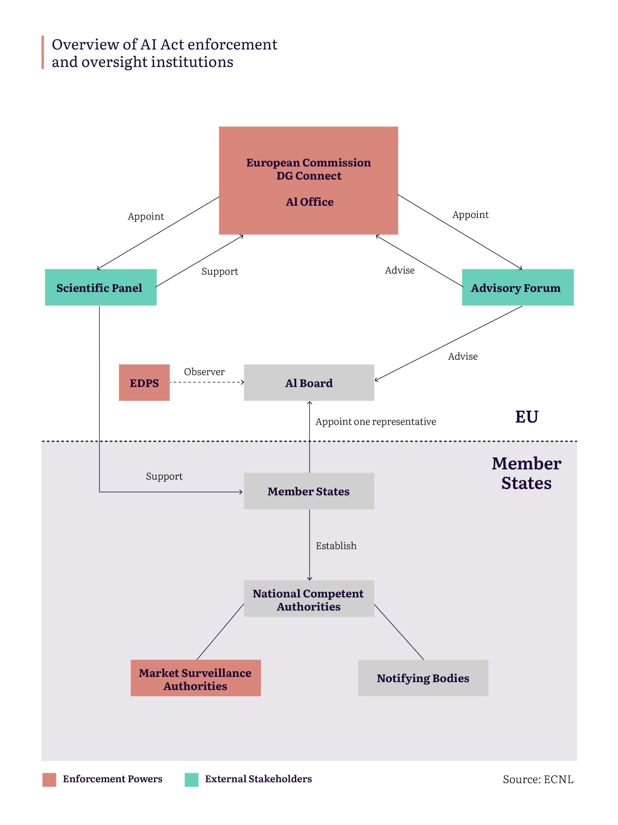
Enforcement
Market surveillance logic
No straightforward redress mechanism for affected people
External expertise involved in the Scientific Panel and Advisory Forum
A role for Equality Bodies

Slide 14
Implementation
Guidelines on prohibitions | To be adopted by February 2025
Guidelines on the definition of AI | To be adopted by February 2025
Set up of AI Office, AI Board | Done
Advisory forum and scientific panel | End 2024/Beginning 2025
Code of practice on GPAI | Ongoing, to be adopted by May 2025
Guidelines on high-risk AI | To be adopted in 2025
Template on FRIAs | To be adopted in 2025
Code of practice on transparency of generative AI and guidelines on transparency towards people affected | CoP be adopted by May 2025 Guidelines: unclear
Technical standards | Ongoing, first votes in H2 2025, to be potentially approved in 2026

Slide 15
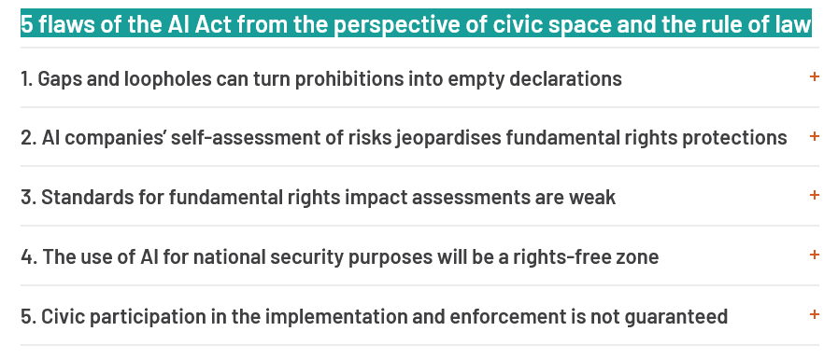
Important effort to regulate AI but not a golden standard

Slide 16
Part of a larger regulatory trend
Council of Europe Framework Convention on Artificial Intelligence – the first international treaty on AI, open to signatories from around the world
National-level legislation in the US, China, Canada, Brazil, Costa Rica, others...
UN General Assembly Resolution on Artificial Intelligence
Global Digital Compact

Slide 17
Questions?
European Center for Not-for-Profit Law

