Slide 1
Fundamental rights in a just and green transition
Ursula Till-Tentschert, Equality, Social Rights and Roma Unit
Equinet Seminar: Climate Change and its Equality Implications in Focus: Tools for Equality Bodies
20 November 2024, Brussels
Notes:
FRA’s work
2) Legal & policy frame, with a focus on a just transition
3) Challenges
4 ) Ways forward
For the FRA strategic plan 2022-2028 7 key future challenges and implications for fundamental rights were identified, climate change was one of those
Challenges to Justice and the rise of a Security-based Agenda
Threats to Democratic Value
Deepening Inequality and Increased Discrimination
Changing Patterns of Migration
Economic and Social Trends
Digital Transformation and AI
Climate Change

Slide 2
FRA‘s projects/work on environment & climate change
2022-2024: Business and Human Rights: Consumer Protection and the Environment
Since 2024: Fundamental rights in corporate sustainability and due diligence
Since 2023: The right to environmental protection/Fundamental Rights in a Just and Green Transition
2023 Foresight exercise on climate change and the green transition
2023 report: EU funds: Ensuring compliance with fundamental rights
Survey data on environment and energy poverty

Slide 3
1) Business and Human Rights: Consumer Protection and the Environment
Methods
FRANET desk research in 10 Member States
Stakeholder and expert consultation
Research identified and analysed relevant national law, policy and practice, to identifying
scope of available legal instruments;
gaps or obstacles in the implementation of the law and possible ways to overcome them
examples of promising practices as regards empowering consumers to influence businesses to adopt more environmentally sustainable behaviour.
Objective: How businesses can be held accountable for their environmental statements (green claims) and how consumers can have access to adequate information to be able to make informed choices to consume in a more sustainable and environmentally friendly way.
Article 38 CFR : ‘Union policies shall ensure a high level of consumer protection.’
The research report Enforcing consumer rights to combat greenwashing was published in March 2024:
Notes:
It provides positive examples and examples of shortcomings or inconsistencies in the implementation of existing EU legislation, identifies areas in need of improvement and offers solutions for closing existing gaps.

Slide 4
2) Fundamental Rights in corporate sustainability and due diligence
Objective: to provide guidance on corporate due diligence and addressing actual and potential adverse impacts of companies’ activities on fundamental rights and the environment.
Main outputs:
Thematic chapter of the FRR 2025
Legal opinion(s) on corporate sustainability reporting standards when requested by the EC and / or ESMA
Report (legal study and findings from the fieldwork research, 2026)
Webinars on human rights due diligence in corporate sustainability framework
Symposium on access to justice in the CSDDD (Q1 2025)
Methods
Legal analysis
FRANET Desk research
FRANET In-depth interview-based research with relevant practitioners 8 MS
Stakeholder consultations and outreach
Advice on transposition of CSDDD

Slide 5
EU law – FRA reference
Directive on Corporate Sustainability Due Diligence (CSDDD)
Advice on guidelines - sector agnostic, specific sectors or specific adverse impacts
Observer at the European Network of Supervisory Authorities (tbc)
EU-Taxonomy Regulation 2020/853/EU
Platform on Sustainable Finance: minimum social safeguards
Corporate Sustainability Reporting Directive 2022/2464 (CSRD)
European Financial Reporting Advisory Group e.g. development of the sustainability reporting standards
Legal opinions (European Commission, European Securities and Markets Authority (ESMA))
5

Slide 6
3) Fundamental rights in the just and green transition
METHODS
Stakeholder & expert consultation
Desk research in 30 countries (all EUMSs & AL, RS, MK)
National Energy and Climate Plans (due in June 2024)
Just Transition Mechanism (JTM) and its key priorities
FRANET research in 10 Member States (BE, CZ, DE, EE, EL, ES, FR, PL, RO, SE):
Selected projects to reach the climate targets with a focus on
Energy efficiency
Energy poverty
to identify the most urgent social and fundamental rights dimensions of the EU’s green transition and relevant implementing legislation against the background of climate change and in light of the overarching principle of the Agenda 2030 to leave no one behind.
To raise awareness on the relevance to take a fundamental rights perspective to the green transition
To provide evidence on gaps and challenges and identify promising practices and principles for the just transition with a focus on persons in vulnerable situations
To complement existing research and data on the green transition (eg from EEA & EC) taking a new focus on fundamental rights
To inform, advise and provide guidance to EU institutions and Member States

Slide 7
Research 2024: What do we ask?
Selected projects:
Energy efficiency
Energy poverty
Expert interviews from:
Coordination
Implementation
Civil Society
Other (academia, media,...
Target groups: eligibility, impact, safeguards, gaps
Accessibility: equality and non-discrimination, barriers, gaps
Information & Communication: public perception, social acceptability
Stakeholder engagement & Participation
Monitoring, Data & Accountability
Overall assessment and ways forwards
Notes:
Premept the results, I can already say that it

Slide 8
Where are fundamental rights in the green transition?
“© Ssstocker/AdobeStock
Notes:
Needle in the haystack search

Slide 9
Main Outputs
Stakeholder/expert meeting November 2023
Main results report in Q3 2025
Stakeholder consultation on follow up research
Follow up research end of 2025: climate change resilience, mitigation measures, groups and localities at risk to be left behind
Forthcoming: Focus paper on fundamental rights in the Green Deal to be published in January 2025
Provide a conceptual frame
To raise awareness
To build capacity

Slide 10
EuropeanGreen Deal (Climate law (EU) 2018/1999)
To transform the EU into a modern, resource-efficient and competitive economy, ensuring:
no net emissions of greenhouse gases by 2050
economic growth decoupled from resource use
Fit for 55: reducing net greenhouse gas emissions by at least 55% by 2030 compared to 1990 levels
no person and no place left behind
new Commission to set the 2040 target
One third of the €1.8 trillion investments from the NextGenerationEU Recovery Plan, and the EU’s seven-year budget will finance the European Green Deal.

Slide 11
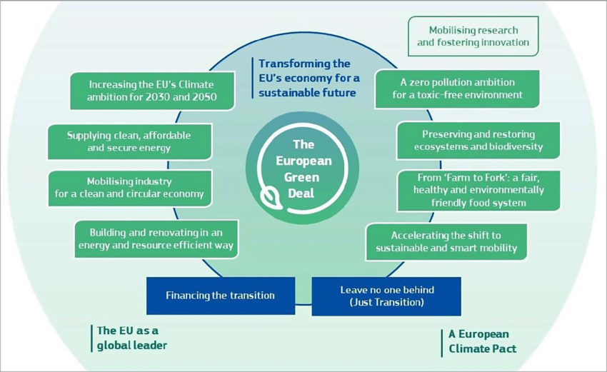
The EU Green Deal

Slide 12
Human rights frame
Policy frame
2015 Paris Agreement: enshrines the global obligations for United Nations Member States as a response to the urgent threat of climate change aiming to cut greenhouse gas emissions and “to limit the temperature increase to 1.5° C above pre-industrial levels.”
EU Charter for Fundamental Rights:
Article 37 – Environmental protection
Article 21 - Non-discrimination
Article 23 - Equality between women and men
Article 24/25 - Rights of the child/elderly
Article 26 – Integration of persons with disabilities
Article 34 - Social security and social assistance
Article 36 - Access to services of general economic interest)
European Green Deal & Fit for 55
8th Environment Action Programme
UN Sustainable Development Goals and the principle to “leave no one behind”
European Pillar of Social Rights
action plan
20 principles
Notes:
Solidarity: Article 37: Environmental protection
A high level of environmental protection and the improvement of the quality of the environment must be integrated into the policies of the Union and ensured in accordance with the principle of sustainable development.
Although Article 37 of the Charter is a principle and not a right, it can be read in conjunction with other Charter rights to enhance the protection of the individual in the context of the environment.

Slide 13
Key legislation & instruments
Just Transition Mechanism
Social Climate Fund
Energy Efficiency Directive (revised EU/2023/1791): asks MS to ensure that the competent authorities take actions to mitigate significant negative direct or indirect impacts of energy efficiency measures on energy poor, low-income households or vulnerable groups when designing and implementing energy efficiency measures.
Common Provisions Regulation (EU) 2021/1060 of the European Parliament and of the Council of 24 June 2021 laying down to govern 8 EU funds and enabling conditionality
Horizontal principle to ensure respect for fundamental rights and compliance with the Charter of Fundamental Rights of the European Union and the Convention on the Rights of Persons with Disabilities in the implementation of the funds.
includes the just transition fund, ESF+, ERDF, cohesion fund,…
does not include the upcoming social climate fund 2026 and the next generation fund (2021-2026)
European Pillar of Social Rights & Union of Equality
Notes:
The definition of energy poverty is included in the Directive EU 2023/1791 on energy efficiency and Regulation EU 2023/955 establishing a Social Climate Fund: Energy poverty refers to a household’s lack of access to essential energy services, namely services that provide basic levels and decent standards of living and health, including adequate heating, hot water, cooling, lighting and energy to power appliances.
The EU is committed to addressing energy poverty and ensuring a fair and just transition in Europe, as part of the European Green Deal. The Commission has adopted a specific recommendation on energy poverty in 2023. In this guidance, age is not expressly considered as an influential household characteristic, but households with higher energy needs are considered to include families with children and older persons. Households of young adults are not dealt with separately.

Slide 14
Challenges in the green transition from existing legislation and policies
Reinforcing existing inequalities
CC impact on health on all, but disproportionally on vulnerable groups
Energy poverty hits those already at the margins
Employment and new jobs in the green transition
Equal access to essential services
Lack of data and systematic monitoring

Slide 15
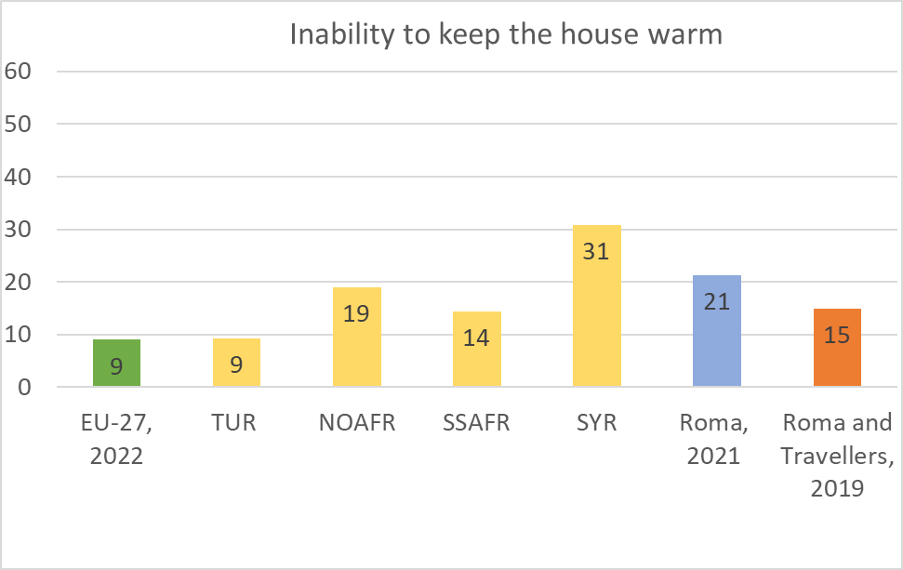
Energy poverty in the EU-27 and among people of different ethnic or immigrant backgrounds (%)
Minority groups disproportionally affected
Lack of systematic disaggregation of data for people in vulnerable situations
Source: FRA (2024): Fundamental Rights Report (Fig 1.3.,31 p.)
Notes:
‘Inability to keep home adequately warm’ is one of the key indicators used to measure energy poverty in the EU.
In 2023, 10.3% of the EU population were unable to keep their home adequately warm. That is a sharp increase from 2021, when the percentage was 6.9 %, showing also that the population faces increased levels of energy poverty. There is a lack of data for children and youth living in households with energy poverty. Despite the well-established fact that poverty affects more the youngest populations, age disaggregated data on energy poverty and this indicator are not published either by Eurostat or by EPAH (the Energy Poverty Advisory Hub). Given the consequences of poverty and energy poverty that were presented above, it requires a thorough disaggregation of all relevant indicators on age!
Data collected between 2019 and 2022 from different FRA surveys on hard-to-reach populations – while not directly comparable – show that immigrants, descendants of immigrants, and Roma and Travellers have a considerably higher risk of experiencing energy poverty than the average in the EU-27. The proportion in the EU-27 (first green column) was 9 % in 2022. Among immigrants and descendants of immigrants (4 subsequent orange columns), people of Syrian descent are at the highest risk of energy poverty, with nearly a third (31 %) not being able to keep their home adequately warm, followed by people of North African descent (19 %). The Roma surveys (two last columns) also indicate much higher percentages than the EU average.

Slide 16
Ways forward for fundamental rights in the Green Deal
A human rights based approach to the Green Deal
Systematic integration of fundamental rights in the EU’s green transition to leave no one behind
Explicit grounding in human rights
Effective application of fundamental rights as enabling conditions of EU Funds
A monitoring framework for a just transition
Effective participation
Access to justice and adequate enforcement
Notes:
HRBA:
Explicit grounding in human rights
Attention to people in situations of vulnerability
Non-discrimination
Participation
Accountability: Accountability relies on a robust legal and regulatory framework that protects rights and provides effective redress mechanisms.
Monitoring
Sustainable production and consumption

Slide 17
Any questions? Thank you!
ursula.till-tentschert@fra.europa.eu
FRA – EUROPEAN UNION AGENCY FOR FUNDAMENTAL RIGHTS
Schwarzenbergplatz 11 – 1040 Vienna – Austria
T +43 158030-0 – F +43 158030-699

