Slide 1
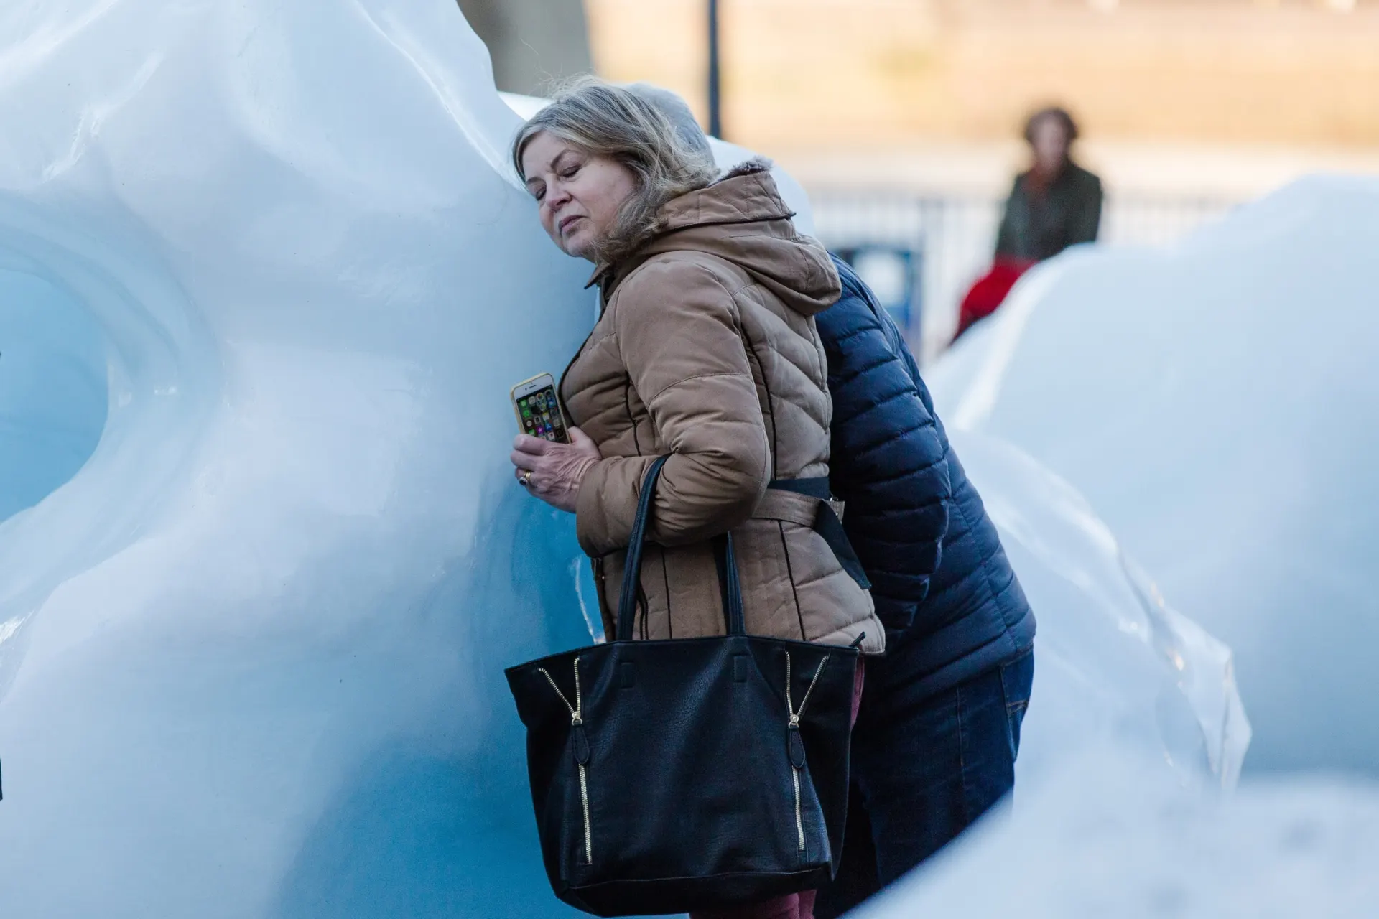
Tackling Climate Change with Gender Equality
Notes:
Picture Olafur Eliasson (2014)
“Tackling Climate Change with Gender Equality” project is part of the Worklife Balance Programme, supported by the EEA Grants 2014-2021, in Portugal.
EEA (European Economic Area) is agreement signed back in May 1992 between Iceland, Liechtenstein, and Norway.
The EEA and Norway Grants s have two goals – to contribute to a more equal Europe, both socially and economically – and to strengthen the relations between Iceland, Liechtenstein and Norway, and the 15 Beneficiary States in Europe. One of which is Portugal
CIG – is the Portuguese Programme Operator; Cig means Commission for Citizenship and Gender Equality
Equality and Anti-discrimination Ombud (LDO) is the Norwegian Donor Programme Partner

Slide 2
Part I – The project
Part II - The relationship between climate change, gender equality in art
Part III – Final Remarks
Objectives
Framework
Main Activities
Final report
Historical context and state of the art
Study trip and Veslemøy Lilleengen - NOR art works
Art as an advocacy tool
Bridging art and science
Key findings
Next steps

Slide 3
Part I
The project - Tackling Climate Change with Gender Equality

Slide 4
Objectives
Present how advances in gender equality can have a positive impact on social and environmental well-being
Establish an inclusive, long-term awareness-raising plan and global citizenship campaigns to create a more equal, ecological and sustainable society.
Awareness
Education
Empowerment

Slide 5
Framework
Global challenge - requires concerted and holistic approach.
Gender equality is linked to better environmental outcomes.
Vulnerability at different spatial scales is exacerbated by inequality and marginalization related to gender, ethnicity, low income or a combination of these, especially for many indigenous peoples and local communities.
Recognizing the importance of women's contributions as leaders, educators, caregivers and experts can lead to successful, long-term solutions to climate change.
Notes:
Global challenge - requires concerted and holistic approach.
Gender equality is linked to better environmental outcomes. Higher levels of gender inequality (as measured by the Gender Inequality Index) have led to lower levels of sustainability," according to the United Nations Human Development Report 2011.
Women and men experience climate change differently: differences in access to information, decision-making, resources and training.
Vulnerability at different spatial scales is exacerbated by inequality and marginalisation related to gender, ethnicity, low income or a combination of these, especially for many indigenous peoples and local communities. Indigenous and Afro-descendant women and girls, older women, LGBTIQ+ people, women and girls with disabilities, migrant women, and those living in rural, remote, conflict- and disaster-prone areas are particularly vulnerable.
Climate Change 2022: Impacts, Adaptation and Vulnerability from the Intergovernmental Panel on Climate Change.
Recognizing the importance of women's contributions as leaders, educators, caregivers and experts can lead to successful, long-term solutions to climate change

Slide 6
Main Activities
State of the Art
Study Trip (to Norway)
Thematic conference at Portugal with experts.
Exhibition (at Portugal and Norway)
Climate Change
Gender Equality
Arts
rescheduled
+ Final Report
Notes:
The project main activities are:
State of the art
We carried out a relatively exhaustive search for documents and or initiatives that highlight through art the differentiated impact of climate change on gender equality, on women and girls, in all their diversity and from an intersectional point of view.
I will address this topic later
Study Trip
In April we went on a study trip to Norway to explore different perspectives on gender equality and climate change. We’ve been with Veslemoy Lilleengen,
It was eye-opening, inspiring, and, most importantly, educational. I’ll talk about her work in just a moment.
There were two activities that had to be rescheduled, essentially due to logistical issues.
Thematic Conference and Exhibition: we want it to be a gathering of like-minded individuals discussing gender equality, climate change, and art.
Plus, an exhibition showcasing the incredible artworks created as part of this initiative.
These activities were part of the Work Life Balance Project Seminar, funded by EEA Grants, which will take place at the beginning of December at the Calouste Gulbenkian Foundation in Lisbon, Portugal
I mention this because when I started preparing this presentation, I thought that the very venue where the activities were to take place was well suited to the theme, since the Calouste Gulbenkian Foundation in Lisbon is the best place to hold the seminar, because they're all about promoting sustainable development through art, science, education, and philanthropy.
At the end of the project, a final report will be produced, which we hope will serve as a guide to the main conclusions and recommendations. A guide, full of ideas from our thematic conference and illustrated with artworks from the exhibition, which will be a reference resource for achieving positive change on the impact of climate change on gender equality.
With these activities, we aim to better understand the relationship between climate change, gender equality and how art can promote this cause.

Slide 7
Part II
The relationship between climate change and gender equality in Art

Slide 8
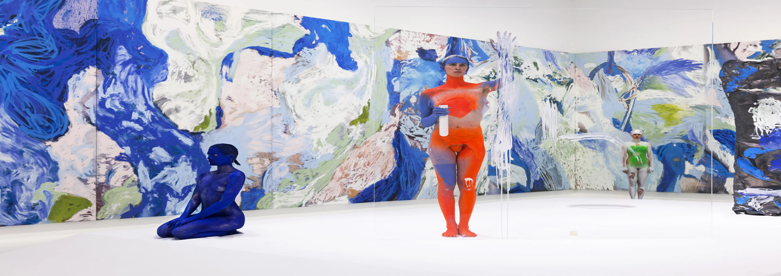
Part II
Historical context and state of the art
Notes:
Fonte da Fotografia: https://www.pca-stream.com/en/explore/ecofeminist-art-on-the-concepf-of-heritage/
Notas sobre a fotografia e seu contexto artístico:The Anthropocene invites us to move beyond the idea of progress, universalism, and the logic of separation or domination of the modern project. It results in a fundamental change in the paradigm of contemporary art, especially around ecofeminist practices, which Tara Londi views as stemming from the feminist avant-garde of the 1960s and 1970s. The critique of the capitalist exploitation of nature, therefore, ties in with that of the patriarchal oppression of women in ecofeminist artistic practices, revealing the unspoken history of women, Indigenous peoples, or animals. Beyond the rationalism of the visual realm and of language, archaic animist and holistic visions are revived.

Slide 9
Embroidery
Notes:
Artistic movements have historically played a crucial role in advocating for social and environmental changes, shaping public awareness and discourse on climate issues.
This image: is about how at the beginning of the 20th century, English suffragettes used embroidery as a way of demonstrating their struggle for the right to vote for women; the scarf bears sixty-six signatures of women who were imprisoned in Holloway Prison for their participation in the suffragette demonstrations.
Throughout the 20th century, various artistic movements like Dadaism and Modernism challenged societal norms and inspired environmental consciousness. These movements laid the groundwork for artists to engage with themes of nature, ecology, and sustainability, responding to industrialization's impact on the planet.

Slide 10
Dadaism
Notes:
This is an image of a ready-made: the displacement of an object from its context to another, in such a way as to generate strangeness. An example is the artwork Fountain by Marcel Duchamp (1887-1968), in which a urinal is moved from its original context to be exhibited in an art gallery.
Surrealism's dreamlike imagery and exploration of the subconscious opened up new avenues for expressing humanity's relationship with nature. Artists like Salvador Dalí employed surrealism to critique modernity's disconnection from nature, urging viewers to reconsider their environmental footprint

Slide 11
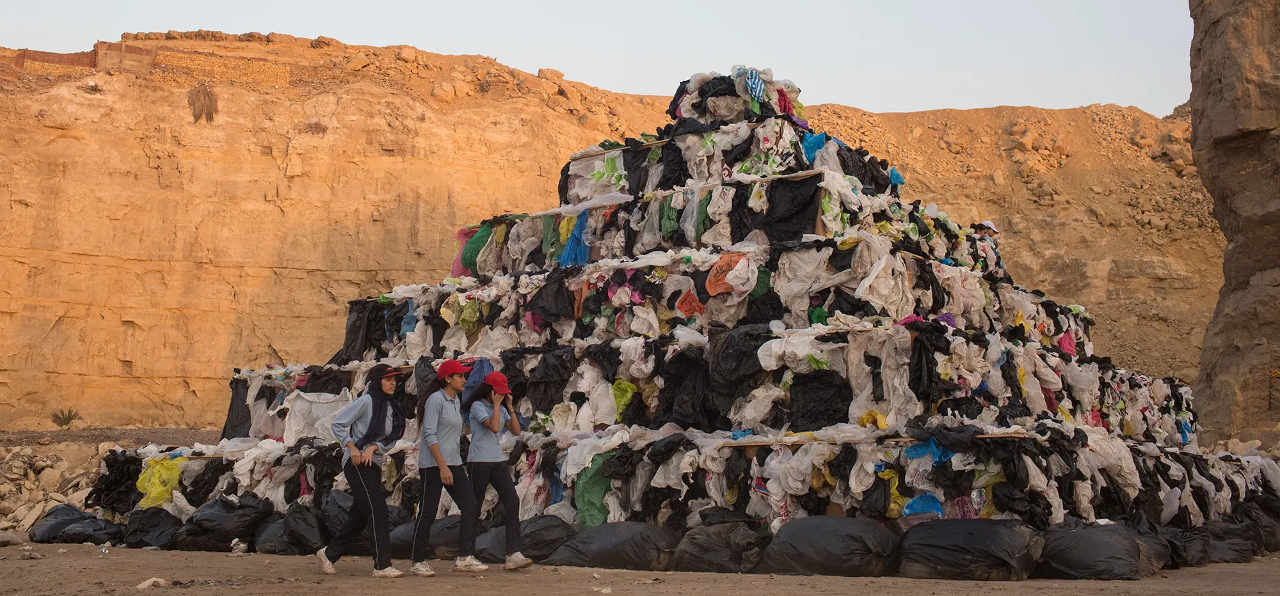
Public Art
Notes:
Cairo is perhaps best known for the nearby Pyramids of Giza, the last surviving wonder of the ancient world. But today, in the shadows of one of humankind’s greatest architectural achievements, is also the city’s massive waste-management problem. To highlight the issue, artist and historian Bahia Shehab decided to build a pyramid of her own — out of trash. On display for one week at a location in Cairo, the pyramid challenges people to rethink their consumption and waste habits. [fonte: https://ideas.ted.com/6-public-art-projects-that-make-climate-change-up-close-and-personal/]

Slide 12
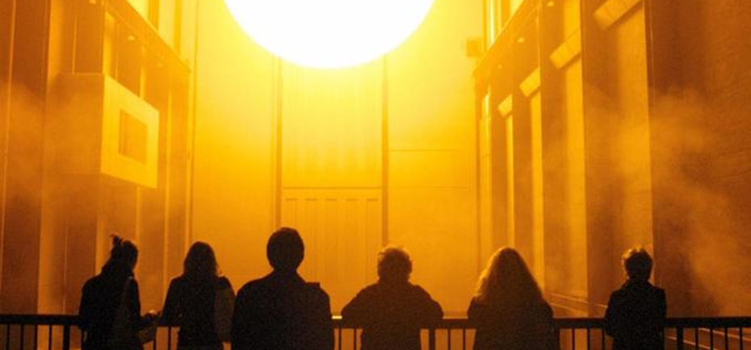
Installation
Notes:
Na installation from Olafur Eliasson (2003), in Tate Galery, London
The weather project, an enormous artificial sun shrouded by mist, in the Turbine Hall of Tate Modern, London, which was seen by more than two million people
Some information about Olafur Eliasson:
Icelandic-Danish artist Olafur Eliasson is another artist-activist creating ecologically-minded sensorial experiences. His blockbuster pieces emphasise how valuable firsthand experience is when it comes to raising awareness and delivering lasting impact. The renowned conceptualist was recently appointed Goodwill Ambassador for Climate Action by the United Nations Development Programme and has previously presented on art’s ability to provoke visceral responses to climate change at UN Climate Action Summits.

Slide 13
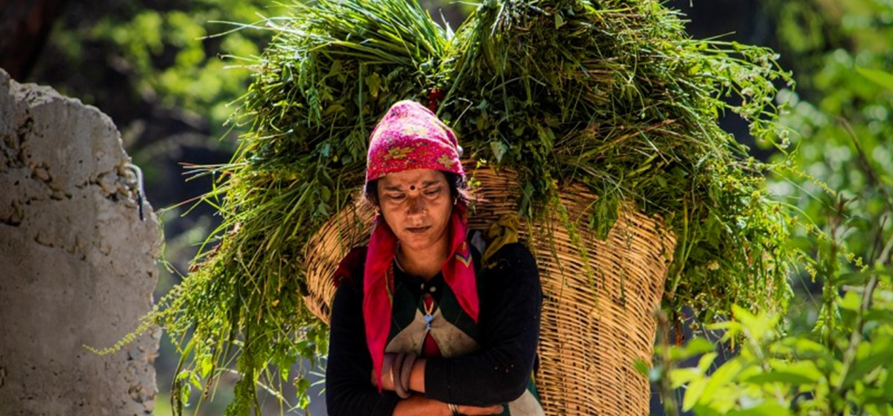
Ecofeminism
Notes:
. Ecofeminism highlights how women are often at the forefront of climate-related challenges, such as water and food insecurity, as they are the ones who are disproportionately affected by environmental degradation first. A recent report by the Food and Agricultural Organization (FAO) of the United Nations shows how climate change is unjust for rural women. According to the report, if climate change increases by another one degree Celsius, female-headed households income could reduce by 34 percent as compared to male-headed households. There are a myriad of the other impacts of climate change where women are affected first, directly and more severely. According to UN Women data, climate change altered unpredictability in rain patterns will increase water collection burdens on women. 8 out of 10 times, it is the women who in charge of fetching water in the world’s households that lack its direct access.

Slide 14
New Media Art
Notes:
As rising seas continue advancing upon coastlines, millions of people in the US alone are at risk of displacement. (Worldwide, one estimate says the number could be close to 500 million people.) To illustrate this threat, new media artist Matt Kenyon designed an art installation called TIDE. This art work provides a visceral representation of the next housing crisis, when homes lose their value and families are displaced due to the forces of climate change,” he said in an interview. [Fonte: https://ideas.ted.com/6-public-art-projects-that-make-climate-change-up-close-and-personal/]
TIDE is a 15-foot-tall champagne glass pyramid. Each glass holds a miniature house (shown above) made from a unique material that appears to turn invisible when submerged in water, symbolizing the homes lost to rising tides.
https://www.riseart.com/article/2485/9-artists-confronting-climate-change

Slide 15
Study trip and Veslemøy Lilleengen - NOR art works
Part II

Slide 16
Study trip to Norway (April) and Lillegen Veslemoy works of art
Notes:
Norwegian artist like Lilleegen Vesmoley, who incorporates feminist themes in her works, are at the forefront of addressing climate change and gender equality. Her art prompts public reflection and connects emotional responses to ecological crises.

Slide 17
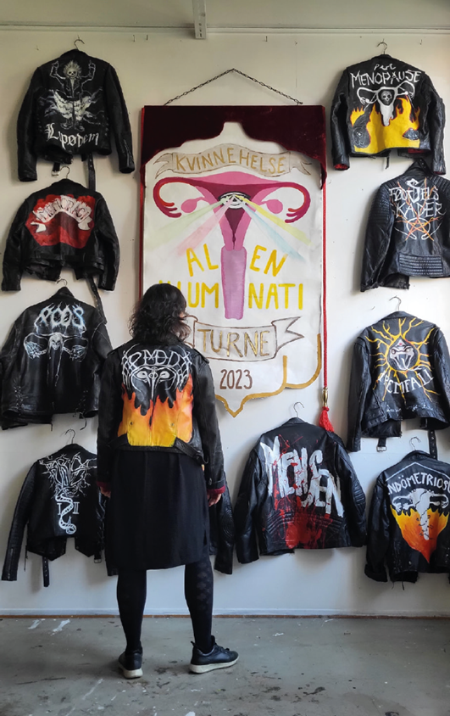
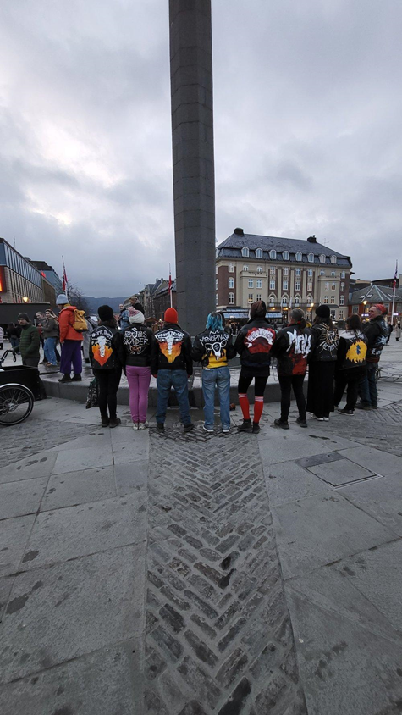
Notes:
Through public performences and community engagements, audiences are encouraged to reflect on the interconnectedness of these global challenges.

Slide 18
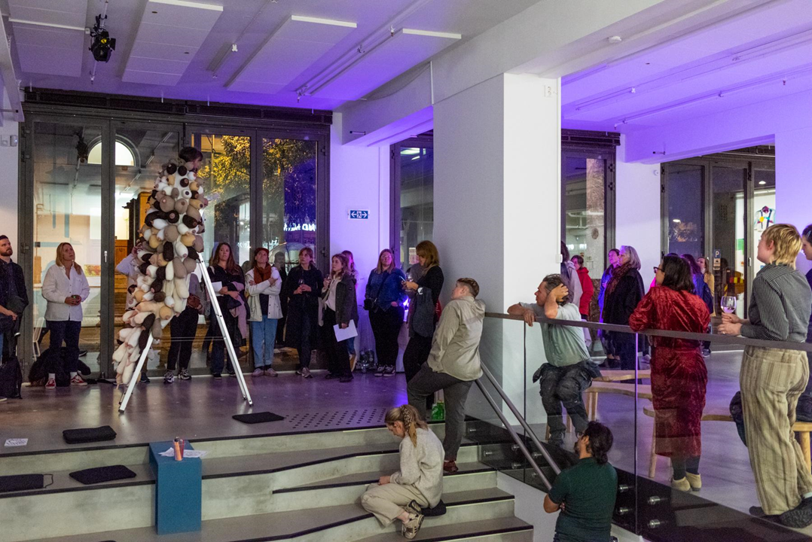
Usynelighetskappe 2022
Notes:
Her diverse art works, nameley performance, merges activism with creative expression to higlight social issues.

Slide 19
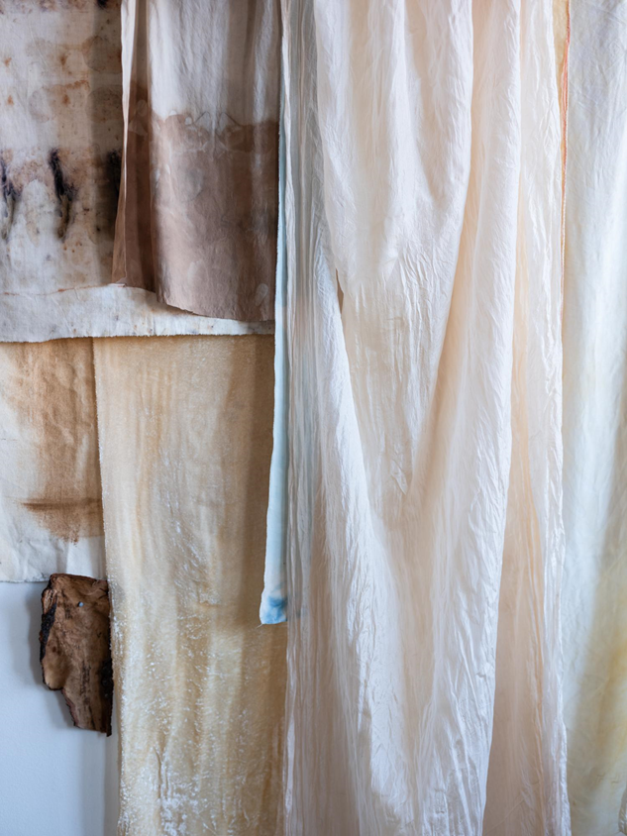
“Bunad med sølje”
2024 (280cmx110)
silk,cotton,linen,
dyed with earth,bark from Alder,seaweed and Potteblått from urine and indigo.

Slide 20
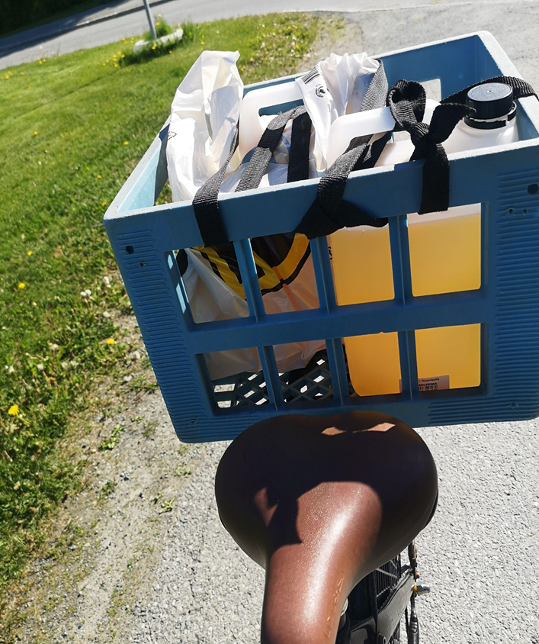
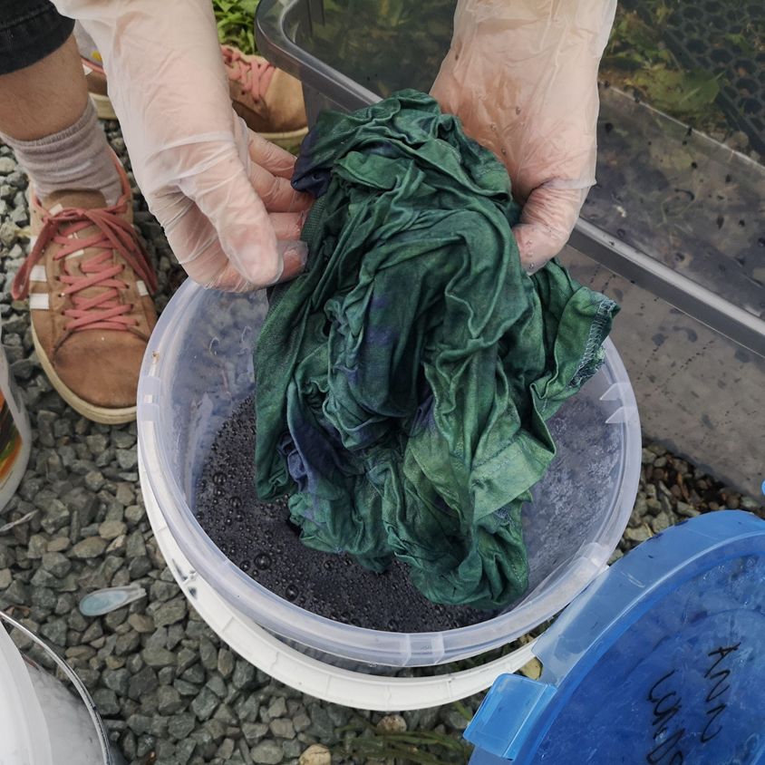

Slide 21
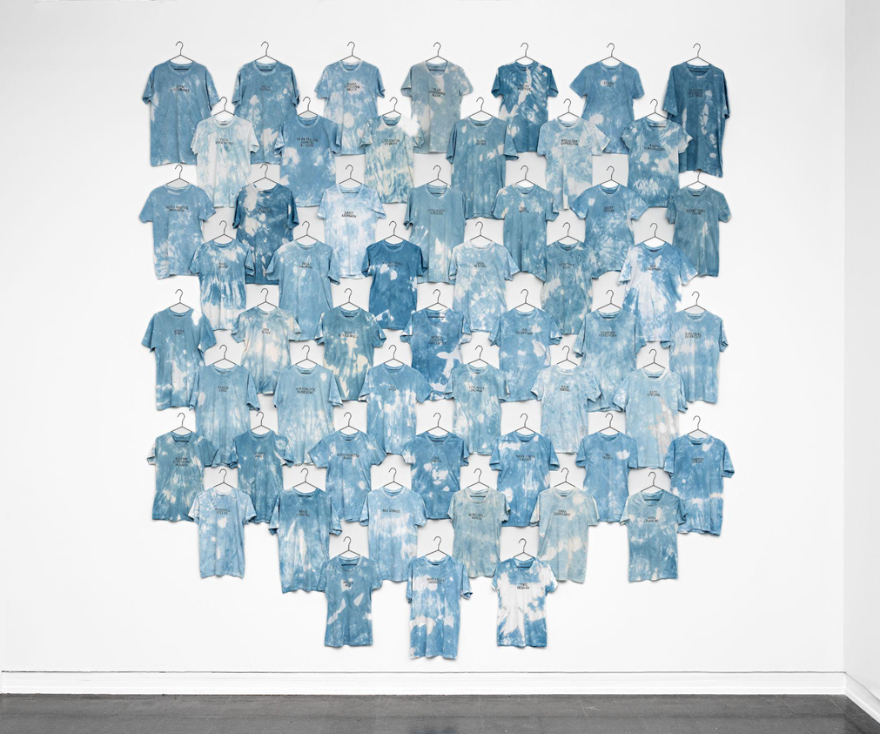
Norsk Bauta Trøndelag 2021 Potteblått,
urine and indigo .

Slide 22
Part II - Art as a tool for advocacy
. Raising awereness through exhibitions
Engaging communities in dialogues
Creating visual narratives on issues
Influency policy through creativity
Bridging Scince and art
Notes:
Understanding equality is essential in addressing climate change effectively
Picture: Eco-visionary Mary Mattingly explores innovative ways of reframing our relationship with nature with photography, sculpture, installation, and performance works. Mary interrogates the systemic and political frameworks impacting our relationship to the environment, as well as what we can collectively do to decelerate climate change. In 2016, Mary launched the biodegradable Swale, a floating, edible landscape. The public exhibition beckoned visitors to enter the renegade garden show and pick their own produce. The show encouraged communities to get back in touch with their food sources and local ecologies and to appreciate their bond with nature.

Slide 23
Defining Equality in Climate Discourse
Central to climate justice discussions
Relates to rights and access
Equity in resource distribution
Inclusive decision-making processes
Affects policy formulation and implementation
Notes:
Fonte da Fotografia: https://medium.com/@durreen/why-feminism-and-climate-change-are-intertwined-99aad6b13197

Slide 24
Vulnerable Populations and Climate Change
Systemic inequalities worsen impacts and gender inequality increases vulnerability
Higher exposure to climate hazards
Increased displacement due to climate events
Economic disadvantage in climate response
Limited resources for adaptation
Limited access to clean resources
Disparities in recovery efforts
Health impacts exacerbated by poverty
Notes:
Picture:A girl carries her sibling as she walks through stranded flood water, following rains and floods during the monsoon season in Nowshera, Pakistan, last September.
Photograph: Fayaz Aziz/Reuters

Slide 25
Intersection of Art and Environmental Justice
The intersection of art and environmental justice addresses issues of equity, representation, and community in environmental movements. Artists illuminate marginalized voices disproportionately affected by climate change, using their platform to advocate for systemic change and inclusive policies.
Notes:
The intersection of art and environmental justice addresses issues of equity, representation, and community in environmental movements.
Artists illuminate marginalized voices disproportionately affected by climate change, using their platform to advocate for systemic change and inclusive policies.

Slide 26
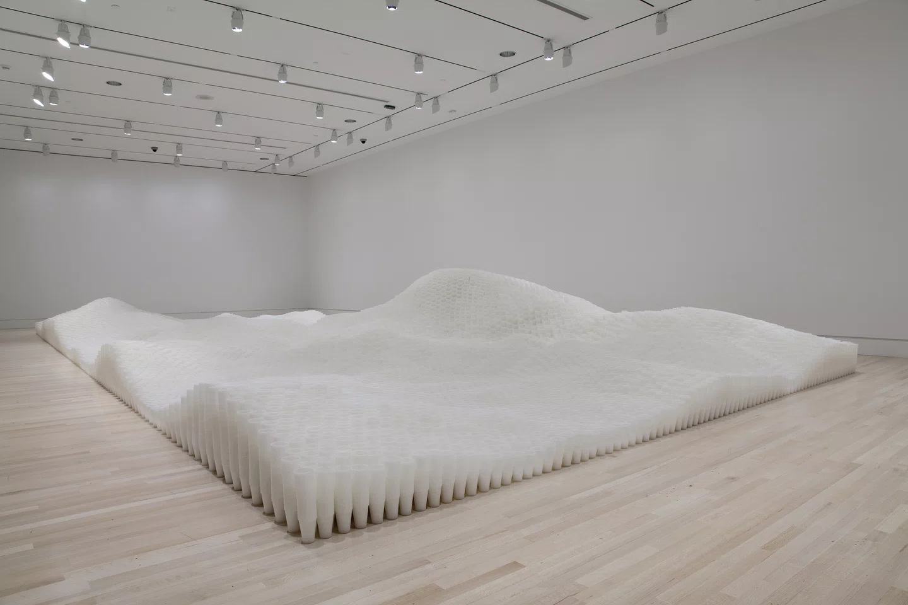
Part II - Bridging science and art
Art and Science converge to illuminate the stark realities of climate change, fostering awareness and inspiring action through creative expressiona
Notes:
Part II - Bridging scince and art [Fonte: https://www.solutions-to-climate-change.com/the-intersection-of-science-and-art-in-solving-climate-change/]
Art and Science converge to illuminate the stark realities of climate change, fostering awareness and inspiring action through creative expression
Picture: In 2005, Donovan joined Pace Gallery and presented a year later Tara Donovan: New Work, her first major solo exhibition with the gallery. For this show, she produced Untitled (Plastic Cups), a large-scale installation that stacked plastic cups until these formed an unworldly topography reminiscent of ocean waves or rolling hills. She now debuts most of her new projects in solo and group exhibitions at Pace and its several global locations in London, Beijing, Hong Kong, Seoul, and Palo Alto. Fonte:https://www.pacegallery.com/artists/tara-donovan/

Slide 27
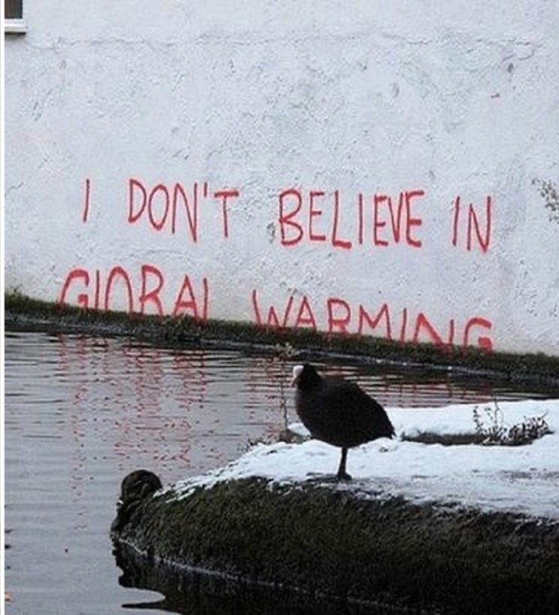
The collaboration between artists and scientists enhances communication of climate issues, bridging gaps between empirical data and emotional experiences. This synergy can galvanize communities and foster collective activism against climate change.
Notes:
The collaboration between artists and scientists enhances communication of climate issues, bridging gaps between empirical data and emotional experiences. This synergy can galvanize communities and foster collective activism against climate change.

Slide 28
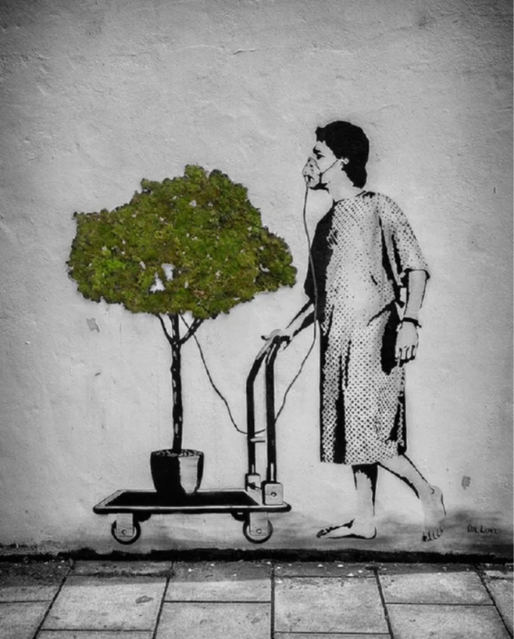
Historically, art and science have often intersected, from early naturalist illustrations to modern eco-art movements. Artists have long used their work to reflect on human impact on nature, amplifying scientific findings into broader social dialogues.
Notes:
Historically, art and science have often intersected, from early naturalist illustrations to modern eco-art movements. Artists have long used their work to reflect on human impact on nature, amplifying scientific findings into broader social dialogues.

Slide 29
Part III
Final Remarks

Slide 30
Part III –Key Findings
Art serves as a powerful medium to convey complex scientific facts, transforming data into visual narratives that resonate with audiences.
Art fosters emotional connections by narrating the impact of climate change, evoking empathy and prompting action. Through storytelling, artists spotlight environmental issues and personal experiences tied to scientific realities.
Artists utilize various techniques to graphically illustrate scientific data, making abstract concepts tangible. Innovative methods such as infographics, installations, and interactive media allow audiences to engage with facts more meaningfully.
Modern technology plays a critical role in climate art. Tools like augmented reality and data analytics allow artists to create immersive experiences, presenting climate data in compelling ways that resonate with broader audiences

Slide 31
Part III – Future Directions
Collaborative and interdisciplinary projects, blending art, science, and activism. Artists are increasingly engaging with local communities to create works that highlight specific environmental issues, making art a vehicle for social change.
Future efforts are likely to engage technology and data visualization, making climate issues more accessible and urgent to wider audiences.
Social media has transformed how climate art is shared and perceived, allowing artists and activists to reach wider audiences. Making social media an ally in the quest for greater climate justice, namely by giving visibility to the people and communities that suffer most from inequality.
As climate change concerns grow, audience perceptions of art relating to environmental issues are shifting. Public interest in sustainability and eco-consciousness is increasing, leading to greater appreciation for artists addressing these themes authentically and urgently.

Slide 32
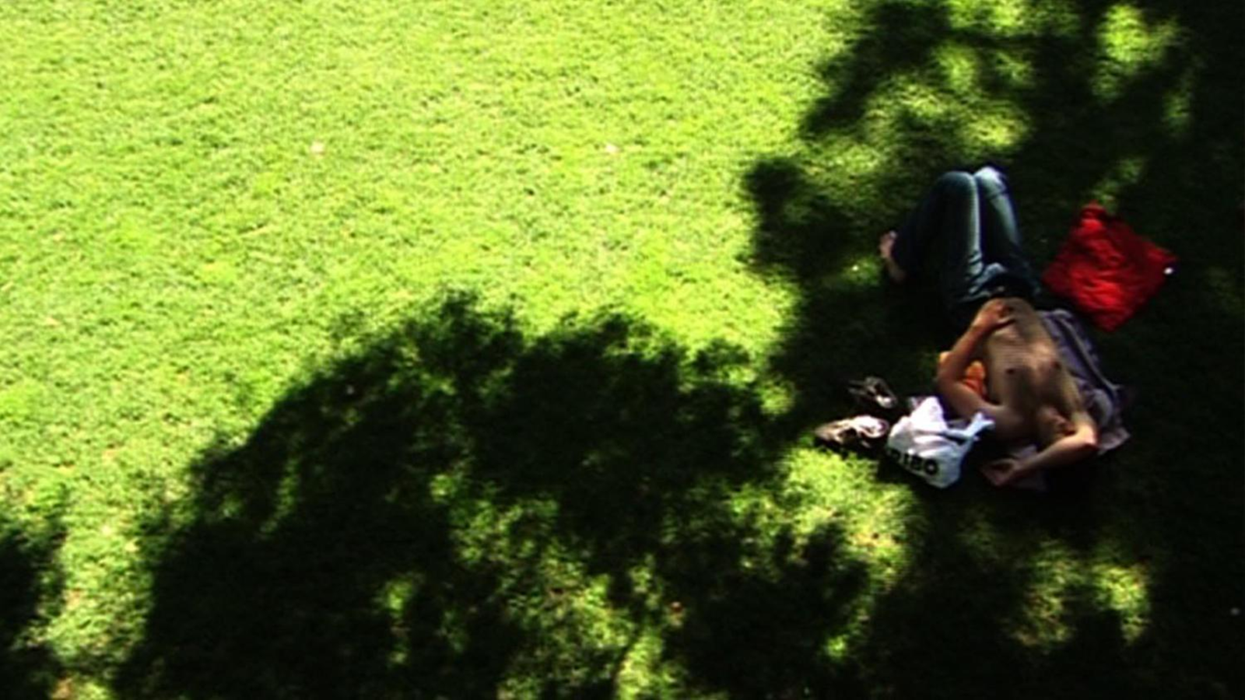
Yes, I know that trees don't have eyes, water doesn't have a mouth and stones don't have ears.
Nevertheless, we communicate.
Thank you! Email: sara.trindade@cig.gov.pt

