Slide 1
The Importance of Equality and the
EU Green Deal
Equinet Climate and Equality Seminar | 20-11-2024
Siel Hoornaert, Katrien van der Heyden & Babs Verhoeve

Slide 2
Contents
Introduction
Our research
Climate (policy) and inequality
The EU Green Deal
Opportunities for equality bodies

Slide 3
A Window of Opportunity
Introduction | Our research | Climate and Inequality | EU Green Deal | Opportunities
Notes:
We have a chance to ensure that inequality is avoided/prevented → by helping to shape policy
Those most affected by cc = also those who will be affected by measures
There’s momentum, “just transition”
Our research:
Equinet thought that Ebs could play a role and saw that there was a need for info
Our report = first overview because the policy was still being developed
Scope: we couldn’t include all of the Green Deal, so we focused on measures with high risk for inequality

Slide 4
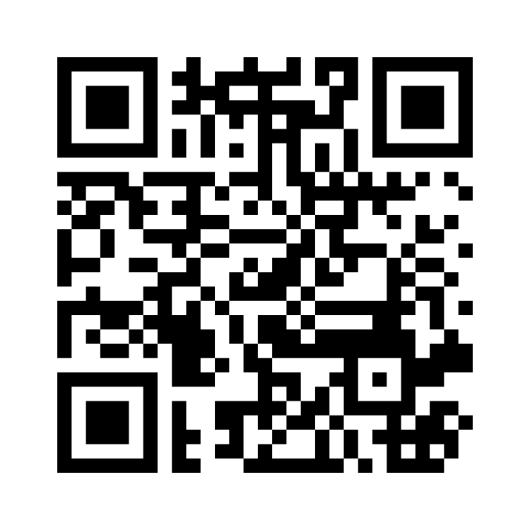
Join our mentimeter
Introduction | Our research | Climate and Inequality | EU Green Deal | Opportunities
Scan the QR code or go to menti.com and fill in the following code:
  6921 3568

Slide 5
Menti:
Have you encountered climate change as a theme/cause for inequality in your work?
Introduction | Our research | Climate and Inequality | EU Green Deal | Opportunities

Slide 6
Menti:
How familiar are you with the unequal impacts of the climate crisis on different groups in society?
Introduction | Our research | Climate and Inequality | EU Green Deal | Opportunities

Slide 7




Our Research
Introduction | Our research | Climate and Inequality | EU Green Deal | Opportunities
Analysis of EU Green Deal Measures
Impact of measures on vulnerable groups
Survey of equality bodies
Gauging whether (consequences of) climate change are on EB’s radar
Approach
Recommendations for equality bodies
How to be involved and ensure measures do not exacerbate inequality in Europe
Interviews with equality bodies
In-depth conversations about EB priorities and whether they work on climate change already
Notes:
Started our research in 2022
1. Analysis
At the time of our research, the EU Green Deal was not yet final. It was still being developed and many measures hadn’t been adopted.
Some of the Green Deal needed to and still needs implementation into national legislation
4. Recommendations
Legislation has been adopted on the EU level. Part of it needs to be converted into national legislation in European countries. This is where civil society can have impact.
The EU is aware of inequalities and has made money available (handed out by member states) to combat inequality. It is important to be aware of and involved in this process. We hope that Ebs will be equipped with knowledge in order to be involved

Slide 8
Survey Outcomes
Introduction | Our research | Climate and Inequality | EU Green Deal | Opportunities
Survey sent to all EBs
Received a response from 12
Current work
Socioeconomic inequality is not part of the scope of EB’s work (3/12)
Half have never encountered climate change as cause of inequality to date
Sectors that will be affected by climate change
Currently not a high priority for EBs
Limited/no experience with equality mainstreaming in these sectors
Involvement with climate change projects
Spreading information and awareness
(E.g., newsletters or special campaigns, commissioning research reports, treating individual complaints, and advising on laws and policies)
Insufficient expertise, need for extra resources
Notes:
Asked about current work: still the case?
Survey was done a long time ago, 2 whole years ago. Outcome would likely be very different if we did it today. Equinet has made a lot of strides, the fact that everyone is present here in a conference about this topic is a testament to this.
Sectors:
Those that will be most affected by climate change itself and at a high risk for exacerbating inequality by policies (such as transport and energy sectors)

Slide 9
Interviews
Introduction | Our research | Climate and Inequality | EU Green Deal | Opportunities
Climate issues as a driver of inequality
Limited experience
Not a priority at the time of writing the report
Expertise & resources
Distinction between effect of climate change and measures in place to combat climate change
Lack of knowledge and tools
7 interviews
5 equality bodies & 1 European Parliament member
Mandates & grounds for discrimination
Socio-economic status
Intersectionality
Potential role of EBs is unclear
  EBs have expertise
  There is momentum (EU & member state level)
Interest in knowledge development and involvement for policy
Policy & legislation at the national & EU Level
Strategies to collaborate with governments & civil society
Equality as an afterthought
Involved from design stage
Notes:
Bottom line: Potential role of Ebs is unclear
Intersectionality: always important, but we see see that with a complex issue such as climate change, focusing on/paying explicit attention to intersectionality is important
Policy & legislation: EB already have strategies, there is interest to make use of the opportunity to be involved with policy and legislation, despite the fact that there is not much priority/experience/knowledge. What Ebs currently sometimes experience is that equality is an afterthought. We want to avoid this.

Slide 10
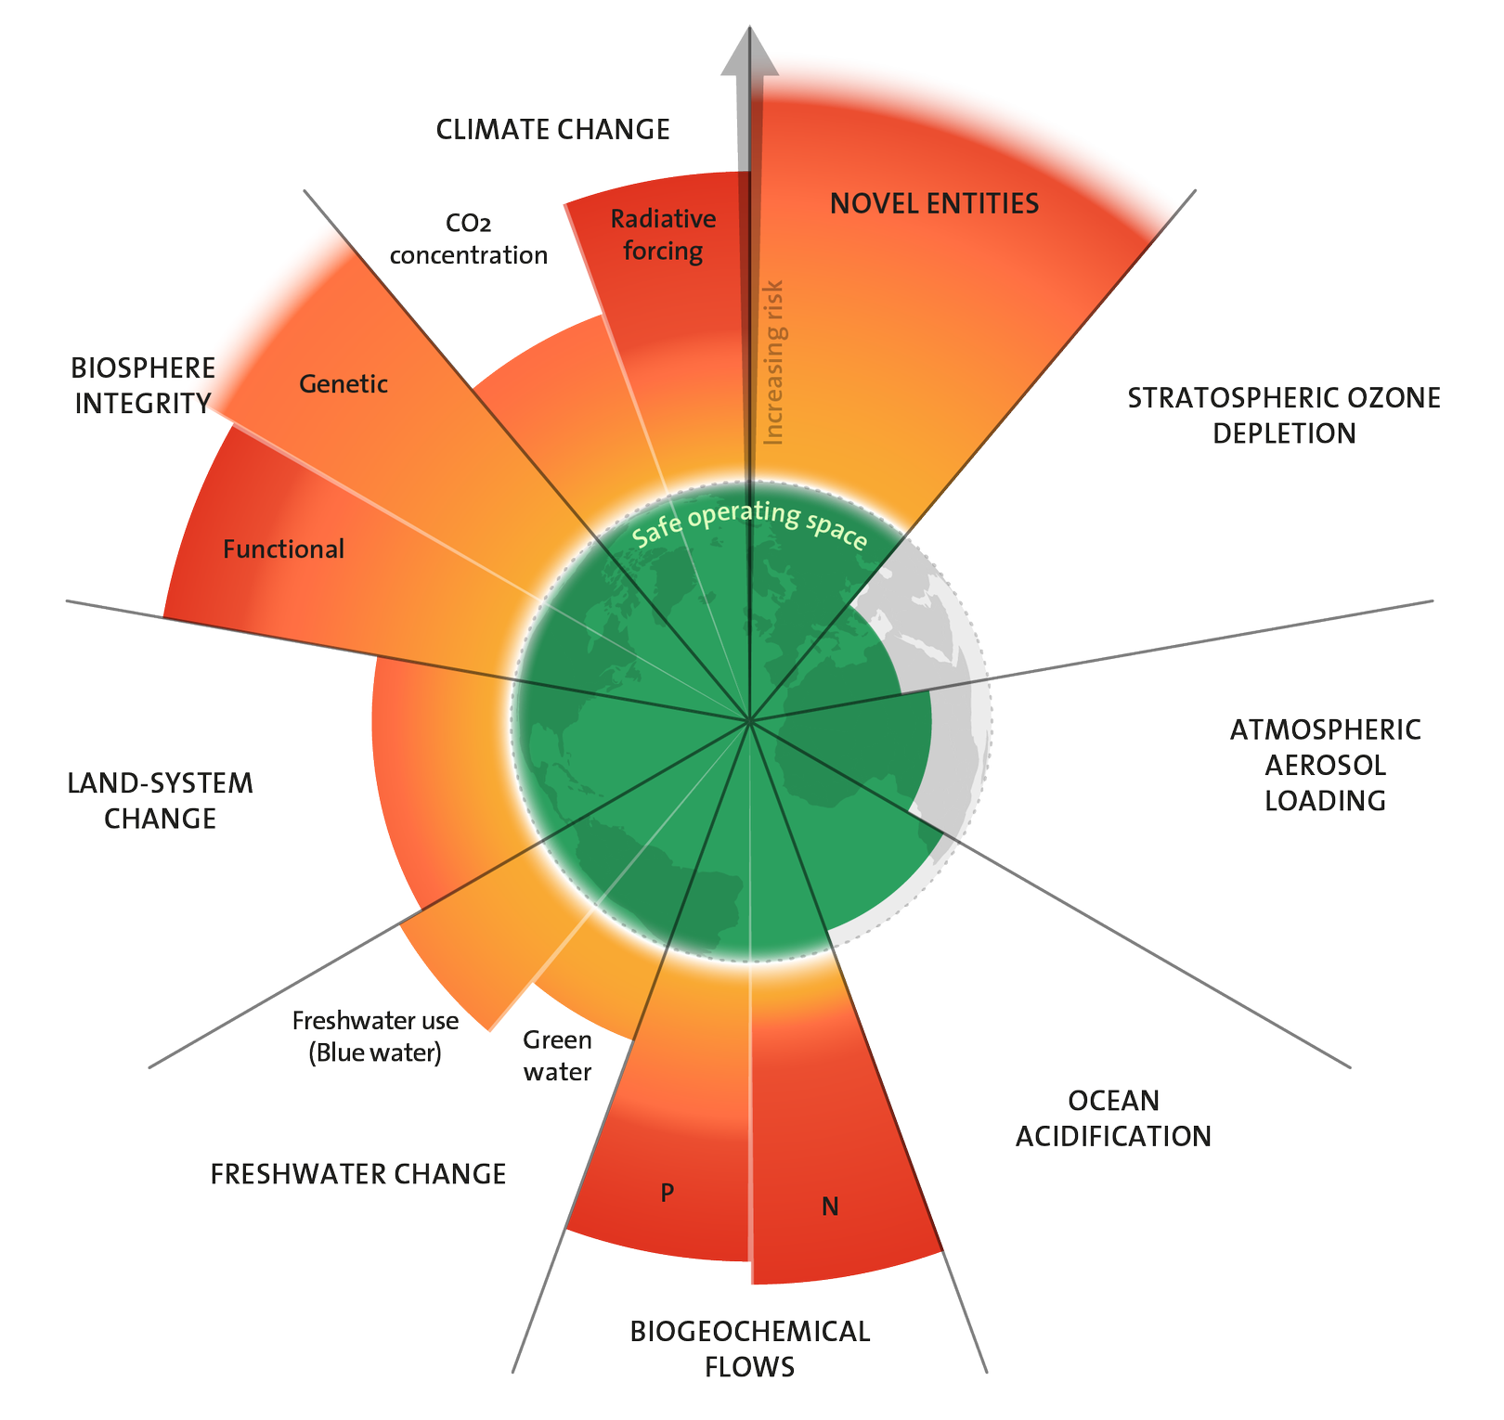
Planetary boundaries:
9 boundaries
6 crossed
Introduction | Our research | Climate and Inequality | EU Green Deal | Opportunities
Source: Stockholm Resilience Centre

Slide 11
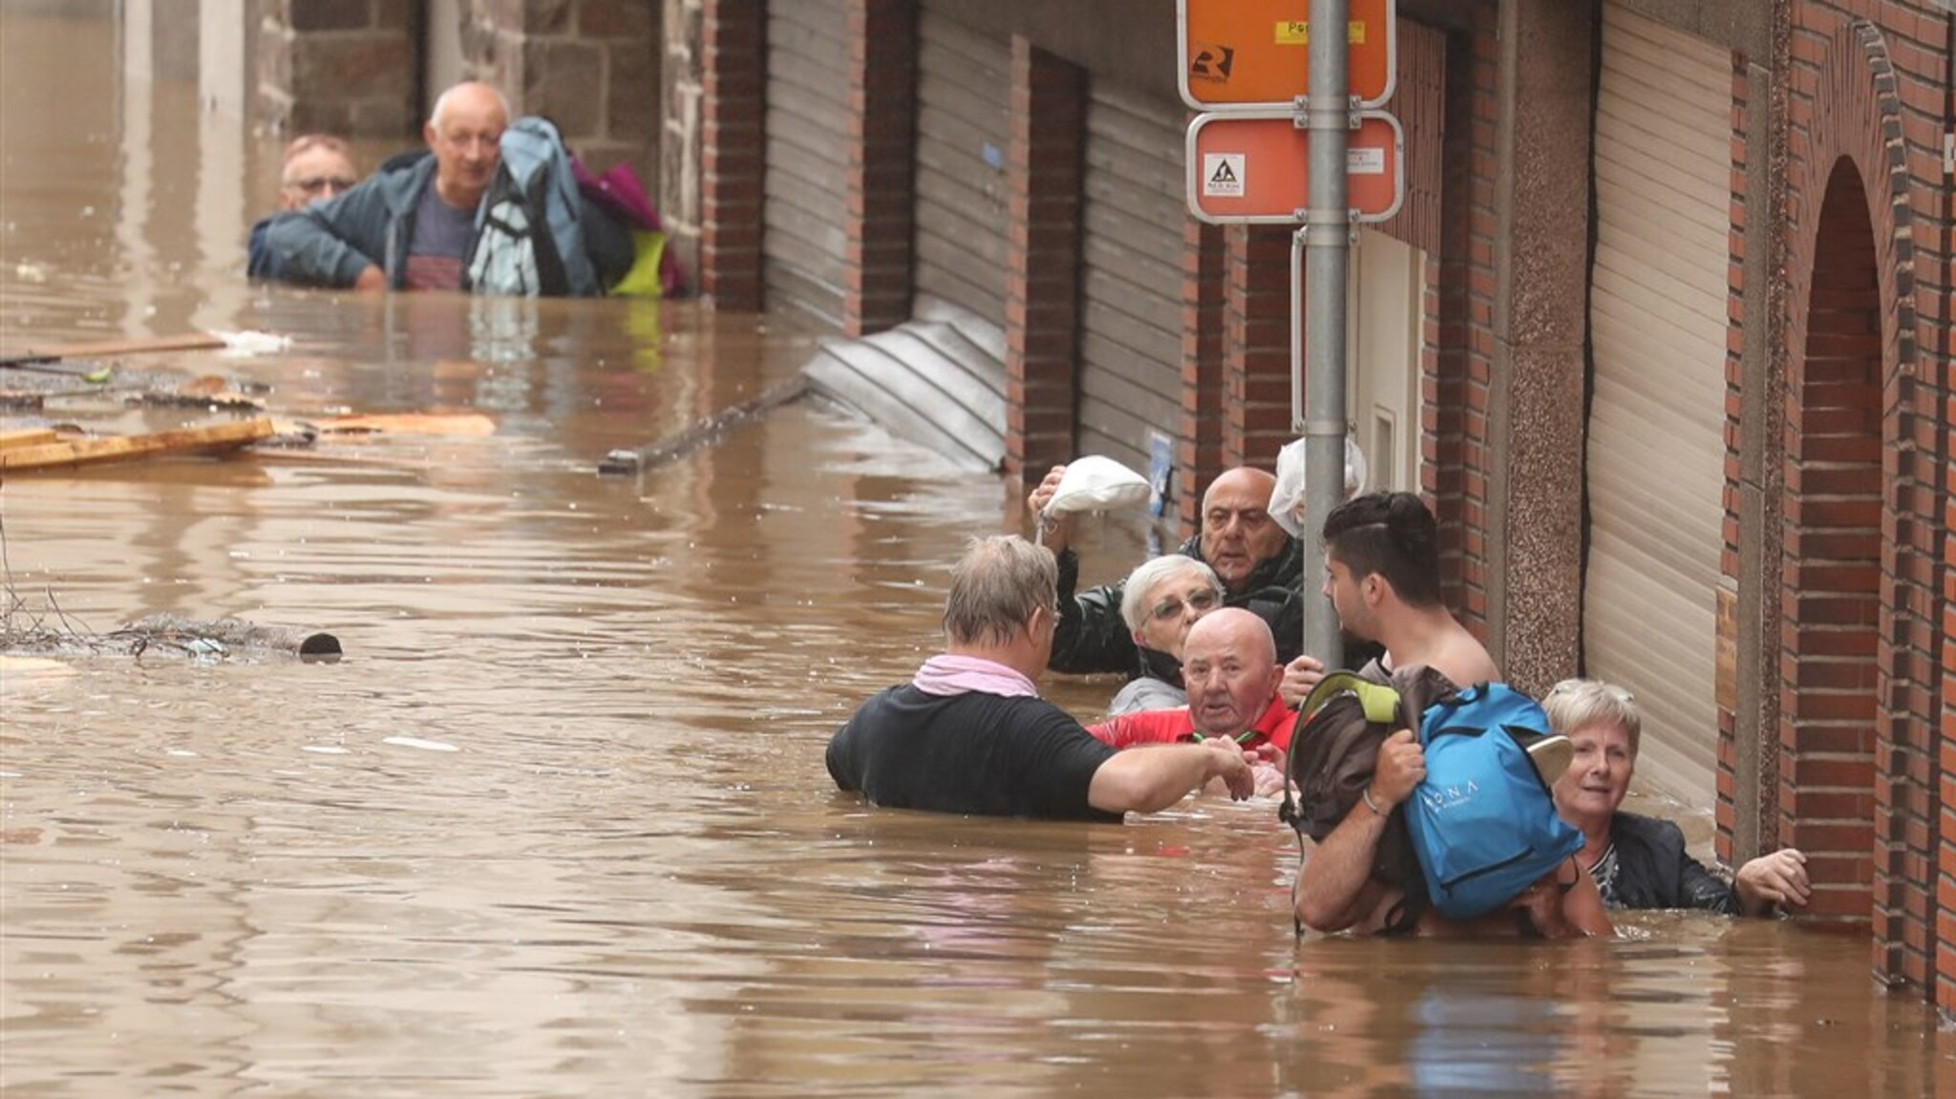
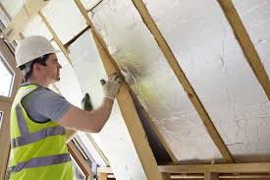
Vulnerable groups are more affected by impacts of environmental hazards and transition measures.
Introduction | Our research | Climate and Inequality | EU Green Deal | Opportunities

Slide 12
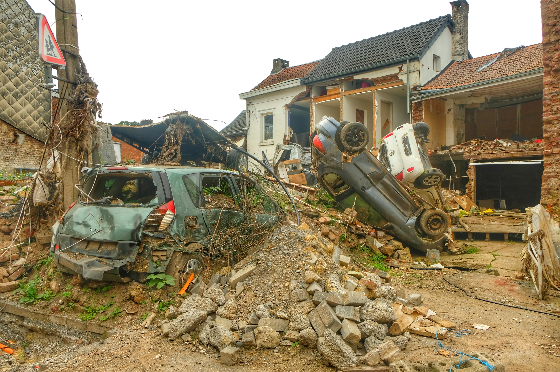

Unequal Impact
Introduction | Our research | Climate and Inequality | EU Green Deal | Opportunities
Age, health, gender, poverty, disability, ethnic group influence sensitivity to these hazards.
Socio-economic status and living conditions shape the ability to prepare for, respond to, and recover from hazards.
Access to social networks, digital skills, and language proficiency also impact adaptive capacity.
Socio-economic status often determines higher vulnerability to potential adverse effects of transition measures.
(Report CERAC, 2024)
18.6% of the Belgian population is currently at risk of poverty or social exclusion
(Statbel 2024)

Slide 13
Menti:
Which grounds for discrimination does your equality body work around?
Introduction | Our research | Climate and Inequality | EU Green Deal | Opportunities

Slide 14
CO2 Emissions Per Capita According to Income in Belgium
Introduction | Our research | Climate and Inequality | EU Green Deal | Opportunities
The bigger your income,
the higher your emissions.

Slide 15
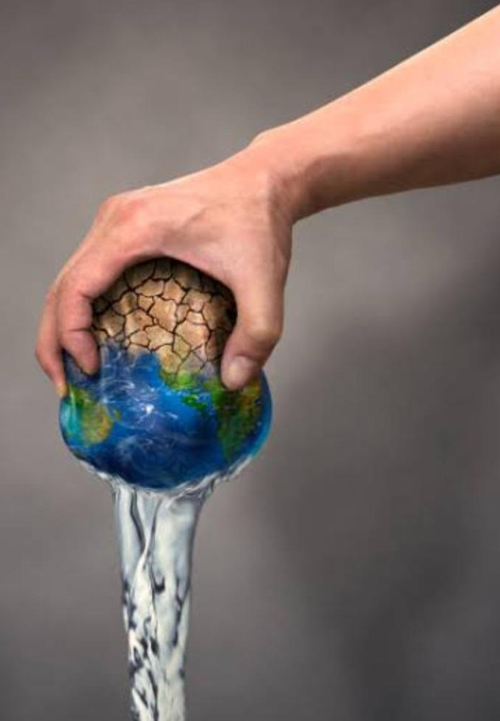
Water Poverty
Introduction | Our research | Climate and Inequality | EU Green Deal | Opportunities
Water affordability and quality go down
Conflicts for water use (farming, drinking, industry)
Impacts energy production and industrial processes
Negative impacts on crop yields
Potential (local) food accessibility/affordability issues
5 to 14% of the Belgian households were in a situation of water poverty in 2021
(Fondation Roi Baudoin 2023)

Slide 16
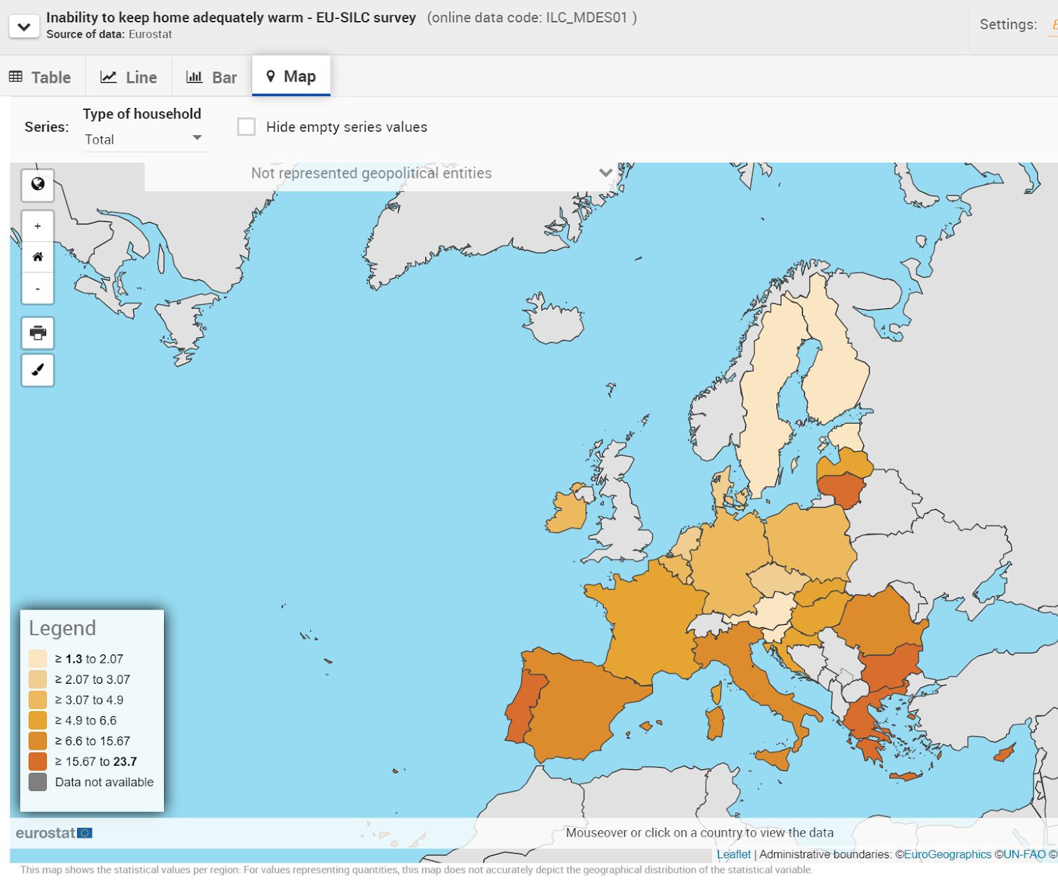
Energy Poverty and Inequality
Introduction | Our research | Climate and Inequality | EU Green Deal | Opportunities
Intersectional dimension:
28.4% of persons with disabilities are at risk of poverty and social exclusion compared to 18.4% of persons without disability.
The same goes for gender, ethnic minorities, etc.
Notes:
ETS = biggest market, effective (41% reduction since 2005)

Slide 17
Menti:
Can you think of specific climate policy measures that might impact 1 group more than others?
Introduction | Our research | Climate and Inequality | EU Green Deal | Opportunities

Slide 18
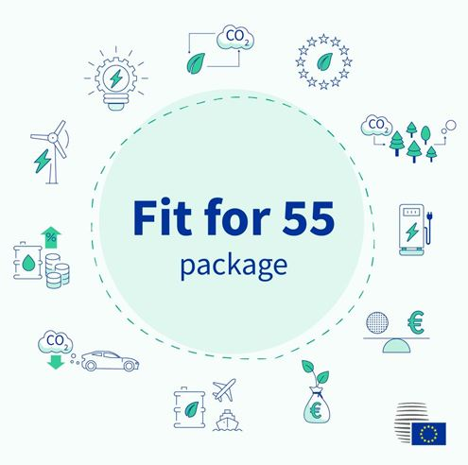
EU Green Deal and Fit-for-55
Introduction | Our research | Climate and Inequality | EU Green Deal | Opportunities
Ambitious package of new climate legislation
Become climate neutral by 2050
Innovation – competitiveness – socially fair
Implementation by Member States

Slide 19
Under-recognised Inequalities
Introduction | Our research | Climate and Inequality | EU Green Deal | Opportunities
Instruments to address socio-economic impact of climate policy:
  ‘Efforts Sharing’: emission reduction and energy efficiency targets for each EU country
  Modernisation Fund for projects in lower income EU countries
  Revenues of emission trading system
  Social Climate Fund
No systematic approach for impact on:
  Sex, racial/ethnic origin, religion/belief, disability, age, gender identity/expression and sexual orientation

Slide 20

Social Climate Fund
Introduction | Our research | Climate and Inequality | EU Green Deal | Opportunities
Key solidarity instrument
ETS II
87 Billion Euros
2027 - 2032
Member States
  Draft Social Climate Plan
  Consult civil society
  Demonstrate reduction gender inequality
  Co-funding
EU Commission
  Support
  Guidelines
  Approval of measures

Slide 21
Menti:
Has your organisation been invited to a Social Climate Fund stakeholders meeting?
Introduction | Our research | Climate and Inequality | EU Green Deal | Opportunities

Slide 22
Social Climate Fund – Opportunities for EBs
Introduction | Our research | Climate and Inequality | EU Green Deal | Opportunities
Momentum – Submission Social Climate Plans by June 2025
Engage in Stakeholders Meetings: feedback on proposed measures
Focus on measures that bring structural change for vulnerable groups
Collective measures rather than individual measures
ETS II and CBAM revenues

Slide 23
Menti:
Is the Just Transition on the political agenda in your country/region?
Introduction | Our research | Climate and Inequality | EU Green Deal | Opportunities

Slide 24
Menti:
Is your organisation planning on/expecting to work on climate issues in 2025?
Introduction | Our research | Climate and Inequality | EU Green Deal | Opportunities

Slide 25
Recommendations for Equality Bodies
Introduction | Our research | Climate and Inequality | EU Green Deal | Opportunities
Network facilitation by Equinet
Capacity building/knowledge development
Exchange with organisations involved with climate and/or equality
Get involved in stakeholder meetings
  E.g., Social Climate Fund measure choice
Mandate
Find link with climate risks/climate adaptation policies
Notes:
First summarise:
There is a considerable risk of rising inequality as a consequence of climate policy
Unfair: same groups who are already disproportionately affected by climate change itself
There is momentum:
Both at European level as in member states
EU wants to avoid more yellow vest protests
In Member states, topic of just transition has been picked up
Equality Bodies have expertise on discrimination and inequality, so it’s logical that they should be heard in this discussion
To be able to do that → recommendations
Facilitation by Equinet → sharing knowledge, research, use practises (like conference today). Ensure that Ebs can learn from each other instead of doing isolated work.
Stakeholder meetings: Social climate Fund
Example gender: the government must show that the measures will decrease gender inequality → this is an opportunity for Ebs to share expertise
Mandate: get creative. There may be opportunities to reevaluate mandate, even if mandate is limited- you can work on this topic via the grounds you do work on and via intersectionality broaden this.
Find link: Try to actively ensure that, for example, money is going to right causes/people. You can have a role in ensuring that the adaptation measures take vulnerable groups into account. E.g., Katrien’s example: not just defending the homes against floods, but really looking at who lives there? Is it single parents, older people, rural communities, etc.
Vraag: Zien jullie dat mandaat als probleem of zien jullie mogelijkheden om iets te doen? Of verhindert uw mandaat u echt om Hiermee bezig te zijn? Zien jullie binnen jullie mandaat mogelijkheden om hier iets mee te doen,

Slide 26
Menti:
What would your organisation need to successfully work on climate issues in the future?
Introduction | Our research | Climate and Inequality | EU Green Deal | Opportunities

Slide 27
Thank you.
Questions?
Notes:
Als er geen vragen komen:
Ongelijkheid wordt groter. Waar zien jullie opportuniteiten om te wegen in maatschappelijk debat hierover?

