Slide 1
Climate change and equality from an intersectional perspective
Dr. Monika Mayrhofer
Equinet Seminar, 20 and 21 November 2024, Brussels

Slide 2
Climate change and equality from an intersectional perspective
Introduction
How are climate change and intersectional inequalities connected?
  Unequal emissions
  Unequal impact
  Climate policies and the advancement of equality
Conclusions

Slide 3
Example: The role of inequality in turning a hazard into a disaster
IPCC: Climate change will increase the magnitude and frequency of extreme events (high confidence) → increase in numbers of disaster
Disaster: “A serious disruption of the functioning of a community or a society at any scale due to hazardous events interacting with conditions of exposure, vulnerability and capacity, leading to one or more of the following: human, material, economic and environmental losses and impacts.” (UNDRR)
Study finds out: „Female hurricanes are deadlier than male hurricanes“
Jung, K/Shavitt, S./Viswanathan, M. and Hilbe, J. M. (2014) Female hurricanes are deadliner than male hurricanes, Proceedings of the National Academy of Science, June 2014, 111 (24) 8782-8787

Slide 4
What can we learn from this example?
Climate change and inequalities/discrimination often interact in implicit and subtle ways
Terminology matters
Climate change-related events impact in societies and communities that are structured by inequalities:
  “What makes a hazard into a disaster depends primarily on the way a society is ordered. […] people are at risk not simply because they are exposed to hazards but also because they have been made marginal in some way by a combination of variables such as class, gender, age, ethnicity, or disability.” (Greg Bankoff, 2010)
Inequalities influence how we address climate change
Climate measures influence inequalities (implicit or explicit)

Slide 5
How are climate change and inequalities connected?
Inequality is a major factor in driving climate change
Climate change disproportionately impacts different regions, communities and people (e.g. gender, age, class, ‘race’, dis/ability, …)
Climate policies or measures and in/equality

Slide 6
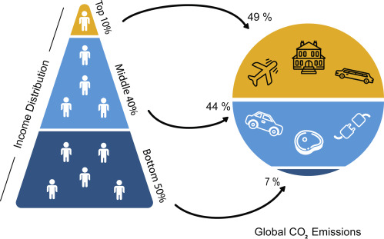
1) Inequality is a major factor in driving climate change
Fergus Green and Noel Healy (2022) How Inequality Fuels Climate Change:
The climate case for a Green New Deal, One Earth, Volume 5, Issue 6, 635 - 649
Notes:
Description: The graph shows that 50 % of the people with the lowest income only contribute 7% of the global emissions. 40% of the population with middle income contribute 44 % of global emissions and the top 10% of the wealthiest people contribute almost half (49%) of the global emissions.

Slide 7
2) Climate change disproportionately impacts different regions, communities and people
Carbon map vs people at risk
Global mismatch: greenhouse gas emissions & burden of climate change
Global carbon inequality: Losses vs. emissions vs. capacity to finance

Slide 8
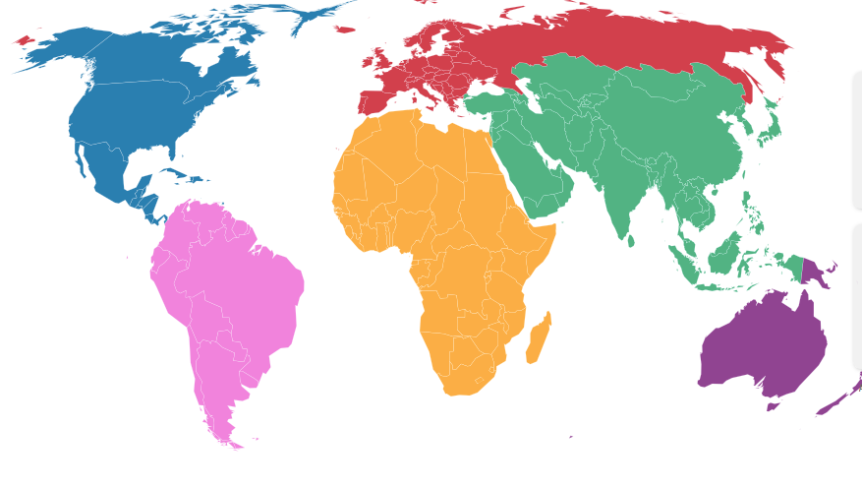
Area map
Notes:
The slides show and area map. Country sizes show actual land area. Most world maps don't show this accurately as it isn't possible to represent the globe as a flat map without compromising on either shape or area.

Slide 9
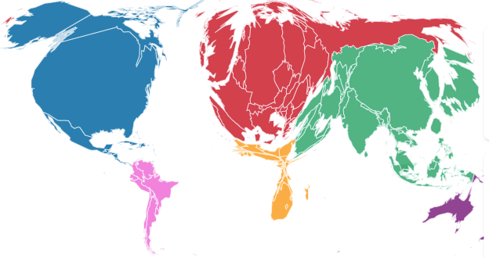
CO₂ emissions from energy use 1850–2011
https://www.carbonmap.org
Notes:
The Carbon map cumulatively shows CO2 emissions from energy use 1859-2011 and illustrates that the Global North, in particular European countries and the USA have disproportionally contributed to CO2 emissions.

Slide 10
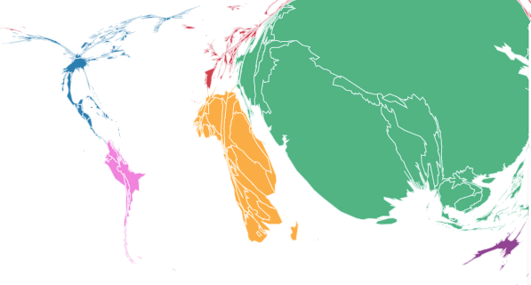
People at risk
https://www.carbonmap.org
Notes:
The map shows that people at risk are mainly located in South-East Asia and, to a lesser extent, in Africa.

Slide 11
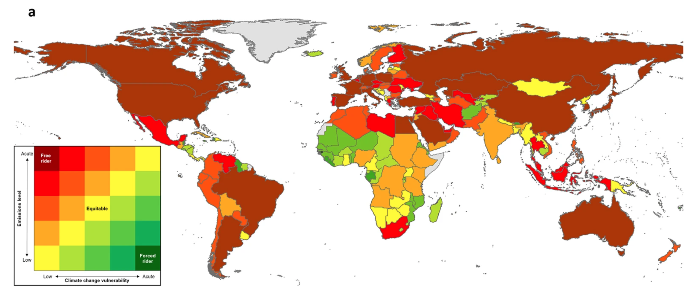
Global mismatch: greenhouse gas emissions & burden of climate change (2010)
Source: Althor, G., Watson, J. & Fuller, R. Global mismatch between greenhouse gas emissions and the burden of climate change. Sci Rep 6, 20281 (2016).

Slide 12
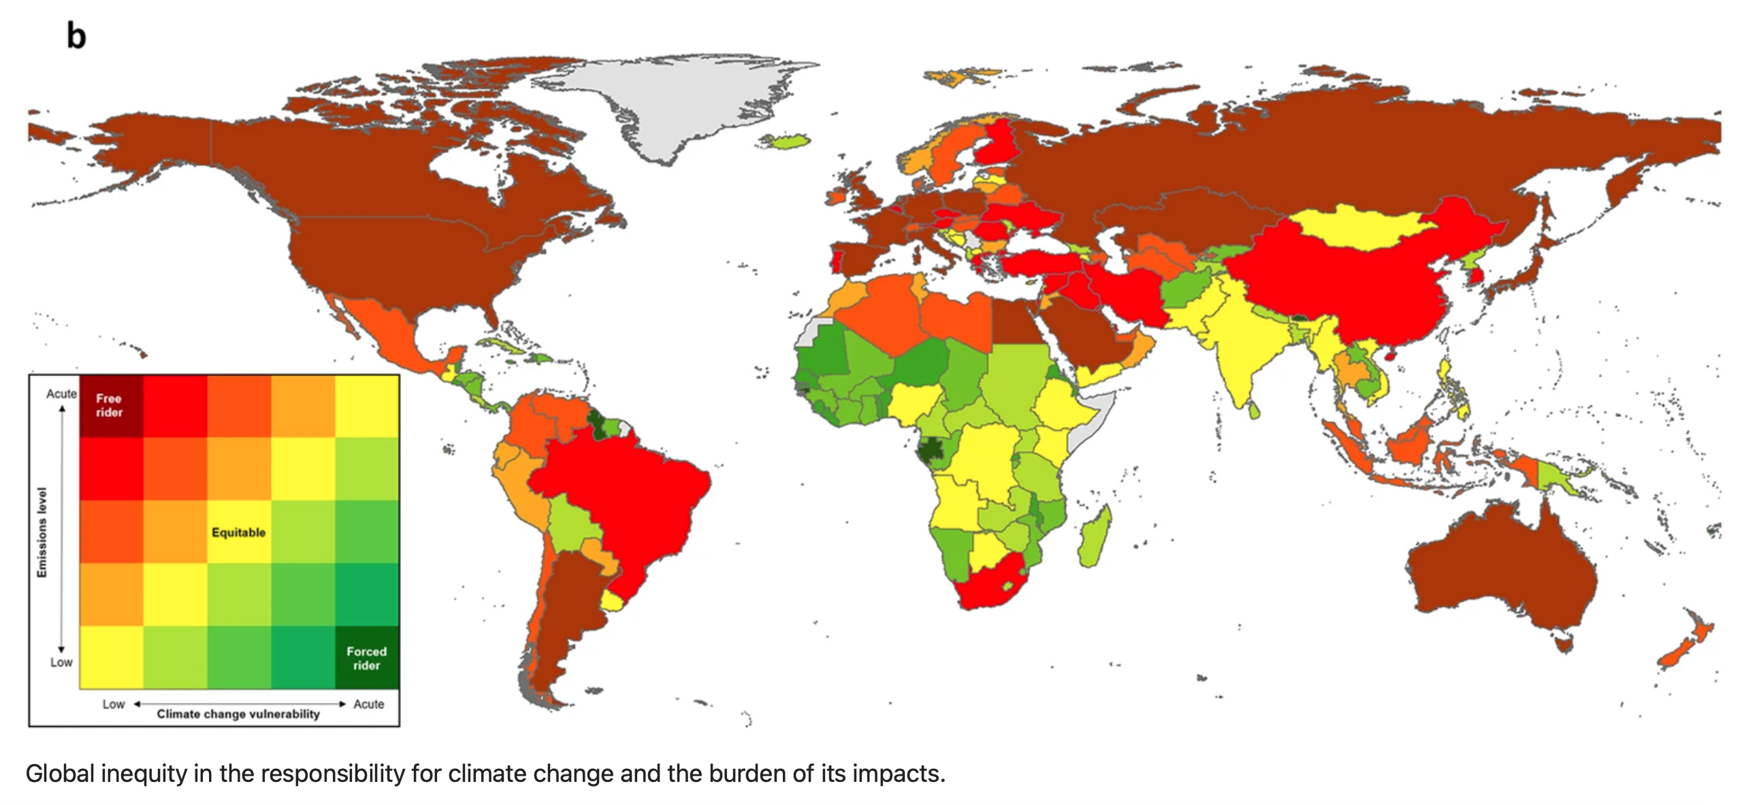
Global mismatch: greenhouse gas emissions & burden of climate change (2030)
Source: Althor, G., Watson, J. & Fuller, R. Global mismatch between greenhouse gas emissions and the burden of climate change. Sci Rep 6, 20281 (2016).

Slide 13
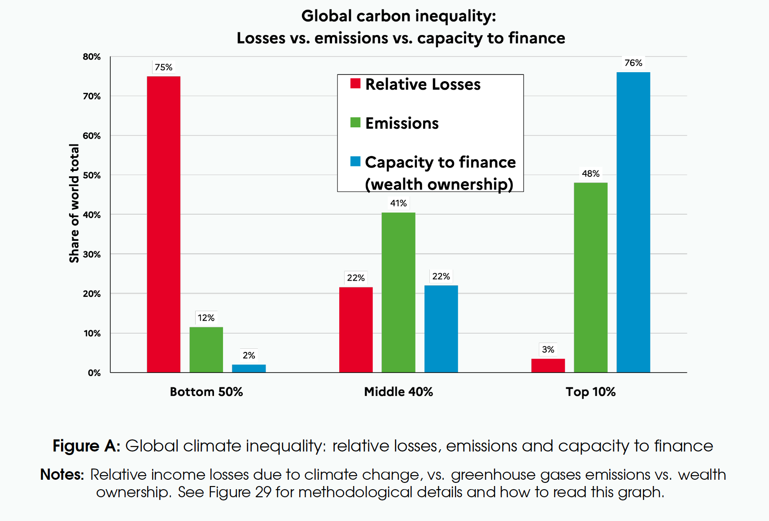
Global carbon inequality: Losses vs. emissions vs. capacity to finance
Climate Inequality Report 2023
Notes:
“The graph shows that the 50% of the world population contributes to 12% of global emissions but is exposed to 75% of relative income losses due to climate change. Conversely, the top 10% of the world population, is responsible for close to half of all emissions, but faces just 3% of relative income losses. The graphs also highlights that the top 10% of the world population owns about three quarters of total personal wealth worldwide, while the poorest 50% owns just 2% of it. In other words, those who pollute less face more relative losses, but also have less resources to adapt.” Climate Inequality Report 2023, p. 85

Slide 14
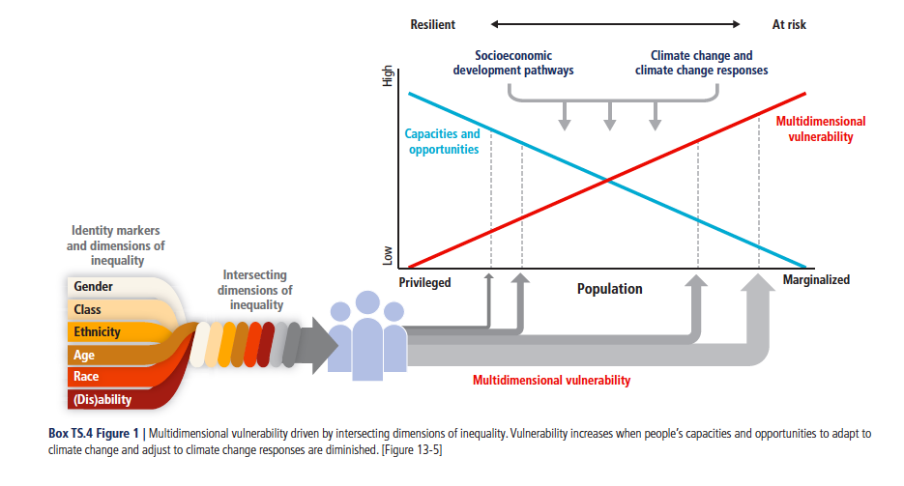
Intersecting dimensions of equality and impact of climate change
IPCC 2014
Notes:
The graph which was presented in the IPCC 2014 report shows that different identity markers and dimensions of inequality such as gender, class, ethnicity, age, race or (dis)ability intersect and lead to different impacts of climate change (multidimensional vulnerability). Privileged segments of the population have high capacities and opportunities to cope with the impacts of climate change while marginalized persons, groups and communities often have little capacities and opportunities to cope and thus are profoundly at risk (multidimensional vulnerability).

Slide 15
Example: Heatwaves 2003 and 2022 in Europe
Heatwave of 2003 → 71.449 excess deaths in Europe
Heatwave of 2022 → Disaster with the most fatalities in 2022 → between 30 May and 4 September 2022, there wer e an estimated 61,672 heat-related deaths in Europe.
2022: 56% more heat-related deaths in women than men
Gender, age, socio-economic disadvantage, housing, social isolation, educational status, literacy were decisive factors when experiencing the impact of the heatwave
However: Studies of heatwaves in Chicago showed an increased mortality of elderly men → social isolation
Ballester, Joan et al (2023) Heat-related mortality in Europe during the summer of 2022, Nature Medicin, Vol. 29, 1857-1866
Klinenberg, Eric (2015/2nd edition) Heat Wave. A Social Autopsy of Disaster in Chicago. University of Chicago Press

Slide 16
Example: Hurricane Katrina, New Orleans 2005
Category 4 Hurricane that devastated New Orleans at the end of August 2005
Breaking of levees: Neighbourhoods inhabited by poor Afro-Americans were flooded.
Most people left the city, yet, people with lower incomes, lower education, single moms, old people and Afro-Americans were mostly affected, stayed in their homes or sought refuge in emergency shelters
62% of the dead and 80% of those stranded on rooftops in New Orleans were black
Aftermath: black residents received less governmental aid compared to White residents; higher unemployment rates, greater levels of stress and depression, and unequal access to health care among black residents.

Slide 17
3) Climate policies/measures and inequality
Unequal participation and representation of marginalized or disadvantaged persons and groups in climate decisions (e.g. gender gaps → overrepresentation of men)
Climate policies may (re)produce inequalities or promote equality

Slide 18
Three pillars of climate policies/measures
Mitigation: Reduce the effects of climate change → reduction of greenhouse gases
Adaptation: Adjust to climate change
Loss & Damages: How to deal with loss and damages, e.g. compensation
→ Equality aspects must be integrated into all three pillars
Notes:
The three pillars of climate policies and measures are mitigation, adaptation and loss and damages. Mitigation means the efforts to reduce the effects of climate change by cutting emissions. Adaptation means adjusting to the inevitable changes and transformations due to climate change. Loss and damages focus on how to deal with irrevocable losses and damages to infrastructure, housings, human lives, habitats and more.

Slide 19
Is the concept of vulnerability beneficial for the advancement of equality?
Vulnerability is widely used in climate policies and by different institutions when they analyse and assess the impact of climate change → usually attributed to people whose rights are particularly in danger
Vulnerability is hardly ever defined, nor is there a reflection on the added value of the concept
Vulnerable groups and persons are defined as the problem, not structures of inequality and discrimination
Mobilizes problematic narratives → somatic metaphor which is attached to individuals and groups → similar to racist, sexist and other discriminatory discourses

Slide 20
Conclusion
Intersectional inequalities and discrimination are deeply intertwined with climate change. Inequality in emissions drives climate change and climate change-related impacts affect people differently.
Intersectionality is an important concept also in the context of climate change as it draws attention to the interaction of different dimensions of social inequality and takes into consideration specific local contexts.
Without thoroughly mainstreaming gender and other forms of equality and addressing intersectional inequalities in all forms and in all aspects of the climate crisis and climate policies, we will not be able to tackle the challenges of climate change.
Equality bodies can contribute profoundly to the success of climate policy, as they have a great deal of knowledge about the (re)production of inequality structures on the ground. This means they can make a significant contribution to creating fairer local, national and international mitigation and adaptation policies.

Slide 21
Thanks a lot for your attention!

