Slide 1


Legal responses to intersectional inequality in the algorithmic age:
Opportunities for improving the protection offered by Equality Bodies
Dr. Raphaële Xenidis, Sciences Po, Law School

Slide 2




Outline
The problem: intersectionality and algorithmic discrimination
The legal gaps: 'two round holes and a square peg'
The invitation: Revisiting non-discrimination law to improve protection
Notes:
1. The problem: we know that algorithmic discrimination is often intersectional due to granularity of profiling and invisibility of those intersections
2. We have a legal gap, but nonetheless some legal resources that can be used
3. How to revisit the concepts we have?

Slide 3

1. The problem

Slide 4




Photo by Jonathan Borba on Unsplash

Slide 5
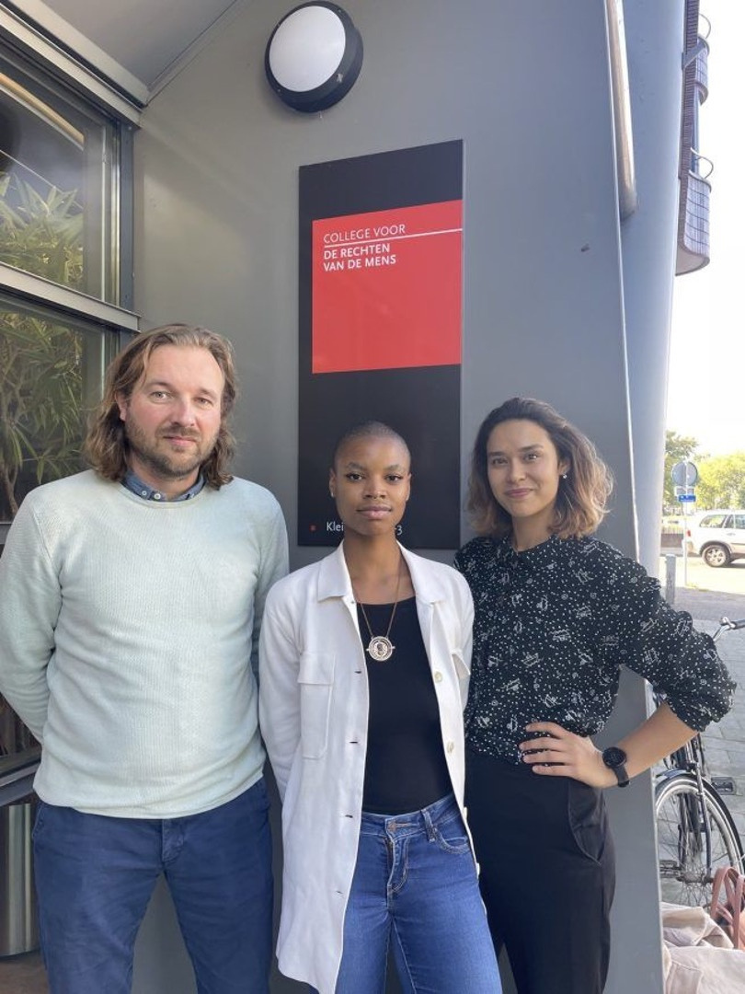

AI’s broken promises:
Facial recognition in education
‘Face not found’
‘Room too dark’
Source: https://racismandtechnology.center/
Source: Shalini Kantayya, Coded Bias (Netflix, 2020)

Slide 6

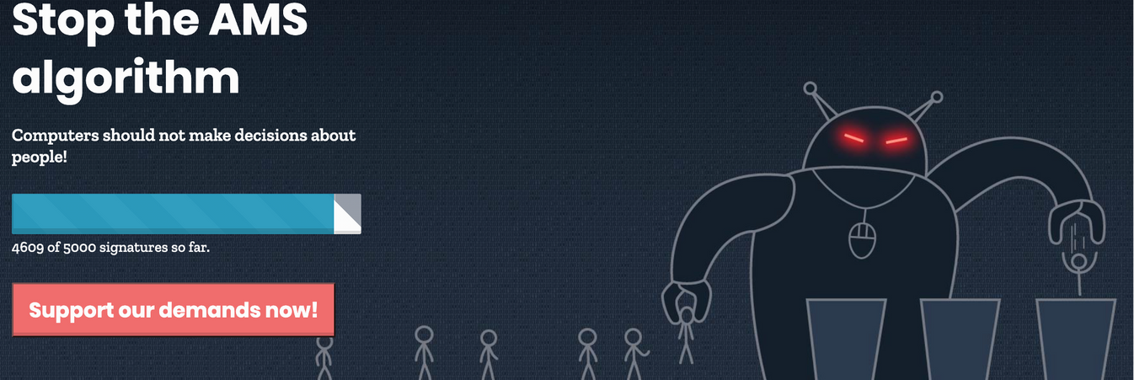

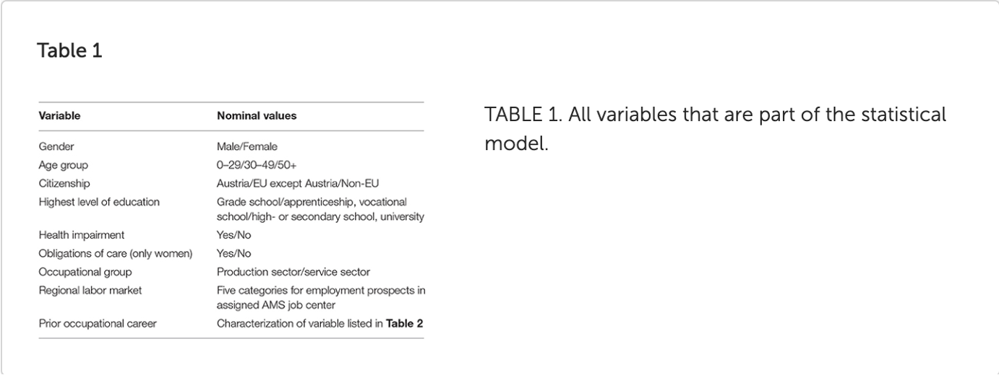
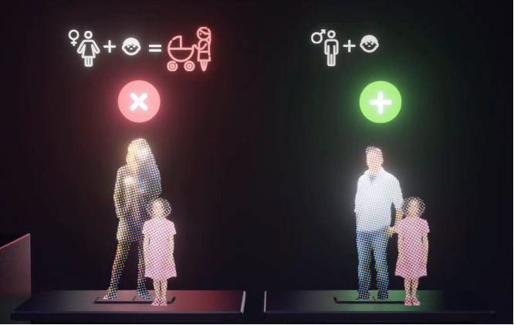
AI’s broken promises 2:
Risk scoring in the welfare state
Variables used in the satistical model
Source: https://amsalgorithmus.at/en/
Source: Doris Allhutter et al., ‘Algorithmic Profiling of Job Seekers in Austria: How Austerity Politics Are Made Effective’ (2020) Frontiers in Big Data

Slide 7
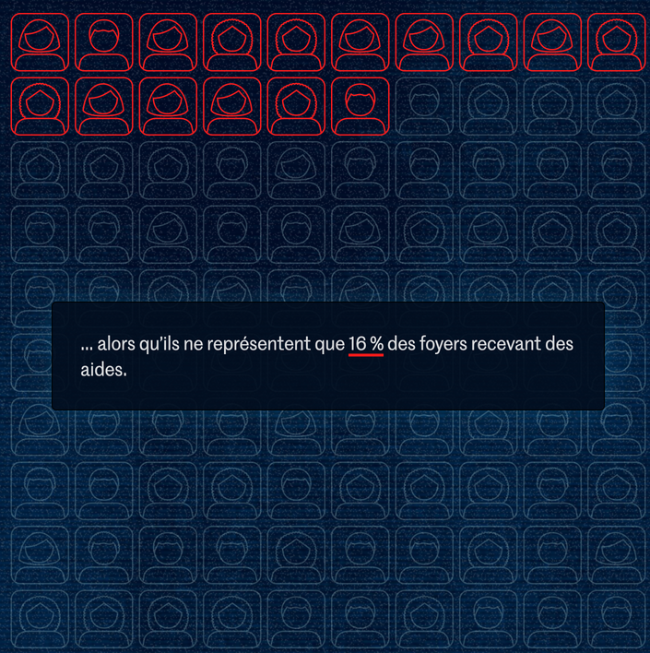



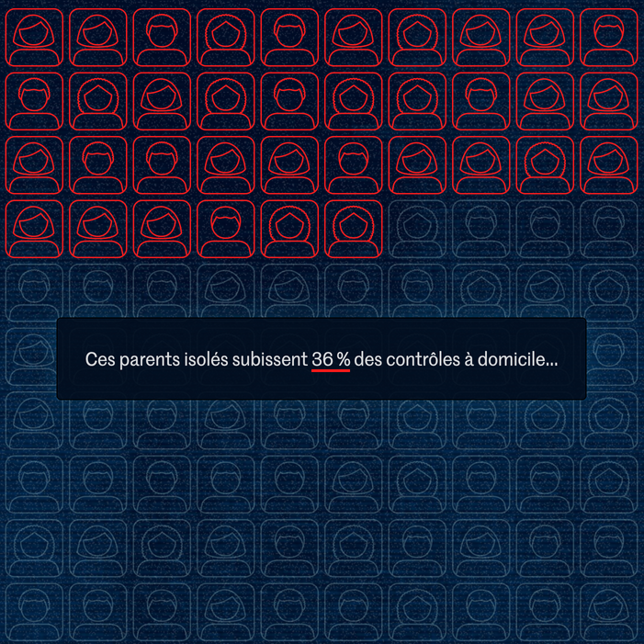
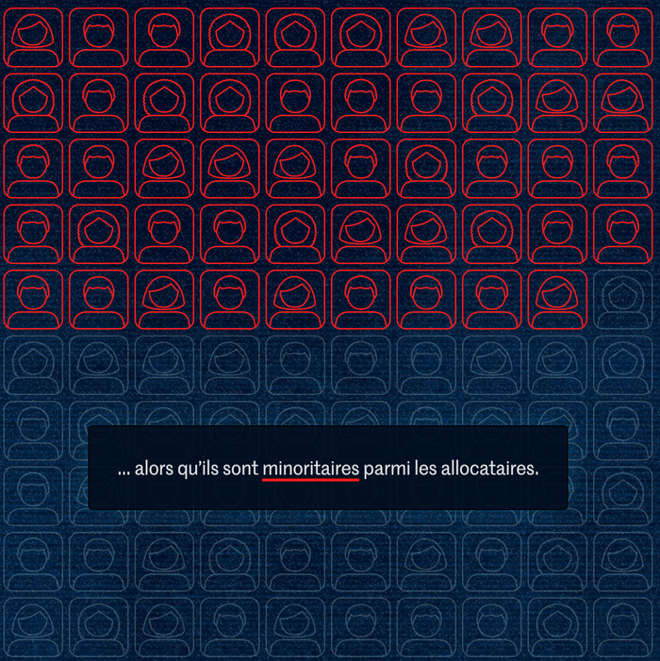
AI’s broken promises 3:
Risk scoring in the welfare state
In collaboration with Lighthouse Reports and La Quadrature du Net
the algorithm also uses age, marital status, income and disability benefits as risk factors...
Notes:
Nationalioty abandonned < DDD
women = 80% of single parent families

Slide 8



Behind the veneer of objectivity
Algorithmic bias in credit scoring
The financial institution‘refused to grant credit to A in connection with A making online purchases, based on matters classified as grounds of discrimination, such as gender, age, language and their combined effect’
National Non-discrimination and Equality Tribunal of Finland, case 2xx/2017
Source: Lorenz Matzat und Minna Ruckenstein, ‘Kreditscoring: Urteil aus Finnland wirft Fragen zur Diskriminierung auf’ (2018) AlgorithmWatch available at https://algorithmwatch.org/en/automated-discrimination-facebook-google/
& https://www.yvtltk.fi/en/index/opinionsanddecisions/decisions.html
Notes:
STEREOTYPING
"a tribunal threatened to fine Svea Ekonomi AB for 100,000 euros on the grounds that it declined credit to a customer by using statistical models that are in violation of anti-discrimination laws. The case raises some hard questions about the practice of credit scoring and how it could be done."
"a Finnish-speaking man in his thirties from a sparsely populated rural area of Finland, requested the company to justify the negative decision. The company first responded that their decision required no justification, and then argued that the decision had been based on a credit rating made by a credit scoring service using statistical methods, combining data from various databases. Such services do not take the creditworthiness of individual credit applicants into account and therefore, the assessments made may significantly differ from the profile of the individual credit applicant. This, the credit company agreed, may seem unfair to a credit applicant."
Since the applicant had no prior payment defaults in the internal records of Svea Ekonomi, nor in the credit data file, the scoring system assigned him a score based on factors such as the place of residence, gender, age and mother tongue. Svea Ekonomi did not investigate the applicant’s income or financial situation, and neither was this information required for the credit application.
Instead, the automated system calculates, based on population information, the percentage of groups of people with poor credit history and awards points proportionate to how common deficient credit records are in the group in question. As men more often default on payments than women, men are awarded fewer points in the scoring system than women. Similarly, those with Finnish as their first language receive fewer points than Swedish-speaking Finns. Had the applicant been a woman, or Swedish-speaking, he would have met the company’s criteria for being granted the loan.

Slide 9
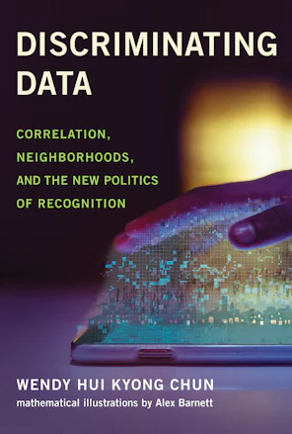



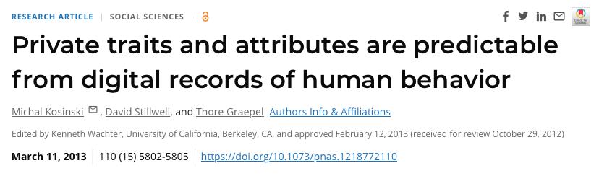
Behind the veneer of objectivity 2
Profiling and targeting
Facebook “likes” predicted by the model
Britney Spears
Wu-Tang Clan
sexual orientation
Human rights campaigns
Waking up confused after a nap

Slide 10
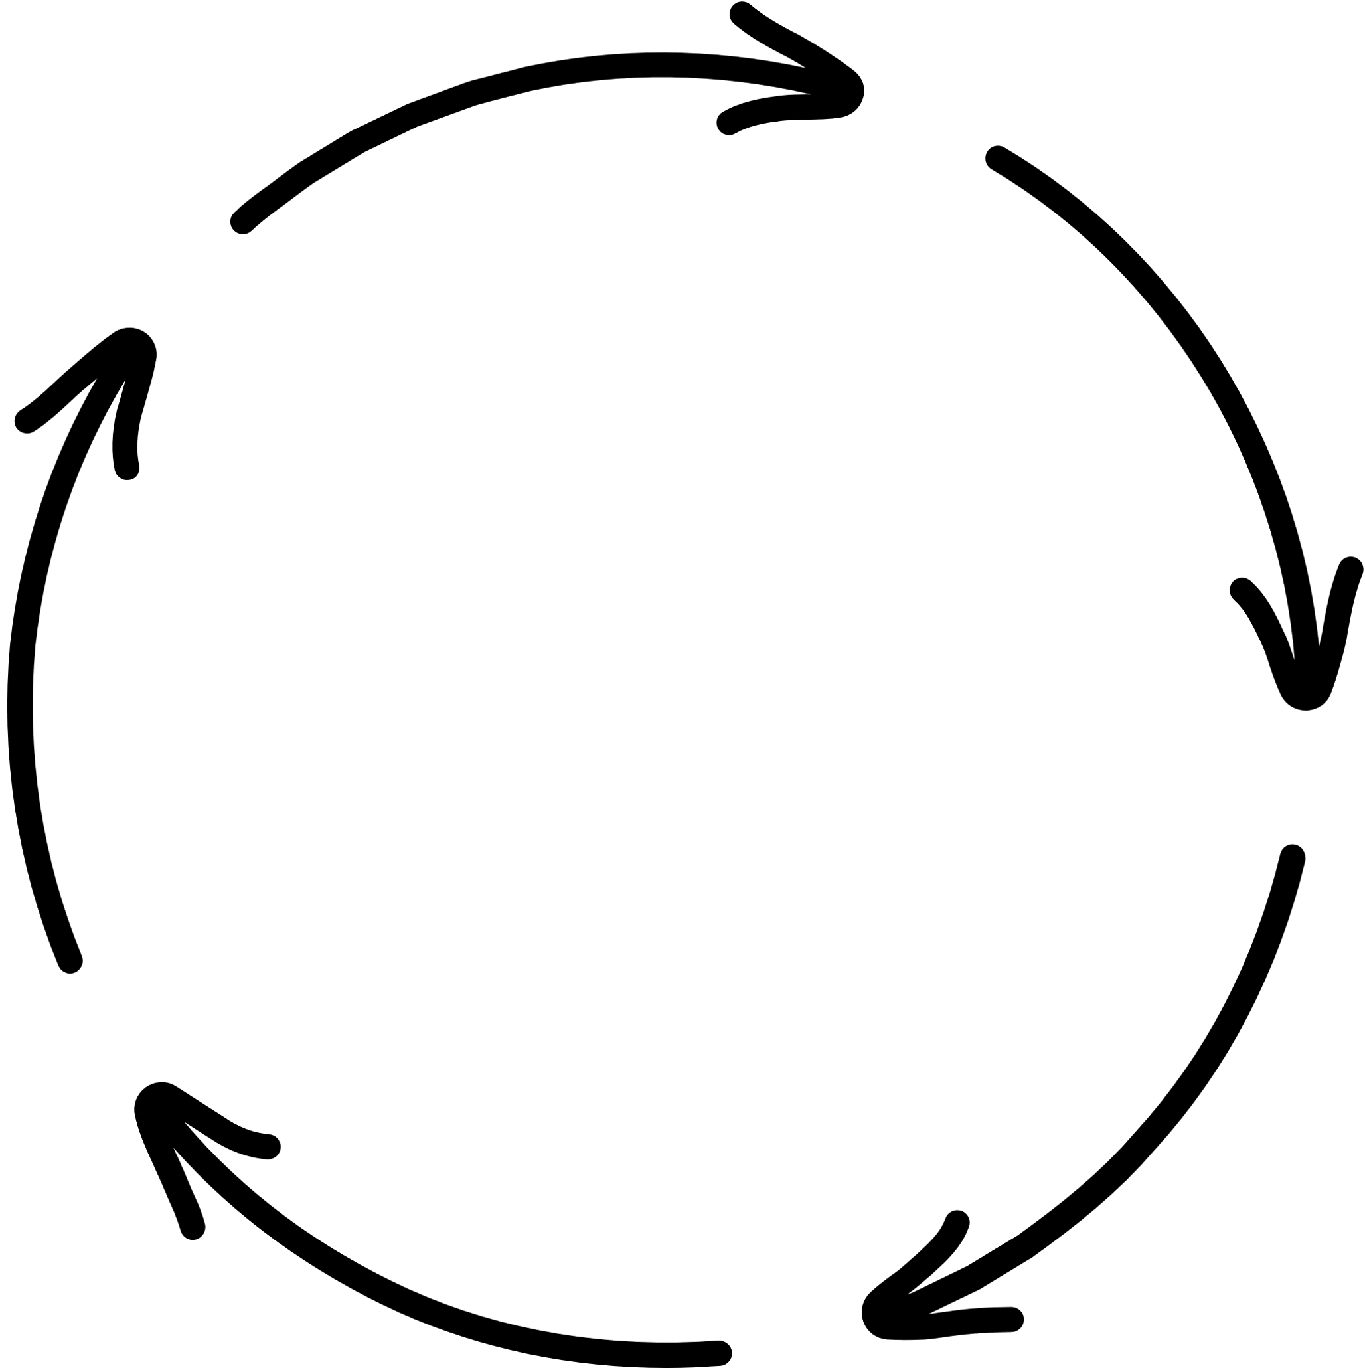

'Garbage in,
garbage out'
problem design
data
model
decision
output
Notes:
Past discrimination
Prejudices, stereotypes
Structural inequalities
Compounded intersectionality

Slide 11
2. The legal gaps

Slide 12
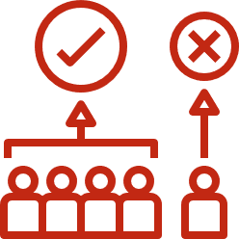

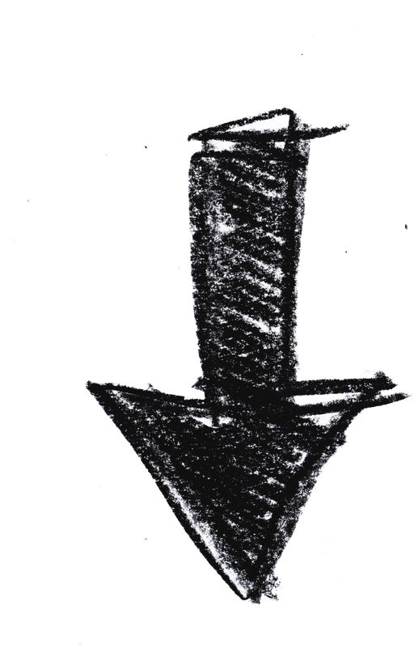


From algorithmic bias to discrimination
Bias
Discrimination
Notes:
protected characteristics
material scope
intersectional bias reduced by the law's categories --> single axis approach

Slide 13

The legal framework: EU anti-discrimination law
Minimum requirements
  Directive 2000/43: race or ethnic origin (employment, goods and services, education)
  Directive 2000/78: age, religion or belief, disability, sexual orientation (employment)
  Directive 2004/113: sex (goods and services)
  Directive 2006/54: sex (employment)
  Art 19 TFEU: sex, race or ethnic origin, religion or beliefs, disability, age, sexual orientation
  Art 157 TFEU: equality between men and women at work and in pay
  Art 21 Charter of Fundamental Rights: non-exhaustive list of protected criteria including
  Art 23 Charter: equality between men and women

Slide 14


Intersectional discrimination
  Invisibility & legal erasure
  C-443/15 Parris: 'there is [...] no new category of discrimination resulting from the combination of more than one of those grounds...'
  Protected grounds of discrimination
  'Single-axis' model: e.g. discrimination based on gender or race

Slide 15


Emergent patterns of discrimination?
  Article 19 TFEU: exhaustive list
  Article 21 Charter: open-ended
  C‑354/13 FOA: no extension by analogy
  New forms of social sorting
  Function and boundaries of non-discrimination law?
Notes:
Also a problem: granularity so reconfiguration and mediation and invisibilisation of intersectional discrimination --> subcategories

Slide 16



Legal resources
Recitals (3) and(14) of the Framework Directive and the Race Directive: recognition of multiple discrimination
“In implementing the principle of equal treatment, the Community should [...] aim to eliminate inequalities, and to promote equality between men and women, especially since women are often the victims of multiple discrimination.”
Pay Transparency Directive 2023/970: recognition of intersectional discrimination
  Recital 25: “ it should be possible to take such a combination into account, thus removing any doubt that may exist in this regard under the existing legal framework and enabling national courts, equality bodies and other competent authorities to take due account of any situation of disadvantage arising from intersectional discrimination, in particular for substantive and procedural purposes, including to recognise the existence of discrimination, to decide on the appropriate comparator, to assess the proportionality, and to determine, where relevant, the level of compensation awarded or penalties imposed”
  Recital 32: transparency
  Art. 3(2)(e) : new definition of “intersectional discrimination, which is discrimination based on a combination of sex and any other ground or grounds of discrimination protected under Directive 2000/43/EC or 2000/78/EC”
  Art. 16(3): compensation
  Art 29(3)(a): monitoring and awareness-raising
Notes:
But there are some resources...
protected characteristics
material scope

Slide 17

Case law resources
Implicit recognition of intersectional disadvantage: C-152/11 Odar, para 69 and C-312/17 Bedi, para 75:
“Severely disabled persons have specific needs stemming both from the protection their condition requires and the need to anticipate possible worsening of their condition”
Implicit choice of intersectional comparators:
  C-258/17 E.B., para 60: comparing the position of individuals convicted for “male homosexual indecency” with that of those convicted for “heterosexual or female homosexual indecency”, reflects awareness that both protected grounds play a role in shaping discrimination
  Opinion of AG Mengozzi in C-528/13 Léger, para 44: “clear indirect discrimination” “consisting of a combination of different treatment on grounds of sex – since the criterion in question relates only to men – and sexual orientation – since the criterion in question relates almost exclusively to homosexual and bisexual men”
Intersectionality and the proportionality test:
  Opinion of AG Kokott in C-443/15 Parris: intersectionality should affect the strictness of the proportionality test
  C-804/18 and C-341/19 WABE and Müller: Sharpston advised “an enhanced level of scrutiny to the sequential aspects of the justification being advanced by the employer”
  Opinion of Advocate General Kokott, C‐157/15 Achbita, para 121: “‘...it is important to take into account, when striking a balance between the interests involved, whether differences of treatment on other grounds are also present. The fact, for example, that a ban imposed by the employer puts not only employees of a particular religion but also employees of a particular sex, colour or ethnic background at a particular disadvantage might indicate that that ban is disproportionate”
Notes:
But there are some resources...
Implicit recognition by the Court

Slide 18


Algorithmic discrimination: proxies and inferences
Photo by Scott Webb on Unsplash
  Discrimination: direct or indirect?
    'on grounds of'
    vs correlations inferred based on proxy attributes
  Link to protected ground:
    C-177/88 Dekker: 'inseparable link'
    vs C-668/15 Jyske Finans: no 'direct or inextricable link'
Photo by Charles Deluvio on Unsplash
  Recent case law on Islamic headscarves and neutrality rules <=> algorithmic neutrality?
    Sharpston: “‘neutrality’ that in reality predictably denies employment opportunities to particular, very clearly identifiable, minority groups is false neutrality” (C-804/18 and C-341/19 Wabe & Müller)
    Intersectionality as a tool to contest neutrality
Photo by Jonathan Borba on Unsplash
Notes:
Not seing the intersectional link with protected grounds is problematic because proxy discrimination then falls under ID
Intersectionality might also influence the relationship to a protected ground and hence the presumption of neutrality in cases of proxy discrimination, and hence the qualif as direct or indirect

Slide 19



From algorithmic bias to discrimination 2
protected ground
protected area
Discrimination
Bias
Notes:
Intersectionality might also influence the relationship to a protected ground and hence the presumption of neutrality in cases of proxy discrimination, and hence the qualif as direct or indirect
2 criteria
protected characteristics
material scope

Slide 20

Two round holes and a square peg
Differential treatment: 'direct discrimination'
--> ‘one person is treated less favourably than another is [...] in a comparable situation o﻿n any of the [protected] grounds’
Disproportionate disadvantage: 'indirect discrimination'
--> ‘where an apparently neutral ﻿provision, criterion or practice would put [members of a protected category] at a particular disadvantage compared with other persons...’

Slide 21
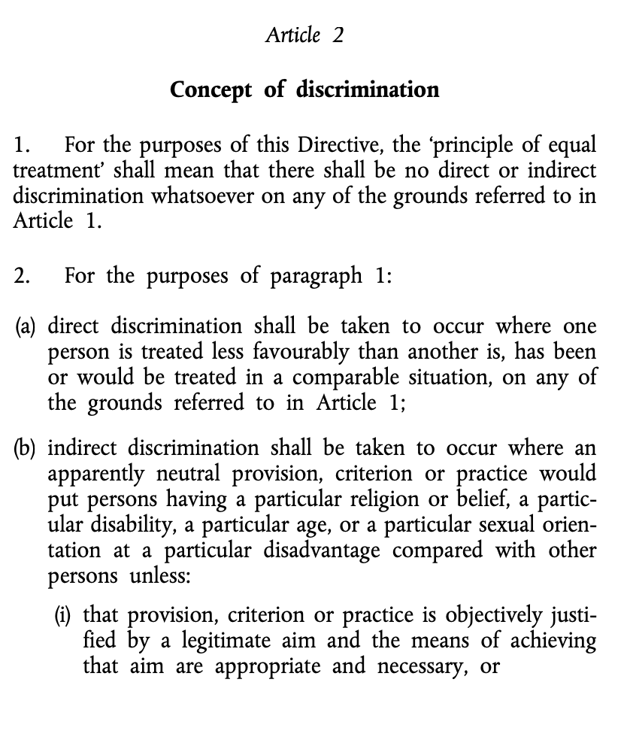




Legal consequences of the direct/indirect qualification
No justification in principle, save for exceptions, e.g. genuine and determining occupational requirement
Open-ended justification regime: proportionality test (pure economic justifications excluded in principle)

Slide 22
3. The invitation

Slide 23
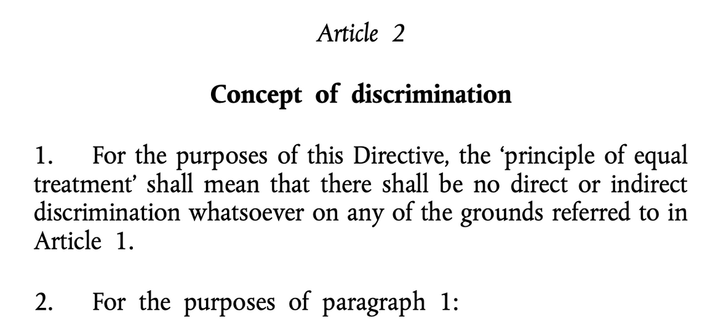



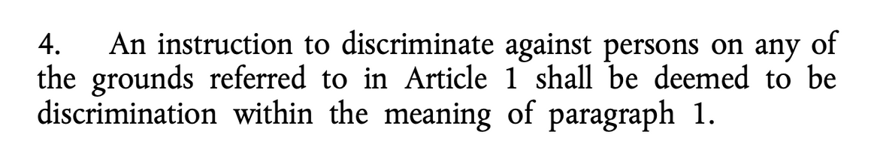
Instruction to discriminate
Why?
  unchartered territory
  epistemic congruence
  legal resilience

Slide 24
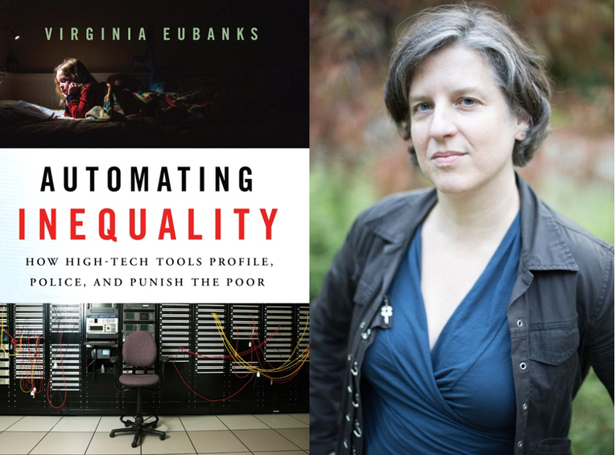
Quote:
'[w]hen automated decision-making tools are not built to explicitly dismantle structural inequalities, their increased speed and vast scale intensify them dramatically'

Slide 25

From discrimination by design to equality by design
Foreseeability and scale of intersectional algorithmic bias
Presumption of algorithmic bias in case of failure to reasonably prevent algorithmic discrimination
Liability for instruction to discriminate: negligence (Moreau)

Slide 26

Consequences
A new legal test for algorithmic discrimination
  Shift of the burden of proof
  Strategic allocation of liability to users of ADMS
  Infringed proportionality test: obligation to reasonably prevent bias
  Reasnable accommodation test (cf. disability)
  Transformative approach centering prevention and positive action
  Facilitates access to justice

Slide 27








Ending
equalgo.wordpress.com
@RaphaeleXenidis
PROFILE
PROFILE
This project has received funding from the European Union’s Horizon 2020 research and innovation programme under grant agreement No 898937.

