Slide 1
Diving Deeper EU Funds and Independent Living
Rita Crespo Fernandez, European Network on Independent Living Steven Allen, Validity Foundation
16 November 2023

Slide 2
Legal framework
Charter of Fundamental Rights of the European Union
Has the status of a Treaty – i.e. highest level in the hierarchy
Article 21: Prohibition of discrimination on grounds “such as sex, race, colour, ethnic or social origin, genetic features, language, religion or belief, political or any other opinion, membership of a national minority, property, birth, disability, age or sexual orientation”
Article 26: Integration of persons with disabilities: “The Union recognises and respects the right of persons with disabilities to benefit from measures designed to ensure their independence, social and occupational integration in the life of the community”
Subsidiarity: only applies to member States when they are “implementing Union law” (Art. 51)
Convention on the Rights of Persons with Disabilities
‘Confirmed’ by the EU in 2010 – giving it legally binding effect across all areas of EU action
Art. 216 TFEU states: The EU may conclude ‘international agreements’
EU law and must be interpreted in accordance with the CRPD and authoritative guidance of the CRPD Committee; actions must be consistent with EU law and CRPD
Article 263 Treaty on the Functioning of the European Union (TFEU)
The CJEU can review legality of acts of the European institutions, including the European Commission, and Member States in the implementation of EU law
Acts deemed to violate EU law can be ‘annulled’ – this nullifies the decision in full or in part

Slide 3
EU law and CRPD prohibit institutionalisation as discrimination
Discrimination on the basis of disability is defined in Article 2 CRPD: “any distinction, exclusion or restriction on the basis of disability which has the purpose or effect of impairing or nullifying the recognition, enjoyment or exercise, on an equal basis with others, of all human rights and fundamental freedoms in political, economic, social, cultural, civil or any other field. It includes all forms of discrimination, including denial of reasonable accommodation.”
CRPD Article 5: Equality and non-discrimination – negative and positive obligations
CRPD Committee General Comment No. 6 (CRPD/C/GC/6)
CRPD Article 19: The right to live independently and to be included in the community
CRPD Committee General Comment No. 5 (CRPD/C/GC/5)
Guidelines on Deinstitutionalization, including in Emergencies (CRPD/C/5)

Slide 4
What is an institution?
Not only size, location, name, legal status or presence of staffing
Requires a complex rights-based assessment – as distinct from ‘needs-based’
Does it promote or inhibit independent living and inclusion in the community? (not only one or the other)
Some defining elements of an institution (para. 14, DI Guidelines)
obligatory sharing of assistants with others
no or limited influence as to who provides the assistance
isolation and segregation from independent life in the community
lack of control over day-to-day decisions
lack of choice for the individuals concerned over with whom they live
rigidity of routine irrespective of personal will and preferences
identical activities in the same place for a group of individuals under a certain authority
a paternalistic approach in service provision
supervision of living arrangements
a disproportionate number of persons with disabilities in the same environment

Slide 5
Case study: Bulgaria
Call for Proposals – March 2018 – support for DI of social services for older people and people with disabilities; app. 18 EUR from ERDF
Used for the building, renovation, furnishing and equipment of 6 day-care centres and 68 care homes for older people and people with disabilities (over 2 years)
Total of 29 municipalities selected, with 1 – 9 services per municipality
Example: one municipality (population 7,968) to host 7 care homes for 100 women with disabilities (12 per ‘home’)
In the COs on Bulgaria from October 2018, the CRPD Committee expressed concerns about the strategy of moving residents from large institutions to small group homes, contrary to A 19 CRPD – rec. to ensure that EU Funds are used to “promote the inclusion of persons with disabilities in society”
Lesson from “DI” of children – the majority of children with disabilities placed in group homes continue to live in isolation

Slide 6
Access to justice barriers
Outcome at General Court
Accepted the Commission’s refusal to act was a legally challengeable decision
Accepted the Commission’s decision had legal effects, but only on Bulgaria
The decision did not have direct and individual effects on persons with disabilities in Bulgarian institutions who may have been beneficiaries (actual or future) of the CFP
The action was deemed inadmissible, applicants must pay the costs
Appeal
Validity Foundation and Center for Independent Living Sofia v. Commission (Appeal): Case C-622/20 P
Grounds
The first instance decision does affect the rights of persons with disabilities as beneficiaries of EU funded programmes – and are ‘directly and individually affected’
No other legal remedies exist to protect or enforce the rights of persons with disabilities affected, and so the CJEU should act to ensure a genuine and effective remedy for disability rights violations

Slide 7
Legal challenge: first stage
ENIL and Others v. European Commission: Case T-613/19
Claim
Refusal of European Commission to interrupt/suspend payments to Bulgaria for a discriminatory CFP should be annulled
Pleas
The failure of Commission amounted to discrimination on basis of disability in violation of Articles 19 and 13(1) CRPD
The decision affects the legal position of a clearly identified group of people who could not represent themselves
The failure of the Commission amounted to a violation of the EU funds regulations with CRPD and Charter
Third-party interventions
Key battlegrounds: admissibility (“Is it a challengeable decision having legal consequences?”) and standing (“direct and individual concern”)
Grainne de Burca: The decision of the Commission is a legal act, ‘direct and individual concern’ and question of ‘locus standi’, access to justice gap for people in institutions/under guardianship in Bulgaria, need to recognise standing of NGOs in limited circumstances
Gerard Quinn: Institutionalisation as discrimination in terms of EU Treaties, CRPD and Charter of Fundamental Rights, interpretation of subsidiary EU Funds law in accordance with substantive CRPD duties

Slide 8
Court of Justice of the European Union
Judicial branch of the EU, based in Luxembourg
Two levels: (i) General Court, (ii) Court of Justice
Jurisdiction: interpretation and application of EU law
Legality of actions taken by EU institutions
Legality of actions taken by EU Member States – when implementing EU law
Authoritative and binding interpretations of EU law

Slide 9
Challenging disability discrimination under EU law – where do we stand?
Final judgment
Acts of EU institutions are only challengeable where they have individual and direct effects
General and collective interests of a category of persons is not sufficient to establish admissibility
“any difficulties, however serious, faced by persons with disabilities in challenging a measure which is of direct and individual concern to them cannot warrant an action being brought against that measure by a third party to whom that measure is not of direct and individual concern, even if it is a non-governmental organisation the purpose of which is to defend the rights of such persons”
Should persons with disabilities have their rights infringed by being placed in institutions in Bulgaria, then Bulgaria is responsible (rather than the Commission)
“Shared competence” not only allows Commission and Member States to pass the buck – it also creates closed international agreements that can rarely be challenged by persons with disabilities or their representative organisations – lacking legal standing

Slide 10
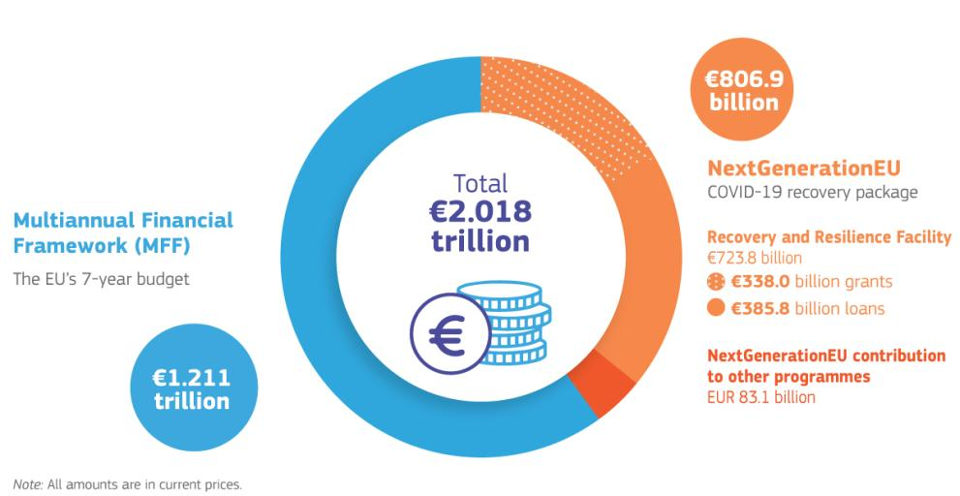
Independent Living in the EU’s financial framework
European Strategy on the Rights of Persons with Disabilities: the Commission commits to “support national, regional and local authorities in their efforts for deinstitutionalisation and independent living, including through the 2021 – 2027 shared management funds.”
In the Common Provisions Regulation 2021-2027, implementation of the CRPD is listed as an enabling condition – but all countries are considered to fulfill it
Regulation of the European Social Fund Plus: promoting the transition from residential or institutional care to family and community-based care.

Slide 11
Independent Living in the EU’s financial framework – Funding outside of the EU
Funding outside of the European Union
European Consensus on Development: takes a rights-based and leaving-no-one-behind approach, committing to measures to better target, protect and support persons with disabilities.
EU Action Plan on Human Rights and Democracy 2020 – 2024: several objectives on persons with disabilities, including access to inclusive services
Regulation of the Neighbourhood, Development and International Cooperation Instrument(NDICI): it refers to deinstitutionalisation, but only regarding children, and promoting the CRPD.

Slide 12
Structural Funds have great potential to support Independent Living…
The European Social Fund Plus can support access of disabled and older people to personal assistance and other support services, and access to employment and inclusive education.
The European Regional Development Fund can support, among other, the development of social housing, housing adaptations, the building of community mental health centres, the provision of technical aids and devices, as well as accessibility of mainstream services.
Through technical assistance, EU funds can support, among other, the work of disabled people’s organisations, as well as development of strategies and action plans.
The EU could invest its development cooperation funding into deinstitutionalisation and community-based services globally.

Slide 13
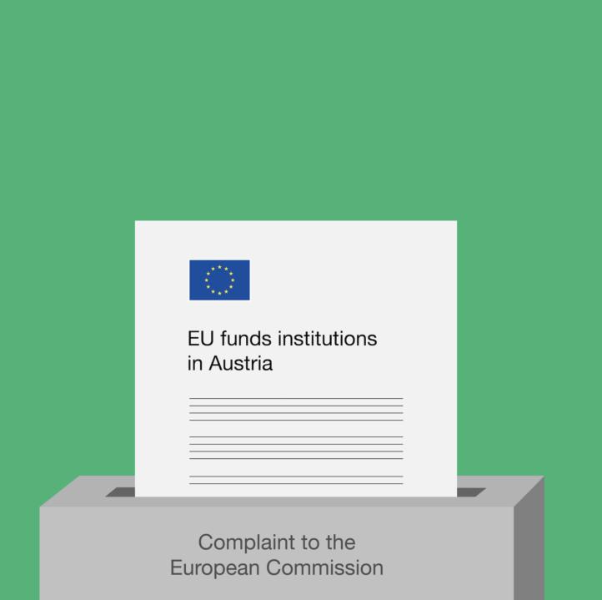
… but they are still being used to fund segregation.
We have reported numerous cases of investments into institutions to the European Commission, without response.
« The relevant authorities (…) do not believe that segregating persons with disabilities into institutions amounts to discrimination” – Special Rapporteur on the Rights of Persons with Disabilities
The EU Ombudsman has recommended to the European Commission to provide clear guidance on deinstitutionalisation to staff and Member States, and to take action to end investments into institutions.

Slide 14
Obstacles to monitoring the use of EU funds
National Level
Disabled People’s Organisations (DPOs) lack capacity and resources to actively engaged in monitoring committees at national level.
Even when present in monitoring committees, DPOs perceive that they are not being properly consulted and listened to, and they report a lack of transparency over the projects that are being financed.
European Level
Under the shared management principle, the European Commission is in charge of monitoring and controlling the funds, but there is little use of the infrigement procedure.
The European Commission’s internal legal documents consider that in some cases, investing in institutions is acceptable and even necessary.

Slide 15
What roles might Equality Bodies and NHRIs play?
Proactive and ongoing assessment of national deinstitutionalisation strategies: publish fundings, present to the European Commission
Review findings of the Inquiry concerning Hungary conducted by CRPD Committee (CRPD/C/HUN/IR/1):
“The Committee finds the following violations of article 19: […] (g) Public funds, including funding from the European structural and investment funds, continue to be invested in building, renovating and expanding large- and small-scale institutions, thus removing resources for support for independent living and the development of accessible, community-based services that foster inclusion” (para. 101)
“The Committee recommends that the State party, guided by general comment No. 5: […] (e) Reorient the investment of public funds – including the way in which funding from the European structural and investment funds is allocated – from institutions to support in the community by accelerating the development of a full range of in-home and other community services offering support in daily life, including personal assistance, and other forms of supported decision-making” (para. 112)
Proactive and ongoing assessment of EU funds at national level: Partnership Agreements, Calls and participation in national monitoring committees
Review CRPD Committee Concluding Observations on EU Member States and the EU
Assess complaints or consider ex officio or thematic investigations: Assess all forms of institutionalisation through the lens of non-discrimination, equality, CRPD jurisprudence (be wary of complaints about staffing, conditions in a vacuum)
Make preliminary references to the Court of Justice of the European Union – Validity can support with this
Access to information is a particular challenge – help civil society to overcome this through enhancing transparency
Support DPOs to participate in national monitoring committees, through capacity-building and calling for better accessibility and engagement of DPOs

Slide 16
Resources
Personal Assistance: Handbook for Understanding Independent Living - Katrin Modic, Elena Pečarič, Domen Retelj
Briefing on the use of EU funds for Independent Living - ENIL
Factsheet on EU funding – ENIL
Role of the European Union funding in supporting deinstitutionalisation around the world: A Call for Change – European Disability Forum, ENIL
Visit to the European Union - Report of the Special Rapporteur on the rights of persons with disabilities
Decision on the own initiative inquiry into how the European Commission monitors EU Structural and Investment funds to ensure they are used to promote the right of persons with disabilities to independent living and inclusion in the community – European Ombudsman
Inquiry concerning Hungary under article 6 of the Optional Protocol to the Convention - Committee on the Rights of Persons with Disabilities
Ensuring Independent Living and Deinstitutionalisation: Criteria for the Assessment of EU Funded Call for Proposals and Projects in the 2021-2027 Period – Bridge EU, Stowarzyszenie Instytut Niezależnego Życia, Validity Foundation, ENIL
ENIL Shadow report on the implementation of the UN Convention on the Rights of Persons with Disabilities in the European Union

Slide 17
Thank you for listening!
Rita Crespo Fernandez, European Network on Independent Living – rita.crespo-fernandez@enil.eu Steven Allen, Validity Foundation – steven@validity.ngo

