Slide 1
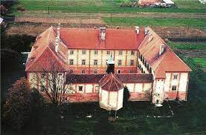
Deinstitutionalisation in Croatia through the work of the Disability Ombudsman
Branka Meic Salie, advisor to the disability ombudsman

Slide 2
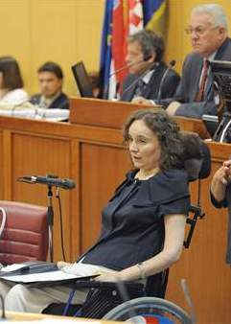
Office of the ombudsman for persons with disabilities, Croatia
Established 2008
ombudsman appointed by the Parliament at the government recommendation, 8 year term of office
Independent body for monitoring the CRPD Art. 33, para 2
Equality body: Anti-discrimination Act
Ombudsman’s office-maladministration
National human rights institution-promotes disability rights=human rights
Staff of 20

Slide 3
Anka Slonjšak, ombudswoman for persons with disabilities
Advisors specializing in social welfare,
health,
work and employment, accessibility,
education,
legal capacity and mental disability
Visits to institutions – write reports to the ministry, give recommendations, ask for inspection
Individual complaints, complaints by NGOs

Slide 4
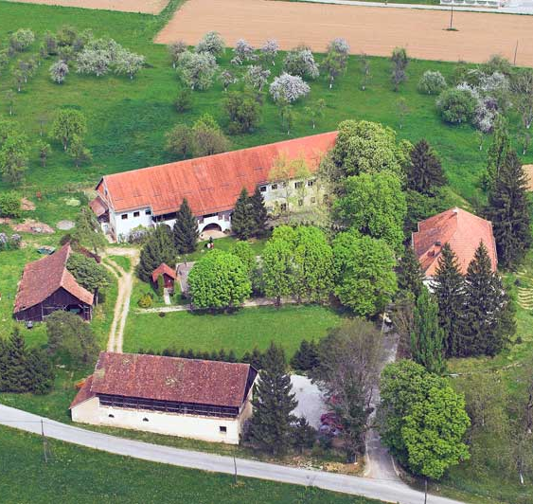
Institutions in Croatia in numbers
88 homes
42 state homes
15 non/state homes
8 other egal persons
23 family homes (5 to 20 users)
6.757 users in 2013
8 300 in 2021 + 2 000 in foster families
2.781 children and adults with physical and intellectual disabilities (600 children) 3.976 adults with mental disabilities

Slide 5
Beginning of deinstitutionalization 1997 2016 – RUSHED PROCESS!
Association for promoting inclusion – professor Borka Teodorović, PhD from Humboldt university in Berlin, educational rehabilitator
Association for self-advocacy

Slide 6
Transformation of institutions – centers for providing support in the community
Organised housing - Group homes with 8 people
24 h support

Slide 7
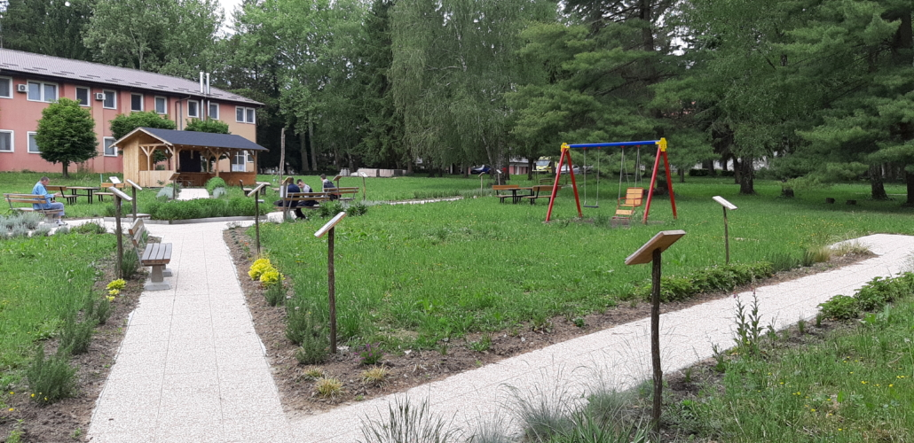
Masterplan of deinstitutionalisaton, 2010 – 30 % less by 2016, 20 % less by 2018 for mental disabilities)
2015 leftwing government – transformation of 5 institutions
CENTERS FOR REHABILITATION

Slide 8
Cooperation with international organisations
Human Rights Watch, Once you enter, you never leave, 2010
MDAC, Out of Sight Out of Mind, 2011
WHO Quality Rights Toolkit,
2017
LACK OF POLITICAL WILL – a left wing political concept

Slide 9
OPERATIONAL PLAN FOR DI 2022-2027 Goal: ensuring measuers for life of elderly persons in the family and community Specific goal: 1. ensuring available and quality community based services for elderly with a special emphasis on development of community based support services as well as integrated social services: counselling and assistance, psychosocial support, at home assistance, day care) Indicators: a number of elderly persons that received out of institutioncare compared to the number of them in institutions

Slide 10
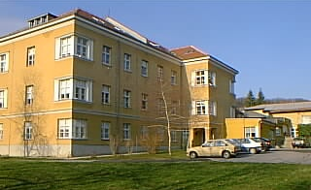
Resistance
Family members, guardians, parents – fear of losing everything
Local community – loss of property value
Staff – job insecurity

Slide 11
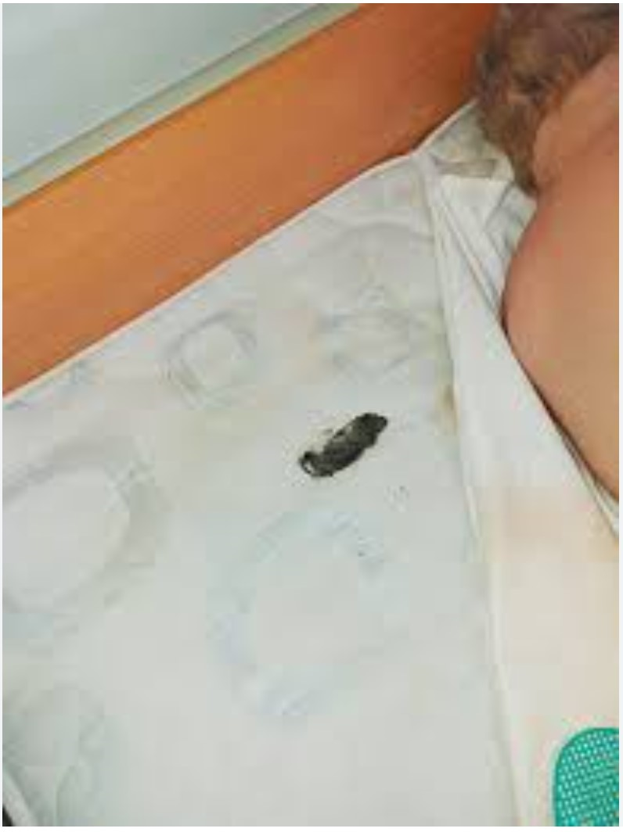
Resistance: Home for adults Osijek – Center You as Me
March 2018 final court judgment: discrimination in the form of harassment on the ground of health
October 2018 media coverage, images of filth, dismissal of the head who led the DI process LADISLAV LAMZA
Funds secured in EU funds but the process stopped

Slide 12
Rights of persons with disabilities placed in foster families and family homes – deposited for safe keeping, warehoused

Slide 13
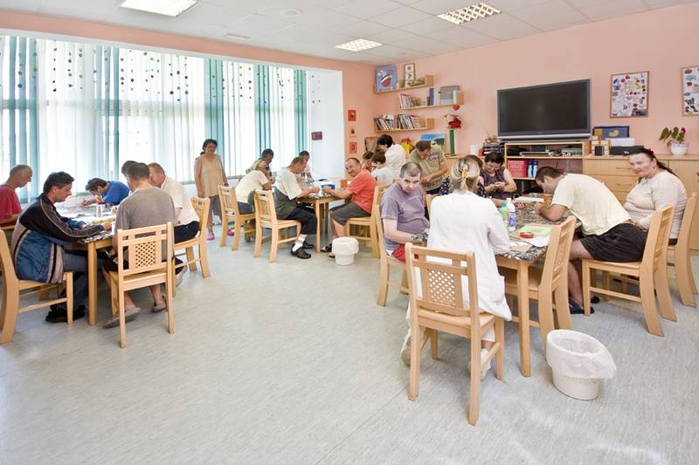
https://drive.google.com/file/d/1svDAZMva8Voqoi91q7gxFz29IrQvFq9R/view
FUTURE?

Slide 14
Thank you for your attention
CONTACT DETAILS
Ombudsman for persons with disabilities
Savska cesta 41/3
10 000 Zagreb
Croatia
tel. 01/6102 170, fax: 01/6177 901
e-mail: ured@posi.hr
Internet page: www. posi.hr

