Slide 1
Community, alternative or independent living? A critical reflection on de-institutionalisation from the perspective of older persons
Philippe Seidel, Policy Manager on Social Protection
AGE Platform Europe
Brussels, 16/11/2023

Slide 2
From where do I speak?
Credit: AGE Platform Europe
Notes:
Created in 2001
Non-profit organisation with Belgian statutes
European Network with ~105 Member organisations
Co-financed by a grant of the EU (DG JUST grant / CERV and different research projects) and by its members (~20%)
Advocacy and project work in different domains : pensions, employment, volunteering, health, human rights, accessibility, digitalisation, etc.

Slide 3
Sections
1# Thinking care
2# Issues around long-term care
3# Challenges to deinstitutionalisation

Slide 4
1# Thinking care

Slide 5
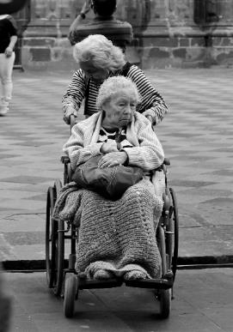
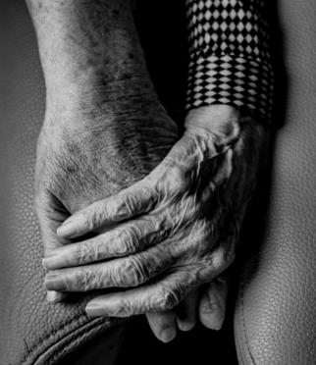
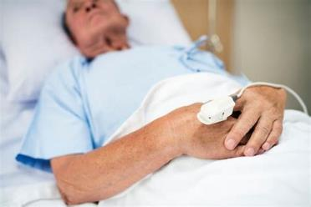
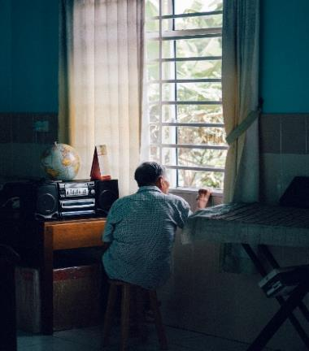
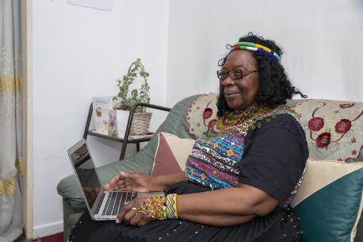
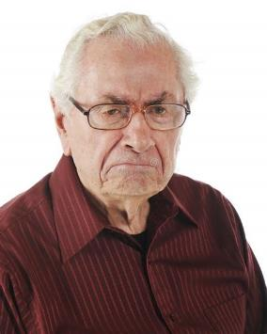
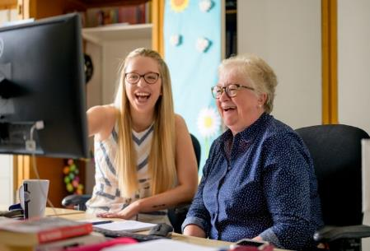
Choose which image represents ageing to you
1
2
3
4
5
10
6
9
7
8
11
14
13
12
15
Notes:
Pick a picture that resembles how you imagine yourself when you will be old, or when you think about being old?
Share your thoughts with us.
Raise hands –
how many chose a picture with an uneven number
and how many with an even number?
Notice that the even numbers are somewhat connected to more negative aspects of ageing (not all…).
But when people Imagine themselves, it is not always the negative aspects.
→ Considering/comparing to the picture that you choose, how is ageing generally described or portrayed by society? By healthcare professionals?

Slide 6
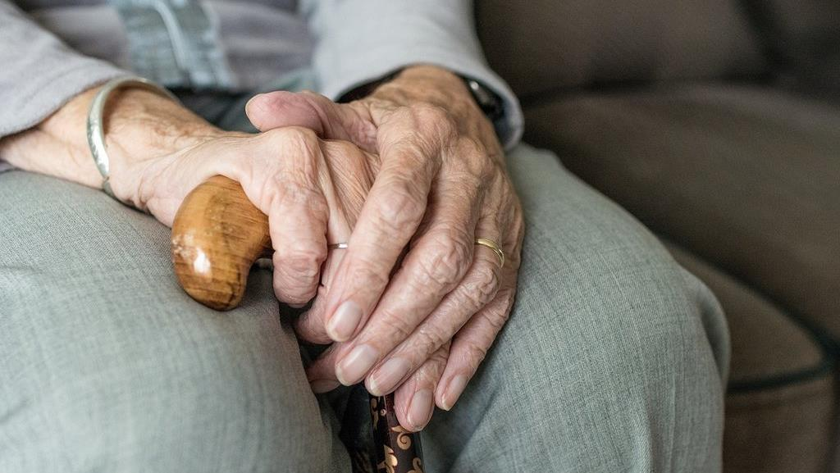
Most-often used image of ageing
Notes:
Usually, our cultural representation of older persons bring us back to this – someone lonely, with stick to walk showing the health issues. Wrinkled hands are often used to picture older people – inspire pity or loneliness.
The lack of diversity is also very often pointed out, it has enormous consequences on people’s health. Although many older people are living with a disability, disability can take various forms and not only be physical. People have very different experience over their life, they might have face discrimination for their gender, their sexual orientation or their race/ethnicity, and these discrimination might today intersects with age discrimination.
Older people are far too often pictured as passive, looking at others or contemplating the landscape from a bench, receiving care or guidance rather than doing things or passing on knowledge.

Slide 7
Three dimensions of ageism
Notes:
Ageism means treating people unfairly because of their age (HelpAge)
Most widespread form of discrimination
It can take different forms: it can be about how we think (stereotypes), feel (prejudice), and act (discrimination).
But Socially accepted
Can you give me 5 common Ageist stereotypes ?
old people are all sick
old people have no sex life
old people are incapable of learning
old people all suffer from dementia of varying degrees of severity
old people don't know how to use new technologies

Slide 8
Our vision for care
Advocacy for reforms in care should not only point to challenges and opportunities: it must be grounded in a vision – a horizon that triggers greater imagination and ambitious change in policies, services, and societal attitudes.
AGE’s vision is anchored in key human rights principles. It is a call for care not to be the end goal, but the means that help us achieve the things that matter to us¹⁰:
Care empowers.
Care supports and enables inclusion and participation.
As we receive care, we feel better. We can remain included in the community, contribute to society and participate.
¹⁰ Our vision for change is based on the outcomes of Re-thinking Care, a process conducted with AGE members in 2021. To get to know more about it, you can check the dedicated Policy Brief.

Slide 9
Policy brief setting out our vision of care
As the voice of older people in Europe, we call for care systems that empower people at all stages of their lives, enable their participation and support their autonomy. Care systems that ensure older people can be part of society as equal and full citizens.
Notes:
Outcomes were
A position paper – visual and concise – reflecting the results of the process, which was disseminated to relevant stakeholders, notably the team of the European Commission which prepared an initiative on long-term care that was released in 2022.
Toolkit for AGE members (extracts will be shared with you today)
Link with Consultation to Green Paper on Ageing → see previous chapter

Slide 10
2# Issues with long-term care in Europe
Access, affordability and quality

Slide 11
Care and support services are widely unavailable
Care and support services are widely unavailable
Prevalence of informal care | 80% of care is estimated to be delivered by informal carers, unpaid
Lack of choice | Only 1 in 3 persons over 65+ with severe difficulties in personal care or household activities used homecare services¹ 47.2% had an unmet need for help²
Affordability | Without social protection, the costs of care would put the majority of older people in the EU at risk of poverty In EU countries, 60% of older people would be at risk of poverty even after receiving public support In 2016, financial reasons were the most prevalent reason why people did not use professional homecare services
^{1,2} % of people aged 65+ with severe difficulties in personal care or household activities. Source: 2021 Long-term care report, vol. 1, European Union ¹ Figure for EU-27, 2014 ² Figure for 22 EU countries, excluding Belgium, France, Germany, Malta and Spain, 2019 Other figures: 2021 Long-Term Care Report, vol. 1, European Union

Slide 12
Care and support services are widely unavailable (2)
 | Care and support services are widely unavailable (continuation)
Segregation | Care policies and services tend to treat older people as a segregated group without the same rights to equality and inclusion as anyone else. The vast majority of people want to stay at home, but many are unable to do so.
Organisational issues | Poor care is often characterised by the lack of coordination of services. Older people who access care often have insufficient or inadequate care.
Difficult working conditions | Care workers experience difficult working conditions, including low wages, lack of training and heavy workloads.
Maltreatment | Care services may aggravate the health conditions of people using them. Prevention and rehabilitation are weak or inexistent. There are situations that may be qualified as abusive.
In Europe 1 in 4 older people with high care needs experience maltreatment⁸
⁸ Source: European report on preventing elder maltreatment, World Health Organization, 2011

Slide 13
#3 Challenges in deinstitutionalisation from an older age perspective

Slide 14
What elements hinder rights-based approaches to long-term care?
 | What elements hinder rights-based approaches to long term care?
Ageism from society | Institutional care seen as the standard model; path-dependency on existing model
Time pressure | Demographic developments need that more care services have to be rolled out quickly. Tendency to think it is more efficient to build new projects with large capacity.
Funding | Evidence suggests that home and community-based care is less expensive, but funding/social protection models can favour institutional care (‘in-kind’ service provision by municipalities)
Preferences | Internalised ageism or other elements leading to older persons choosing to move into institutional or hybrid settings

Slide 15
What elements hinder rights-based approaches to long-term care? (2)
 | What elements hinder rights-based approaches to long-term care?
Age-’unfriendly’ environments | How would one continue to be included in society, at home and with impairments (mobility, offer of social activities etc.)?
Care ecosystem | Home care and community-based care need coordination, sharing of information, additional roles (domestic help), additional expenses (mobility of care staff)
Informal care | If coordination and support services are lacking, community-based and/or home care can place higher burden on informal carers

Slide 16
Thank you! Do you have questions?

Slide 17
Want to know more about us?

