Slide 1
De-institutionnalisation in the European Union
November 16th 2023
Notes:
EDF logo
Title of the presentation
Replace this section with your name
And this one with the date

Slide 2
Current context
A report from 2020 funded by the European Commission concluded, among other things, that:
there are still at least 1’438’696 persons living in institutions in the EU, although there are still severe gaps in reliable data collection;
the number of people in institutions does not seem to have substantially changed over the past 10 years.

Slide 3
Current context II
The persistence of EU funding going towards institutional care settings was recently criticised in the report by the UN Special Rapporteur on the Rights of Persons with Disabilities on his visit to the European Union, launched in February 2023.
As part of the EU Strategy on the Rights of Persons with Disabilities 2021-2030, the Commission committed to creating new Guidance for the EU Member States on Independent Living and Inclusion in the Community.

Slide 4
Definition of independent living
will most commonly require the following:
Choice over where to live;
Choice over whom to live with;
Choice over how long to live there;
Access to one’s own personal possessions;
Choice over how one is supported;

Slide 5
Definition of independent living II
Choice over who provides services if needed;
Choice of one’s own friends and relationships;
Choice over how to be healthy and safe;
Choice over how to take part in the community;
Control over how to resolve issues that affect you (such as problems within the family or in a living arrangement)
Having the same rights and responsibilities as other citizens

Slide 6
What is an institution?
an institution has a number of defining elements. These include:
isolation and segregation from the community;
no or limited influence over whom one has to accept assistance from;
obligatory sharing of assistants with others (having an assistant that is supporting multiple people at once) meaning that a person cannot partake in separate activities from people with whom they share assistance;
lack of control over day-to-day decisions, such as what time to get up, what to eat, who you spend your free time with, etc.;

Slide 7
What is an institution? II
lack of choice over whom to live with;
not being able to decide freely when to visit friends or family, or having this decision taken by someone else;
facing restrictions over if and when one can have guests over;
rigidity of routine irrespective of personal will and preferences;
Imposing group activities under the authority of the service provider.
The absence, reform or removal of one or more institutional elements alone cannot be used to characterise a setting as community-based.

Slide 8
And what is De-institutionalisation (DI)?
process of closing down institutions and moving towards independent living with the necessary community-based services.
is a transition
requires detailed plan for closure, supporting the people concerned, and ensuring their transition to accessible housing
essential that the process of moving away from institutions does not result in residents of institutions being left homeless or in vulnerable situations because of poorly planned closure of institutions

Slide 9
And what is De-institutionalisation (DI)? II
There is no reason for the transition to last a long time.
This is why it is essential to create conditions for living in the community as a matter of priority, so that people can move out of institutions.

Slide 10
Human rights issues we observe
Persistently:
Denial of choice over one’s life
Not allowed to see who they want
Restrictions over having guests
Denied ability to form meaningful relationships
Compelled to partake in certain activities

Slide 11
Human rights issues we observe II
In some cases institutions can become sources of sever abuses, violence, sexual assault, and even forced sterilisation.
Children in institutions lack support for their development and are more likely to be outside of education

Slide 12
Institutions in the EU using EU money

Slide 13
Innovative institution Home sweet home in Lodz, Lodzkie

Slide 14
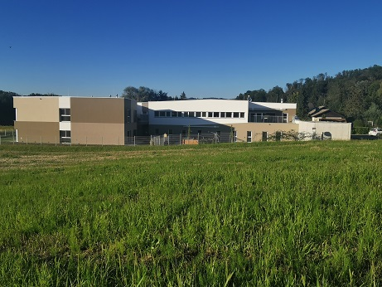
Austria : Upper Tyrol

Slide 15
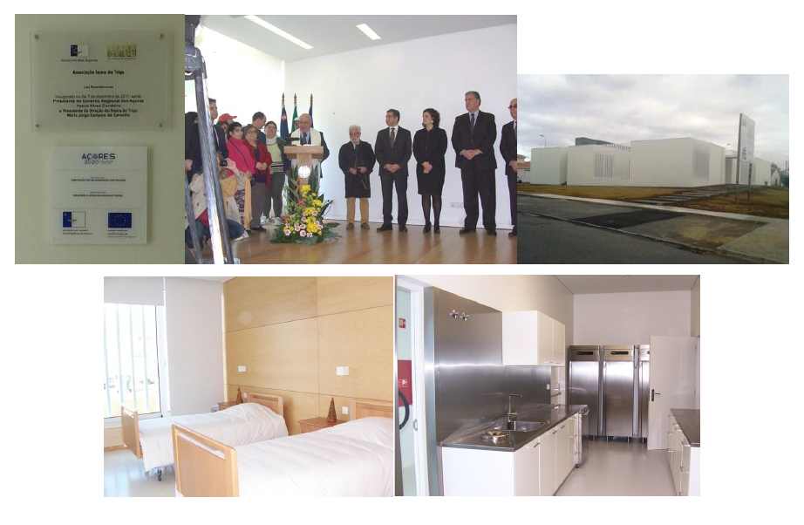
Portugal Azores

Slide 16
Green flags: Things worth investing in
A) Services that give the service user control over their own life
The person must be able to decide where and with whom they live
Each locality should have on offer a sufficient range of different types of services and ensure the accessibility of mainstream services, to respect the right to choose of the service user
The services on offer should include personal assistance for those in need, ensuring that the level of personal assistance provided meets each person’s needs for support.

Slide 17
Green flags II
The budget available for assistance should be delivered directly to the person who then uses the service
Peer support can be offered, as well as forms of supported decision-making for people requiring support in making choices about their living arrangements

Slide 18
Green flags III
B. The location of the service must not result in the person being more segregated or cut off from their community
1. A person living in regular housing, such as in an apartment block or a house, with support provided to live there if required.
2. The provision of housing (contract with a regular landlord or the service provider overseeing the provision of personalised accommodation) not being tied directly to the support services a person receives.

Slide 19
Green flags IV
3. Can promote self-managed co-housing for people who want to share accommodation to reduce costs (persons with disabilities who decide to live together and receive support services in the place they have chosen to live).
4. Ensuring that the person’s accommodation is not on the same site as the place they work or study etc
5. When personalised accommodation is provided as part of a larger support service provision, this should be within the community and located alongside other standard accommodation

Slide 20
Green flags V
C. The service must be designed around the requirements of the person
1. Services should be flexible in offering different levels of support, ranging from 24 hours per day, to several hours per week
2. Services should be right-based, centred around the needs and wishes of the people they support.
3. Services should focus on establishing and maintaining the person’s social roles (employment, family, friends, etc.)

Slide 21
Green flags VI
4. To the greatest extent possible, services that the person requires in different areas of their life should be covered by mainstream services
5. The provision of services should be accompanied by a well-trained and adequate workforce
6. In order to ensure the provision of adequate and quality services, it is essential that Member States recognize the current shortage of staff needed to provide satisfactory support

Slide 22
Green flags VII
D. Some other positive approaches
Support informal carers
Prioritise accessible public spaces and transport
Increase stock of accessible new builds and identify existing housing that can be retroactively made accessible
Accessibility and inclusion in mainstream education
Provide incentives for businesses, restaurants, cafes and centres offering cultural activities to be fully accessible to persons with disabilities

Slide 23
Thank you for your attention
The European Disability Forum
www.edf-feph.org
Avenue des Arts 7-8, Bruxelles 1210, Belgium
Twitter: @MyEDF
Facebook: @MyEDF
Notes:
Thank you for your attention
The European Disability Forum
www.edf-feph.org
Avenue des Arts 7-8, Bruxelles 1210
Belgium
Twitter: @MyEdf
Facebook: @?

