Slide 1
Family policies and inequalities: What does the Work Life Balance Directive do well and what can it do better?
Prof. Heejung Chung, University of Kent

Slide 2
Today
Goals of family policies, especially with regards to equality
What does the Work-Life Balance directive do well, the great potential for equality
Potential problems for equality
Unequal division of labour
Flexibility stigma and its impact on women
Modest suggestions for solutions?

Slide 3
What are the goals of family policies?
To ensure better integration of work and private demands for all workers (not just parents – as care is something everyone is involved in, e.g. informal care, and work-life balance should be something all workers should achieve)
To ensure well-being of families (including children – as social investment)
To ensure equality (across gender, classes, sexuality, disability, race etc)
Changing norms around work, work-life balance and gender roles

Slide 4
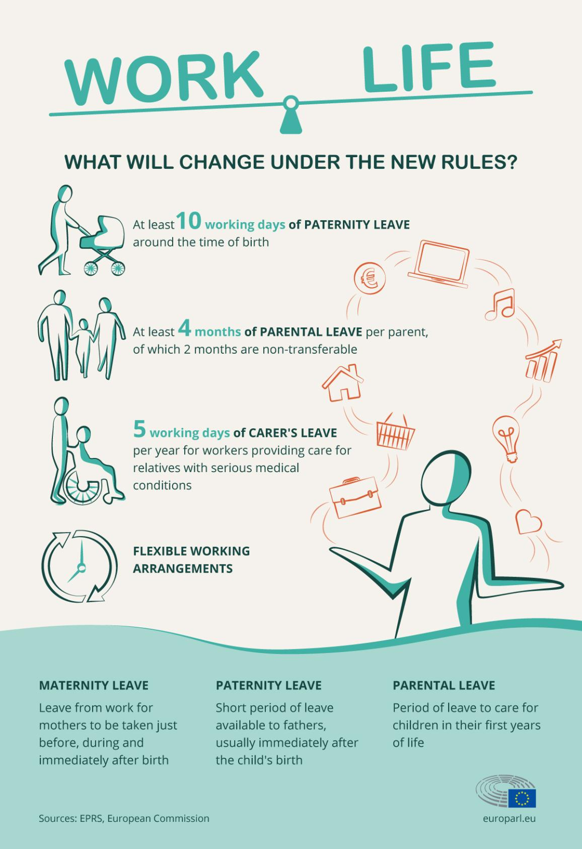
Key changes in the new directive
Providing fathers and 2nd parents ear- marked provision (use it or lose it)
Right to request flexible working arrangements beyond part-time working (for parents)

Slide 5
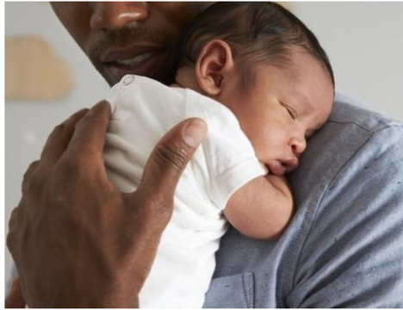
The positives: Daddy leaves
Increases child well-being and a range of other child outcomes – reduction of problems, and increase well-being, cognitive development (for a summary see Chung, 2021
Increases father’s own well-being (Walthery & Chung 2021)
Helps mothers return to work after childbirth Andersen, 2019
Increases fathers’ involvement in childcare beyond early years (Nepomnyaschy and Waldfogel, 2007; Norman et al. 2014, Knoester, 2019), and likelihood to reduce working hours→ in combination helps reduce gender inequality patterns both at home and in the labour market
Decreases couple conflict, likelihood of divorce or separation (Schober; Ruppaner et al) – family well-being
Changes the nature of masculinity (hegemonic → care masculinity), and gender norms about men’s roles at home and in society

Slide 6
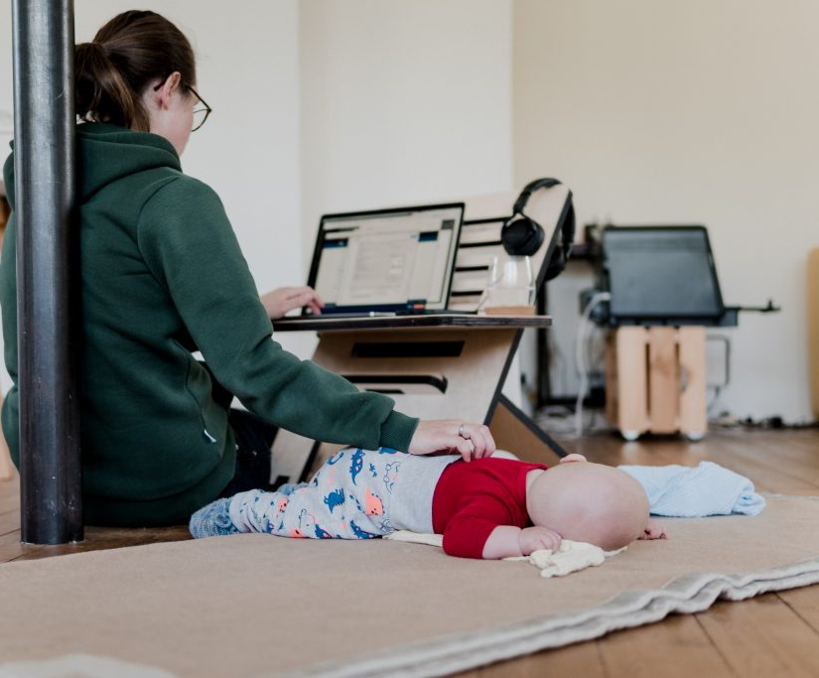
The positives: Flexible working arrangements
Better integration of family and work roles with improvement in work-life balance satisfaction (Chung 2022)
Flexitime, teleworking increases women’s likelihood of not dropping out of the labour market post childbirth (Chung & van der Horst, 2018)
Reduces mother’s likelihood of moving into shorter hours/non-lucrative jobs (Chung & Vander Horst, 2018; Fuller & Hirsch, 2018)
Can help reduce gender pay gap

Slide 7
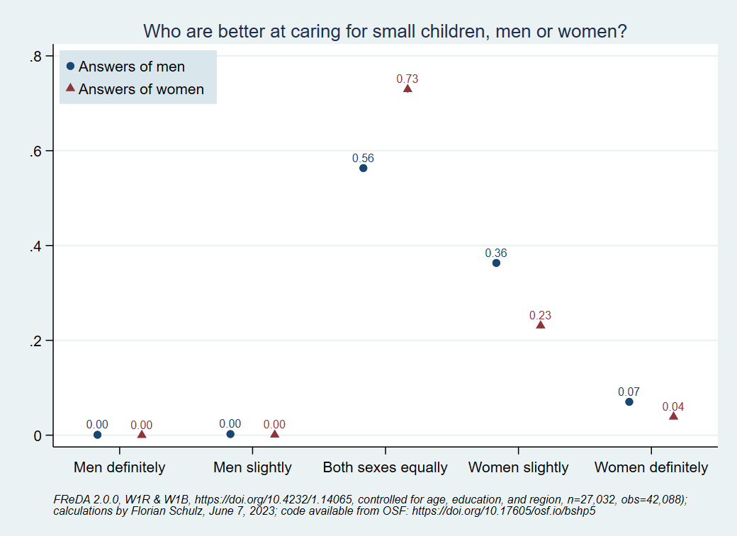
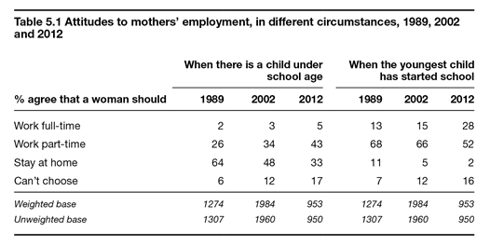
The potential problems for inequality: unequal division of labour
Previously maternity leave or “gender neutral” leaves meant mothers take up all leaves which solidifies the role of mothers as carers and fathers as breadwinners.
2 months ear-marked paternity/2nd parent leave is a good start BUT not enough to really equalise the playing field, especially when fathers are earning more than mothers(which leave taking will further increase the gap) (*and also language to be trans inclusive)
British social attitude survey 2012

Slide 8
The potential problems for inequality: unequal division of labour (cont)
Flexible working enables couples to ‘do gender’ resulting in the traditionalisation of gender roles (Chung & van der Lippe 2020)
Due to social norms women use & are expected to use flexible working to meet the household/family demands (Hilbrecht et al. 2008, Sullivan& Lewis, 2001)
Women/mothers increase their household work/childcare when working from home but men do not (Kim, 2020) increasing the total hours of ‘necessary work’ women need to carry out (Kurowska, 2018)
German study using GSEOP – women increase childcare hours by 3 hours, men increase overtime hours by 3 hours when working from home (Lott, 2019) Mothers use homeworking to do more childcare, men do less (Chung & Brooker, 2023)
Women work in communal spaces (dining room table, living room), while men generally have separate working spaces (uninterrupted time)

Slide 9
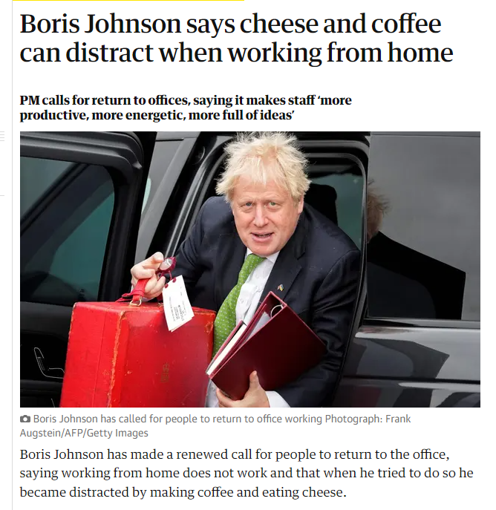
The potential problems for inequality: flexibility stigma

Slide 10
Flexibility stigma
The ideal worker?
The belief that flexible workers (those who take up flexible working arrangements and take up leaves) are not as committed, motivated, productive as non flexible workers and therefore (are expected to) experience negative career outcomes
Largely linked to the ideal worker culture (Acker 1990; Williams 1999) – where the ‘ideal worker’ in a manager’s head is someone who has no other responsibilities outside of work, prioritises work above all else in life (based on the 1950s breadwinner) and can sacrifice all other aspects of one’s life – it is possible due to the female care giver who takes all reproductive responsibilities

Slide 11
Flexibility Stigma (flexible working is badly perceived by colleagues) across Europe (% of workers who totally agree or tend to agree) (source: Eurobarometer 2018)
Chung & Seo (in review) show that this is sig associated with work culture, gender norms and family policy contexts

Slide 12
Flexibility Stigma (flexible working has/had a negative impact on one’s career) across Europe (% of workers who totally agree or tend to agree) (source: Eurobarometer 2018)

Slide 13
Flexibility stigma and gender
Femininity stigma – men are likely to experience double stigma of flexibility + femininity stigma – deviating away from the breadwinner image (Redman&Rusher)
Double whammy stigma – those who are likely to experience biases against their work productivity (mothers, ethnic minority workers, working class/lower-skilled, disabled, LGBT+) are more likely to experience flexibility stigma – the stigma is only triggered for those groups.
Evidence is mixed
Kelland et al. 2022 – fathers fear stigma and do not use part-time and leaves
Munsch 2016 fathers using flexitime evaluated positively
Chung, 2020- mothers more likely to fear and have experienced stigma; Lott&Chung, 2016; Glass&Noonan, 2016 – mothers are not compensated for overtime when working flexibly;
Wang & Chung (forthcoming) – teleworking mothers experience worst stigma but the added stigma of teleworking stronger for fathers. (BUT all workers experience stigma)

Slide 14
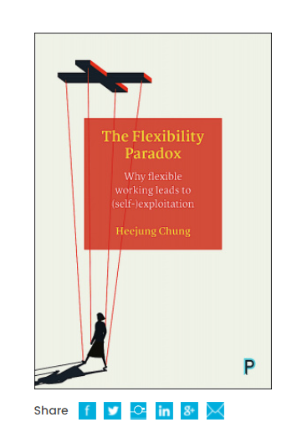
Outcomes of stigma
Non-use of policies --> especially among fathers as men are deemed to be the breadwinners and fear negative career outcomes more while mothers have no other option
Workers who use policies (leaves or flexible working) are discriminated against (proximity bias – Cristea & Leonardi, 2018; Coltrane et al 2013)
In combination you get a two-tiered labour market – with women and carers in the outer market with dead end careers (c.f. part-time)
Workers who use policies end up working harder and longer to (over)compensate for the stigma – the so-called flexibility paradox(Chung 2022) --> flexibility results in boundary blurring where work encroaches into family life --> worse work-life balance and well-being outcomes (burn out)

Slide 15
Solutions Flexible working: normalisation of practices
Ensure that policies are universal – as previous social policy literature shows how stigma is reduced for universal policies (Albrekt-Larsen, 2014; Baumberg, 2016)
When flexible working becomes more of a norm, it is seen as a right & more of a smart working policy (Been et al, 2017; Kelly et al, 2014; van der Lippe & Lippenyi, 2020)
Countries with high levels of flex use → less stigma
As when teleworking policies are targeted to parents, or worse mothers, stigmatised views are more likely to occur (Wang & Chung, in review) against ALL workers
Stronger right to flexible working (rather than right to request?) for ALL WORKERS (not just parents) – see FI, UK, NL

Slide 16
The problem with gendered policies
Policies that only support mothers bad even for mothers, and other workers as well
Similar results for all workers and at the organisational level take up
Figure 4. Interaction effects of teleworking status with national policy context on employer perceptions for mothers

Slide 17
Solution : Right to disconnect?
We need to ensuring that the rise of remote working which can does not result in social costs - workers’ reduced work-life balance, burn out results in high social costs not only for workers, but family company –society
Right to disconnect does NOT mean that workers lose their flexibility – as workers CAN do work, but there is no expectations
The rise of ‘always-on’ culture can exacerbate gender inequality patterns as marginalized individuals(mothers, workers with care responsibilities, disabled workers, racial minorities others with fewer resources) may be less able to perform to this expectation
Enabling a right to REST (Chung, 2022; see also Barcelona Time Use initiative) - mandated and protected time away from work – both physically and mentally which can help with productivity outcomes (Sonnentag)

Slide 18
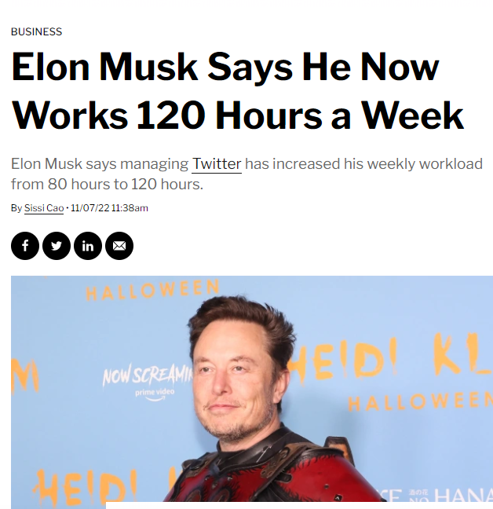
Solution: Changing the ideal worker culture
Problem with both leaves and flexible working lies in the current ideal worker culture that exist in many of our labour markets (more in certain countries than others)
The idolisation of long hours busyness at work – especially in times of recession – goes against scientific evidence around work productivity (Pencavel, 2014; Caruso et al. 2006; Bellet et al., 2019).
We need to change norms around “ideal worker” of someone who has responsibilities outside of work where work life balance is something that contributes to one’s productivity
4 day week as a solution?
Generous family policies as a solution

Slide 19
Solution : Changing gender norms
Ear-marked daddy leaves already a great start in the right direction
Ensuring strong national policies with high levels of pay, longer duration would benefit more (Petts et al 2022)
This will also allow the gendered flexibility paradox to not happen → maybe men will be less likely to fear or be penalized for flexible working

Slide 20
Summing up
European Directive of WorkLife Balance is a great move in the right direction
However, there are some potential negative outcomes we need to be aware of
These are not very difficult to tackle, as long as we are aware of the issue can use concerted policy efforts – such as stronger flexible working rights for all workers, introducing right to disconnect, challenge ideal worker norm through shorter working legislations or enhancing family policy provision, and challenge gender norms through policy and campaigns.

Slide 21
Thank you and questions?
See this video for more: https://www.youtube.com/watch?v=Yya0lP7cy40
About The Flexibility Paradox: https://policy.bristoluniversitypress.co.uk/the-flexibility-paradox
@HeejungChung
http://www.heejungchung.com

