Slide 1
Equal Pay in Denmark
Liv Navntoft Henningsen, L.L.M.
Special Adviser, gender and LGBT+

Slide 2

FREQUENCY OF WORK AND EDUCATION IN DENMARK
2020:
♀ 4th highest employment rate in the EU
♂ 6th highest employment rate in the EU
Denmark has a high employment rate for both men and women seen in an international context
Women generally have a higher level of education than men (age group 30-64)
Men have lower unemployment rates than women
Source: Ministry of Employment (2022)
Notes:
Kilde: Beskæftigelsesministeriet (2022): Mænd og kvinder på arbejdsmarkedet

Slide 3
PAY GAP IN DENMARK
The general pay gap between men and women is 15 %
Even when checking for training, experience, sector, industry, absence and position, there is a residual and unexplained pay gap.
Notes:
Kilde: Beskæftigelsesministeriet (2022), SFI (2016), VIVE (2020) & VIVE (2018)

Slide 4
Main Issues
Few complaints to the Equal Protection Board
and few court cases
Vague criteria in the law
Lack of transparency about salaries and criterias
High personal costs
Notes:
The Equal Pay Act has had limited success
There are few cases. Approx. 200-300 cases per year at the equal treatment board, of which 1-3 are about equal pay. Very few have been successful, and many of those cases are about salary negotiations during maternity leave. Very few judgments. Some cases are probably settled before they go to trial, and there are also quite a few arbitration cases (decided by judges and other members).
Vague criteria in the law
The concept of equal pay is very unclear, and this makes it difficult to make a comparison.
Difficulties in providing evidence that pay differences are not factually justified when the terms 'same work' and 'work of equal value' are so relatively diffuse.
Case law is fragmented and unclear.
Lack of transparency
6 out of 10 do not talk to their colleagues about pay (IMR 2017). In a study from 2014, where IMR had interviewed a number of people who had been involved in a complaint, the complainants expressed a fear of victimisation.

Slide 5
Danish Equal Pay Act section 1
1. There shall be no discrimination in pay on grounds of sex in contravention of this Act. This applies to both direct discrimination and indirect discrimination.
Entry into force: 1976
Later: Implementation of DIRECTIVE 2006/54/EC

Slide 6
Danish Equal Pay Act - Section 1
2. Every employer shall provide women and men equal pay in respect of all elements of pay and conditions of pay, for equal work or for work to which equal value is attributed.
3. The assessment of the value of the work must be based on an overall assessment of relevant qualifications and other relevant factors
Notes:
As far as ambiguity about the definition of work of equal value is concerned, the wording of the law could not be more open than it is. This makes it difficult to prove that it is work of the same value, when, for example, level of education or previous experience can also play a role in the assessment of the work's value. ECJ has however established some criteria.

Slide 7
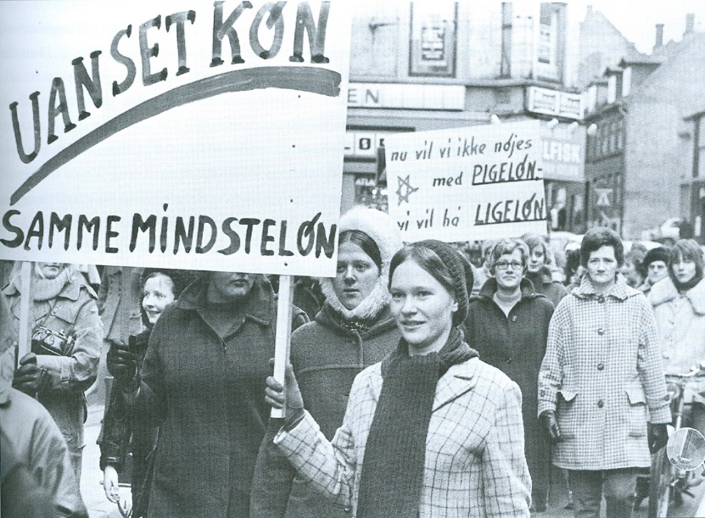
REPORT ON THE EXPERIENCES OF APPLICANTS IN
EQUAL PAY CASES (DIHR 2014)
Taboo on discussing wages
Difficulties with establishing the facts
Lack of transparency about the wage statistics and policies
Inadequate information and counselling
Fear of victimisation
Discomfort at work – especially after an individual case
Lengthy proceedings and few appeal cases
Lack of dialogue with the Board of Equal Treatment
Notes:
Victimisation: negative consequences, discomfort in relation to employer, mistreatment, rejection of promotion, worsening af working condition, social sanctions, etc. High personal costs.
Group cases are less burdensome. About half of the complainants obtain a new job afterwards.
Difficult for the individual woman the bear the burden of a case and conflict.

Slide 8
Recommendations
Guidelines to the legislation
with clarification of concepts
General information about the rules
Education of union representatives
Obligation for employer to inform about rights
Offer of subsequent mediation after cases

Slide 9
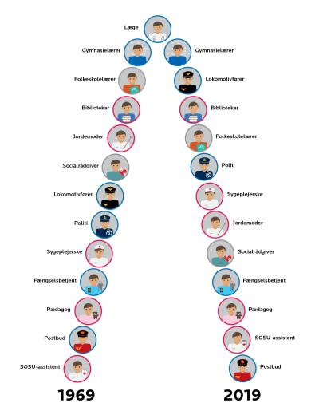
REPORT ON EQUAL PAY IN THE
PUBLIC SECTOR (DIHR 2020)
Gender segregation on the labour market
Persistent pay gap between men and women
(despite equivalent levels of education)
Lower wages in professions with a high proportion of women
Static salary hierarchy for civil servants from 1969
Lack of objectivity and transparency about criteria
Professions like librarians, teachers, prison guards, nurses,
midwives, doctors, care worker, police officers, social workers, railroad engineers, day care teachers
Notes:
More than 60 % women = red
More than 60 % men = blue
Balanced = grey
In some instances, the demands of education have become higher for women without any effect on their position in salary hierarchy…

Slide 10
Agenda with orange bar
COURT CASES ON EQUAL PAY
Many barriers to initiating a case
Mainly cases about maternity leave or
cases about salary determinations for the (exact) same work
The role of trade unions
Collective complaints
Notes:
An examples is a case where a woman takes over a position from a man, but does not receive the same salary without some objective reasons to point to. So undeniably the same work.
At the moment, a case is pending before the courts which has been initiated by a trade union. The case regards unequal payment between female laboratory technicians and male technicians.

Slide 11
Supreme Court (2009)
"There are no written guidelines, etc. that explain the principles on which the salary determination was based. Neither is there any written material that explains how the salary for the individual employee has been determined.”
Notes:
(UfR 2009.2993 H) In this case, the employer argued that the reason for the pay difference was a desire to retain the new employees who had special expertise (as former leaders) that the company would like to make use of, but had not provided evidence that this was actually relevant to the work the consultants performed. It would probably have been accepted if there had been a general gender neutral policy on the maintenance of the level of salary in relation to job changes within the company,
The result thus differs from an earlier judgment from 1990, where the Supreme Court ruled that a female employee was paid less than two newly hired male consultants, since the employer had stated that he intended the male consultants to carry out some tasks that the female consultant did not perform. KODA-sagen (UfR 1990.871 H).

Slide 12
Slut på præsentation - tak
THANKS

