Slide 1
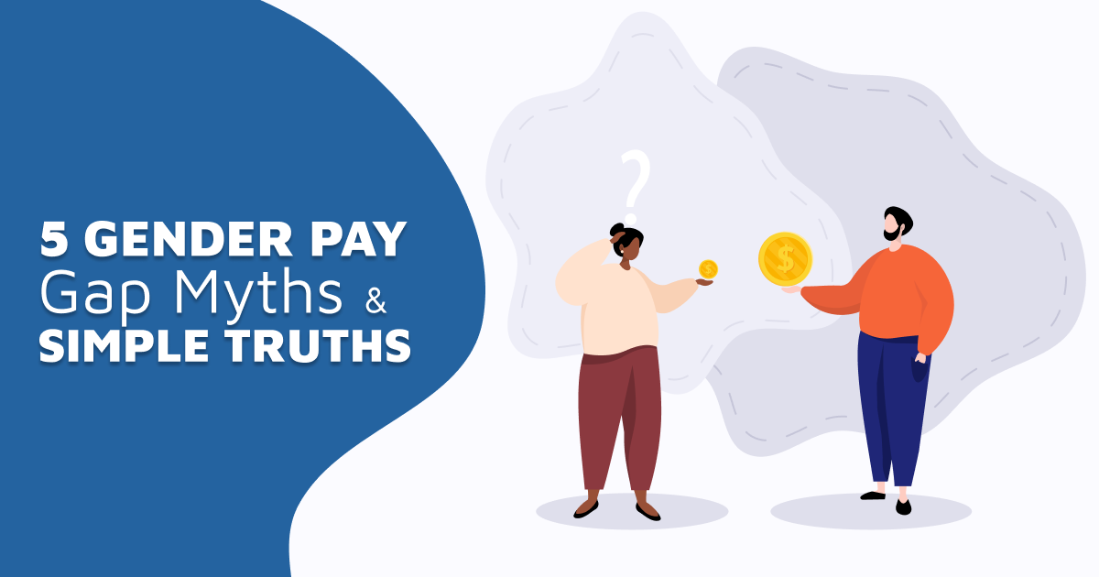
Setting the scene: equal pay in the eu
Dr Sara BENEDI LAHUERTA – University College Dublin (UCD)
Equinet Seminar on Pay Transparency – Brussels, 29-30 November 2022

Slide 2
Preliminary clarifications
Gender Pay Gap (GPG) ≠ Equal Pay:
Individual comparison → Equal pay: right for a worker to perceive the same remuneration as another who does like or equal value work
Global comparison → GPG = difference in average gross hourly earnings between women and men
Different BUT related concepts
GPG is usually decomposed into:
‘Explained’ part: linked to diffs in average characteristics between M/F (sector, age, occupation, tenure, etc.)
‘Unexplained’ (residual) part: linked to unobservable variables (e.g. negotiating skills, career breaks)
→ may/may not be linked to discrimination/biases
Adjusted GPG: refers only to the explained GPG (usually lower)
Unadjusted GPG: includes both the explained and unexplained GPG (usually higher)
Effects of lower female participation in labour market and gender segregation not fully captured
Notes:
EUROSTAT 2021:
“Tackling possible discrimination in earnings between men and women is one of the key priorities of gender policies at both EU and national levels. The unadjusted gender pay gap (GPG), which is calculated as the relative difference between the average earnings of women and men, is widely used as the key indicator to monitor progress in this area.However, the unadjusted GPG does not capture discrimination as such in the sense of ‘equal pay for equal work or work of equal value’. Indeed, the unadjusted GPG combines (1)possible differences in the average characteristics of men and women in the labou rmarket (e.g. different occupations, economic activities and average age) and (2) gendergaps for the same average characteristics”
Characteristics which can be OBSERVED BY EUROSTAT in calculated the ADJUSTED GPG:
Age, education, occupation, job experience in the current enterprise, employment contract,
Working time, economic activity of employer, employer size, public or private ownership of employer, geographical local of employer
“The decomposition of the unadjusted GPG does not capture all of the segregation effects between men and women in the labour market. In particular, women work, on average, fewer hours per month than men in the labour market do. Moreover, a lower proportion of women than men participate in the labour market. This is shown by the lower employment rates for women throughout the Member States. Figure 4 shows all the possible factors that may influence the expected earnings of women and men of working age (15–64 years old).”
“Given their importance for public policies, official statistics on gender equality attract much attention from the media and from the public. The unadjusted GPG in particular, owing to its simple definition, is a prominent indicator in this respect. It is sometimes viewed as a tool to measure possible gender discrimination on the labour market. However, ‘u nequal pay for equal work, among male and female workers’ is just one of the possible causes of the unadjusted GPG. The other possible drivers of the GPG are the different characteristics of male and female employees and possible gender gaps in financial returns for the same characteristics. In countries with a lower employment rate of women, the former component may partly come from segregation effects, including ‘self-selection’: women who decide to engage in the labour market are those with higher education levels or skills levels. In such cases, the unadjusted GPG may be null or even turn negative just because the subpopulations of male and female employees have different profiles. The unadjusted GPG is therefore an equivocal (non-bijective) indicator of gender inequalities in the labour market, as illustrated in Figure 6.”

Slide 3
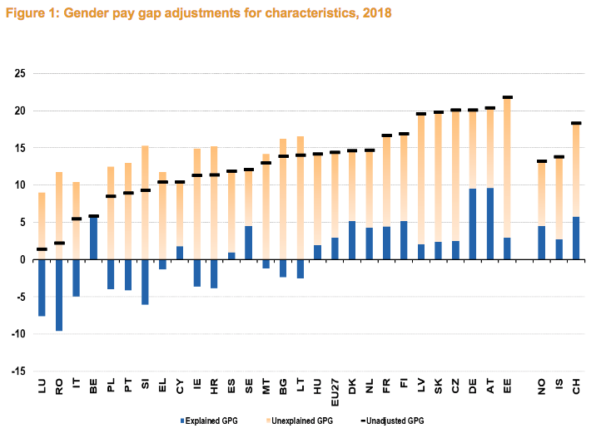
EXAMPLE: GPG ADJUSTMENTS FOR CHARACTERISTICS -2018 DATA (Eurostat 2021)

Slide 4
Socio-economic context: KEY DATA
Variable | 2006 (EU-28) | 2014 (EU-27) | Latest data
GPG (unadjusted) | 17.6% | 16.7% | 13.0%
Median hourly earnings (in thousands) | 10.6 (F) 12.3 (M) | 12.2(F) 14.1(M) | 17.6 (F) (2020) 19.8 (M) (2020)
Elderly poverty | 19.2% (F) 14.5% (M) | 15.7% (F) 11.2% (M)
Labour force participation rate | 62.7% (F) 77.4% (M) | 66.5% (F) 78.1% (M) | 65.3% (F) (2016) 76.8% (M) (2016)
Employment rate | 57.0% (F) 71.4% (M) | 59.5% (F) 70.0% (M) | 67.7% (F) (2021) 78.5% (M) (2021)
Incidence of part-time employment | 25.0% (F) 6.0%(M) | 22.5% (F) 7.8% (M) | 23.3% (F) (2021) 7.5% (M) (2021)
Women representation in company boards | 9.1% | 20.8% | 31.5% (2022)
Job satisfaction | 82.7% (F) 81.1% (M) | 85.6% (F) 85.7% (M)
Sources: Eurostat, OECD, Eurofound, EIGE
Notes:
EUROSTAT 2021:
“As an unadjusted indicator, the GPG gives an overall picture of the differences in paybetween men and women. It measures a concept that is broader than the concept of ‘equal pay for equal work or work of equal value’. A part of the difference in earnings between men and women can be explained by differences in the average characteristicsof male and female employees ( European Foundation for the Improvement of Living and Working Conditions, 2010). The differences in the average characteristics can result from many factors, including the concentration of one sex in certain economic activities or the concentration of one sex in certain occupations. The first phenomenon is called ‘sectoral gender segregation’ and the second one is called ‘occupational gender segregation’. Sectoral gender segregation may explain part of the difference in earnings between men and women, since women tend to be concentrated in the low-paying economic sectors. For example, women tend to work in education and health domains whereas men tend to work in the finance and IT sectors. Similarly, occupational gender segregation may explain the difference in earnings between men and women, since one sex tends to be concentrated in low-paying occupations. Occupational gender segregation may also be partially caused by men being more likely to be promoted to supervisory and management positions than womendue to discrimination or self-restraints. The term ‘glass ceiling’ is used as a metaphor to describe an invisible barrier that keeps women from rising beyond a certain level in an enterprise’s hierarchy.Another possible source of GPGs is the difference between the financial returns paid to women versus those paid to men with the same average characteristics. Such differences may stem from ‘unequal pay for equal work’ but also from the lack of information on detailed economic activities and occupations in which men or women maybe concentrated. Such effects of segregation cannot be captured directly because SES variables are collected at a rather aggregated level (e.g. NACE sections). The unadjusted GPG is therefore a complex indicator. Its measurement covers possible discrimination between men and women through ‘ unequal pay for equal work’; the differences in the average characteristics of male and female employees and further segregation effects that would show up in the different financial returns of men and women.”

Slide 5
Causes of the gpg
Many different factors, including:
Gender stereotypes around caring
Work-life balance policies – still more women take care breaks
More women pushed to part-time and lower quality/low-paid jobs
Differences in negotiation styles
Differences in educational choices, e.g. less women in STEM subjects
Information assymetry: employer v workers
Actual pay discrimination
Glass ceiling
Occupational and sectoral segregation →

Slide 6
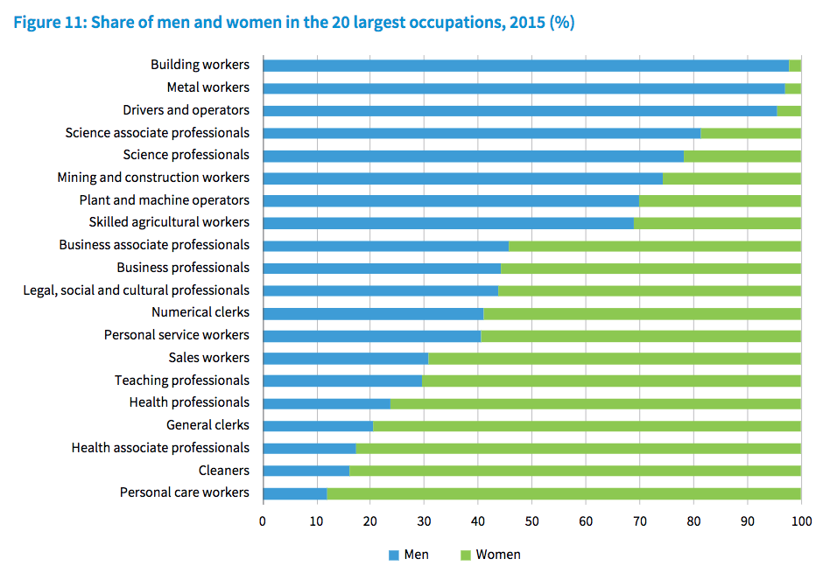
Occupational segregation
Source: Eurofound (2020), Gender equality at work, European Working Conditions Survey 2015 series, Publications Office of the European Union

Slide 7
pay transparency as a tool to address the gpg
WHAT IS UNDERSTOOD BY ‘PAY TRANSPARENCY’?
‘Series of regulatory strategies designed to improve accessibility to pay information’
Collective measures require the employer (often with the social partners) to take initiative to report and/or analyse pay data broken down by gender and may also require to take action to address the sources of pay inequity
Individual measures tend to empower workers to better understand their relative position within the wider pay structure and facilitate recourse for those willing to challenge pay inequity
Value:
Reduces information assymetry between job applicants/workers and employers
Rebalances wage setting power
Increases employers accountability towards workers, shareholders, costumers/service users, …
→EU Recommendation on strengthening the principle of equal pay through transparency (2014/124/EU)
→ EU Directive Proposal to strengthen the application of the principle of equal pay through pay transparency,
COM(2021) 93 final

Slide 8
Evolution of eu law (I)
ORIGINS OF EU LEGISLATION →Article 119 EEC Treaty – current Article 157 TFEU
Art. 157(1) TFEU: ‘Each Member State shall ensure that the principle of equal pay for male and female workers for equal work or work of equal value is applied.’ + now: Art. 23 CFR + European Pillar of Social Rights
DIRECT EFFECT:
Case 43/75 Defrenne (No.2) [1976] → vertical and horizontal direct effect
Case C‑624/19 Tesco Stores Ltd [2021] → direct effect both for ‘equal work’ and ‘equal value’ claims
Case C‑486/18 Praxair MRC [2019] → applies to action of public authorities, collective agreements and individual contracts
BROAD SCOPE:
Case C– 256/01 Allonby → ‘Worker’: ‘a person who, for a certain period of time, performs services for and under the direction of another person in return for which he receives remuneration.’
Art. 157(2) TFEU + Art. 2(1)(e) Dir 2006/54 → ‘Pay means the ordinary basic or minimum wage or salary and any other consideration, whether in cash or in kind, which the worker receives directly or indirectly, in respect of his employment, from his employer’ [+ case law]

Slide 9
Evolution of eu law (II)
THE STRONG INFLUENCE OF CASE LAW:
What is ‘like work’ → Case C–381/99 Brunnhofer → look at:
Comparators → Acceptance of:
“non-contemporaneous” comparators (Case C-157/86, Macarthys)
Comparators doing work of lower value (Case C-157/86, Murphy)
Don’t need to work for exactly the same employer → acceptance of:
Same establishment or service (public or private)
Discrimination arising from legislative provisions or collective labour agreements
“Single source” principle (Cases C-320/00, Lawrence; C-256/01, Allonby): same body must be responsible for paying the claimant and the comparator
the nature of the work actually performed;
the training requirements;
the actual working conditions
(Defrenne (No.2); Macarthys)

Slide 10
Evolution of eu law (IV)
SECONDARY LEGISLATION:
Initial Equal Pay Directive: 75/117/EEC → reinforced concept of ‘equal value’ (Art. 1)
IF job classification systems used → same criteria for M/F and non-discriminatory (Art. 1(2))
Replaced by Directive 2006/54/EC (Recast)
Prohibits direct and indirect discrimination: “For the same work or for work to which equal value is attributed, direct and indirect discrimination on grounds of sex with regard to all aspects and conditions of remuneration shall be eliminated.” – Art. 4(1)
Same provisions re Job Classification Systems (Art. 4(2))
Introduces equality bodies – Art. 20
(Mild) proactive measures – positive action allowed (Art. 3); prevention required/encouraged through social dialogue and NGOs (Arts. 21, 22, 26); mainstreaming required (Art. 29)

Slide 11
Evolution of eu law (V)
EU Recommendation on strengthening the principle of equal pay between men and women through transparency (2014/124/EU)
Recommends choosing one out of four potential measures: Right to request pay information Publication of pay information by gender for employers with 50+ employees Pay audits Equal pay (and pay audits) dealt with through collective bargaining

Slide 12
Evolution of eu law (III)
No measures | Some mild obligations, not effective / not aligned with 2014 Rec | At least one 2014 Rec implemented
Bulgaria Czech Republic Greece Hungary Malta Romania (Estonia) (Poland) (Netherlands) | Latvia Slovenia Slovakia Cyprus | Croatia Finland* Germany* Italy* Lithuania Luxembourg* Spain Ireland Portugal Denmark Sweden* France Austria* Belgium*
(*) Denotes that some legislation was already present before the 2014 Rec was published

Slide 13
Obstacles to pay equity (I)
INDIVIDUAL LEVEL:
Burden to take action is on the individual
Lack of knowledge on how to do it + fear of retaliation + cost
→Individuals often ignore if they are being paid less than their peers!
EVEN WHEN THEY KNOW:
Difficult to find an valid comparator → Macarthys → interpreted as not allowing “hypothetical comparators”
Lack of clarity on the “equal value” concept
Confusion about the (shift) of the burden of proof
Caps on compensation
Lack of / insufficient penalties

Slide 14
Obstacles to pay equity (II)
COLLECTIVE LEVEL:
Individual equal pay claims don’t trigger structual action
Lack of employers’ responsibility
Lack of information and accountability
Wealth of practices that encourage structural pay inequity
Secrecy around pay (e.g. non-disclosure clauses)
Salary history enquiries
Lack of pay determination politices based on objective gender-neutral criteria
Working time practices that push women into part-time work & low-paid jobs
Working-time regulation
Work-life balance and flexible working policies
Availability of diverse
child care and adult care options
Minimum and living wage regulation
→Info. Assymetries + Regulatory failure = Market failure

Slide 15
Dir. Proposal: key measures
EU Directive Proposal - COM(2021) 93 final (to strengthen the application of the principle of equal pay through pay transparency
-Individual transparency measures – ALL employers: +During recruitment: Ban of salary history enquiries Duty to provide salary range +During the employment relationship: 1. Right to pay information -Collective transparency measures - Employers with 250+ workers: +Public reporting of pay aggregated data by gender +Internal reporting of pay gaps by gender ‘by categories of workers’ +Joint pay reports + duty to take action to address gaps -Other measures: +Clarifying concepts +Improving access to justice +Improving enforcement
EQUALITY
BODIES

Slide 16
Concluding remarks
Pay transparency is NOT the panacea
BUT, with other tools, can contribute to reduce the GPG by:
Reducing information asymetries
Improve employers’ accountability
The 2021 Directive Proposal also focuses on measures to:
Clarify key concepts → access to justice and enforcement of Dir. 2006/54/EC
Other measures also helpful to improve pay equity:
Work-life balance Directive (2019/1158/EU)
Women on Company Boards Directive (political agreement – Jun 2022)
Minimum Wage Directive (political agreement – Oct 2022)
”Women need to ask,
men need to disclose, and employers need to consider that while pay secrecy may seem expedient in the short term, it has a long-term cost in economic justice and efficiency”
(Carrie Gracie,
former BBC China editor)

Slide 17
References
C Auymar-Pintar, ‘Pay transparency in Europe: First experiences with gender pay reports and audits in four Member States’ (2018) Eurofound, 12.
S Benedí Lahuerta, (forthcoming in 2022) 'EU transparency legislation to address gender pay inequity: What is on the horizon and its likely impact in Ireland' Irish Journal of European Law, Vol. 24.
S Benedí Lahuerta (2021) 'Comparing pay transparency measures to tackle the Gender Pay Gap: Best practices and challenges in Belgium, Denmark and Iceland', European Equality Law Review 2021/2 [Open Access]
J Blundell, ‘Wage responses to gender pay gap reporting requirements’ (2020) Discussion Paper 1750 of LSE’s Centre for Economic Performance (CEP), <https://cep.lse.ac.uk/pubs/download/dp1750.pdf> accessed 7 October 2022.
Ceballos et al, ‘Mind Gender Gaps! How Men and Women Get Equal Working Opportunities and Wages’ (2022) 23 CESifo Forum 4.
L Gow and S Middlemiss, ‘Equal Pay Legislation and Its Impact on the Gender Pay Gap’ (2012) 11 International Journal of Discrimination and the Law 164
J Hofman, M Nightingale and M Bruckmayer, ‘Equal Pay for Equal Work. Binding pay-transparency measures’ (European Parliament Committee on Employment and Social Affairs, February 2020) <www.europarl.europa.eu/RegData/etudes/STUD/2020/642379/IPOL_STU(2020)642379_EN.pdf>
J Rubery, ‘Why is Women’s Work Low-Paid? Establishing a Framework for Understanding the Causes of Low Pay Among Professions Traditionally Dominated by Women’ (2017) Oxfam Discussion Papers
J Rubery and A Koukiadaki, ‘Closing the Gender Pay Gap: A Review of the Issues, Policy Mechanisms and International Evidence (ILO 2016) 28.
THANK YOU!
(sara.benedilahuerta@ucd.ie)

