Slide 1
Use of Equality Data in the Work of Unia - Interfederal Centre for Equal Opportunities
Equinet training, 27 October 2022
Presentation by Nele Roekens and Rachel Waerniers

Slide 2
Project ‘Improving Equality Data Collection in Belgium’
3 Outputs:
Mapping of equality data sources
Online Data hub centralising data sources
Report on gaps and recommendations
This project was funded by the European Union’s Rights,
Equality and Citizenship Programme (REC 2014-2020).

Slide 3
An example of equality data by Unia (1)
Socio-economic Monitoring 2022 Labour market and origin
Describes inequality on the labour market on the
basis of people's origin

Slide 4
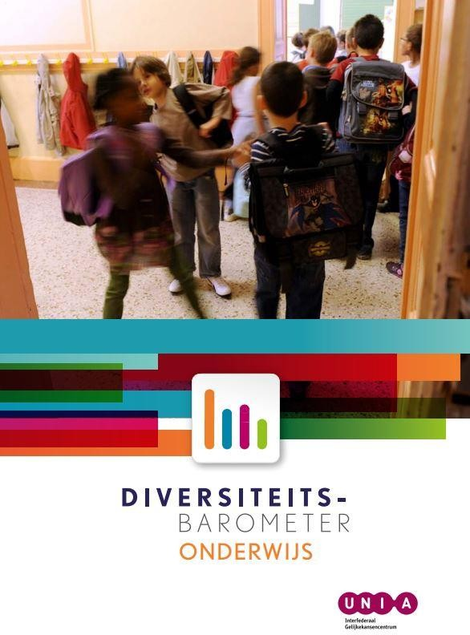
An example of equality data by Unia (2)
Diversity Barometer Education (2018)
A study about equal opportunities and discrimination in Belgian education

Slide 5
Uses of equality data?
Recommendations
Awareness raising
As evidence in UNIA’s non-discrimination work?
→ Lack of cooperation between research and non-discrimination legal work
→ Some good or failed practices?

Slide 6
Use of Equality Data in case handling
Use in counselling process and investigation of complaints
Collection and use of ED in negotiations & strategic litigation
III.
Use of ED for positive action

Slide 7
Example of the use of ED in negotiations & strategic litigation for a legal case
Collection and use of complaints data in negotiations
Case of structural racism at Brussels fire brigade
use of ‘witness report’ (+-20)
Witness Report Electronic Link
Results
structural reform and;
compensation for the victim,

Slide 8
2. Use of complaints data in strategic litigation
Accessibility concerns public transportation
We lack concrete evidence (no witnesses, no acknowledgements,...)
Negotiations failed
Strategy: built a case around the amount of received complaints:
Unia received 30 complaints during 2016-2020 related to a denial of service on the grounds of disability
Federal law to combat certain forms of discrimination of 2007 (similar to Article 36 §1 of the Equal Opportunities Decree)
Art. 28 1° the data showing a particular pattern of unfavourable treatment [...] including several disconnected reports made to the Centre [...]
Unia started a judicial procedure, challenges:
30 complaints on a 4-year spam could be considered ‘relative’
Lack of Belgian caselaw
→ tips?

Slide 9
3. Use of statistics and complaint data in strategic litigation
Headscarf cases
Statistics (e.g. activity, participation rate,...) and reports are consequently used to
demonstrate the impact of the ban on certain vulnerable groups;
Taken up by the judge in the labour court case to support the intersectional nature of the discrimination
EB statistics (Unia)
“cases handled by Unia from 2017 to 2020 concerning the prohibition of the wearing of religious symbols in the workplace concern 95% of the Islamic headscarf and therefore of women”
Statistics of a public employment agency (Actiris)
Reports of CSO (Amnesty International)

Slide 10
“Take aways” use of Equality Data in case handling
Challenges:
“Iceberg effect”
Lack of knowledge regarding applicability standards on the use of ED
No reflex
Possibilities:
Improve cooperation with Research Department: combine statistics with complaint data
Intersectionality/AI cases: no more need for comparator when multiple complaints ?

Slide 11
Data on (in)equality & discrimination in Belgium
Datahub Equality Data
www.equalitydata.unia.be

