Slide 1
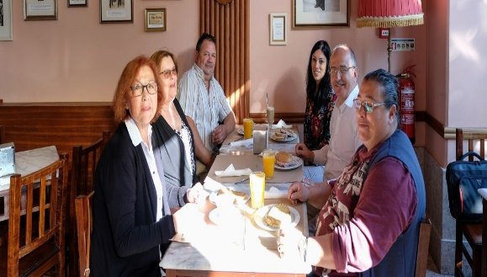
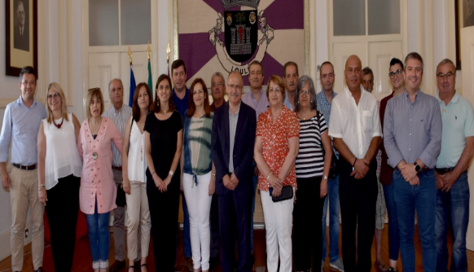
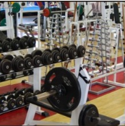
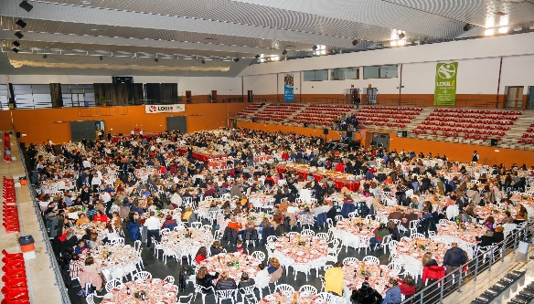
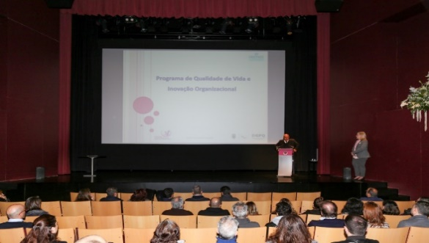
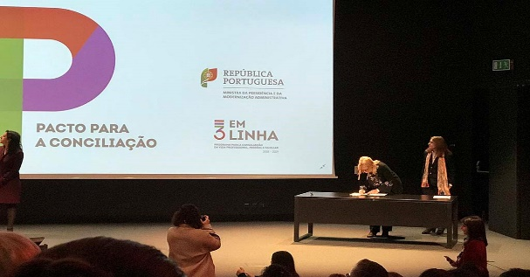
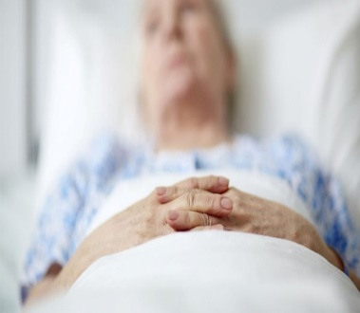
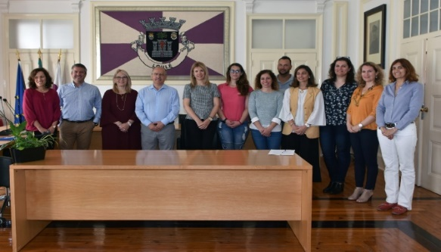
CONFERENCE: EQUALITY BODIES SUPPORTING EQUALITY PLANNING
.
Dália Paulo May 19, 2022

Slide 2
Loulé City Council Employees
Loulé City Council Employees
2.000 employees on December 31, 2021
740 men
1.260 women
63% of women out of the total number of employees
Men: 37%
Women: 63%
CONFERENCE: EQUALITY BODIES SUPPORTING EQUALITY PLANNING
2

Slide 3
Loulé City Council b. Work, Family and Personal Life Balance Management System
Loulé City Council b. Work, Family and Personal Life Balance Management System
2019 - Employee Wellness Program (Programa de Qualidade de Vida e Inovação Organizacional)
2019 - Joining the work, family and personal life balance pact and 3 em Linha Program (Government work, family and personal life balance program)
2020 - Certification of Loulé City Council in NP 4552:2016 - Work, Family and Personal Life Balance Management System
CONFERENCE: EQUALITY BODIES SUPPORTING EQUALITY PLANNING
3

Slide 4
Loulé City Council b. Work, Family and Personal Life Balance Management System II
Loulé City Council b. Work, Family and Personal Life Balance Management System
HOW we came up with the initiatives:
We analyse the world reality of work (numbers of the European agency for safety and health at work)
Study “Happiness Works Portugal” 2015
Active listening to workers
WHO and HOW we consulted:
Employees (interviews, inquires)
Unions (informal presentation/ meeting)
Local and regional persons and institutions (CCDRAlgarve)
CONFERENCE: EQUALITY BODIES SUPPORTING EQUALITY PLANNING
4

Slide 5
Loulé City Council c. Municipal Equality Plan
Loulé City Council c. Municipal Equality Plan
2020 - Cooperation protocol for equality and non-discrimination between Loulé City Council and CIG (Commission for Citizenship and Gender Equality)
2021 - Constitution of the Equality in Local Life Team
2021 - Designation of 2 Local Councilors for Equality
2021/2022 – Charing our practice with other national municipalities
2022 - Diagnosis Report for the preparation of Loulé Municipal Plan for Equality and Non-Discrimination
CONFERENCE: EQUALITY BODIES SUPPORTING EQUALITY PLANNING
5

Slide 6
Loulé City Council c. Municipal Equality Plan II
Loulé City Council c. Municipal Equality Plan
A few measures already implemented:
Internal Training Plan 2021/2022 with the forecasting of various training actions related to the theme of Equality between Women and Men
Celebrations for the Municipal Equality Day 2021 (october 24):
Walk for Equality
Cinema session at the Cineteatro Louletano for high school students with short films on the theme of Equality between Women and Men followed by a debate
Actions in the Library: book highlighting and storytelling sessions related to the theme Equality between Women and Men
Placing billboards in high schools to engage students on the topic of Equality.
CONFERENCE: EQUALITY BODIES SUPPORTING EQUALITY PLANNING
6

Slide 7
2. Work, Family and Personal Life Balance at Loulé City Council
2. Work, Family and Personal Life Balance at Loulé City Council
Loulé City Council's policy for work, family and personal life balance is based on the following commitments:
Promote work, family and personal life balance measures aimed to improve well-being and quality of life;
Contribute to the well-being, satisfaction and productivity of employees;
To involve stakeholders continuously;
Establish and maintain internal and external communication channels.
And subscribes to equality and non-discrimination as a structuring principle.
CONFERENCE: EQUALITY BODIES SUPPORTING EQUALITY PLANNING
7

Slide 8
2. Work, Family and Personal Life Balance at Loulé City Council
2. Work, Family and Personal Life Balance at Loulé City Council
The ways we communicate our initiatives inside and outside:
We have an email address, we have an Intranet, with a specific place for this project, we have newsletters, we have leaflets, we have suggestions boxes;
We have a “Manual of the worker” that have information, we do awareness actions;
We publish information about the project in the Municipal Bulletin and in specific conferences and workshops.
CONFERENCE: EQUALITY BODIES SUPPORTING EQUALITY PLANNING
8

Slide 9
Annual report
WE HAVE AN ANUAL REPPORT WITH THE CONTRIBUTIONS OF THE EMPLOYES AND INSTITUTIONS
77% of the workers feel heard and involved;
87,1% of the workers think that the Conciliation System is improved conciliation between personal, familiar and professional life;
82,8% of the workers consider that the information about conciliation is clear and sufficient;
86, 9% of the workers are satisfied with the SGC (conciliation system)
CONFERENCE: EQUALITY BODIES SUPPORTING EQUALITY PLANNING
9

Slide 10
Employee feedback quotes
“Congratulations on the launch of the Work, Family and Personal Life Balance Management System. It already has a great number of measures, all of them positive, and more are expected in order to increase the range of offers.” “Congratulations on the innovative approach of implementing these measures that help promote better job satisfaction.” “My deepest thanks to all those who work to ensure that these measures reach us employees. An asset that motivates us even more in our daily work in this City Council.” (Employees comments on the Work, Family and Personal Life Balance Management System Questionnaire – 2021)
CONFERENCE: EQUALITY BODIES SUPPORTING EQUALITY PLANNING
10

Slide 11
Thank you
Thank you! ☺
CONFERENCE: EQUALITY BODIES SUPPORTING EQUALITY PLANNING
11

