Slide 1

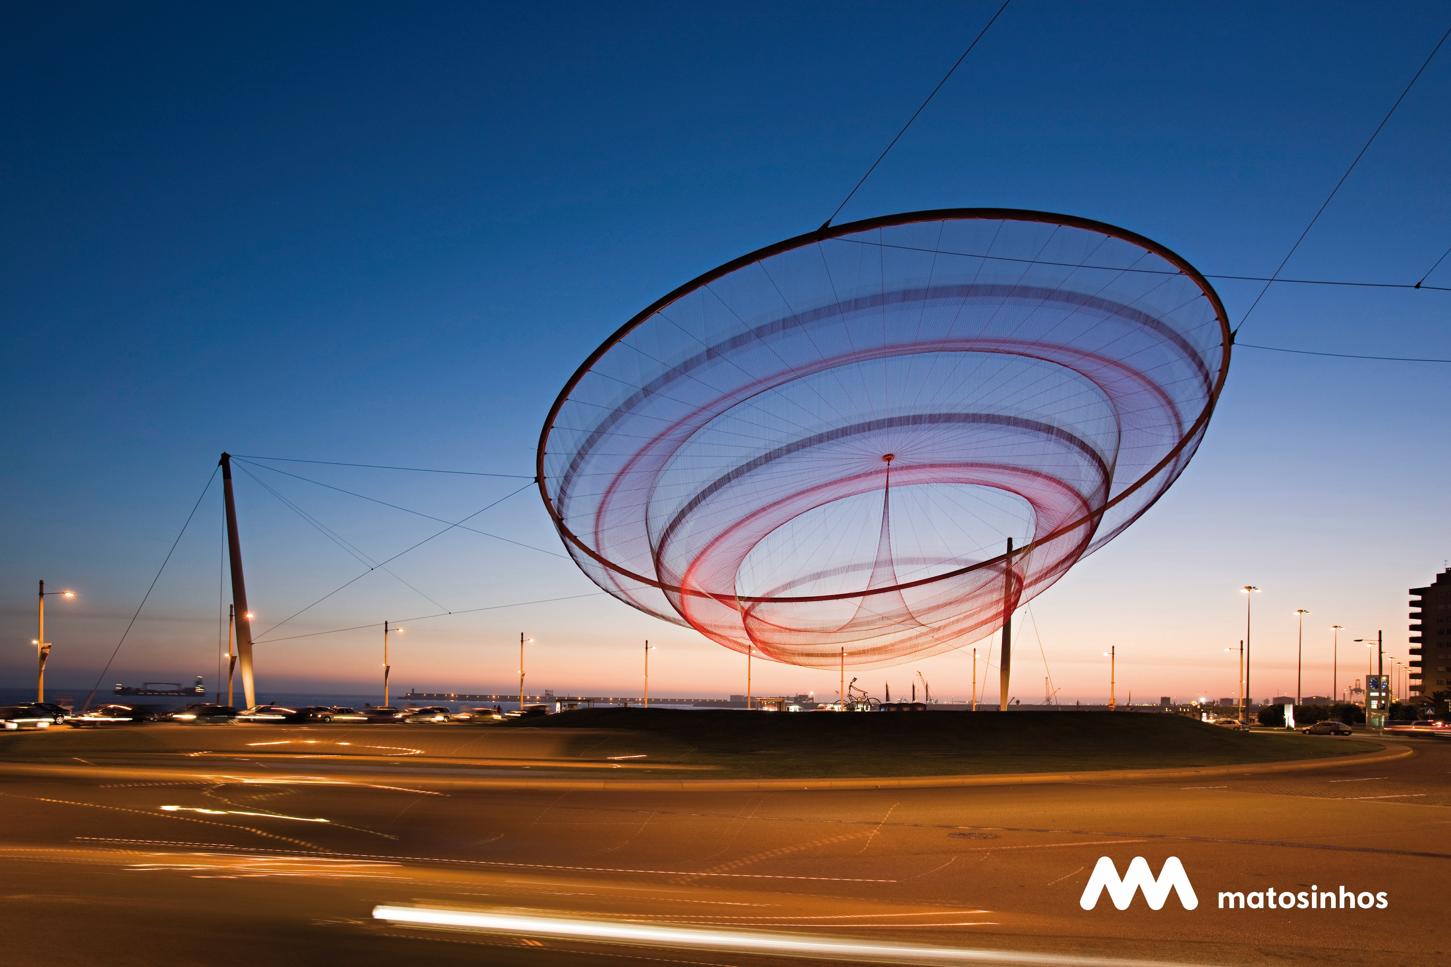

Equinet Conference
on
Equality Planning
=IgualIgual
19 May 2022
The Matosinhos experience

Slide 2
How did we get here?
=IgualIgual
=IgualIgual
National Strategy for Citizenship and Non-Discrimination, “Portugal+Igual”
Municipality of Matosinhos
2030 Agenda for Sustainable Development
Equality Plan of Matosinhos
Campaign =IgualIgual
Municipal Counselor for Equality
Award “Viver em Igualdade” 2020

Slide 3
Campaign to promote gender equality
=IgualIgual
OBJECTIVE - to contribute to the transformation of inappropriate perspectives and behaviors that perpetuate unequal models in social roles, based on gender inequality and that lead to discrimination, social exclusion, victimization, abuse of power and even episodes of violence in relationships.
Social networks
Influencers
Contest

Slide 4
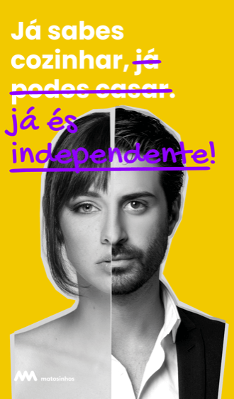
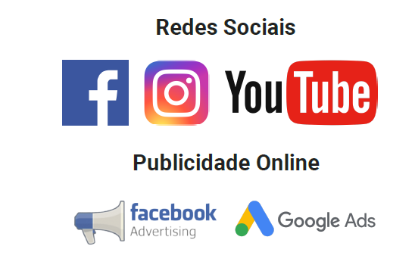
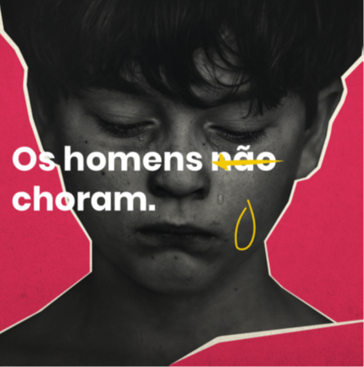
Social networks - messages conveyed through videos on the main social networks and on its own website
=IgualIgual

Slide 5
Influencers
=IgualIgual
Juliana Rocha
Iberian Boxing Champion
Diogo Faro
Comedian
Clara Não
Blogger

Slide 6

Contest:“Concurso de Criatividade #SQN” (creativity contest)
=IgualIgual
drawings
videos
69 works received
theatre performances
paintings
poetry

Slide 7
Contest: Winning works
=IgualIgual
Jury decision
Ana Luísa Silva
Public decision
Ana Luísa Almeida
“Boys cannot play with dolls and girls cannot play with cars. Why does this separation have to exist when imagination has no gender?”
“To express the nudity of this environment. In the leadership that the other wants, and in the submission I feel. Creating barriers in intimacy that I try to preserve.”

Slide 8
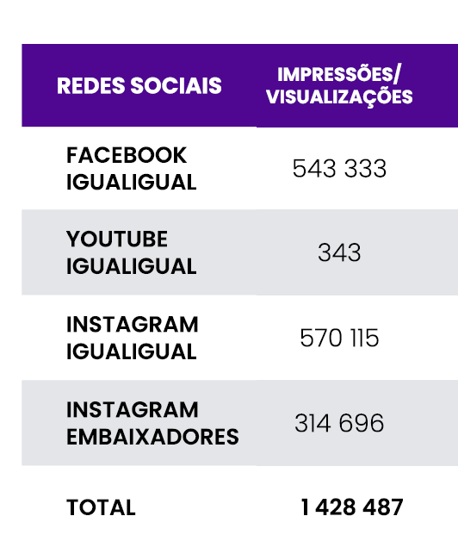
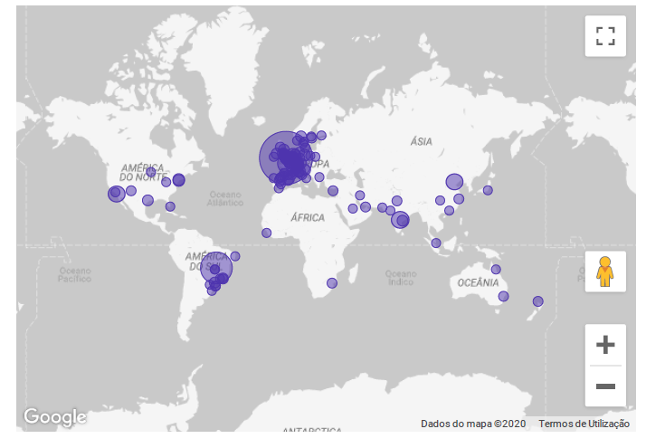
1st edition Campaign reach >>>>
=IgualIgual
Social networks Impressions/Views

Slide 9

2 edition
=IgualIgual
2nd edition:
2022 - Campaign IGUALIGUAL – gender inequalities in sport
Theme launched on the Municipal Day for Equality with an informal gathering called “À Conversa com…”, alluding to Equality issues in the world of sport.
Campaign integrates:
. Contest - 2 target audiences
Youngs
Sports clubs
. Awareness and training actions
. Young people
. Technical team
. association leaders, coaches, athletes and guardians, physical education and citizenship teachers

Slide 10
Obrigada!
=IgualIgual
Our email:
igualdadeconselheir@cm-matosinhos.pt

