Slide 1
COVID-19 vaccination deployment and rollout in the EU: fundamental rights considerations
24 June 2021

Slide 2
FRA Bulletins: Coronavirus pandemic in the EU – Fundamental Rights Implications
FRA Bulletins: Coronavirus pandemic in the EU – Fundamental Rights Implications
Bulletin 1, April 2020
Bulletin 2, May 2020: + Focus - Users’ data, their privacy and data protection
Bulletin 3, June 2020: + Focus - Impact on fundamental rights of older people
Bulletin 4, July 2020
Bulletin 5, Sept. 2020: Focus – Impact on Roma and Travellers
Bulletin 6, Nov. 2020
Bulletin 7, June 2021: Vaccine rollout and equality of access in the EU
Bulletins 1-6 collected information on the pandemic’s impacts on fundamental rights (impact on daily life and on particular groups in society).
Data collection for FRA Bulletins
FRANET (research network) in the EU MS + RS + MK
FRA Bulletin
www.fra.europa.eu
FRA Bulletins + FRANET country reports

Slide 3
FRA Bulletin 7 – Vaccine rollout and equality of access in the EU
FRA Bulletin 7 – Vaccine rollout and equality of access in the EU
Covers 27 EU Member States
Reporting period 1 March – 30 April 2021.
Focuses on equal access to vaccines from planning to rollout

Slide 4
Gaps in vaccination strategies and rollout that need addressing:
Gaps in vaccination strategies and rollout that need addressing:
Prioritisation – the focus on older people, those with medical conditions and key workers sometimes overlooked other at-risk groups. Only one third of EU countries class detainees as a priority group despite an increased risk of infection due to crowded living conditions. Not all EU countries adhere to international guidance on prioritising vulnerable groups, such as Roma and Travellers, homeless people, or those with drug dependencies.
Queue jumping – allegations of non-priority people receiving vaccines in some Member States undermine trust in the fairness of national strategies.
Access – prisoners, homeless people, asylum seekers and irregular migrants, who are often not covered by national health schemes, face difficulties accessing vaccines. But some countries waive the formal requirement of having a social security number to get vaccinated.
Information – countries rarely provide accessible information for people with disabilities or in different languages for those who do not speak the national language well, like migrants or ethnic minorities.

Slide 5
NATIONAL VACCINATION STRATEGIES – PLANNING AND PRIORITISATION
“Everyone has the right of access to preventive health care and the right to benefit from medical treatment under the conditions established by national laws and practices. A high level of human health protection shall be ensured in the definition and implementation of all the Union’s policies and activities.” (Art. 35 of the EU Charter of Fundamental Rights)
Vaccines will help in protecting people’s rights to health and life, and in lifting restrictions to other fundamental rights.

Slide 6
Vaccine priorisation
In view of the shortage of COVID-19 vaccines, Member States prioritised groups for vaccination at high risk of severe complications or death from COVID-19, and people who were highly susceptible to infection because their work, critical to maintaining essential services, exposed them to the virus.
In practice, this translated into prioritising for vaccination:
older people, especially those living in long-term care facilities
people with underlying medical conditions who are more likely to develop a severe form of the disease or die if they contract COVID-19
frontline health workers and staff of long-term care facilities

Slide 7
Older People
All Member states: highest rank of priority: older people living in long-term care facilities
All Member States: high rank of priority: Older people living independently with or without underlying medical conditions (in descending order starting with oldest age groups)
Challenges older people face when trying to access vaccines
difficult to reach vaccination centres or had to travel long distances to vaccination sites (FR, NL)
Difficulties in contacting older people by mobile phone to invite them for vaccination (PT)
Good practice: increase vaccine uptake by older people
The Estonian government is offering people aged 18 and over the opportunity to get vaccinated when they accompany a person over 70 to get to vaccination locations in areas with lower vaccination coverage. The younger person does not need to be related to the older person, but they both have to reside in the same region.

Slide 8
Past bulletins
FRA Bulletins have consistently highlighted the pandemic’s disproportionate impact on persons and groups in vulnerable situations.
EU-level guidance on vaccination strategies has highlighted the importance of
including people in vulnerable situations in national vaccination strategies alongside older persons, people with underlying health conditions and key workers.
Vulnerable groups such as
people with disabilities
people deprived of their liberty and people unable to physically distance because of where they live (e.g. prisons or detention facilities for migrants)
homeless people
asylum seekers and migrants in an irregular situation
socially deprived communities, in particular Roma and Travellers.
Member States have not always taken up guidance in prioritising certain of these groups, particularly during the first phase of the vaccine rollout.

Slide 9
How were particular vulnerable groups prioritised in the national vaccination strategies?
Persons deprived of their liberty
Only a third of EU MS defined detainees as a priority group in their national vaccination strategies (AT, HR, CY, DE, EL, IT, LV, PT, RO)
Homeless persons
AT, DE, HU: homeless people in shelters as a high-priority group
PT, RO: homeless people (not limited to people in shelters) as a high-priority group
Roma and Travellers
MS did not include them as priority group for vaccination

Slide 10
Persons without legal residence or with insecure status
Persons without legal residence or with insecure status
persons without legal residence or with insecure status, particularly when living in shared accommodation (AT, HR, CY, DE)
migrants living in centres and all other categories of migrants (RO)
free vaccination is expressly open to asylum seekers (AT, LV, SE)
migrants living in ‘hotspots’ on the Greek islands did not have priority for vaccination (EL)
vaccinations available for everyone irrespective of health insurance status (BG, HR, EE, FR, DE, EL, LU, PT)
vaccines available to third-country nationals only if they are registered in the public health insurance system. Since those groups are usually not registered in this system, they may not have access to the vaccine (CZ, LT, MT, SK)
eligibility for vaccination limited to permanent and temporary residents (BE, DK, LT, SI)

Slide 11
Persons with disabilities
Persons with disabilities
Most national vaccination programmes take the vulnerability of people with disabilities into account and include them among priority groups for COVID-19 vaccination albeit in different forms.
Many MS (AT, BE, CY, CZ, DK, FR, HU, LT, LU, MT, NL, PT) included people with disabilities living in long-term care facilities among the highest priority groups for vaccination.
Some MS (BG, HR, IT, LT, LV, RO, SE) list ‘persons with disabilities’ as a separate priority group.
DE, FI, FR, IE, NL, PT, SE, SI: specifically mention Down syndrome as a condition for prioritisation.
HR, DK, FI, IT, LT, RO, ES: close contact persons, family members, caregivers, guardians are priority groups
AT, CY, CZ: merge risk criteria related to disability under the category ‘underlying health conditions’
DE, IE: specifically refer to persons with intellectual disabilities as a priority group

Slide 12
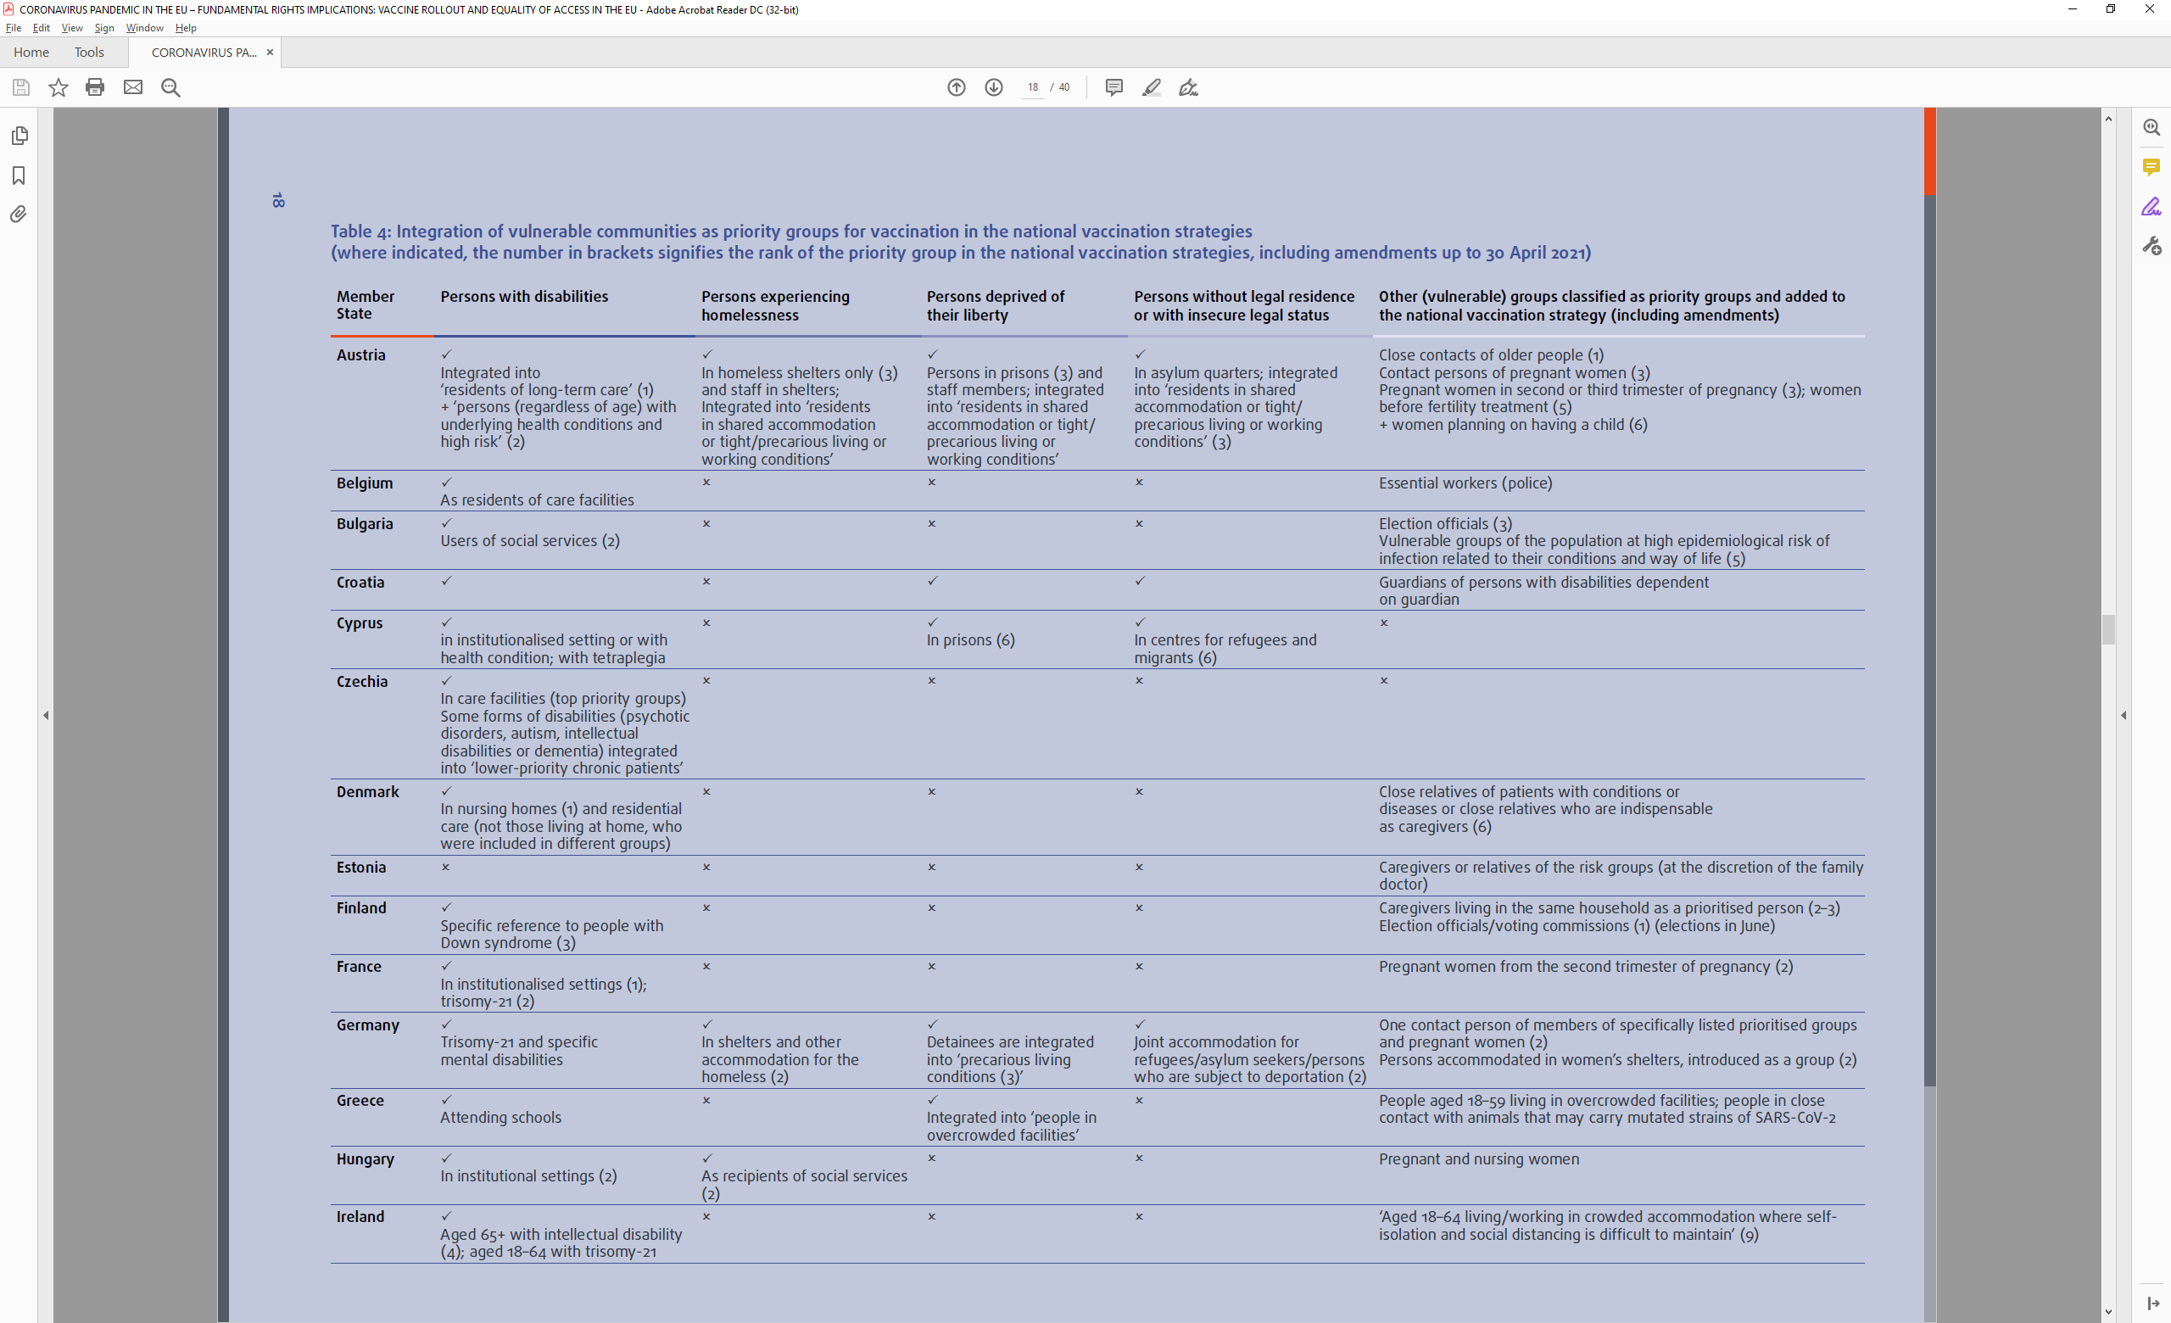
Table from the bulletin

Slide 13
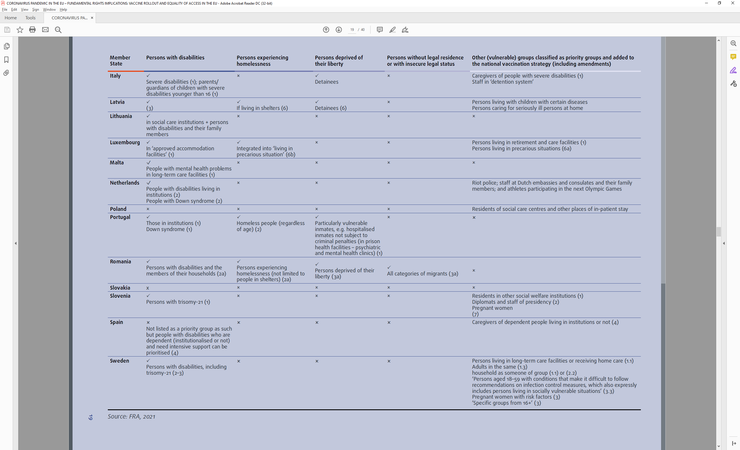
Table from the bulletin 2

Slide 14
Vaccination rollout – Communication
Member States use various channels to give information about their national and regional vaccination strategies, phases of vaccination and prioritisation of groups, ways to (pre)register and all other aspects of the vaccination process.
Websites
call centres/hotlines for public inquiries
regular press conferences by authorities
use various communication materials, such as video and audio clips, posters, leaflets and digital campaigns on social media platforms.
Some countries established channels for interactive information or took measures to tackle online disinformation.
PT: social media campaign to increase the public’s level of trust in COVID-19 vaccines
FI: webcasts for the public to ask about vaccines
IT: websites had information on the most common fake news about vaccines.

Slide 15
Vaccination rollout – Communication 2
Many countries have developed vaccination information campaigns, but rarely tailor them to diverse population groups in vulnerable situations, who are often hard to reach.
not all countries provide information in different languages for those who may not speak the national language well, such as ethnic, national or linguistic minorities, migrants, asylum seekers and refugees;
campaigns specifically targeting Roma and Travellers are rare;
and disability-inclusive and accessible information remains a challenge in some Member States

Slide 16
Tailored outreach to individuals in vulnerable situations
Tailored outreach to individuals in vulnerable situations
Ethnic or national minorities, migrants, asylum seekers and refugees: availability of information on vaccination in various languages varies widely across the EU.
Official Bodies sites
A third of EU MS (AT, DK, NL, FR, IE, DE, LU, SE): information in a number of languages to reach various immigrant groups.
BG, HR, PT, RO: only national languages information about vaccines and vaccination procedure
CY, CZ, EL: information in English in addition to the national language
BE, EE, FI, LV, LT, PL, SK, SI: translations in national official or minority languages
Private bodies, civil society, international organisations
CY, IT, LV, MT, PT, RO: provide translations

Slide 17
Roma and Travellers
Roma and Travellers limited outreach efforts to improve vaccination uptake by Roma and Travellers.
IE: Irish authorities developed an information video and poster, incl. video interviews with Traveller Primary Healthcare Workers, who are Travellers themselves + Roma COVID-19 helpline is available in EN, Romanes and Romanian.
SK: Office of the Government Plenipotentiary for Roma Communities launched an information campaign with a series of videos in both Romani and Slovak + Community workers also communicate information on vaccination and assist people with online registration.

Slide 18
People with disabilities
People with disabilities
disability-inclusive and accessible information concerning COVID-19 remains a challenge.
Only just over a third of the EU MS provided (either by public institutions or civil society organisations) information in easy-read format
Some countries created specific web pages for people with disabilities on the vaccination plan and rollout (IE, NL, SE, FR)
Most countries ensured sign language interpretation during regular press conferences on vaccination strategies.
websites with information in sign language (FI, FR, IE, SE)
Support from NGOs:
Developing information in accessible formats (ES, BE, BG, MT)
Registration hotspots helping people to register an email account and get access to computers with internet access to enable vaccine registration (HU, PL).

Slide 19
VACCINATION ROLLOUT - (PRE)REGISTRATION CHANNELS FOR VACCINATION
An essential component of equitable vaccination rollout is non-discriminatory registration. These processes should be adapted to the difficulties certain population groups may face when registering for vaccinations, which should be easily accessible to everyone.
All EU MS made efforts to ensure the availability of registration options catering for older people, those with disabilities and those with low digital skills (incl. websites, mobile apps, registration via phone or doctor/pharmacy or employers or at vaccination centres).
More than half of EU MS established central registration channels.
Some countries take a decentralised approach where vaccinations are administered via subnational entities (provinces, Länder, etc.) (AT, FI, DE, IT, LT, ES, SE). Of these countries, some have a unified point of entry to the various registration portals (AT, SE, DE, IT).

Slide 20
Online vs Offline registration
Online registration
Almost all MS have online registration platforms
Preregistration is open for all (AT, LV, RO)
Preregistration open to those of a priority group currently being vaccinated (IT, SE)
Mobile apps used (SE, IT, SI)
Offline registration
Hotlines: almost all MS
Medical doctors: around a third of MS
Employers registration: particular professional groups (NL, DE, EE, FR, LV, LT)
Other possibilities: pharmacy/citizen service centre (EL), cash machines in post offices (IT), directly at vaccination centres (BG, PL)

Slide 21
Challenges
Challenges
Accessibility concerns for people with disabilities (FI, RO, AT)
‘Digital Divide’ - People without internet access or the skills to use an online registration system (SK, DK, FR, HU)

Slide 22
Good Practices: Registration channels for specific target groups
Good Practices: Registration channels for specific target groups
family doctors contact people aged over 70 and those at very high risk (IE)
COVID-19 helpline: people with hearing impairments can text the helpline to register for their vaccination or use the Irish Remote Interpreting Service (IE)
Municipalities sent letters, text messages or made phone calls to older persons and risk groups to set up vaccination appointment (FI, MT, PT)
Some municipalities offer tailored support services for older people (registering for a vaccination, transport to vaccination venues, personal assistance during vaccination) (DE)

Slide 23
ADMINISTRATION OF VACCINATIONS
COVID-19 vaccination is free of charge in all EU Member States.
Vaccination locations
All MS administer vaccines in healthcare facilities or in dedicated vaccination centres (convention centres, sports arenas or schools)
Some MS offered mobile vaccination options or drive-throughs.
In several MS, family doctors or general practitioners can also vaccinate (either their own patients or people registered through a centralised system)
Several MS designated different vaccination locations for specific target groups, e.g. depending on age, profession or disability (FI, FR, IE, LU, NL, SE, EE)

Slide 24
Vaccination for persons with reduced mobility and homeless people
Vaccination of people with reduced mobility or living in remote areas
Several MS deployed mobile vaccination facilities to reach those with reduced mobility or those living in remote areas (BE, BG, SK, SE, SK, LT, PL, FR, CY, HU)
Some MS used mobile facilities to reach residents in long-term care (AT, SI, MT, RO)
Vaccination services for homeless people
Some MS made efforts to vaccinate homeless people (BG, IE, DE) e.g. - specific vaccination programme for high-risk people who are homeless or living in shelters + support in transporting homeless people to a vaccination centre (IE) - temporary vaccination centre for homeless people (BG) - sending mobile teams to administer vaccinations in facilities for homeless people (DE)
Use of single-dose vaccines for homeless people, as it may be challenging for homeless people to present themselves twice at vaccination centres for double-dose vaccines (PT, BE)

Slide 25
Other challenges in the administration of vaccines
Other challenges in the administration of vaccines
Favouritism and queue jumping undermine public trust in the vaccination procedures (AT, HR, SI)
Allocation of ‘leftover’ vaccines, for those scheduled to be vaccinated who did not appear, which would otherwise be destroyed, being used by people not belonging to priority groups (EE, MT, IE, PL)
Random vaccination undermines the prioritisation of particularly vulnerable groups (RO, BG). BG - ‘green corridors’: allowed all adult citizens who did not fall within the priority groups to receive a vaccine. (BG civil society organisations criticised this as unfair, discriminatory and detrimental to the most vulnerable groups in the population. General practitioners also complained that random vaccination left them with insufficient vaccine doses for their registered patients.)

Slide 26
Good practices: Ensuring access to vaccines for people without a social security number
Good practices: Ensuring access to vaccines for people without a social security number
EL: authorities allow people without a social security number to obtain a temporary number without going through the regular procedure. (Particularly important for undocumented migrants.)
PT: website for migrants not registered with the national health service (incl. undocumented migrants)
CY: special online registration procedure for those not registered in the national health system (criticism: lengthy procedure, lack of choice of the vaccine)

Slide 27
Good practice: Transport services to enable access to vaccination centres
Good practice: Transport services to enable access to vaccination centres
Many MS provided transport to enable people to reach vaccination venues.
Free public transport tickets (BE)
free shuttle buses for people over the age of 65 (LU)
free taxi services (PT)
People who cannot travel alone, in particular people with disabilities, can use an ambulance or a taxi to the nearest vaccination centre, covered by health insurance (FR)
transport services offered to vaccination centres (LT, SE, EE)

Slide 28
Thank you
Stella.Reznyik@fra.europa.eu
+43 1 580 30 629
fra.europa.eu

