Slide 1
The work of equality bodies designated as freedom of movement bodies under Directive 2014/54
Overview and key findings of upcoming Equinet publication
Online Training “Equality Bodies & Freedom of Movement of EU Workers”
17 March 2021

Slide 2
Equinet Members
Network of national equality bodies (47 members from across Europe)
Equality bodies set up on the basis of EU Equal Treatment Directives (2000/43/EC; 2004/113/EC; 2006/54/EC)
Diversity among national equality bodies in terms of size, mandate, grounds, structure and experience
Notes:
Equinet, the European network of equality bodies, arose out of a need for capacity building among members themselves. It is a network for NEBs by NEBs. Starting with the founding six, it has slowly increased in geographical scope. Today we have members in all EU MS, the EFTA countries and candidate countries.
Differences in the legal environments and legislative traditions have led to large differences in the mandates and capacities of equality bodies in Europe. Learning from one another is particularly valuable when, despite great differences, each equality body is responsible for the implementation of the same EU Directives. Our members have differing mandates, but the network as a whole works across all the six grounds of discrimination mentioned in the EU Directives: gender, race and ethnicity, age, religion and belief, disability, and sexual orientation.

Slide 3
EC Report (2019) on the Application of Directive 2014/54
“The Directive is innovative in the way that it obliges Member States to designate a structure/
body to promote equal
treatment of Union workers and members of their family on the grounds of nationality, as well as to tackle unjustified restrictions and obstacles
to their right to free movement. […] This issue (i.e. the allocation of sufficient resources) has been raised with most of the countries.”

Slide 4
Equality bodies as FoM bodies
17 out of 27 EU MS designated an NEB as Art.4 body under Directive 2014/54
Effective work since 2018 – transposition delays and 12 infringement procedures;
NEBs working in national level partnership – often, composite FoM national structures as Art.4 bodies; problems with coordination and effective collaboration
Notes:
At present, 17 EU member states have designated equality bodies as sole or, more frequently, one of two or more national freedom of movement bodies, tasked with the protection of the equal treatment of mobile EU workers under Art. 4 of Directive 2014/54. In practice, due to transposition delays by several states, it was not until the early 2018 when most of our members started engaging with their new mandate and most of them were not provided any additional resources to meaningfully implement the new responsibility. As confirmed by last year’s COM Application Report on the Directive, few of our members have had actual legal cases under the FoM mandate and for the majority of them, their activities in the freedom of movement area have been limited to including relevant information on their websites and/or organizing events at the national level to connect with the other national FoM bodies (most commonly, public employment or EURES services, labour inspectorates and labour ministries).

Slide 5
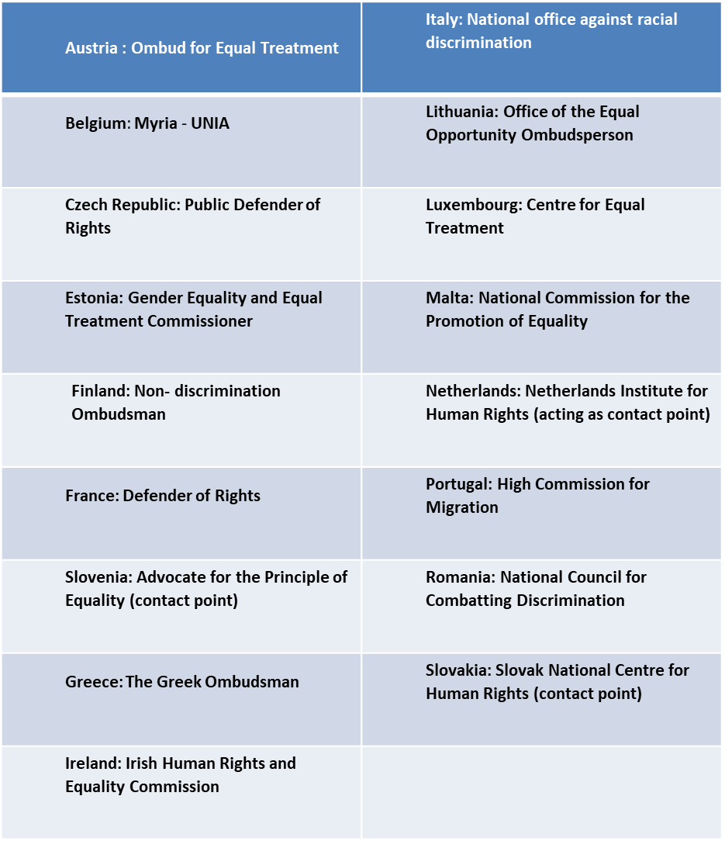
Equality bodies as FoM bodies: A Map

Slide 6
The work of equality bodies
Hard and soft powers
Functions laid down in EU Directives:
Wider functions accorded to Equality Bodies:
Independent assistance to victims of discrimination
Independent surveys and reports concerning discrimination
Recommendations to policy makers on discrimination issues
Exchange of information with European bodies
Communication, awareness-raising and promotion of values
Quasi-judicial decision-making on cases (legally binding decisions)
Work with duty-holders (private and public) – e.g. capacity building, good practice promotion
Freedom of movement mandate
Work-life Balance
Monitoring and supervision

Slide 7
The work of equality bodies as FoM Bodies
Additional tasks
New functions (beyond traditional equality and non-discrimination work) accorded to Equality Bodies under Directive 2014/54:
Tackling “unjustified restrictions and obstacles to the right to freedom of movement” of mobile EU workers and their families;
Conducting surveys and analysis concerning obstacles to free movement;
Making recommendations on any issue relating to unjustified restrictions and obstacles to free movement;
Outreach to and information dissemination among EU workers (unfamiliar group for NEBs)
Collaboration with information and assistance services in the area of freedom of movement (unfamiliar group of partners and unknown institutional landscape)

