Slide 1
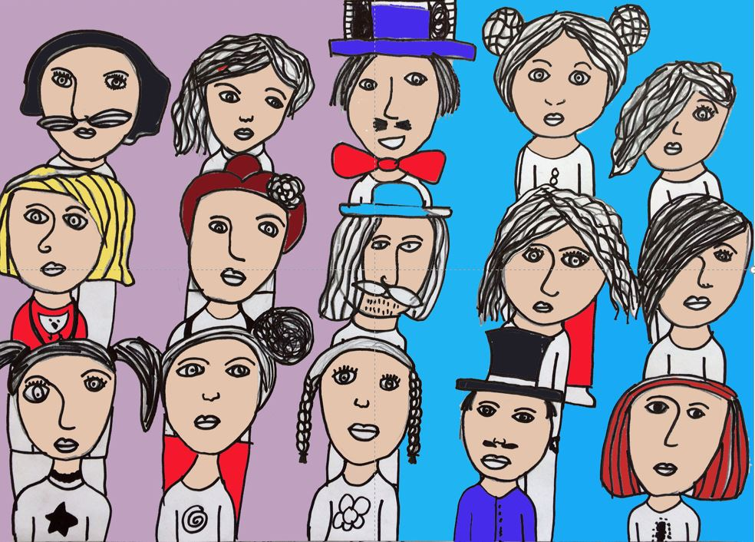
Cooperating with labour inspectorates on national level

Slide 2
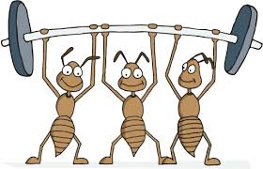
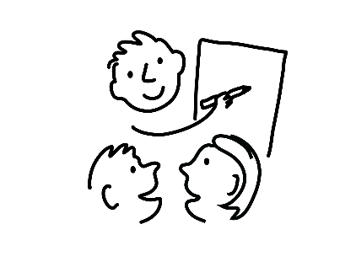
ABOUT US
17 employees
3 regional offices
2 mandates
Marián
Tomáš
Miroslava
How do we work?
Legal Department
National Focal Point for Business and Human Rights
Library
Education and Research Department
Inter-Departmental Team
Boss

Slide 3
Equality Body v. Labour Inspectorates
PROMOTE
EQUALITY
EACH ONE TEACH ONE
WORKING
TOGETHER

Slide 4
We attend and often speak at the events of the labour inspectorates (e.g. workshops, conferences and seminars).
What we do for inspectorates?
We report alleged misconduct at workplace, if such misconduct fulfils the requirement for initiation of labour inspection.
On a regular basis, we provide training on right to equal principle and discrimination to the individual labour inspectorates as well as to the mother institution – National Labour Inspectorate.
We promote responsible business activities together with the mandate and the competences of the labour inspectorates while helping businesses to act in accordance with law.

Slide 5
Labour inspectorates attend and often speak at our events (e.g. conferences, workshops or seminars.)
What inspectorates do for us?
In respect to individual cases of discrimination, the labour inspectorates provides us with information that can not be accessed by the Centre.
Labour inspectorates provide us with statistical data when we are conducting research on topics related to discrimination and harassment at work place.
When discrimination is suspected during the labour inspection or the labour inspectorate is contacted by a victim, the case is referred to the Centre.

Slide 6
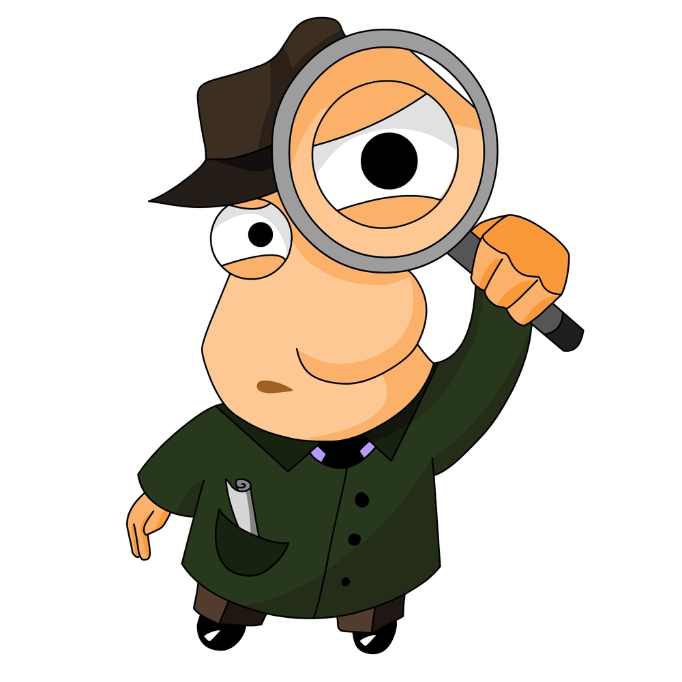
What we do together?
When there is an assumption, that the discrimination takes places at workplace, we participate on the inspection together with the labour inspectorate.

Slide 7
NATIONAL FOCAL POINT ON BUSINESS AND HUMAN RIGHTS
National Focal Point for Business and Human Rights was established to prevent and mitigate negative impacts of businesses on enjoyment of human rights, including the right to equal treatment.
When working with labour inspectorates, we are predominantly:
Raising awareness about the obligation of businesses to conduct human rights due diligence and human rights impact assessment.
Raising awareness of businesses on equality and discrimination to help them gain positive habits and manage human rights violations related risks in the early beginning of their business activities.
Raising awareness about unlawful employment and its consequences.

Slide 8
Time to answer some questions!

Slide 9
