Slide 1


Working Group on Communication Strategies and Practices
6 November 2017, Bucharest

Slide 2
How should we go about Framing Equality?

Slide 3
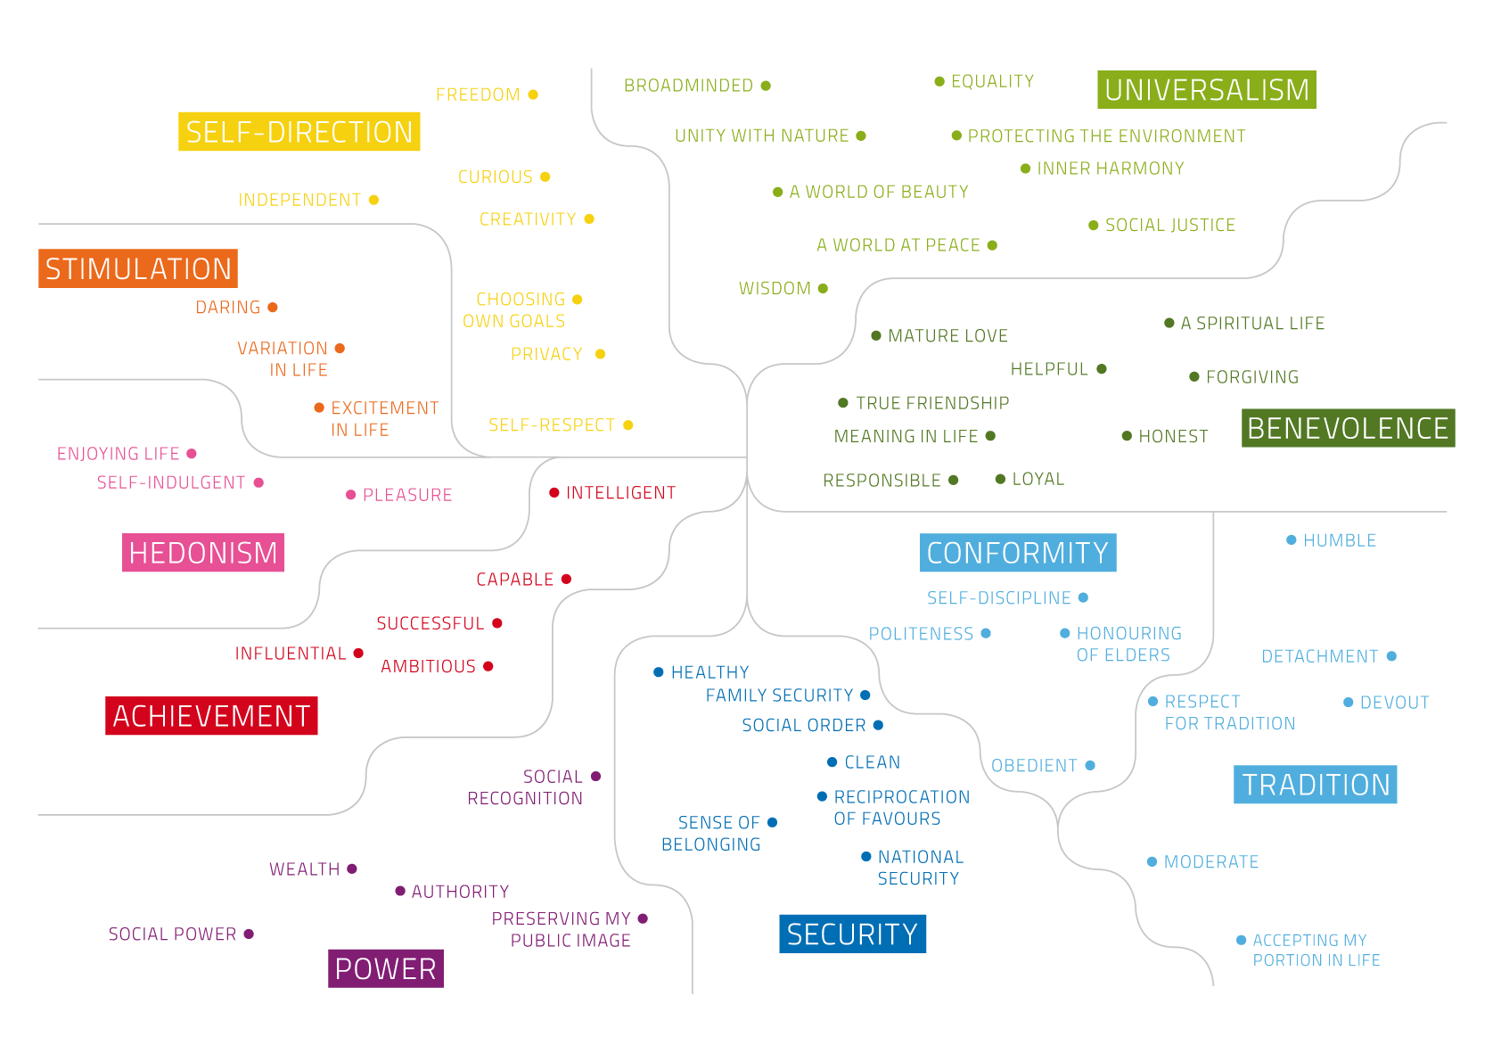

Slide 4
Using Values to create a more Equal Europe
Openness-to-change Self-direction, Stimulation & Hedonism Associated with: Political activism Tolerance of ‘other’ groups Creativity & art Empowerment | Self-transcendence Universalism & Benevolence Associated with: Concern for others and tolerance of ‘other’ groups Concern about global issues Altruism & co-operation
Self-enhancement Power & Achievement Associated with: Materialism & economic concern Racism, sexism, homophobia Belief that some groups are inherently superior to others Competitive behaviours | Conservation Conformity, Tradition & Security Associated with: Nationalism & concern for national security Strong belief in retributive justice Negative stereotyping & prejudice of ‘other’ groups
Notes:
When people strongly hold self-transcendent and openness to change values, they tend to be less discriminatory. And across Europe, the research shows a positive picture: People view these values as most important. So why are people still not treated equally?
Because patterns of prejudice and inequality in Europe are linked to the weight people place on these values compared with others. From attitudes towards minorities in leadership positions to the rate at which people report discrimination, the influence of values is clear and consistent.
These values are not static: they can be engaged and strengthened. We can actively work to bring to the fore the sense of respect and care for others that every person already holds within them.

Slide 5




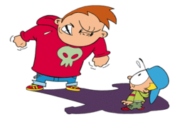
Frames help us make sense of the world
My new job is like………..Being back at school
Notes:
The stories we tell in our communication work matter. They shape how we understand ourselves, what relationships we value and pursue, how we classify ‘us’ and ‘them’. If we deny people certain rights, it’s because of a set of stories we believe in, showing that one group is more deserving than another.
By understanding framing – how these stories interact with our thinking – we can craft our communication to create sustainable social change.

Slide 6


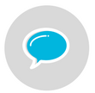
Understanding your framing task
Quick DIY:
What outcome are you looking for?
Who is your audience? What do you want to tell them?
What’s standing in the way of them acting in the way that is needed for the desired outcome?
What does your frame need to do in order for your audience to overcome this barrier? What is needed to motivate their support?
Know your purpose:
What are your vision and goals?
Know your audience:
Who are they and how do they think?
Set your framing task:
What do you want to say?
Problem / Solution / Movivation
Notes:
Know your purpose: Your vision and goals should guide all of your work - and how you frame it. The smaller steps you need to take in order to achieve the long-term are your goals. Your goals could be to promte and raise awareness of the legal acts guaranteeing equal treatment, encouraging supporters to be more active, or shifting public understanding of an issue.
Know your audience: Who you’re talking to is a big strategic question.You might want to target existing supporters, a group you think is persuadable or someone who has particular influence. Once you’ve identified your audience, you need to find out a bit about them. What do they value in life? What makes them tick? How are they already thinking about your issue? Knowing the answer to these questions will help you create frames that move your target audience in the right direction.
Set your framing task:
Problem: Getting agreement that there’s a problem and what it is;
Solution: Getting agreement that there is a solution and what it is;
Motivation: Showing why the audience should care and act.

Slide 7
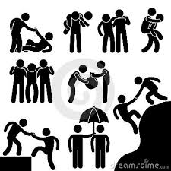
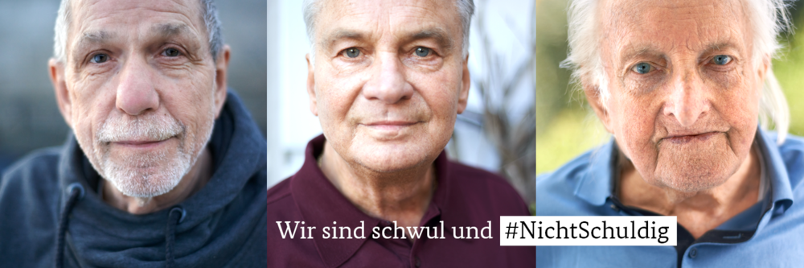
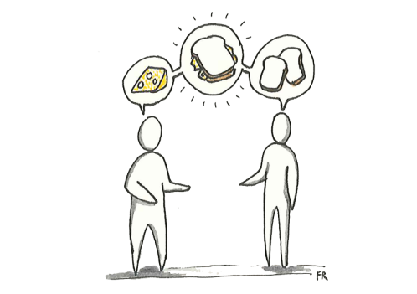


Frame on! Create your frame
1. Speak to people’s best self
4. Make it real
2. Create common ground
3. Talk about change
5. Avoid reinforcing unhelpful frames
Notes:
Speak to people’s best self: appealing to the emotions and values of peoples better selves – the side that most people want to believe themselves to be – can significantly reduce people’s prejudice. Eg. Croatians helping refugees arriving by handing out food.
Remind people that they’re good people
Make people laugh
Tell people that the change you seek will make society nicer
Appeal to the values that underpin human rights and equality
Create common ground: the sense of being part of the same ‘group’ helps people to empathise and support each other. Express shared identities, values and interests. Ask people to take another perspective and use trused messengers. Eg. Power to the Bump campaign, EHRC, UK. Used trusted messangers, created a community of support.
Talk about change: Understanding that a problem is important can demotivate people if they can’t see a way to change the situation. People are also demotivated if they can’t see their own role in change. Eg. Finnish ‘Not in our School’ campaign focused on how a school could be without sexual harassment. It lead with vision, rather than the problem.
Make it real: Avoid relying on facts alone. Give your message a human face. Tell stories and use powerful images that can change an audience’s mind. Eg. German ‘#NotGuilty’ campaign. Includes people, real stories, and shared values and emotions such as ‘the right to love’.
Avoid reinforcing unhelpful frames: Directly responding to something by saying x isn’t true, simply reinforces x in someone’s mind. Focus instead on upbeat and positive stories. Eg. Portugal – The colours of the grey city: new citizens bring vibrancy, colour, new ideas and experiences. They are upbeat stories about diversity. They engage values of universalism and benevolence, asking children to reflect on what really makes a cohesive society. They do NOT counter arguments put forward by opponents to immigration nor attempt to bust myths or use statistics to show the positives of migration.

Slide 8



Test & Refine
Test your communication
Choose your method
Prepare your materials
Choose what outcomes to measure
Choose who you’ll test
2. Measuring impact
Define your impact measures: shift in media framing, attitude changes, behaviour changes, change in policy, referendum votes, social cohesion changes…
3. Monitoring and evaluation
Observe your impact over time
Reflect on the impact and achievements of your framing
Rinse & Repeat

Slide 9
Group Discussion:
Our common vision for NEBs communication?
Linked to your promotion of the equality body in general…
What are your vision and goals? What outcome are you looking for?
Who is your audience and what do you want to tell them?
What do you want to say?
  Problem: Get agreement that there is a problem & what it is
  Solution: Get agreement that there is a solution and what it is
  Motivation: Show why the audience should care and act

Slide 10
Taboo (or how to explain things in a simple way)

Slide 11
Taboo
Groups of 4/5: then split into Team A and B
Team A selects a person in their group to be the Clue-giver. This person places the cards away from their team so that they cannot see them.
Clue cards have the clue word on the top of the card and the taboo words listed below the clue word. Clue-givers then start and have 1 minute to get their team to say the guess-word on the card, without using one of the taboo words in one of their clues. If a taboo word is used, then Team B must say EQUINET which penalizes Team A by causing the current guess card to go into the discard pile.
The team not giving clues must watch for Taboos or other violations of the rules. If they successfully spot a rule being broken, they may shout EQUINE to interrupt play and very briefly explain the infraction. Clue-givers must place the current card into the discard pile and draw a new one. Each card in the discard pile represents one point for the other team.
Once time runs out, the teams are swapped and roles are reversed.

Slide 12
Taboo Rules
Clue-givers may not use any taboo words, including abbreviations and any part of the taboo word.
Clue-givers may not use sound effects or use gestures to indicate the clue word.
Clue-givers may pass on any card at any time, but the card is then placed in the discard pile.
When time is called, the final card does not go into the discard pile, but is instead removed from play.

Slide 13
Plans for 2018

Slide 14
Work Plan 2018: WG Communication
Organise thematic meetings on topical communication challenges that are presented by an expert (internal or external depending on the topic). The group will get to ask questions, identify the values-based messages and work together to develop responses to the challenges.
Following on from work that we did in 2017 on values and combating online negativity, the Working Group will have a practical session on how to combat hate through positive narratives.
Develop recommendations on how to set the agenda on equality and non-discrimination during campaigning periods in the run up to elections.
Support the organisation of the Seminar on Hate Speech from the point of view of Equality Bodies

Slide 15
Work Plan 2018: Hate Speech Seminar
1 ½ day capacity-building seminar which aims to discuss what the issues surrounding hate speech are for equality bodies. It will provide practical solutions from a legal, policy and communication perspective. The seminar will explore how to deal with hate speech in the following ways:
Understanding: Research and data collection help us to better identify the main issues on hate speech in our context, including who carries it out and on what grounds;
Prevention: Embedding the practice of equality inside organisations via their systems, communication and policies, including training and recommendations for educators, media and policy makers;
Management: Legal, policy and communication approaches on how to handle hate speech.

Slide 16
Our work in 2018
What topics would you like to discuss in 2018?
Any experts that you would like to have speak at our meetings?
Concrete ideas for the seminar on hate speech (to be held after the summer)? Ie. Speakers, examples from equality bodies…
New Equinet website to be developed in 2018: any advice?
Save the date: 23-24 January 2018
FRA Seminar with human rights leadership communicators

