Slide 1
Don’t agonize. Organize!
Bratislava 21. November 2016

Slide 2
Notes:
I am sure I wasn’t the only one who wanted to cry, waking up to this on nov 9th… These are the Norwegian newspaper the next day..
The most powerful country in the world now has a president that thinks women and minorities are something you can grab, mock and step on.

Slide 3
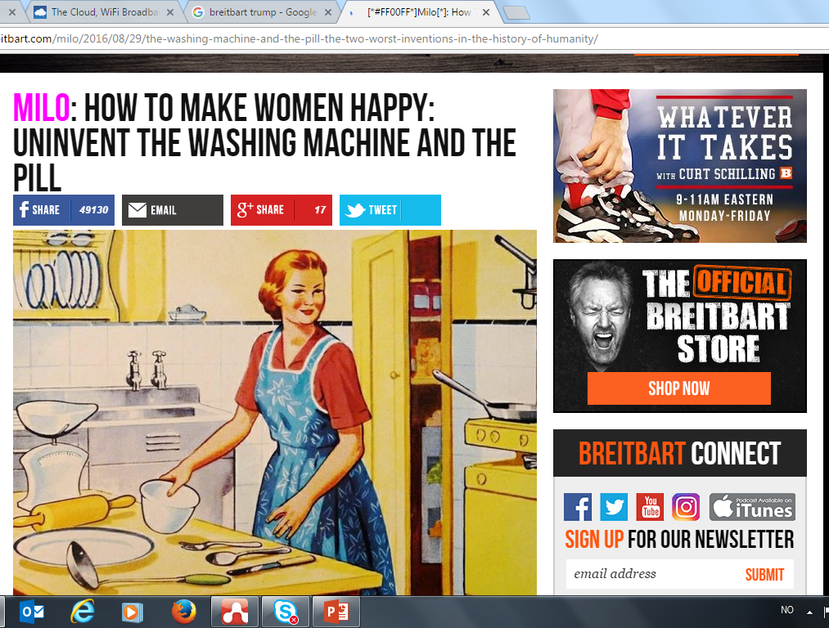
Notes:
We got a president who chose as his advisor and strategist a man that claims women should og back to the 50s. That birth control and washing machines are stopping us from finding and living our true selves.

Slide 4
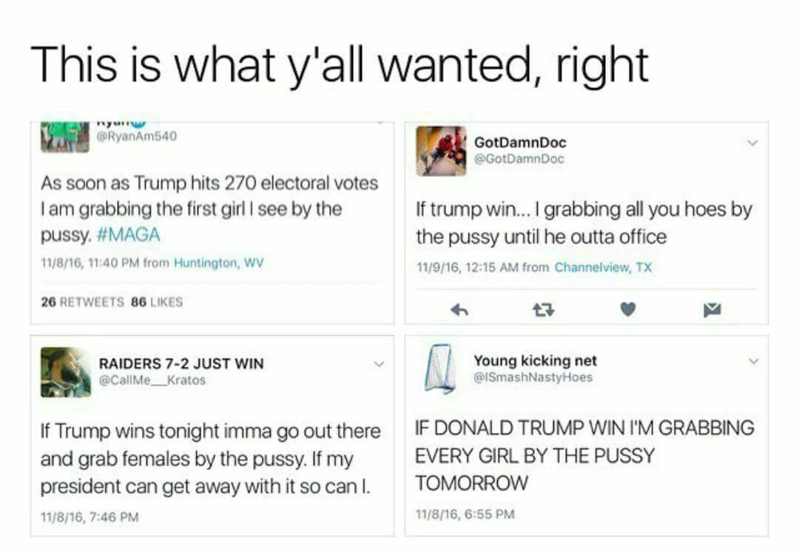
Notes:
And worse, by being elected president, the american people have at the same time said that it is aceptable to talk about people in a disrespectful, hateful way.
He brags about harassing women
He calls mexican people rapists and criminals
He wants to mark and ban people from his country, based on religion
He made fun of a journalist’s disability
He practicaly said to his people: Go ahead! Shit on minorities… you won’t suffer any concequences… or as tweeters put it few days before the election: if my PRESIDENT can get away with it… so can I!

Slide 5
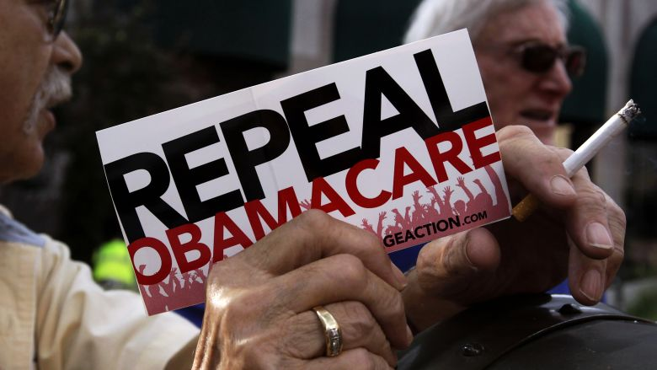
Notes:
And as all of you sitting here know.. Words are always more than «just words». They lead to action.
The first three days after Trump got elected there was a spike in hate crime (women getting their hijabs ripped off, property defaced with swastikas, LGBT Americans threatened)
And the politics he has promised to set into life, is definately not just words… Trump keeps repeating his promise to deport millions of people.. People that will lose their homes. Their families. Their everything
Removing Obamacare, depriving people of life saving health care is on
Building walls.. Not just metaphorically, but also physically,

Slide 6
Notes:
So what has this got to do with us?
Unfortunately… Everything. Cause I’m quite certain you all have you’re own Trumps in your countries as well.
This is Norway’s Trump
Our minister of immigration and integration.. Sylvi Listhaug.
Always talking about us. And them. The others.
Getting headline after headline saying stuff like:
People can’t expect to be carried into Norway on a chair for Kings…as if the overfilled boats in the mediterranian bore any resemblance to that..

Slide 7
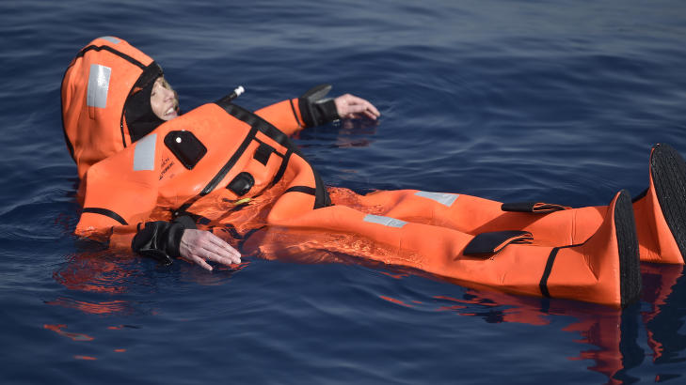
Notes:
She even went swimming in the mediterranian (in a survival suit), claiming she know knows how the people crossing the ocean feel…

Slide 8
Notes:
And it is not like Trump is the only one building walls. They pop up here in Europe as well. Sometimes physically. Like this one, which I think I read is being built in Munich, Ann Katrin? Sometimes with border controls so strict that there might as well be a wall there… Like on the Norwegian boarder to Russia..
So what do we do?
Give up? – Not an option.

Slide 9
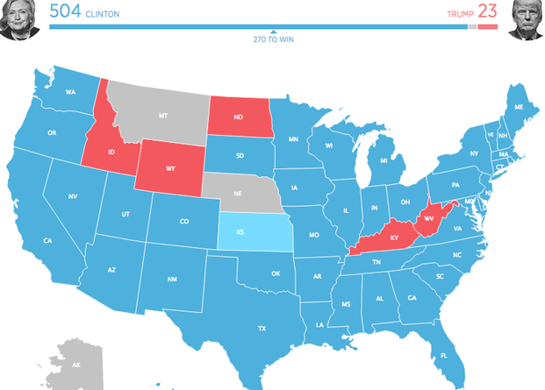
Notes:
Wait for the next generation, who better than our see people, not color? (stole this from your fb, paivi, thanks for sharing☺)
This is a map of how young people voted in the presidential electiom… I call it my map of hope…

Slide 10
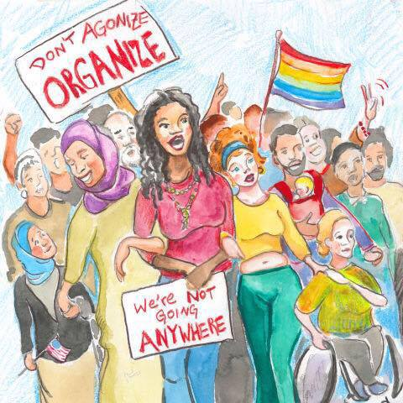
Notes:
But thank god, there are other signs as well
After the results were ready, it didn’t take long until messages like this started spreading…
Don’t agonize. Organize.
This is the time for good forces to stand together. Fight together. Show Trump..or Listhaug…or whatever they are called in your country that we won’t give up.
And that is precicly why we are here. Sharing ideas. Learning from each other’s work.. So that we can og back to our countries with new ideas on how to fight for equality.
I am so happy you are all here, and I really look forward to spending this day in Bratislava with you.
As you may have seen in the agenda, we have three different sessions planned today.
Ann Katrin will start by telling us how they used communication to get rid of an old piece of legislation, that up until 1969 was used to convict gay men.. Simply for being gay.. We really look forward to that..
Then we have invited Marco, that many of you know well, since he used to be one of the veterans of this group, to share the result of the PRISM project. For those of you who weren’t there the last time Marco talked about this; The PRISM project is a european project, dealing with hate speech and how to combat it. We really look forward to getting some ideas of how we, as eqality bodies, can use those results, Marco. I think it is safe to say that this topic has never been more important…
Then Paivi, who I think also most of you know from before, will discuss value oriented theme management and opinion leadership online , and how we can participate in and manage online discussions, using values based messages. A theme that will be really useful to us, since one of our tasks as a working group in 2017 will be to follow up on a report on value based communications that this group made a few years ago.
And then finally, Sarah and I will use the last hour of this meeting to get your input on a SOME-manual that an agency helped us put together after a training session on social media a month ago. I hope you have had the chance to have a look at it, but if not, we’ll walk you through it, and hopefully together come up with a lot of good examples that can make it more relevant to equality bodies.
So again: Welcome everybody, and Ann Katrin: the floor is yours☺.

