Slide 1
Using Communication to Change Legislation
496233948
Ann Kathrin Sost
Federal Anti-Discrimination Agency (FADA), Germany

Slide 2
Criminalization of homosexuality in Germany
„Paragraph 175“ existed for 123 years: basis for criminal sanctions on homosexual acts between men
Development from 1933 to 1945:
§ 175 was toughened to maintain public perception that resolute action was being taken against all „immoral activities“
Men could be imprisoned for up to five years
National Socialists raided and closed meeting places, many homosexuals were sent to concentration camps (estimations: between 5.000 and 15.000 people)
About 50.000 men were charged with homosexuality

Slide 3
Criminalization of homosexuality in Germany
Development after 1945/49:
German Democratic Republic: The stricter version of § 175 was no longer applied; however „acts similar to sexual intercourse“ among men remained punishable until 1968 (after that, the sexual age of consent still remained higher for homosexual acts than for heterosexual acts (18/16), now including women
West Germany: kept the „Nazi“ version of § 175
- The Federal High Court of Justice upheld the unrestricted validity and constitutionality of
§ 175 in several decisions
- law was eased in 1969, similar to GDR (different age restrictions)
Notes:
Fußnoten:
Die Fußnotenzeichen werden mit der Funktion „Hochgestellt formatiert.
Der Fußnotentext wird über die Einzugsebenen formatiert (Ebene 7).
Die Referenz muss manuell gesetzt werden:
Die Zahl gefolgt von einer Klammer, dann einen Tabstopp (ist voreingestellt) und den Text eingeben
Wird dieser Text zweizeilig, dann einen weichen Umbruch einfügen, gefolgt von einem Tabstopp, dann den weiteren Text eingeben

Slide 4
Practice of prosecution, situation of individuals
Systematic prosecution continued:
Up to 50.000 convictions
Grave social risks: risk of losing social standing, being blackmailed, lose job or apartment; pressure to marry; basic rights like freedom of opinion and assembly denied
Men liberated from concentration camps were returned to prison after the war

Slide 5
Decriminalization of homosexuality
1994: abolition of a different treatment of homosexuality under the crimnal code
Until then: up to 50.000 convictions
Rehabilitation of men convicted during the Third Reich (1998, blanket anulment)
2004: change in government directives on hardship payments to victims of wrongful National Socialist measures – victims of § 175 until 1945 could claim compensation
Considerations to rehabilitate victims from 1945 onwards:
Discussion in parliament first in 1995, then 2008, 2009, 2010 – 2013, government declined requests
2000: coalition parties in parliament adopted a motion to express „regret“ and apologized

Slide 6
Why no rehabilitation?
Court judgments handed down in a democratic Germany should not be questioned; „normal course“ in a democracy that laws would be amended and abolished
Decisions from the Federal Constitutional court should not be questioned
Other European countries (UK, Ireland) have not done anything either
Fear that the overturning of convictions of other now-abolished acts would follow (anti-abortion law, adultery, procuration etc.)
Situation in spring 2016: resolution by the Federal Council for rehabilitation and compensation,
ministry of justice repeatedly states that it is „examining“ possibilities

Slide 7
FADA‘s communication acitivities
Finding the right mix:
1.) legal arguments
2.) political strategy
3.) emotional level
Main communication channels: press conference/media, social media campaign, political and NGO contacts

Slide 8
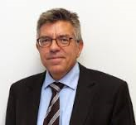
1. Legal arguments
Research done by a well-recognized professor in constitutional law, Prof. Martin Burgi
(conservative lawyer, assignment open-ended)
His main findings: The state cannot only find ways to take action, it is obliged to do so
Stigma of conviction is persistent and still present, state has duty to protect fundamental rights of citizens, the priciple of the rule of law and the principle of the social state
No constitutional concerns: the annulment of the convictions would not constitute a breach of the general principle of equal treatment before the law. In other cases such as adultery and procuring there is either no violation or a clearly less serious violation of the constitutions – laws were enforced less strictly and with less severe impact on the people; § 175 was a violation of human dignity

Slide 9
2. Political strategy
- FADA head Christine Lüders appealing to the government to finally take action
- Discussion with LGBT activists before publication of expertise
- Confidential e-mails, expertise attached, sent to politicians and the minister of justice a week before the press conference
Communicating main messages from expertise: state has to correct itself in order to restore
human dignity – rehabilitation and compensation are necessary

Slide 10
3. Emotional level
Testimonial by Heinz Schmitz who was convicted under § 175
Statements to media, appearance at press conference
Film for Facebook and to be shown at press conference
http://www.antidiskriminierungsstelle.de/SharedDocs/Videos/DE/nichtschuldig_20160512.html?nn=7828686

Slide 11
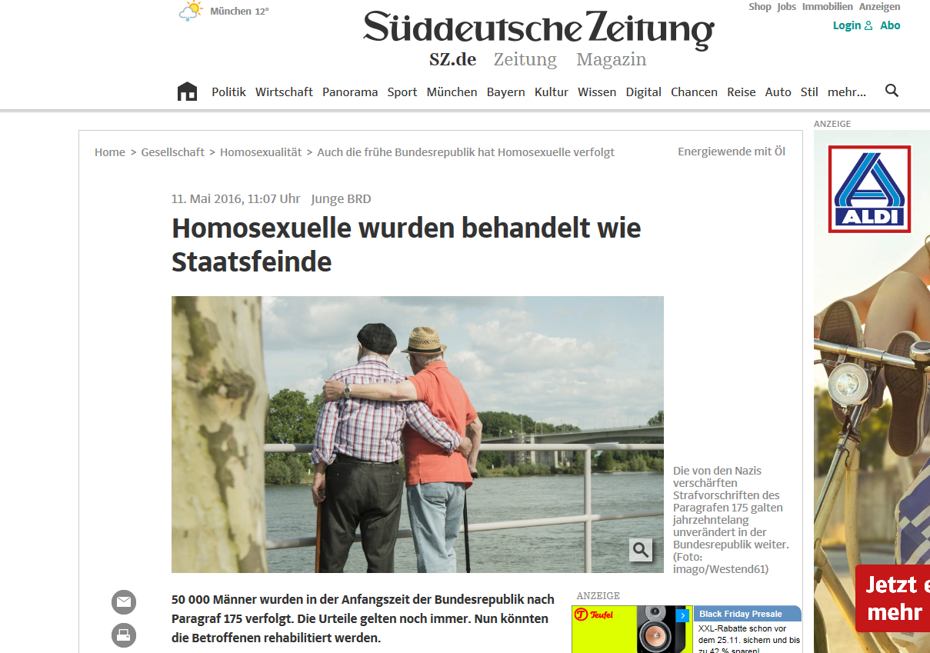
Media strategy
„Leaking“ of expertise to law expert at one of the biggest daily newspapers, „Süddeutsche Zeitung“

Slide 12
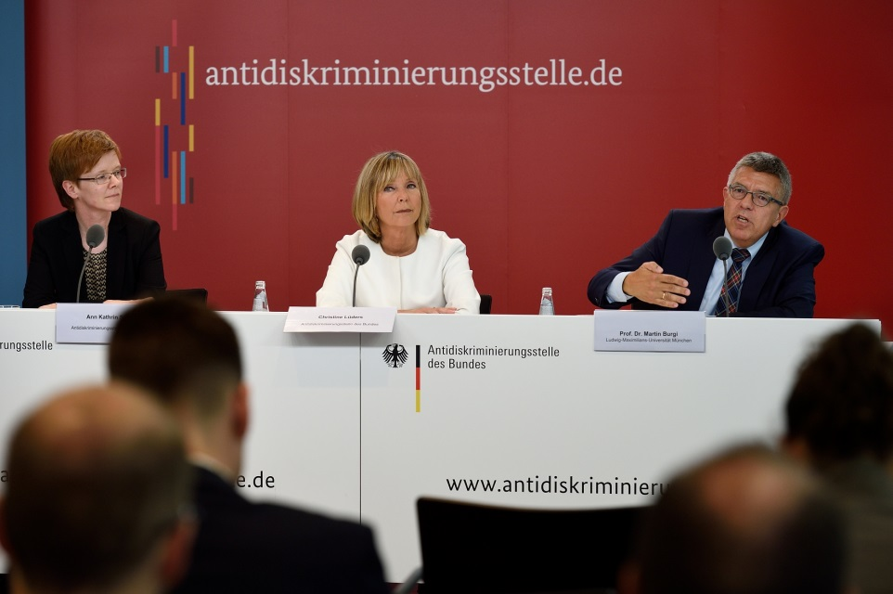
Media strategy
Press conference on 11/5/2016 (ahead of IDAHOT) with Lüders & Prof. Burgi, Heinz Schmitz in first row and film
During the conference, the justice minister announced that he would draft legislation within 2016 to anul the convictions and compensate victims
Coverage in every news broadcast on primetime, wide coverage in national and international newspapers

Slide 13
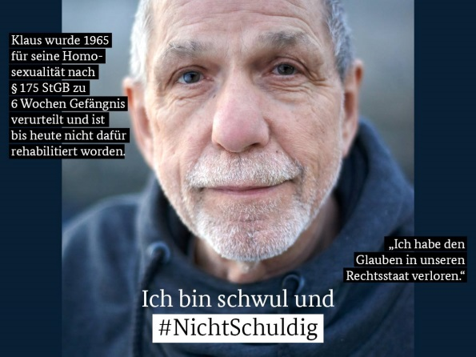
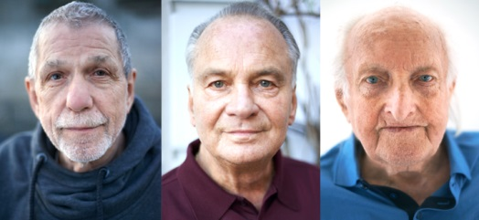
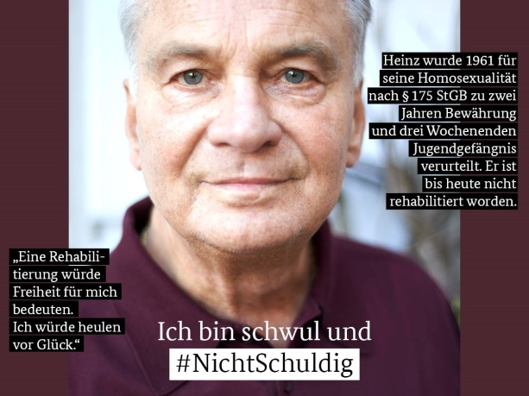
Social media: #NichtSchuldig (#NotGuilty)
Film on Facebook: 297.000 views
Foto campaign on Facebook and Twitter with victims of § 175 on IDAHOT

Slide 14
What‘s next?
Draft legislation is in discussion among the ministries now (FADA is part of this); cabinet is expected to decide over it in December; draft includes anulment and individual compensation, collective compensation (funding for foundation…) will be decided over in parliament, so far 30 million Euros are planned
Working group led by an organisation of elderly gay activists, LGBT organisations, government and FADA on contents of law and terms of compensation, possible public relations work
Heinz Schmitz and other victims of § 175 will be invited by FADA to see discussion and decision in parliament
FADA thematic year 2017: against discrimination on the grounds of sexual orientation

Slide 15
Thank you!
Ann Kathrin Sost, press officer
Antidiskriminierungsstelle des Bundes Glinkastraße 24 10117 Berlin
annkathrin.sost@ads.bund.de
www.antidiskriminierungsstelle.de

