Slide 1
Campaign against pregnancy discrimination
Ombudsman for Equality, Finland
Päivi Ojanperä
6 October 2017

Slide 2
From the framing point of view: what we want to receive
VISION: Zero-tolerance for pregnancy discrimination
Current goal:
  Problem: Getting agreement in the public discussion, that pregnancy discrimination is a huge problem in Finland; highlight a problem
  Solution: Getting agreement around the solution; creating and enforcing the common opinion with the messengers that pregnancy discrimination needs to stop
  Motivation: Inspiring support or action; When discriminated against: Don’t suffer alone, get legal advice, you can get justice

Slide 3
Our audience:
Women being discriminated against
Problem: lack of knowledge (about what is discrimination, about the rights and also what to do); feelings: pessimism, fear
Solution: Offering advice (also anonymously); also trade unions will help; telling about the rights and how to act
Motivation: Empowering with the examples in the media (stories on winning the employer: ”someone had to be the brave one”); showing that you are not alone

Slide 4
Taking into consideration the existing beliefs
Existing discourse in the public discussion:
A strong belief that the employer needs to pay 10 000 e for each pregnant employee (not true); employers natural understandable ’right’ to end the contract when learning about the pregnancy or family leave
The state should be the one paying, not the employers (mom’s employer) at all
That’s how it just is: it would be difficult to solve

Slide 5
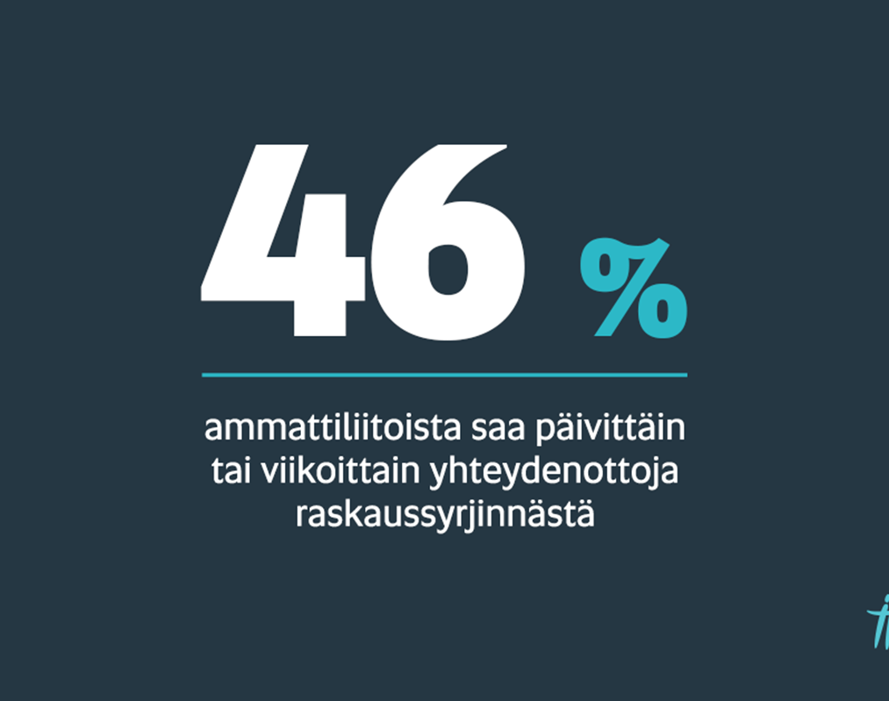
Cooperation with the trade unions (messengers trusted by the audience)
Survey for the trade unions
- About 20 biggest trade unions

Slide 6
Creating common ground
Using trusted messengers
Providing recognisable and friendly campaign materials
Creating a community of support: supportive guidance and information

Slide 7
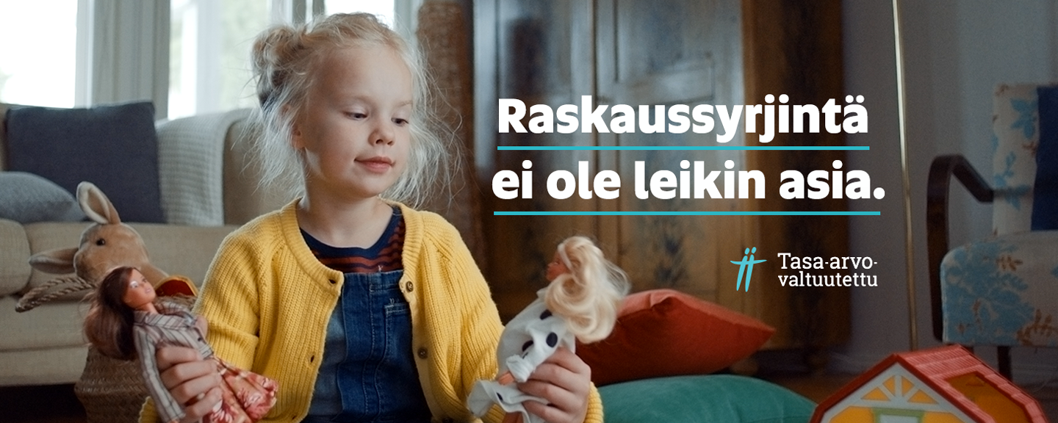
Campaign:
Pregnancy discrimination is no child’s play

Slide 8

Zero-tolerance for pregnancy discrimination

Slide 9
What, to whom and when
Target group: women aged 20-45
Objective:
  raise the knowledge about pregnancy discrimination
  encourage the women suspecting discrimination to contact us (or their trade union);
Campaign period: 2-22 October 2017
  Campaign video on Fb, Twitter, YouTube, Instagram
  Movie theathers (nationwide), tv (NBC)
  Twitter chat + huge presence in the media
  #raskaussyrjintä www.raskaussyrjinta.fi

Slide 10
What happened
Cooperation with the trade unions: campaigning on Facebook, Twitter (and Instagram) together with our messages – a key
Media’s interest was way bigger than we thought: right momentum – lots of previous discussions on the need to reorganise the family leave system (vast agreement on that); media condemning pregnancy discrimination
#raskaussyrjintä hot topic on Twitter (2nd top topic in Finland): public opinion condemning pregnancy discrimination

Slide 11
Creating common ground
Employers unions got angry about the campaign, because they were not invited to contribute; unclear if they will join our second campaign in March
The new campaign will be about good employers: highlighting and reinforcing the good practices of the employers and the the right attitude by examples (spesific practice / different sectors)
Positive vibe and showcases: Videos presenting solutions and great practices to copy (giving the target audiences an active role)
Locating change at a local level (workplace)

Slide 12
Results so far
Reach: 2.1 million impressions (7477 clicks)
50 % of the video watched more than 341 000 times
The whole video: more than 160 000 times
Movie theater reach: 237 762 people
Tv (dont have the numbers yet)
Website www.raskaussyrjintä.fi: 5185 sites seen; 3000 individual users
Media: 41 articles

Slide 13
Campaign on social media
Social media hits: best day 1,3 million impressions
Social media coverage (unique reach: 1.14 million)
Social media: message tone 56 %, 38 % positive, 6 % negative

