Slide 1
Equinet Cluster on Research & Data Collection 1st meeting
Tuesday 20th June Brussels, Belgium

Slide 2
SESSION 1
Setting the scene: defining research and data collection
Anna Chabiera Office of the Commissioner for Human Rights, Poland

Slide 3
Setting the scene: defining research and data collection
Aims
Identify the different ways in which participants engage with research and data collection
Clarify the focus of the cluster by agreeing on common definition of research and data collection.
Plan
Introduction of the participants
your main tasks in the EB
experience in working with r&dc and expectations on the cluster
Main objectives of research and data collection
General overview
Different ways of coping with data collection and research (what is similar, what parts of it are most interesting)
Definition of the research and data collection

Slide 4
Setting the scene: defining research and data collection
Most General Aims
Providing data, arguments, and recommendations
for authorities, duty bearers, all stakeholders
Providing recommendations de lege ferenda,
Raising awareness
in several concrete fields combined with equal treatment issues.

Slide 5
Setting the scene: defining research and data collection
General overview
Since when do you conduct research or collect data
How many in general, how many projects within a year
Within own budget or thanks to external financial resources
How big is your budget (in Euro)
How do you choose topics, do you have any limits of topics to choose
Who works on designing the research, tools and reports: inner or external experts; who does field work – research agency
What kind/type of research do we conduct
Qualitative or quantitative
What kind of result they bring:
auditing,
deepening knowledge on mechanism or scale,
change in society involved in research (research in action)
Other…?

Slide 6
Setting the scene: defining research and data collection
Definition of research and data collection
(to be discussed):
A process encompassing: choosing a topic, preparing a concept and tools, data collection, analyses combing sociological and legal approach, writing a report and doing communication work in order to achieve aims such as providing data and arguments for governance based on knowledge regarding equal treatment, raising awareness on discrimination issues and in long term contributing to social change in attitude towards diversity.

Slide 7
SESSION 2
Main challenges related to research & data collection
Rainer Stocker Federal Anti-Discrimination Agency (FADA), Germany

Slide 8
SESSION 3
Identifying and overcoming research and data gaps
Andrew Harding Equality and Human Rights Commission (EHRC), Great Britain

Slide 9
Session 3 – Identifying and overcoming research and data gaps.
20.06.2017
01

Slide 10
The UK has a rich data landscape.
20.06.2017
02

Slide 11
The UK has a rich data landscape,
with lots of problems.
20.06.2017
03

Slide 12
Incredibly complex
Moves toward more admin data
Underreporting
Unpublished data
Discontinued or changing surveys
Issues with self-reporting
Occasionally limited breakdowns
(by protected characteristic)
Blind spots and subject gaps,
(especially around specific kinds of people at risk)
Sample size issues
Lots of sensitive information
Different approaches between countries
Data held by disparate systems on multiple platforms
Access issues around sensitive information
Limited harmonisation
Standardisation and format issues
(especially around geography)
20.06.2017
04

Slide 13
How did we identify these problems?
20.06.2017
05

Slide 14
Practice
We have a statutory monitoring duty under Section 12 of the Equality Act 2006, most recently resulting in our report Is Britain Fairer?
We have published multiple other reports on specific equality and human rights issues
In each case, using hundreds or thousands of secondary sources
This work is ongoing, and often returns to the same issues to check progress
Familiarity with the data landscape is essential to build a sustainable evidence base
The more we know, the more we understand what is missing.
20.06.2017
06

Slide 15
The EHRC has developed a single measurement framework for equality and human rights.
20.06.2017
07

Slide 16
Domain | Indicators
Education | Educational attainment of children and young people School exclusions, bullying and NEET Higher education and lifelong learning
Work | Employment Earnings | Occupational segregation Forced labour and trafficking
Living standards | Social Care Poverty Housing
Health | Health outcomes Access to healthcare Mental health | Reproductive and sexual health Palliative and end of life care Health inequalities
Justice and detention | Conditions of people resident or detained in public or private institutions Violent, intimate or identity-based crime | Effectiveness of the justice system Restorative justice Rehabilitation, resettlement and reintegration
Participation | Political and civil participation and representation Access to services Privacy and surveillance Social cohesion and good relations Family life
20.06.2017
08

Slide 17
Domain | Indicators | Statistical measures | Breakdown
Education | Educational attainment of children and young people | % achieving good level of development % achieving 5+ GCSEs A*-C | England, Wales, G England, Wales, Scotland, D, E, G, LAC
 | School exclusions, bullying and NEET | % excluded from school % young adults NEET | England, Wales, Scotland, D, E, G England, Wales, Scotland, A, D, E, G, R, SEC
 | Higher education and lifelong learning | % 25-64 with degree-level qualifications % participating in learning activities | GB, England, Wales, Scotland, A, D, E, G, R, SEC
Work | Employment | Employment rate (16-64) Unemployment rate (16-64) | GB, England, Wales, Scotland, A, D, E, G, R, SEC
 | Earnings | Median hourly earnings including overtime
 | Occupational segregation | % in management and the professions % in low-level occupations
 | Forced labour and trafficking | n/a
20.06.2017
09
Notes:
Statistical measures are just one kind of (outcome) evidence, we also look at Structure and Process evidence. Stats are just a fraction, but the most demanding in terms of raw data.

Slide 18
Our full list of protected characteristics are:
Age
Disability
Gender reassignment
Marriage and civil partnership
Pregnancy and maternity
Race
Religion and belief
Sex
Sexual orientation
But we also examine:
Geography
Socio economic condition
And specific factors for at-risk people
20.06.2017
10

Slide 19
The EHRC has developed a single measurement framework for equality and human rights.
It still has lots of problems.
20.06.2017
11

Slide 20
The EHRC has developed a single measurement framework for equality and human rights.
It still has lots of problems.
They’re essentially the same problems.
20.06.2017
12

Slide 21
Incredibly complex
Moves toward more admin data
Underreporting
Unpublished data
Discontinued or changing surveys
Issues with self-reporting
Occasionally limited breakdowns
(by protected characteristic)
Blind spots and subject gaps,
(especially around specific kinds of people at risk)
Sample size issues
Lots of sensitive information
Different approaches between countries
Data held by disparate systems on multiple platforms
Access issues around sensitive information
Limited harmonisation
Standardisation and format issues
(especially around geography)
20.06.2017
13

Slide 22
What are your research / data gap examples? How did you identify them?

Slide 23
What are your research / data gap examples? How did you identify them?
Which innovative methods do you use to tackle them?

Slide 24
How are we overcoming these problems?
20.06.2017
05

Slide 25
How are we overcoming these problems?
Here are some examples.
20.06.2017
05

Slide 26
The Race Disparity Audit
August 2016: race report released to build on evidence from Is Britain Fairer?
Attracted a huge amount of media attention as the biggest ever review into race equality in Britain
Our key recommendation was for Government to develop a comprehensive and well-coordinated race equality strategy
Also asked all governments to improve the range and scope of disaggregated ethnicity data
Nine days later the Prime Minister announced the Race Disparity Audit of public services
20.06.2017
16
Notes:
- Review , considered every aspect of people’s lives. Data to help address the needs of a range of research, statistics and ethnic groups, and their race equality strategies.
- Newly formed Race Disparity Unit has engaged the Commission in a consultative role. Our key suggestion has been to use the Measurement Framework structure and Is Britain Fairer? domains.

Slide 27
Preventing deaths in detention
2015: inquiry report released on non-natural deaths of adults with mental health conditions in detention
Acquiring unpublished data showed that basic but serious errors were repeatedly being made.
We delivered a series of recommendations to inform improvements. A follow-up in 2016 showed some progress, but also continuing issues.
Relevant data gaps are mentioned in the executive summary of the follow-up report.
We have also pushed for routine data publishing on the use of restraint, and on the number of prisoners with mental health conditions.
20.06.2017
17
Notes:
We have legal powers to conduct investigations and inquiries concerning equality and human rights legislation responsibilities
Detention includes prisons, police custody, and mental health institutions.
Use of restraint – in prisons.

Slide 28
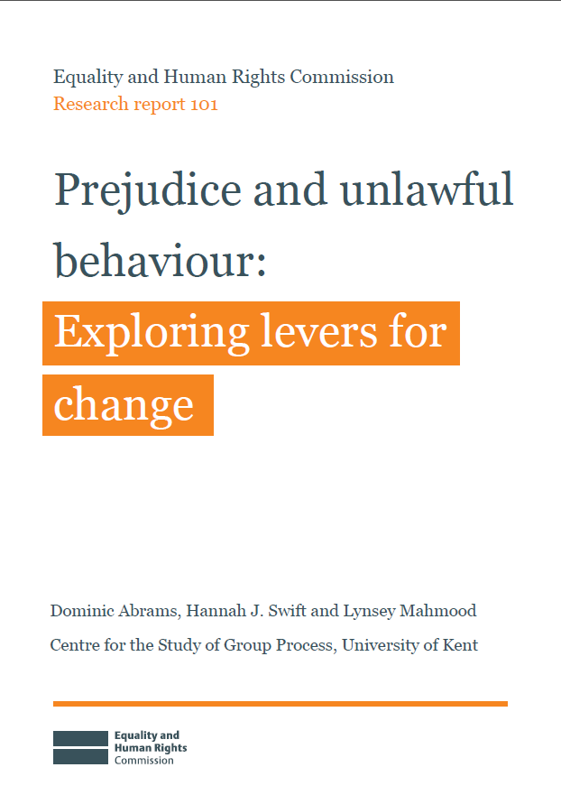
Prejudice work
Phase one (a systematic review) identified that the quality and quantity of relevant evidence (across protected characteristics), and what works to tackle it, is very uneven and varied
The evidence base is not robust enough to make effective policy recommendations.
2017: phase two- improving evidence quality for ‘what works’ to tackle prejudice, discrimination and identity-based violence and harassment:
A guide for evaluating anti-prejudice projects
Evaluating the effectiveness of four promising interventions
Outputs are being finalised, but already interest in our evaluation guide
Exploring options for addressing gaps in evidence by developing a national ‘barometer’ of prejudice and discrimination.
20.06.2017
18
Notes:
Multi-year programme to identify effective levers for reducing prejudice and unlawful behaviour

Slide 29
Harmonisation work
Encouraging development of harmonised principles through membership of the National Statistics Harmonisation Group
Providing guidance on inputs, outputs and definitions for many of the protected characteristics under UK equality legislation
We have contributed to:
questions on disability, including health conditions, impact on day-to-day activities and types of impairment
introduction of a sexual identity question to the census
data collection on civil partnerships and same sex marriages
updates to questions on ethnicity and religion
We commissioned work to develop questions on gender identity, transgender issues and gender reassignment and persuaded the Office for National Statistics to reconsider their position on these topics and data collection.
20.06.2017
19

Slide 30
Other examples
Briefs
In 2016 we briefed the All Party Parliamentary Group on Sex Equality, on data gaps and sample size issues in relation to the experiences of homeless women, women in prison or in youth custody, or those escaping domestic violence.
Influencing others
Supporting (through evidence) the collection of data on protected characteristics in the 2021 Census, calling for questions on sexual orientation and impairment type.
Meeting regularly with the Office for National Statistics and Census stakeholder groups to discuss specific issues.
Collaboration
Letters of support for select research proposals
In 2016, we delivered a presentation to the Chief Executive of the Royal Statistical Society about data gaps in “Is Britain Fairer?” and took on recommendations from the Royal Statistical Society policy team.
Events
In 2015 we co-hosted a data gaps event with the Equality and Diversity Forum and the Centre for Analysis on Social Exclusion (London School of Economics) .
2016: We gave the keynote speech at the RIO Forum and had a breakout discussion on data gaps
2016: We were invited to a roundtable by NatCen Social Research and the Equality and Diversity Forum on data gaps
Blogging
In 2015 we wrote a blog for Civil Service World on departments having to deal with their data gaps.
20.06.2017
20

Slide 31
Conclusions and advice
Make evidence a key part of your process, and get involved in the relevant communities
Report specific data gaps wherever possible, especially in executive summaries
If possible improve your awareness over time, and report again
Influencing the data landscape and filling data gaps are important inclusions in long term strategy. Allocate resources to them if possible.
Where can you influence others?
Where is the issue important enough to tackle yourself?
Support development of data collection
It is important to intervene if essential data are threatened
Talk to your stakeholders to prioritise your needs
Understand their expectations and demands.
20.06.2017
21

Slide 32
Thank you
Any questions?

Slide 34
Concluding session
Ways forward and next meetings of the Cluster
Jessica Machacova Equinet Secretariat

Slide 35
Proposal of Equinet research report The state of equality in Europe – Equality bodies’ perspective
Presentation of the draft proposal
How to define realistic:
Scope,
Methodology and
Timeframe?
Challenges?
Role of the Cluster on Research and Data Collection

Slide 36
Focus and timing of the next meetings
1st Meeting 20th June 2017 Brussels | 2nd Meeting November/December 2017 Location? | 3rd Meeting 2018 Location? | 4th meeting in 2018? Location?
OBJECTIVES: Identify the scope and work plan of the Cluster Discuss experience and main challenges related to research and data collection | OBJECTIVES: TBD | OBJECTIVES: TBD
SESSIONS: Setting the scene: defining research and data collection Main challenges related to research and data collection Identifying and overcoming research and data gaps Ways forward and next meetings of the Cluster | SESSIONS: Presentation of the EU Data Collection Handbook (external speaker) Exchange of experience on collecting data about complaints (outcome: discussion) Equinet Research “The state of equality in Europe” | SESSIONS: Cooperation/influencing Eurostat + cooperation with national statistics bodies and how we can use that with Eurostat Research methods: focus on intersectionality and categorization (external speaker) Impact and links with WG Communication Use of the research work in the institution + Use of data Statistics in courts (U.S experience)/evidence and proofs (eg: equal pay, help with legal departments Improving exchange of information (output: form on sharing research results etc)

