Slide 2
Disse the discrimination dog
Equality ombudsman using humour in social media
Maria Swanljung
Notes:
I’m presenting a Facebook post that we made on april fools day.
I have to admit that there was no strategic plan → we just had a good idea and desided to go for it.
Started to talk about april fools day a few days before the actual day → first discussion about if an ombudsman should fool others and post things that are untrue. We desided that we should do it if we come to think of a good idea.
Then someone got the idea of a discrimination dog.

Slide 3
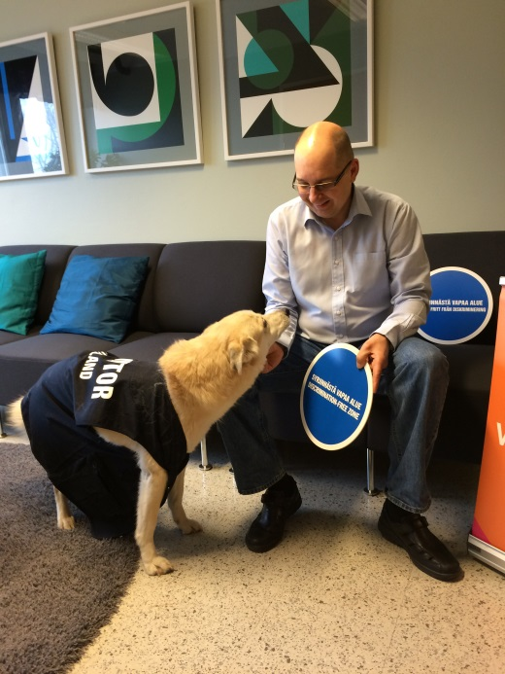
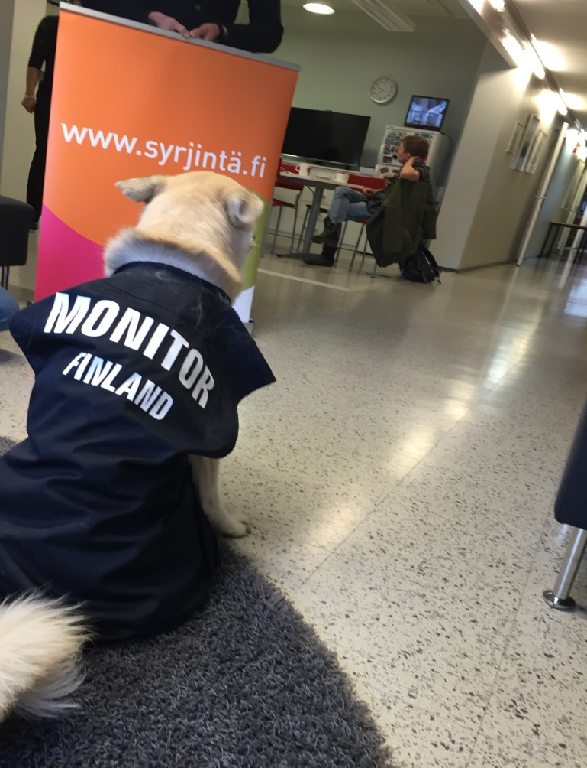
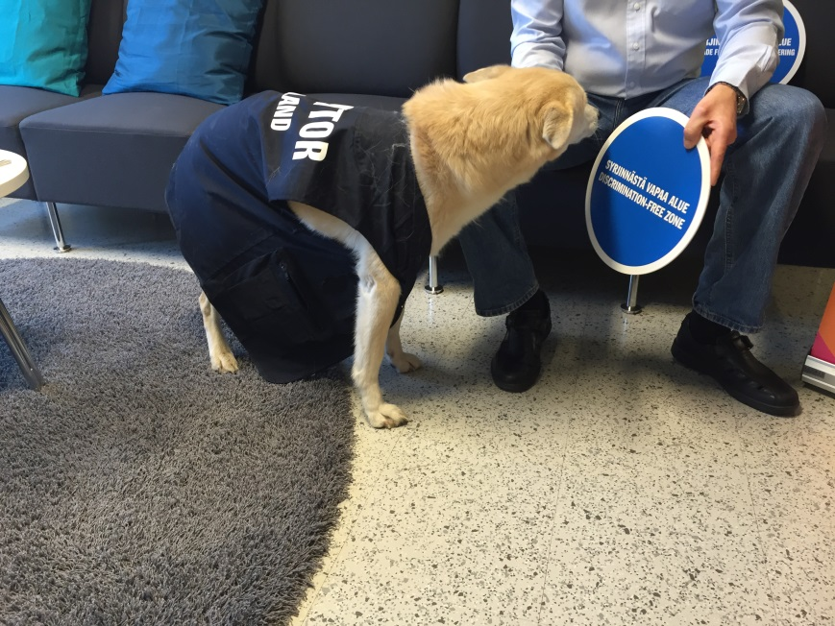
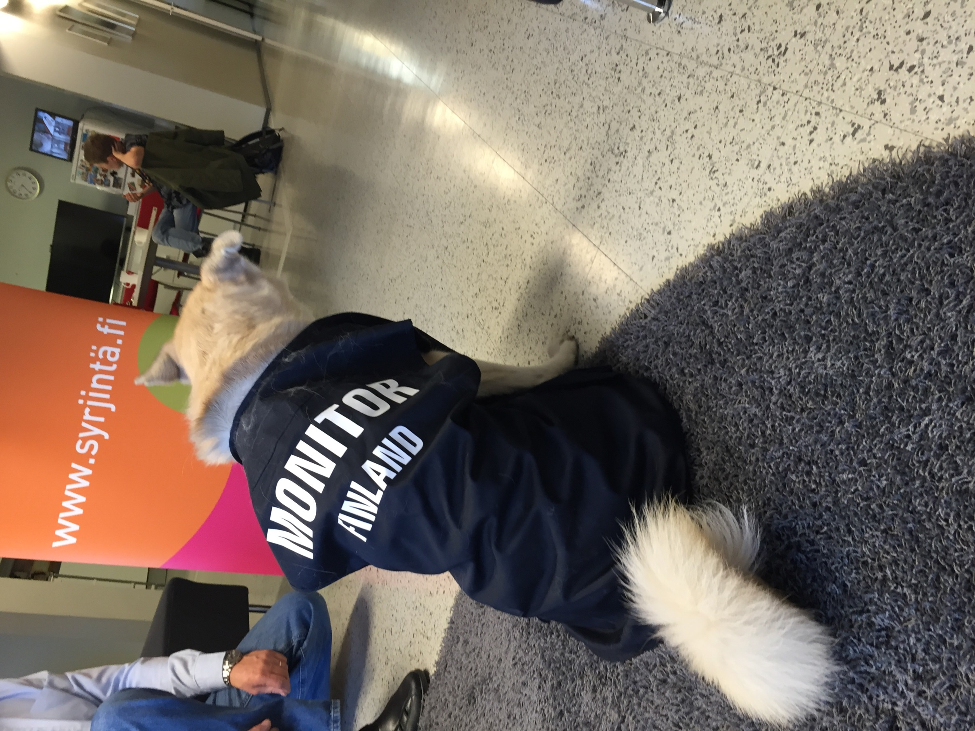
Notes:
So we invented Disse the discrimination dog.
Our Colleague Rainer brings his dog to the office now and then so finding a dog was no problem
We took picutures and wrote captures telling a story about Disse the discrimination dog who has his fisrt working day at the office today, april the first.

Slide 4
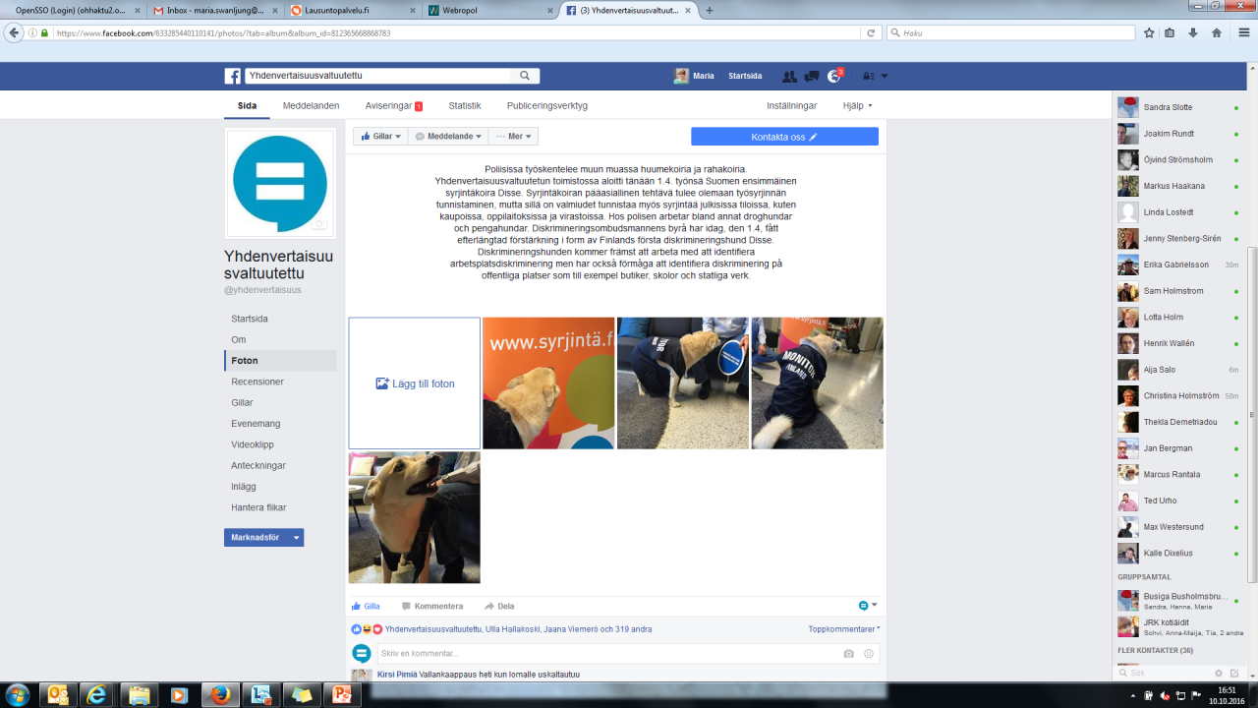
Notes:
The post was made as a photo album and every caption had its own story. I cant translate the posts to English very well but the were acutally quite funny. We compared him to police drug dogs and the main point was that he could tell if there was discrimination on the work place or if a person was discriminating others.

Slide 5
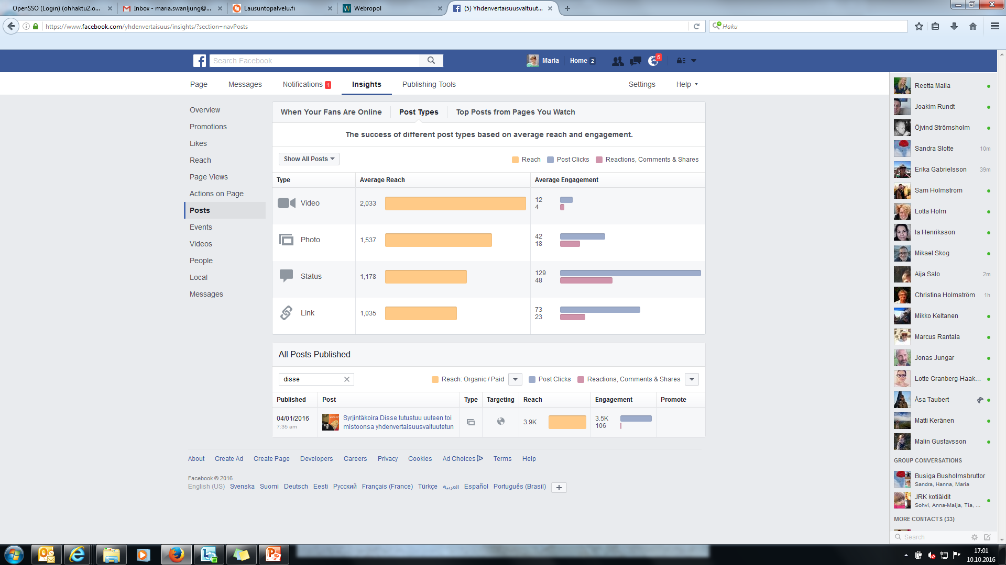
Notes:
The post was a success. We got more likes than ever and also many many more liked not only the post but started to like our Facebook page → this is why i think it was such a good idea. We use humour to get more fans to the page and then when we have something serious to say we reach out to more people.
As we are a quite new authority, at that time only a little bit over one year old, it is extremly important for us to just get our name known to the public. I think this was helpful. This post also made us easier to reach and more human.

Slide 6
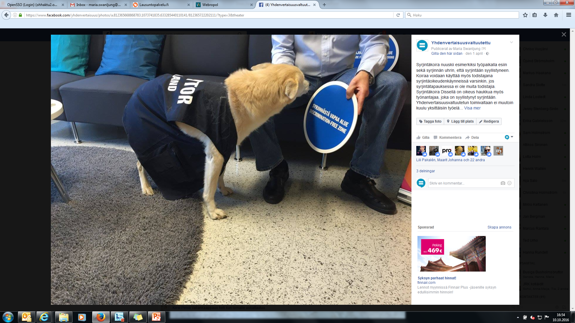
Notes:
The same day both the finnish police and out tax authorty posted their own april fools day posts and we got no critisism what so ever so the fear that a humor post might damage the reputation of the ombudsmans office did not happen.
I think that th success story of this post was:
Humour. We also made fun of ourselves by writing really byrocratic explanations about the dog and made many of ouw stakeholderes day, especially NGO:s loved our post.
Using an animal. Cheap trick.
Using april fools day – people and traditional media make lists of the bests pranks etc and we got on a few of them.
Using a photo album → more visibility from Facebook.

