Slide 1
Innovating at the Intersections Equality bodies tackling intersectional discrimination
By
Niall Crowley

Slide 2
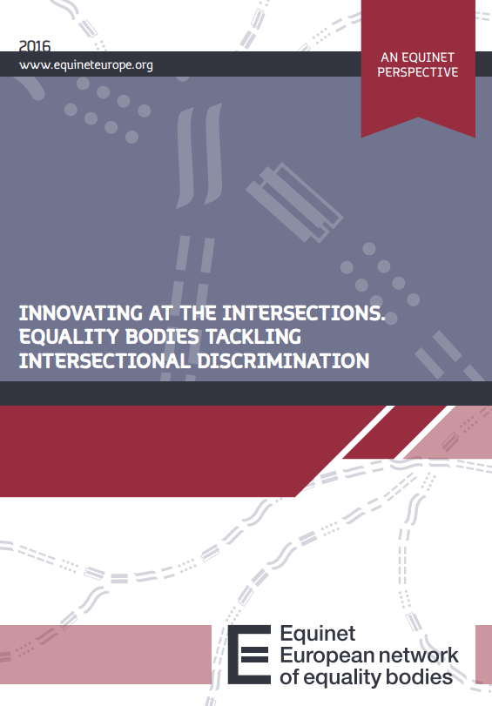
Intersectionality
Recent and underdeveloped in theory, policy and practice
Potential
Challenge norms
Stimulate innovation
Equality bodies providing leadership

Slide 3
Strands of Action
Multiple Discrimination – Discrimination on a combination of grounds
Multiple Identity – intersectional groups of people
Intersectionality – structures of power and exclusion

Slide 4
Equality Bodies Being Systematic
Affording prominence to intersectionality
Developing shared foundations for work on intersectionality
Seeking a legal basis for intersectionality

Slide 5
Equality Bodies Making it Visible
Research initiatives predominate in the work of equality bodies
Policy work
Data development

Slide 6
Equality Bodies Enforcement & Promotion
Promotion
- Limited evidence of initiative
Enforcement
- Significant casework
Internal case management processes
Issues of legal provision, finding a comparator

Slide 7
Equality Bodies Communicating
Initiatives to address under-reporting
Limited evidence of action on building public awareness
Engaging with civil society

Slide 8
Gender Intersections Leading the Way
Labour market settings
Education settings
Access to justice settings
Gender equality planning settings

Slide 9
Enabling Action
Enablers
- Potential of intersectionality
Barriers
Complexity
Legal provisions
Internal

Slide 10
Intersectionality
Towards a new generation of equality legislation
Potential
Focus on systemic discrimination
Reinterpret understanding of the grounds of discrimination
Open up new definitions of discrimination

