Slide 1
Informing policy makers: the work of the German equality body
496233948
Nathalie Schlenzka
Deputy Head, Research Unit, Federal Anti-Discrimination Agency (FADA), Germany
Equinet Conference: Diverse, Inclusive and Equal: Innovating at the intersections of gender equality, 7th December 2016, Brussels.

Slide 2
Agenda
    How can intersections of gender (in-)equality become an issue discussed in public?
    1.1. Report to the German Bundestag (Parliament)
    1.2. FADA Theme Years
    1.3. BIM-Study 2015: Experiences of Discrimination in Germany
    2. Recommendations and Demands

Slide 3
How can intersections of gender (in-) equality become an issue discussed in public?
Three implementation examples from FADA Germany

Slide 4
1.1. Report to the German Bundestag (Parliament)
2010 First Joint Report of FADA and the competent Commissioners of the Federal Government and the German Bundestag affected in their individual fields of responsibility.
Topic: Multidimensional Discrimination
Base: two research reports on multiple discrimination 2010
Aim: to develop a particular and strategic approach to inform policy makers and the general public on issues of multiple discrimination and what responses are required.
Contents:
    definition on multidimensional and intersectional discrimination;
    Legal aspects of multidimensional discrimination;
    Complaints concerning multidimensional discrimination;
    Recommendations and demands
Notes:
Research Reports: (“terms, theories and legal analysis” & “empirical analysis using auto-biographical narrative interviews”)
The first report sought to establish an understanding of the topic from a theoretical and legal perspective.
The second report sought to understand the experiences of multiple discrimination.
What is the report about?
what happens when discrimination is based on the interaction of various, discrete discrimination grounds? It is rare that discrimination is based exclusively on a single discrimination ground.
The Federal Anti-Discrimination Agency addresses a subject of topical interest, both from a political and a scientific point of view, and one which is exceedingly important for anti-discrimination work.
What does the report offer?
what does it mean for persons who experience discrimination if they are discriminated against, not only because of their gender or their disability, but precisely because of their gender and their disability?
Is it possible to identify certain combinations of grounds of discrimination to which discrimination is especially frequently attached?
What possibilities exist for defending oneself in the face of such discrimination?
What challenges does this pose for counselling work and the dispute before the courts in such cases?
Complaints received by FADA: 5 to 7 percent concern multidimensional discriminiation, e.g. club/disco cases, women with headscarfes
Concept: Through the focus on multidimensional discriminiation the living reality of persons confronted with discriminiation can be understood better, more then the addition of grounds
Legal backrground: § 4 General Equal Treatment Act refers to multidimensional discriminiation

Slide 5
1.1. Report to the German Bundestag (Parliament)
Extract of Recommendations and Approaches
Awareness Raising: Campaigns, information for general public and victims of discrimination on multidimensional discrimination → training of lawyers and judges;
Improvement of data on multidimensional discrimination: Research, systematic data collection of anti-discrimination advice centers;
Changes in antidiscrimination counseling: cooperation of different counseling bodies (e.g. for women and persons with disabilities), establishment of horizontal networks, qualification of staff in anti-discrimination advice centers.
Consequences
Limited : Presentation at the German committee for family, seniors, women and youth, but not at the Bundestag plenary session.
→ Stir in the scientific community;
→ New activities by FADA.
Notes:
1 ) In the context of multidimensional discrimination Gender is the category with most public attention – this also applies on women with disability. Already since the 90ies they organized themselves in networks, formulated and implemented their demands in science and politics.
The representation of interest of women with disability have shown that political measures regarding disabled people must never occur without attention on the aspect of Gender!
Gender-specific Nursing
Problems in Realizing the wish on same-sex nursing -> wish due to close personal and physical contact between nurse and the person in need of care. Lack of legal right to protect disabled people/women from sexual abuse!
Demand: to anchor a legal right for same-sex nursing
Equal access to education and work
Strong discrimination on the labor-market, even though the training and employment quote increased.
i.e.. regarding choice of profession: young disabled women – recommended traineeship in office or employment in domestic work area
2) Multidimensional Discrimination: Migration background, Gender, Religion
Wearing a headscarf in Public School
Tension between the fundamental right of religious freedom, governmental educational mission, adult right of education and the negative freedom of religion of students.
Decision of the Federal Constitutional Court: Denying to wear a headscarf in school violates the right of religious freedom! Consequence: 8 German federal states established new basic rights in their school laws which prohibit teachers to visually wear symbols of religion (Principle of neutrality). → primacy of occidental religious symbols
Consequences
Limited, due to its scientific Design → A Presentation was therefore only made at the Committee for family, seniors, women and youth BUT it received great attention in the scientific community!
Hence: There is a need to visualize more concretely intersectionality based on cross-section-characteristics. And the FADA Theme Years represent one measure of doing so.

Slide 6
1.2. FADA Theme Years
Awareness Raising on intersectional discrimination
Theme Year | Examples
2012 Age | Symposium about multidimensional age discrimination
2013 Disability and Chronical Disease | Expertise about labour market access for people with disability and chronical disease – Intersections with Gender
2014 Ethnical Origin | Racial discrimination in the housing market (Gender, Religion, Ethnicity)
2015 Gender | Gender Commission of Experts
2016 Religion and Ideology | Expert Talk „Women with headscarf on the German labour market“ (Gender/Religion)
2017 Sexual Identity | Project „Experiences of discrimination due to sexual orientation with emphasize on multidimensional and intersectional discrimination“
Consequence: higher sensibility in the scientific community, at the political level and in the civil society about specific characteristics and intersectionality!
Notes:
One aim of the theme years was to raise awareness on the issue of intersectional discrimination, with relation to the main discrimination dimension the year focused on
Since 2012 FADA focuses every year on one discrimination-attribute of the AGG (General Equal Treatment Act). With several Actions like symposiums, action week etc. FADA tries to scientifically connect expertise.
Theme years include symposium, action week, commission of experts in order to develop guidelines of action and approaches to dismantle*-Discrimination in Germany, Research, Fact sheets with basic explanations and introduction to the discrimination-attribute, Price of Inclusion (2013), Workshops at schools (2013), …
E.g. Recommendations of the commission of experts in 2012 (Age): dismantling age limit for honorary office and the limits of supplementary income for persons in premature pension.
Examples:
2012: More than 100 experts discussed questions about age discrimination in the labour market and every day life, multidimensional discrimination and non-discriminatory access to health, care and social services.
2013: Idea to discuss and present the topic access and participation of people with disability or chronical disease in the labour market to employers, public and persons concerned, which on the one side not only takes into account „classical“ ways of diabilities, and which also focuses on other discrimination characteristics in the sense of intersectionality.
Socio-psychological, structural and institutional barriers
2014:Within 8 years FADA received more than 260 requests on counselling due to discrimination on the housing market. The majority of these cases applied to persons with migration background. With these facts in theme year 2014 FADA carried out a Testing-Study on the housing market. One aim was to encourage scientific actors in conducting Testing-studies and to deliver certain instructions for its implementation. Besides this the study received great sociopolitical relevance by representing a well-founded base of knowledge about discrimination on the housing market for political actors, civil society and the housing economy. For tenants and counselling centers a guideline has been created.
2015: The commission’s instruction was to develop recommendations for action to areas especially for those who lack public attention. The focus has been therefore on risks of discrimination at the work place – especially sexual harassment, the labour market access situation of trans* and inter*persons and the deprivation of women in irregular employment and low wage groups.
2016: The prohibition of headscarfs on the working place occupied the German law many times. The Expert talk gave an overview of its illegality and practice and deduced conclusions and recommendations for actions. The refusal of headscarfs by employers is in many cases socially accepted and also the juridical support for women is often not sufficient. Recommendations for actions are hence for example the modification of the Berlin law of neutrality and the development and expansion of specific consultation and support offers.
2017: Current evaluation of the BIM study 2015 and additional qualitative evaluation of anonymous FADA complaints and focus groups – results will be part of the third Joint Report of FADA and the competent Commissioners of the Federal Government and the German Bundestag affected in their individual fields of responsibility.
Consequence: higher sensibility in the scientific community, at the political level and in the civil society about specific characteristics and intersectionality! → Nevertheless is there a lack of Data!

Slide 7
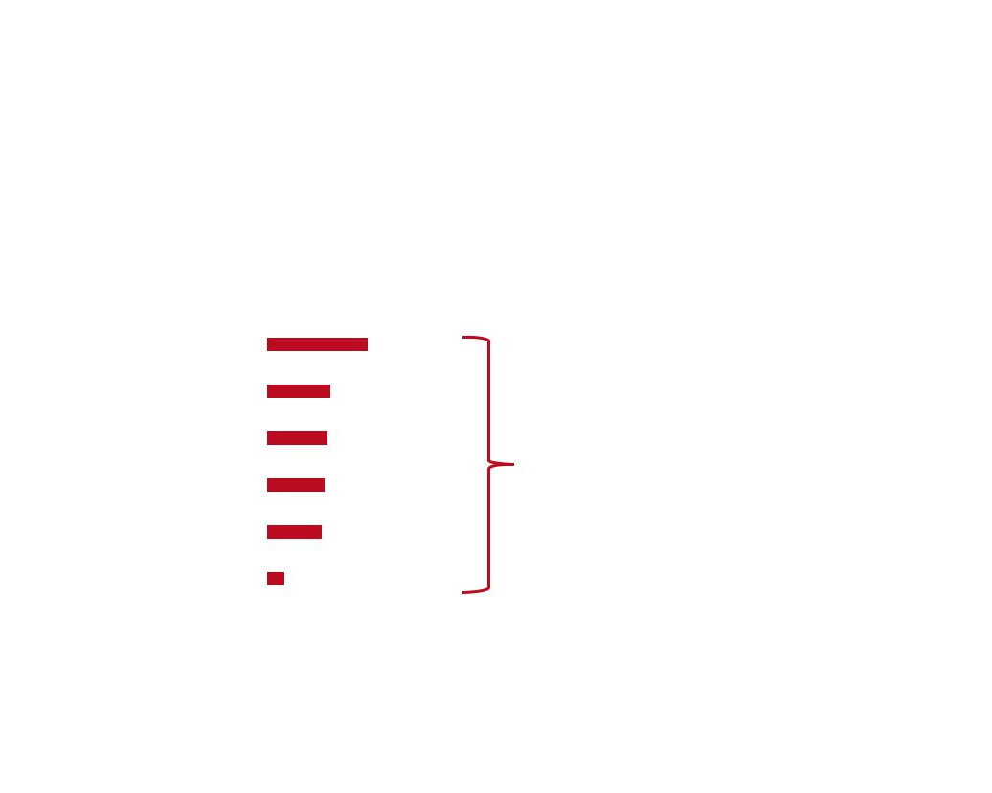

1.3. BIM-Study 2015: Experiences of Discrimination in Germany
Graphic: Population in Germany aged 14 and above (N=992) / given as a percentage
Representative Study: All discrimination experiences in the last 24 month / Target: Random sample from the total population / Interviews in Total CATI: 1,007 (weighted: 992)
Notes:
Recommendation to collect more data: Survey on discrimination in Germany
To date, detailed data on discrimination experiences have been lacking in Germany. The complaints which are submitted to the Federal Anti-Discrimination Agency (ADS) and court judgements only pro-vide an inadequate insight.
The central aim of the "Discrimination in Germany" project is to make discrimination experiences and their consequences comprehensively visible.
The representative survey (992 weighted Interviews) allows statements to be made about how widespread discrimination experiences are in Germany with regard to the total population.
It covers discrimination on the basis of all the characteristics listed in the General Equal Treatment Act (AGG) and, in addition, socio-economic circumstances. Moreover, all areas of life are basically to be considered in the study: from nursery school through school and college to working life; from accommodation through insurance and banking to leisure areas. In addition, questions were asked about the effects of discrimination on the people affected and their strategies for dealing with these experiences.
Graphik
Nearly a tenth of the respondents in each case reported experiencing discrimination due to one of the other reasons for protection defined in the AGG, i.e. on the basis of gender or gender identity (9.2 per cent), religion or world view (8.8 per cent), for racist reasons or on the basis of ethnic origin (8.4 per cent) or due to a disability or impairment (7.9 per cent). The proportion of those who experienced discrimination on the basis of sexual orientation was far lower, at just 2.4 per cent. It should be remembered at this point that these values relate to the total population.
Particular groups amongst whom it can be assumed that they are at particular risk of discrimination, only account in terms of figures for a small section of the population and thus also of the random sample in the representative survey. This applies, for example, for homosexual or bisexual people and also for people who belong to a non-Christian religious community, migrants or people with a disability.

Slide 8
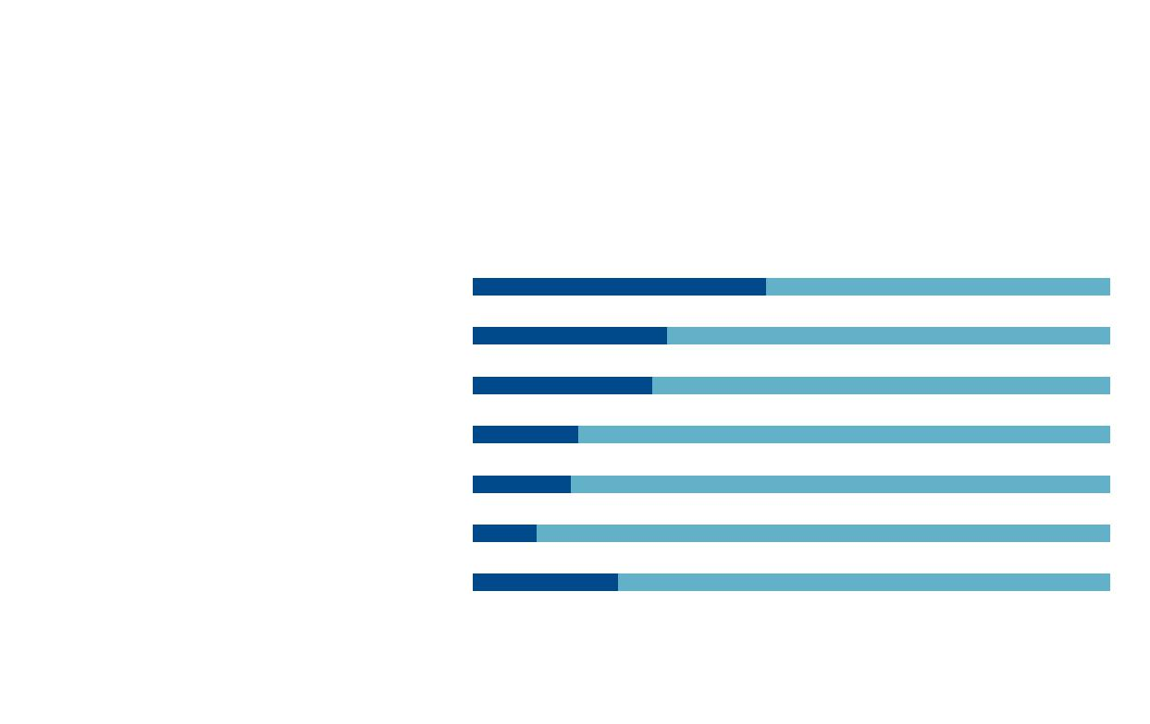

1.3. BIM-Study 2015: Experiences of Discrimination in Germany
Graphic: Population in Germany aged 14 and above (15,814 discrimination experiences from 12,449 respondents) / given as a percentage
Survey of People affected: 1-2 specific discrimination experience(s) in the last 24 month / Target: People who have experiences or observed discrimination / Interviews in Total CAWI/PAPI: 18,162
Notes:
the survey of people affected (18,192 Interviews) helps to understand the diversity of discrimination and provides a deeper insight into specific discrimination situations
Graphic
On the basis of the survey of people affected, it is possible to examine this interplay of different discrimination characteristics. Gender, or gender identity, plays a particularly important role in discrimination that occurs on the basis of several characteristics. The Graph shows a breakdown by characteristics of the proportion of discrimination experiences in which the gender or gender identity of the people questioned was decisive in addition to these characteristics. So in the view of the participants, gender or gender identity played an important part in almost half of the described instances of age discrimination, with discrimination due to socio-economic circumstances this figure is over 30 per cent and for sexual orientation it is 28.2 per cent.
Gender or gender identity thus forms a central cross-cutting category in discrimination experiences.

Slide 9
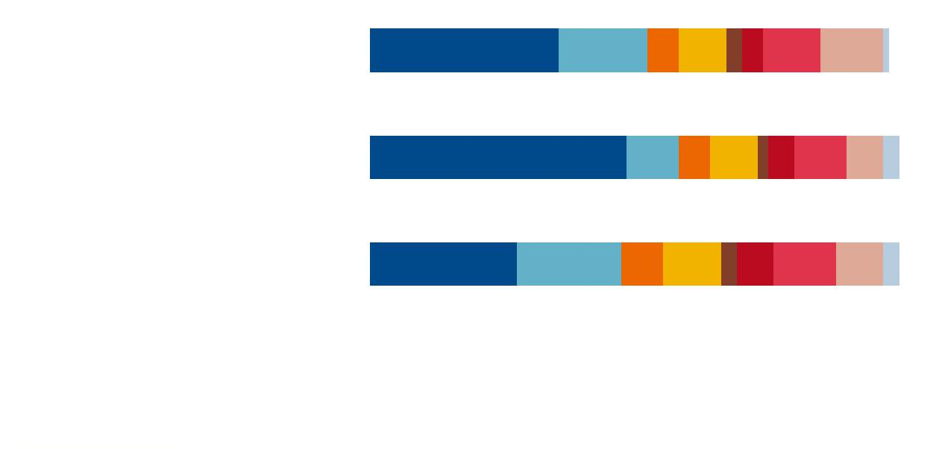

1.3. BIM-Study 2015: Experiences of Discrimination in Germany
Intersectional Discrimination due to age and gender
2,9
2,8
Source: Survey of people affected / Basis: 13,345 discrimination experiences from 10,373 respondents / given as a percentage
Notes:
Discrimination experiences due to both gender or gender identity and age occur particularly at work. There are also large numbers of people for whom the described discrimination experiences are based on both characteristics at the same time; this is reported predominantly by women. A distinction must, however, be made with these experiences as to whether the people affected were perceived to be too young or too old. In both cases, marginalisation at the workplace and a poorer evaluation of their own achievements are very frequent forms of discrimination. But particularly with people who are perceived as being too old, a further form of discrimination is added: they are denied access, they are not taken on or cannot rise any further within the hierarchy, for example, if a person is refused promotion because of their age.

Slide 10
Recommendations and Demands

Slide 11
2. Recommendations and Demands
The clear result is that multi-dimensional discrimination can be observed and pursued only with diverse instruments and strategies.
To pursue the policy assignment we need:
- more data and research;
- more public relations activities;
- more training for staff working on complaints and supporting victims of discrimination.
More data on European- and Nation-State-Level is needed!
Equality-Bodies: collecting more data about multidimensional complaints (surveys, own data)
Official Statistics which break down discrimination on its characteristics (e.g. Federal Statistical Office)
New survey instruments with the ability to capture multidimensional discrimination (e.g. Eurobarometer, Fundamental Right Barometer)
Notes:
Dealing with multi-dimensional discrimination is the responsibility of society as a whole. Furthermore, raising the awareness of society as a whole re-quires a number of elements. These include: data collection, research and measures in the practical operation of counselling services and the courts, as well as (further) training.

Slide 12
Thank you for your attention !
Federal Anti-Discrimination Agency, Germany
Glinkastraße 24
10117Berlin
Nathalie Schlenzka
Tel. +49 3018 555 1813
E-Mail: Nathalie.Schlenzka@ads.bund.de
Head Office
Tel. +49 3018 555 1855
E-Mail: poststelle@ads.bund.de
www.antidiskriminierungsstelle.de
Notes:
Die Antidiskriminierungsstelle des Bundes würde sich daher wünschen, dass Politik, Verwaltung, Akteure im Bildungsbereich und in der Zivilgesellschaft das Positionspapier von BeNeDiSK unterstützen, so dass möglichst bald die Grundlage für eine solche unabhängige Informations- und Beschwerdestelle geschaffen werden kann und wir bald nicht mehr darüber reden müssen, wohin sich Kinder, Eltern, Lehrende und andere Akteure im Bereich Kita und Schule wenden können, wenn sie Diskriminierung erfahren und wirkungsvoll dagegen vorgehen wollen.

