Slide 1

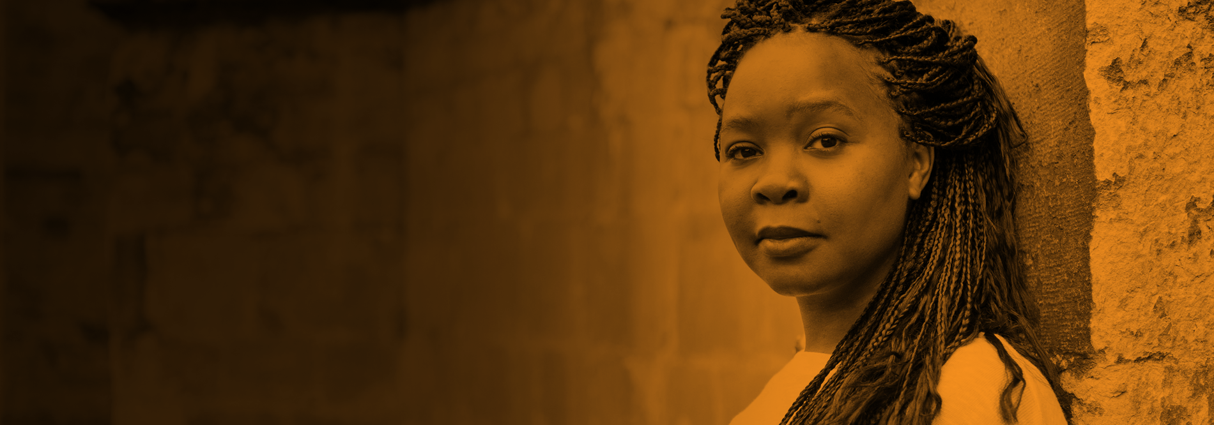
Fighting Discrimination on the Basis of Race and Ethnic Origin
Workshop media
UNIA – Imane El Morabet
Budapest 9 November 2016

Slide 2

Introduction
Objective of workshop
Examples of Belgian cases
Discussion
Notes:
Interfederaal (Samenwerkingsakkoord 12/06/2013 tussen federale overheid, gemeenschappen en gewesten)
Lokale contactpunten!

Slide 3
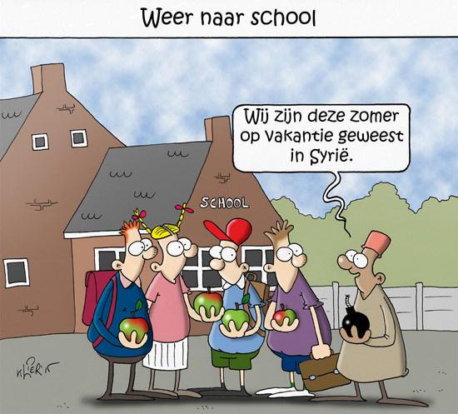
Examples

Slide 4
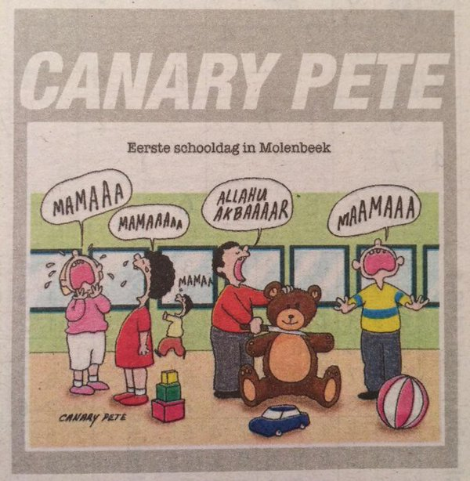
Examples

Slide 5
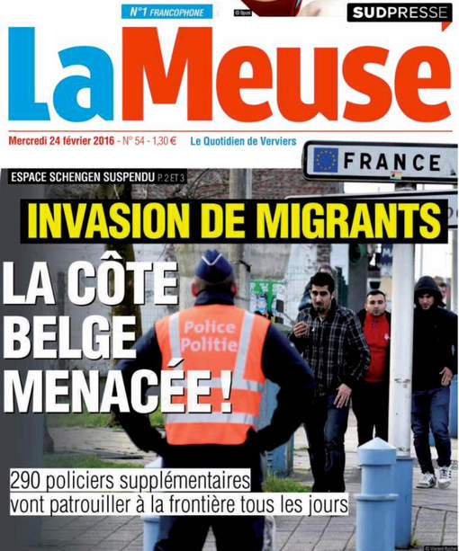
Examples

Slide 6
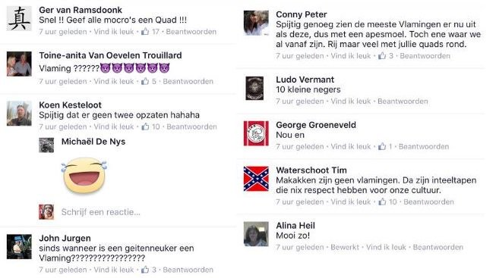
Examples
Racist reactions after young man dies on quad
.

Slide 7
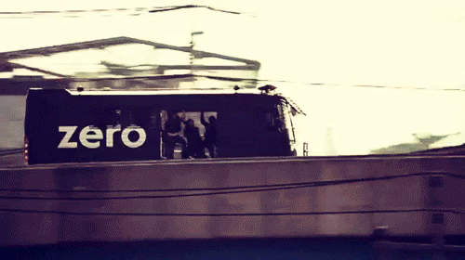
Examples
.

Slide 8
Responsabilities of the media
Avoid stereotyping which can contribute to discrimination, racism, xenophobia and other forms of intolerance in society, including anti-Semitism, Islamophobia and Romanophobia;
Responsibility to adopt its own codes of conduct and ethics;
Effective complaints procedures to investigate complaints about intolerant, racist or xenophobic attitudes in the media are required.

Slide 9
Discussion
How would you deal with these cases in your own country?
Other examples?
The best ways to react? Counterspeech?
Best pratices?
Recommendations?

Slide 10


