Slide 1
CHALLENGES FOR EQUALITY IN EUROPE Evelyn Collins Chair of Equinet & Chief Executive of the Equality Commission for Northern Ireland

Slide 2
European Equal Treatment Law and “shared values”
Article 19
1. Without prejudice to the other provisions of the Treaties and within the limits of the powers conferred by them upon the Union, the Council, acting unanimously in accordance with a special legislative procedure and after obtaining the consent of the European Parliament, may take appropriate action to combat discrimination based on sex, racial or ethnic origin, religion or belief, disability, age or sexual orientation.
Treaty on the Functioning of the European Union

Slide 3
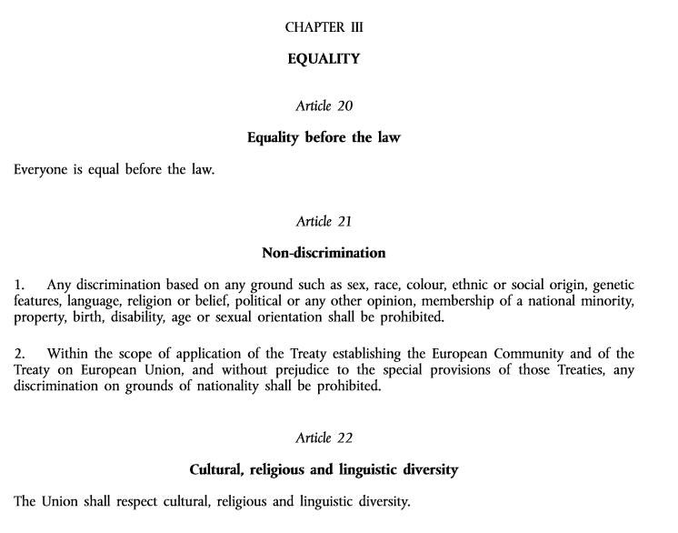
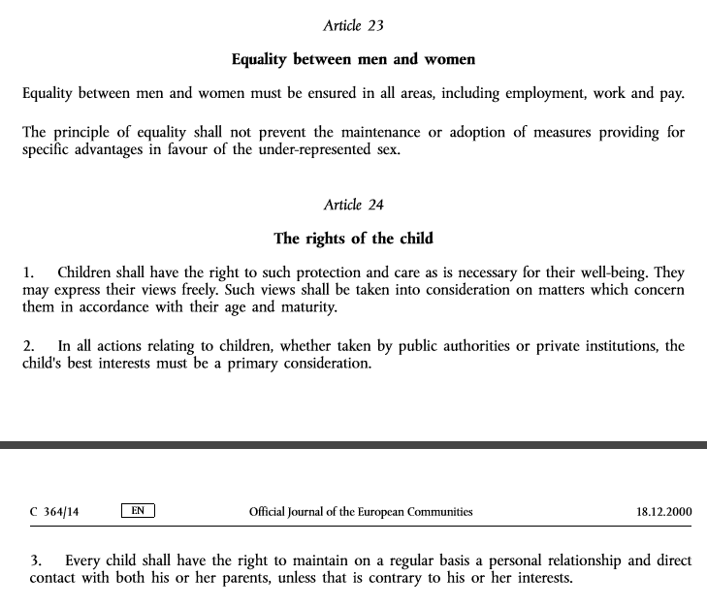
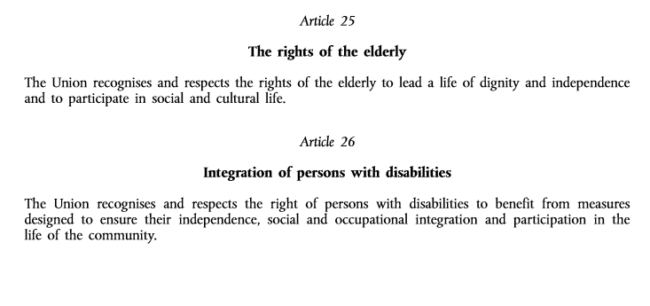
European Equal Treatment Law and “shared values”
Charter of Fundamental Rights of the European Union

Slide 4
European Equal Treatment Directives
2000/43/EC ‘Race’ Directive
2000/78/EC Employment Equality Directive (Religion or belief, disability, age or sexual orientation)
2004/113/EC Gender Goods and Services Directive
2006/54/EC Gender ‘Recast’ Directive (employment)
Other relevant Directives
79/7/EEC Social Security Directive
92/85EEC Pregnant Workers Directive
2004/38/EC Freedom of Movement Directive
2010/18/EU Paternal Leave Directive
Notes:
Functions for Equality Bodies laid in relevant EC Directives:
Independent assistance to victims of discrimination
Independent surveys and reports concerning discrimination
Recommendations on discrimination issues
Exchange of information with European bodies

Slide 5
Gaps in the European Equal Treatment Legislation
Protection gap for persons irrespective of religion or belief, disability, age or sexual orientation outside the labour market
Inadequate protection for parents and carers
The field of media is not covered by any of the Equal Treatment Directives
The field of education is only covered in the ‘Race’ Directive (although vocational training is covered by the ‘Recast’ Directive)
Notes:
The first two gaps would be addressed by the Horizontal Directive and the new WLB package (hopefully) – these are addressed on the next slide.
If the Horizontal Directive goes through, then only protection on the ground of gender would be left out of the field of education.
Media remains unregulated in this context; cannot see any initiatives to tackle that.

Slide 6
European Policy Framework for Equal Treatment
European Commission’s Strategic Engagement for Gender Equality
European Commission Disability Strategy
List of Actions by the European Commission to Advance LGBTI equality
National Roma Integration Strategies
European Agenda for Migration
Notes:
The Gender Strategic Engagement (non-strategy) (2016-2019) covers five priority areas: economic independence and increasing labor market participation, reducing gender pay and pension gap (very important for the Commissioner); equal representation in decision-making; combatting gender based violence (including trafficking in human beings); and promoting gender equality and women’s rights in the world (EEAS external dimension).
The Disability Strategy (2010-2020) is undergoing its midterm review this year. It focuses on accessibility; participation; equality; employment; education and training; social protection; health; and external action, including ensuring implementation of the UNCRPD. The Commission has a 2014 implementation report of the UNCRPD.
The LGBTI List of Actions focuses on improving LGBTI rights; protecting existing rights; fostering diversity and reaching citizens; support actors responsible for promoting LGBTI rights; data collection and research to support policy making; external action and LGBTI rights in enlargement, neighborhood policy and third countries.
The Roma Framework Strategy of the Commission underwent its midterm review, and the EC document on this topic was published in June 2016. Conclusion: strategies all in place now (all but Malta have one, because there are no Roma in Malta), but implementation is the challenge now. (Where is the money?)
The European Commission has proposed distributing refugees equitably between member states; a harmonized procedure for international protection at EU level (with common list of safe third countries); a revised proposal for “smart border protection”; financing of search and rescue initiatives; combatting smuggling of persons; and has set up a fund for migration and integration launched in 2014. For a focus on refugee/migrant women: the Advisory Committee on Equal Opportunities for Women and Men will publish an opinion on the situation of refugee women in November this year. The European Parliament, together with civil society (ENAR and EWL), have also had a particular focus on the situation of migrant and refugee women through hearings and an exhibition.

Slide 7
Current European Initiatives for Equal Treatment
Legislative initiatives
Horizontal Directive (plug protection gap for persons irrespective of religion or belief, disability, age or sexual orientation outside the labour market.)
Women on Boards Directive
New Start Initiative for Work-Life Balance (Replacing the Maternity Leave Directive, will include legislative element)
Accessibility Act (following on from EU obligations stemming from accession to the UNCRPD)
Accession to the Istanbul Convention
Notes:
Maltese Presidency at the beginning of 2017 have put the Horizontal Directive and the Women on Boards Directive on their agenda.
Social partners or the Commission will have to make the legislative proposal on the WLB package by the end of this year
Hopeful that negotiations on accession to the Istanbul Convention can be split into two (one dealing only with signing, and the other tackling issues of subsidiarity), thereby expediting the signature.

Slide 8
Current European Initiatives for Equal Treatment
Policy initiatives
LGBTI awareness-raising campaign
European Roma platform addressing youth discrimination and setting up of national Roma platforms
European Commission recommendation on pay transparency
Year of Action in 2017 to combat Violence Against Women
EU Diversity Charter
EC High-level groups on: Racism, Xenophobia, and Other Forms of Intolerance; Non-Discrimination, Equality and Diversity; Gender Mainstreaming
European Pillar of Social Rights
Notes:
LGBTI campaign launched August 2016 (during everyone’s summer holidays…) Commissioner Jourova also on European Commission’s float on Amsterdam pride.
Next European Roma platform meeting in November, national platforms in the process of being set up. They are financed by the European Commission, but member states had to apply for funds to set one up. 15 member states applied.
The Implementation report for the recommendation on equal pay is coming out at the end of 2016. Depending on the evaluation, the European Commission may consider a stronger instrument to tackle this question.
Our Maltese member, NCPE, is organizing a conference on VAW on 3 February 2017 in Valletta supported by the Maltese Presidency/European Commission
Next Diversity Charter meeting (18 Oct Dublin) will address “selling diversity in a world of diversion” (suppose that’s about communicating business cases for diversity in a fragmented media landscape/working with several actors)

Slide 9
Challenges for European Initiatives for Equal Treatment
Unanimity vs. qualified majority voting (political climate)
Subsidiarity principle (situation of the EU)
Implementation and impact (role, capacity and potential of Equality Bodies)

Slide 10
www.equineteurope.org
EquinetEurope
@EquinetEurope
EQUINET SECRETARIAT
138 Rue Royale / Koningsstraat
B-1000 Brussels, Belgium
Tel: +32 (0)2 212 3182
info@equineteurope.org
Notes:
Moving on to more information introduced by Anne, about equality bodies in Europe and their cooperation within Equinet as our European Network.
And few Equinet Board colleagues from Equality Bodies in different parts of Europe highlighting their experience to you as practical illustrations to complete our initial input, and keen to further exchange and engage in an open discussion with you then.

