Slide 1


HOW TO
COMMUNICATE & MANAGE
DIFFICULT TOPICS
Ana Tretinjak
Office of the Ombudswoman of Croatia
Dublin, 13.10.2016.

Slide 2


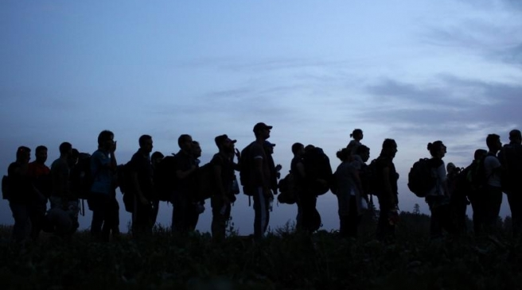
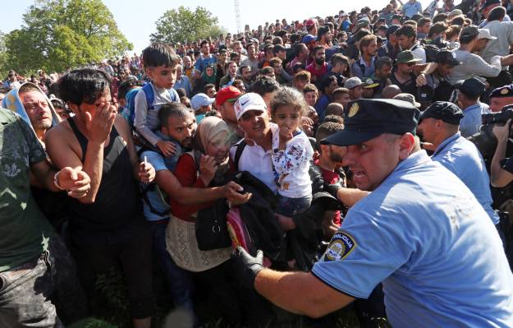
THE BACKGROUND
1 000 – 10 000 refugees per day
555 000 in three months
Mostly positive public discourse
Government - humanitarian approach
GOALS:
Awareness raising
Preventing stereotype-based behaviors
Notes:
Refugee crisis at it’s peak
Hungary closed the borders with Serbia on September 16th
Croatia became a part of the Balkan route
Encouraging and helpful circumstances: positive media messages (sympathetic, factual), humanitarian approach of Croatian government
Atmosphere was positive – but only a matter of time when will it turn around to become negative

Slide 3
STRATEGY
Live – authenticity
MESSAGES:
It could happen to anyone
They are not a threat
STYLE:
Informative, not persuasive
Straightforward, but not aggressive
Simple language
Not pathetic
It’s not about us
DIRECT TARGETS:
Influencers
Media
SECONDARY TARGETS:
Local communities
Volunteers
General public
Notes:
Not planned, spontaneous – gut-led
Ombudswoman put refugee crisis, an extraordinary situation, as one of the Office priorities (important for logistics!)
Most tweets live, as it happens – for authenticity of our communication
Show refugees in the most basic human way
Spread positive messages
Style:
Informative – not telling them what to think and how to feel, only telling it how it is
Straightforward, not aggressive
Simple language
Not pathetic
It’s not about us (no info on where are we heading, what we are doing etc.)
Targets – direct targets are most present on Twitter in Croatia, excellent multipliers outside of the network

Slide 4
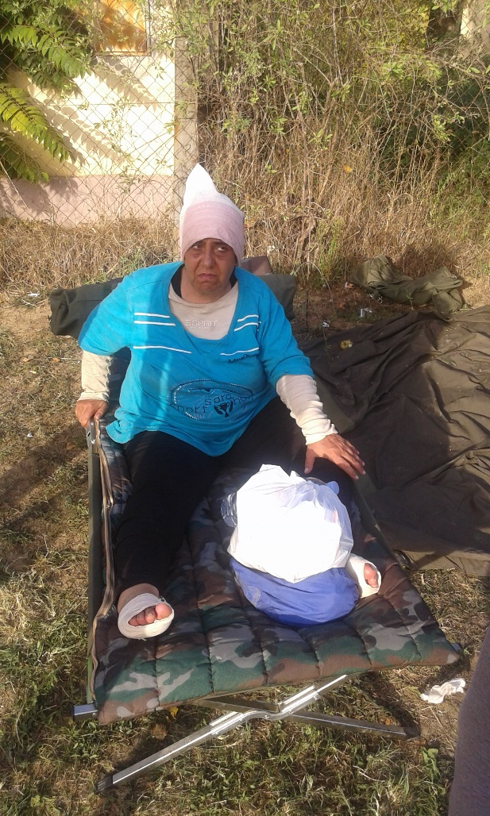
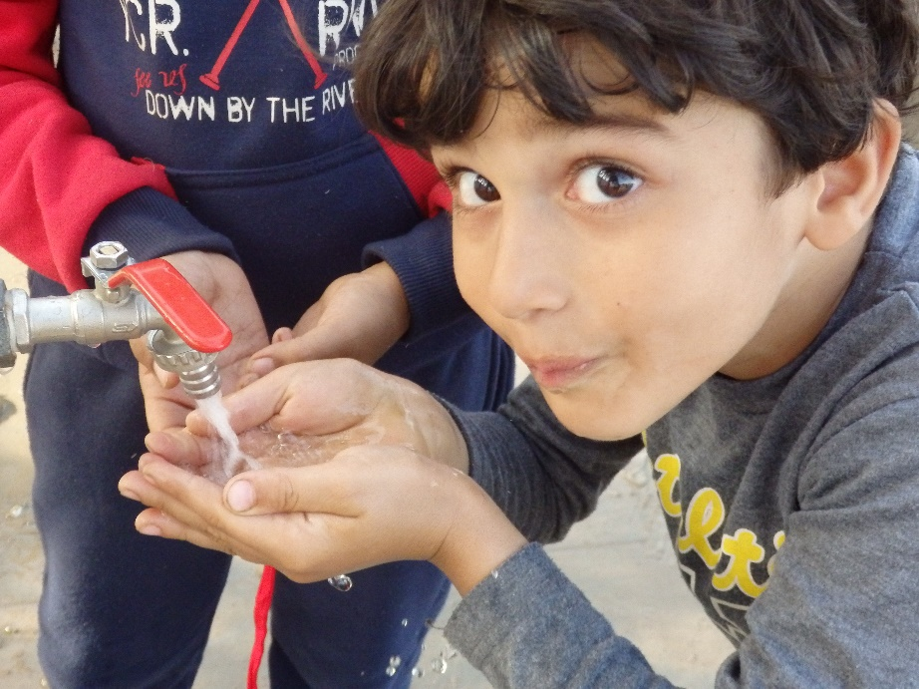
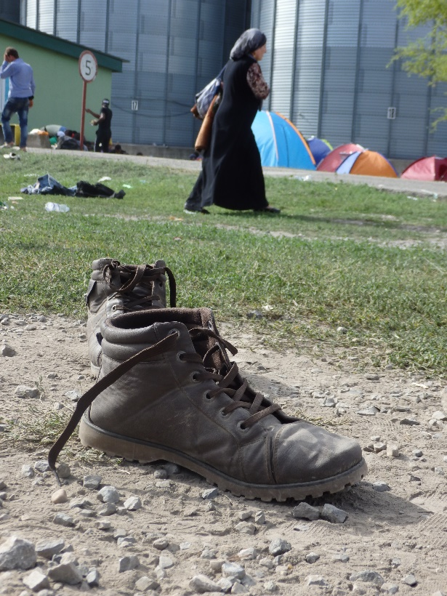
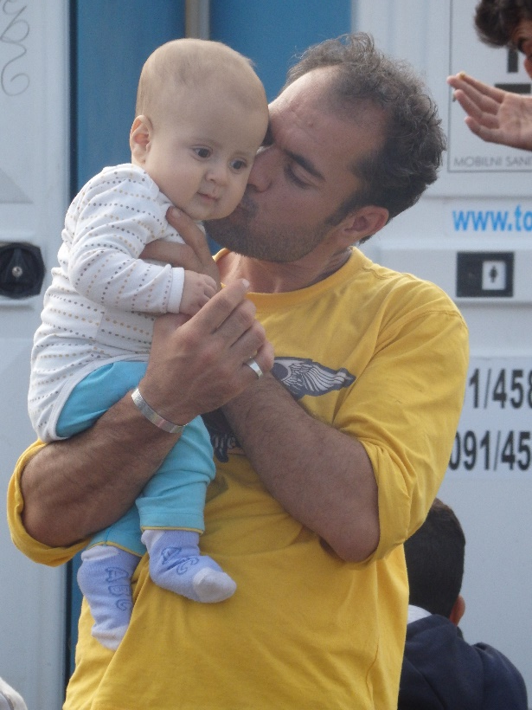
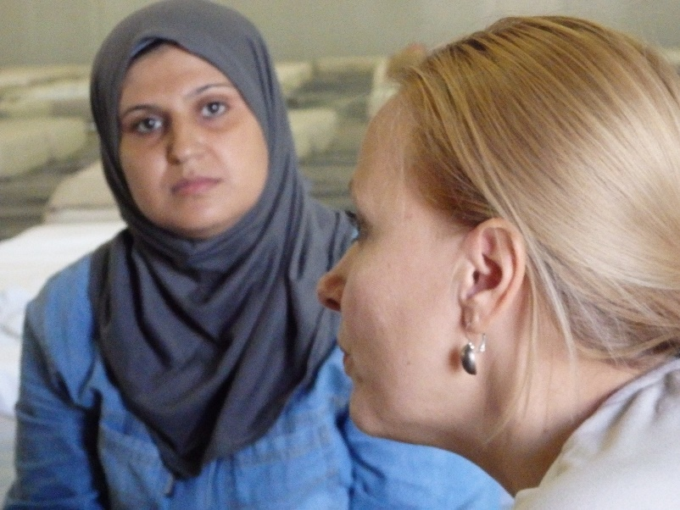

CONTENT
Teams’ info and photos
26 visits, 17 locations
Day and night
+ authorities info, volunteers, police officers
Notes:
Multiple teams from day 1
26 unannounced visits to 17 locations: train stations, camps, border crossings
Talking to refugees, volunteers, observing
Authorities info – looking for translators, a plea to stop spreading false information on the rise of crime among refugees
Twitter only – our only social network channel (lack of staff)

Slide 5
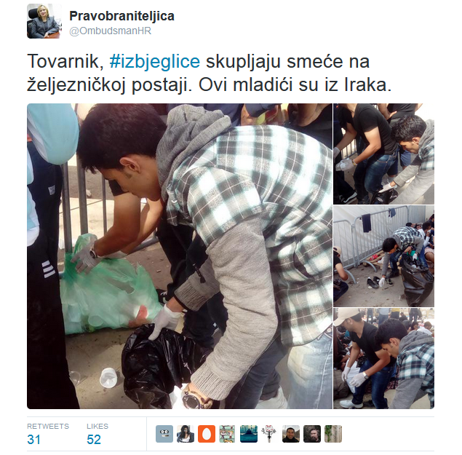
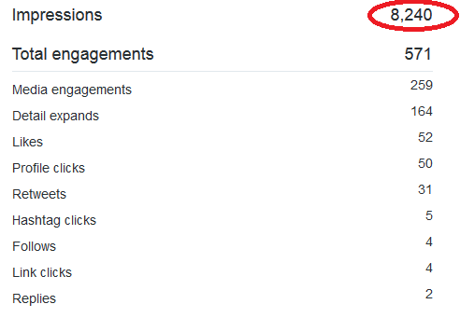
RESULTS
REFUGEES COLECTING GARBAGE AT THE STATION WHILE WAITING FOR THE TRAIN. THESE GUYS ARE FROM IRAQ.
Notes:
Good reach and engagement
At the moment we had less than one thousand followers
There are 50 000 Twitter users in Croatia

Slide 6
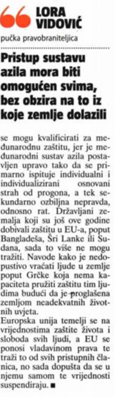
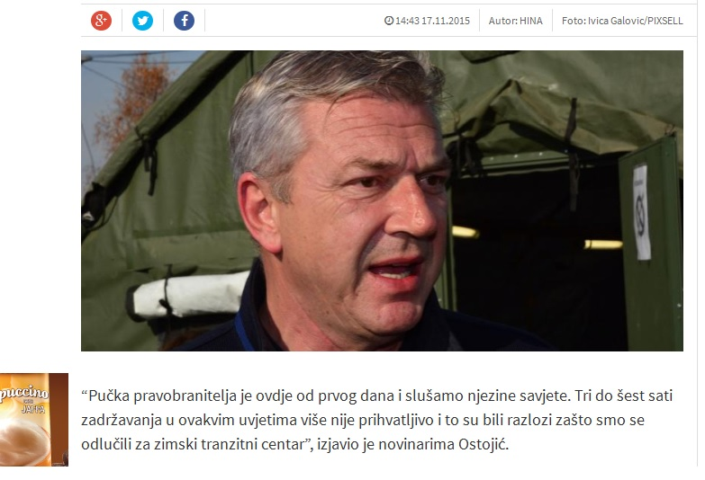
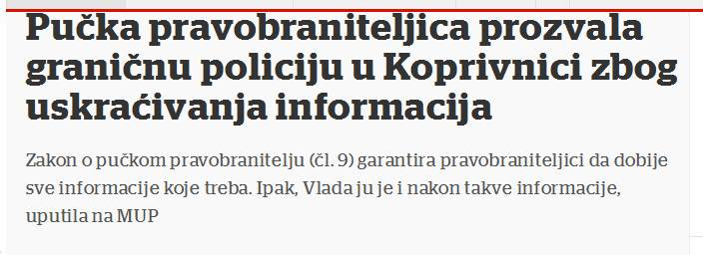
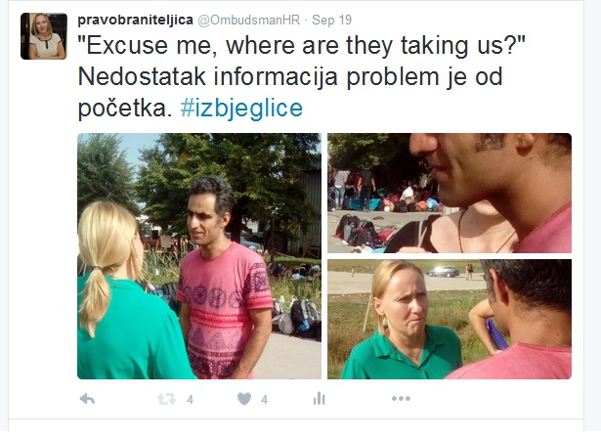
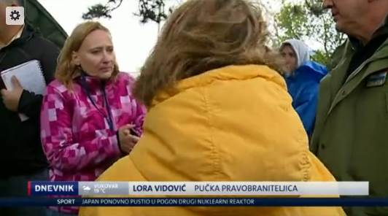
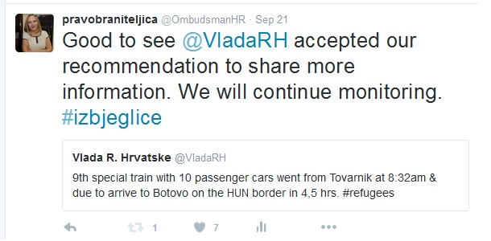
RESULTS
Notes:
Media stories
Publishing what we tweeted
+ retweets by influencers

Slide 7
RISKS
Possible backlash:
“You only worry about refugees”
“Why don’t you visit me”
Thematic profile?
Setting expectations
Self promotion accusations
Notes:
Possible attitude of citizens: why only worry about them, what about Croatian citizens problems? The reason we enhanced the communication of other topics (poverty, elderly etc.) during the refugee crisis
Losing interest and follows of those losing interest in refugees
Expectations – what if we can not keep the tempo in the next emergency situation (floods, etc.)
How long will it last – can we handle it?
Will the same level of activity be expected for other problems from our mandates?
Self promotion – avoided by creating issues, facts and refugees content, not us
None of those fears came true

Slide 8
IMPORTANT ‘BEHIND THE SCENES’ DETAILS
Refugee crisis Office priority
State official on field
Technical operation
Notes:
Decision in the Office level, not Comm team
Ombudswoman approachable, adjustable, always available for checking tweets if necessary
She wore only very basic make up, plain, comfortable clothes
An OK camera will do+a phone with great battery
Don’t forget the refugees rights – do they mind if you take a photo? Ask

Slide 9
QUESTIONS
What more could have been done?
We created a video to summarise our activities, only 2 photos in it were not taken by us – watch it here: https://vimeo.com/148253449
Tweets in English?
Announcements of visits?
More direct communication?
More questions to engage users?

Slide 10



Thank you!
www.ombudsman.hr

