Slide 1

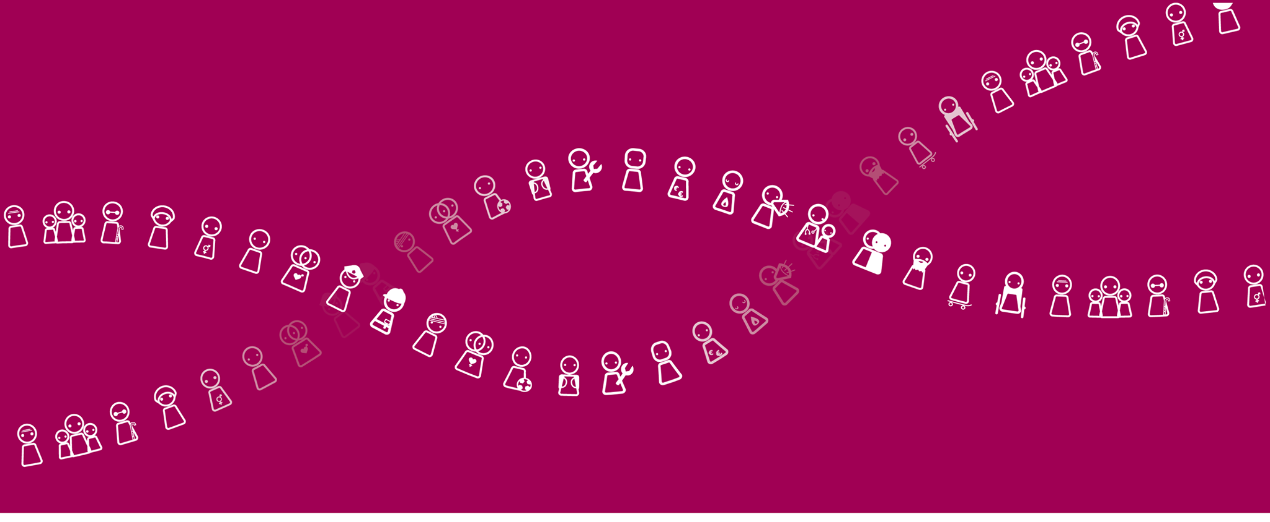
Facebook campaign: HOMOPHOBIA

Slide 2
FacebooK ADS
LIKE ADS:
  To enlarge the group of fans and make sure your message gets heard by a larger community.
  If people become a fan (right before a new campaign), they will see the update from the page organically.
BOOST POST:
  Organically, it’s not possible to reach the entire fanbase
  By directing the posts to the current fans, friends of them will see any interaction

Slide 3
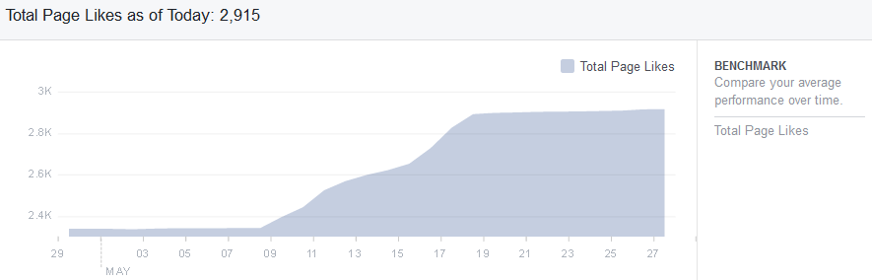
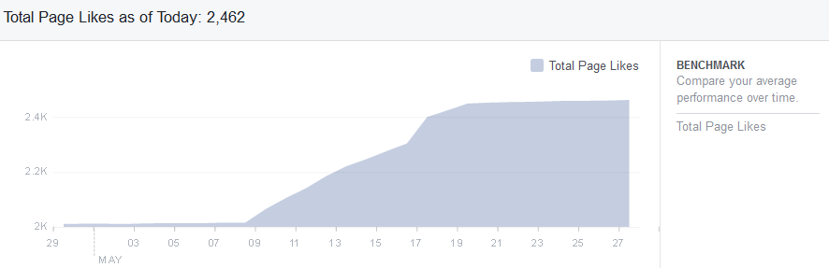
LIKE ADS
  UNIA BELGIQUE:
  UNIA
+ 557 likes from 9/05 to 20/05
+ 436 likes from 9/05 to 20/05

Slide 4
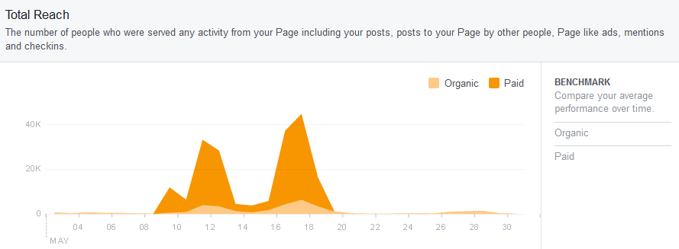
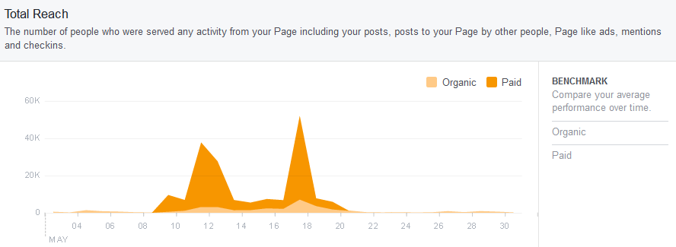
REACh from 9/05 to 20/05
  UNIA BELGIQUE:
  UNIA

Slide 5
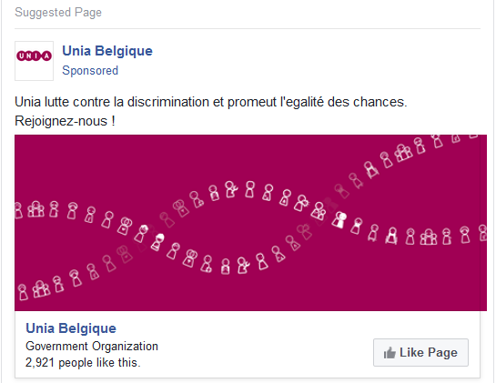
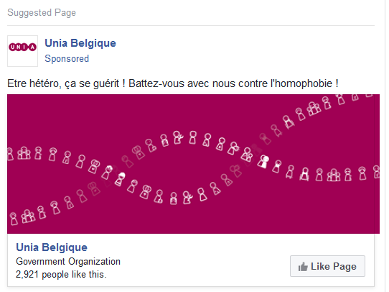
GENERAL
HOMOPHOBIA

Slide 6
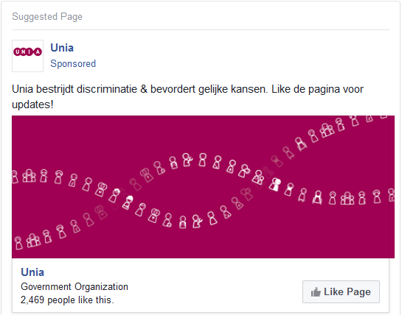
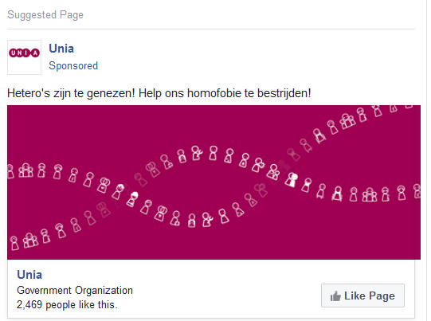
GENERAL
HOMOPHOBIA

Slide 7
LIKE ADS
In total we have gained 962 likes for which we paid.
Furthermore people also liked posts, commented and shared which increased the interaction on your pages.

Slide 8
LIKE ADS
Budget wise, we had to put the page likes for the 18-24 yo target groups on pause because they were very expensive. This budget got redistributed to the ‘General’ targeting which functioned the best (lowest cost & highest return)
→ In this ad set we targeted people who are more generally interested in equal rights, without making a real specific statement against Homophobia.

Slide 9
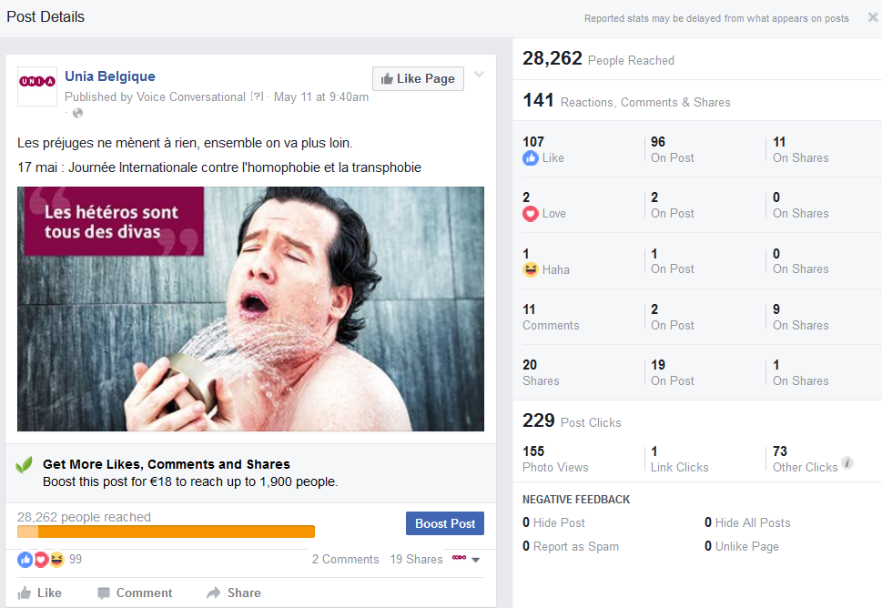
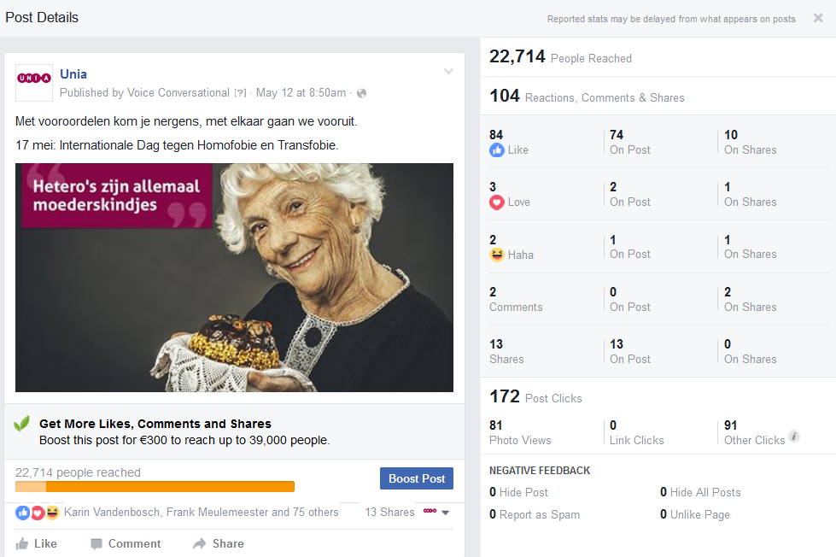
BOOST POST – UNIA/UNIA BELGIQUE

Slide 10
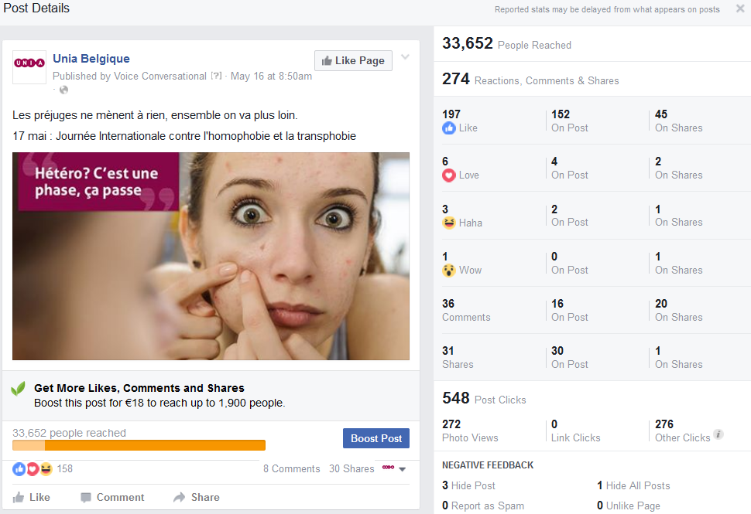
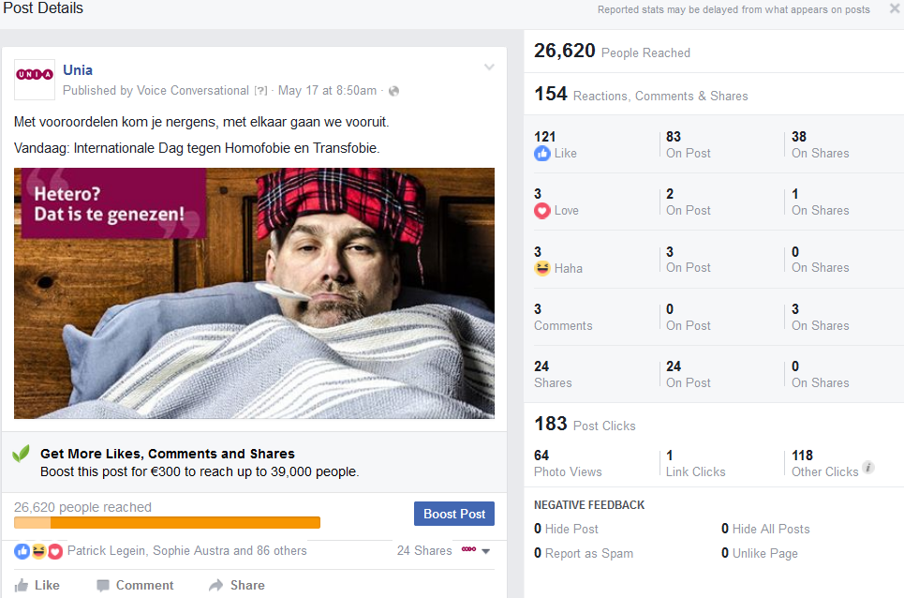
BOOST POST – UNIA/UNIA BELGIQUE

Slide 11
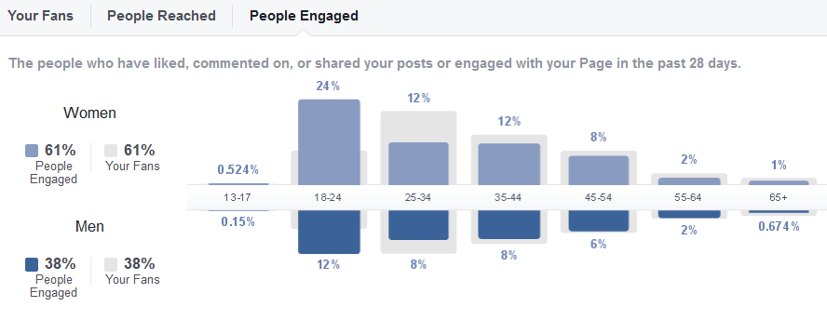
BOOST POST – UNIA BELGIQUE
We engaged a lot of 18-24 year olds during this period. Because they had the most interest in this topic, we targetted them with our social ads.
It is good to have activated this age group because of the fact that they are normally not this active on the Unia Belgique’s page.

Slide 12
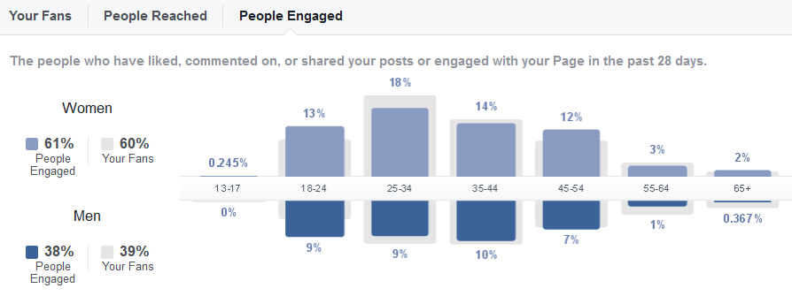
BOOST POST – UNIA
The percentage of people between 18 and 24 yo is lower for the Unia page. Yet they still represent a large part of the interested public for this campaign.

Slide 13
BOOST POST
On the 2 pages we incited 3099 post likes, which signifies a huge increase in terms of engagement.
Furthermore 116.547 people came in contact with your posts during this time over the 2 pages. A huge amount of people were touched by this campaign.

Slide 14
BOOST POST
We have spent almost 700€ to sponsor the posts for this campaign.
Sadly, one post in Dutch on the Unia page did not get sponsored on 16/05 due to technical difficulties on Facebook.
The average cost of 0,19€/post engagement (which can mean a like, comment, share or click) is very good. This means the target group responded well to your campaign and specific posts.

Slide 15
KEY FIGURES
Budget spent – social advertising: 1.692€
People reached: 215.647
Number of likes gained: 993 likes
Post likes: 3.246 post likes

