Slide 1
OMBUDSPERSON FOR GENDER EQUALITY OF THE REPUBLIC OF CROATIA
Preobraženska 4/I, 10000 Zagreb, +385 1 48 48 100, e-mail: ravnopravnost@prs.hr, web: http://www.prs.hr, facebook: Pravobraniteljica za ravnopravnost spolova RH
GENDER EQUALITY IN CROATIAN EDUCATION SYSTEM - EXPERIENCES OF THE OMBUDSPERSON FOR GENDER EQUALITY
Josip Grgić, education adviser
SESSION ONE - Setting the Scene: Promoting Gender Equality in Education
Equinet Seminar – Gender Equality in Education
Prague, 19th of May, 2016.

Slide 2
OMBUDSMANS IN CROATIA
4 INDEPENDENT OMBUDSMAN INSTITUTIONS IN CROATIA:
OMBUDSMAN OF THE REPUBLIC OF CROATIA
DISABILITY OMBUDSMAN
OMBUDSMAN FOR CHILDREN
OMBUDSMAN FOR GENDER EQUALITY

Slide 3
OMBUDSPERSON FOR GENDER EQUALITY of the Republic of Croatia
Independent body for combating discrimination on the basis of:
Sex/gender
Family or marital status
Sexual orientation & gender identity
Pregnancy and maternal rights
AREAS:
Employment and labour
Family (domestic violence)
Sexual and gender minorities
Multiple discrimination
Education
Media
Political participation
Reproductive health
Access to goods and services

Slide 4
OMBUDSPERSON FOR GENDER EQUALITY of the Republic of Croatia
Appointed by the Croatian Parliament upon proposal of the Government of the Republic of Croatia (mandate 8 years)
Monitors implementation of Act on Gender Equality and other regulations on gender equality.
Reports to the Croatian Parliament at least once a year.
Annual reports:
Statistics of complaints
Researhes and analyses
Case descriptions per area
Legal initiatives
Activities (active participation in round tables, conferences, seminars, cooperation with OCS, committees for gender equality and other bodies and mechanisms, international cooperation etc.)
Recommendations

Slide 5
OMBUDSPERSON FOR GENDER EQUALITY of the Republic of Croatia
ADOPTION OF RECOMMENDATIONS/WARNINGS/PROPOSALS OF THE OMBUDSPERSON IN 2015.
81% COMPLETELY
18% PARTIALLY
1% NOT AT ALL

Slide 6
ACT ON GENDER EQUALITY
Croatian Parliament adopted the First Gender Equality Act at its 33rd session on July 14 2003. (75 „in favour”, 14 „reserved”) – bodies for implementation of the Act were founded:
Gender Equality Ombudsperson, Governmental Office for Gender Equality, coordinators in administrative state bodies
On January 16th 2008 the Constitutional Court abolished Gender Equality Act due to the formal inconsistency with the Croatian Constitution. Gender Equality Act was rated as organic law and it should have been adopted with the majority of all parlamentarians – at least 76. The validity of the first Gender Equality Act ceased on July 15th 2008.
Article 82 of the Croatian Constitution prescribes that the laws (organic laws), which regulate constitutionally established human rights and fundamental freedoms, electorial system, organization, scope and mode of work of state bodies and organization and scope of work of local and regional self-government, the Croatian Parliament adopts with the majority of votes of all parlamentarians.
Second Gender Equality Act was adopted by Croatian Parliament on July 15th 2008.
Notes:
6

Slide 7
ACT ON GENDER EQUALITY
EDUCATION
Article 14.
(2) Subject matters related to issues of gender equality shall be an integral part of pre-school, primary and secondary school education as well as higher education and lifelong learning and additional training and they shall include measures aimed at preparing both sexes for active and equal participation in all spheres of life.
(3) Subject matters referred to in paragraph 2 of this Article shall be used to promote non-discriminatory knowledge with regard to women and men, to eliminate inequality of sexes and gender-related stereotypes in the education process at all levels as well as to respect gender-related aspects in all areas of education.

Slide 8
MOST NOTABLE INITIATIVES OF OMBUDSPERSON OVER THE YEARS
EDUCATION - CURICCULUMS AND TEXTBOOKS
2004. – Catholic religious teaching programme in primary school
„To talk about the whole meaning and relation of terms "love" and "sex" and judgement of wrong forms of sexuality (homosexuality, prostitution, incest, transvestism ...)“
2005. – Health education experimental programme (NGO ‘GROZD’)
-Discrimination of common-law and same-sex couples, single parents, and homosexuality in general
2008. – „Together in love”, catholic religious teaching textbook, 7th grade of primary school
„Abortion is a direct murder an unborn child and the greatest betrayal of motherhood. Making an abortion turns the mother, a symbol of security and love, into a murderer of the most innocent being.”
-Every form of contraception is listed as "immoral birth control”.

Slide 9
MOST NOTABLE INITIATIVES OF OMBUDSPERSON OVER THE YEARS
EDUCATION - SCHOOL TEXTBOOKS
2008. – „Biology 8”, textbook for 8th grade of primary school
„Intentional abortion ends the life of a human being and endangers the woman’s health.”
2010. – „With Christ through life”, catholic religious teaching textbook, 8th grade of primary school
„Medicine and psychology find a variety of causes, not explored completely, to such human condition.” (about homosexuality)
2011. – „Gifted by life”, catholic religious teaching textbook, 3rd grade of secondary school
-inappropriate description of abortion and artificial insemination

Slide 10
MOST NOTABLE INITIATIVES OF OMBUDSPERSON OVER THE YEARS
EDUCATION - SCHOOL TEXTBOOKS
Analysis of school textbooks:
2012.: Ethics textbooks for secondary schools
„Why women always want to talk?“
„Women should pay attention to her spouse, as father of the child, that he is not too old for procreation"
„To achieve the objectives in love men are using success, power and wealth, while women try to be attractive.“
„Abortion is not good nor for health nor for moral reasons“
artificial insemination=cloning, woman's uterus=incubator, „Will the children born in that way feel lonely among normally born children?“
„Do you think that marital, common-law and same-sex unions have the same value?“
„Refer to a film that deals with the problem of homosexuality, write about what you think of that problem – should it be a problem or is it a matter of taste?“

Slide 11
MOST NOTABLE INITIATIVES OF OMBUDSPERSON OVER THE YEARS
EDUCATION - SCHOOL TEXTBOOKS
Analysis of school textbooks:
2012.: Religious teaching textbooks for primary and secondary schools (catholic, orthodox and islamic)
"It is not recommended for women to attend the funeral of the deceased because of their gentle nature” (islamic)
"Unlike men, love pervades the woman's whole being; key words for her are "person" and "love" (…) Create a poster on the theme "Typical man and typical woman" (catholic)
"I stopped cooking, I did not care for my fiance, recalls 28-year-old” (catholic)
„Mother is gradually introducing daughters into housework, while father is introducing sons into everyday work not assigning them tasks immediately” (islamic)
"Induced abortion, regardless of the way it is performed, is intentional and direct murder of a human being in the initial phase of its existence” (catholic)

Slide 12
MOST NOTABLE INITIATIVES OF OMBUDSPERSON OVER THE YEARS
EDUCATION - SCHOOL TEXTBOOKS
Analysis of school textbooks:
2013.: Nature and society, Nature and Biology textbooks for primary schools
overemphasis of girls' and young women care about physical appearance
stereotypes on the roles of women and men, in particular on women as housewives
under-representation of women in graphics and textual content
invisibility of homosexuality in textbooks - it remained stigmatized in the context of AIDS

Slide 13
MOST NOTABLE INITIATIVES OF OMBUDSPERSON OVER THE YEARS
EDUCATION - SCHOOL TEXTBOOKS
2012. – Ministry of science, education and sports established Committee for asessment of school textbooks with ethical standards and appointed Ombudsperson for gender equality, Višnja Ljubičić, as one of its members.
→ Committee was soon adjourned due to financial reasons

Slide 14
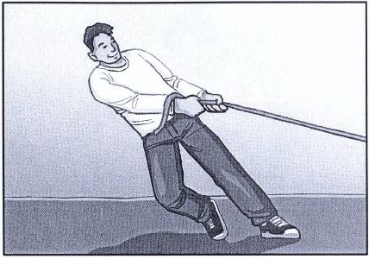
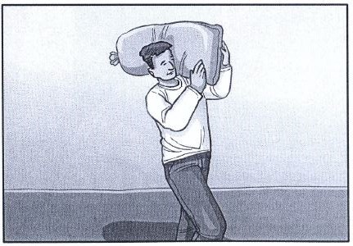
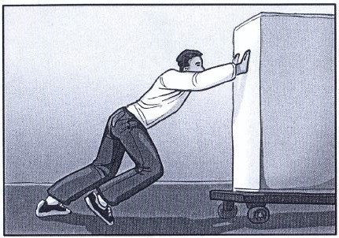
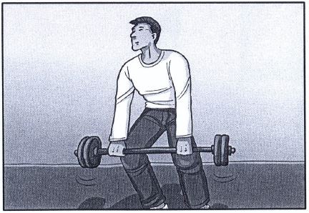
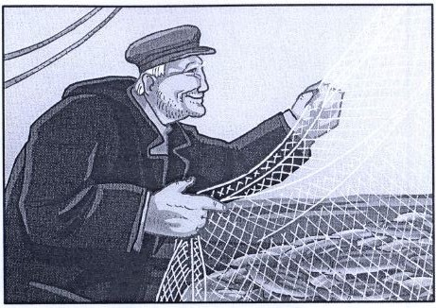
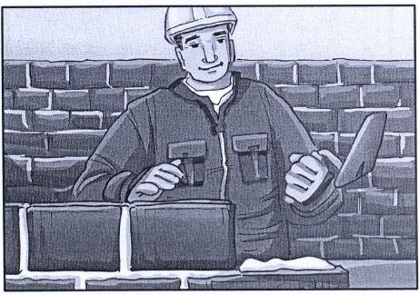
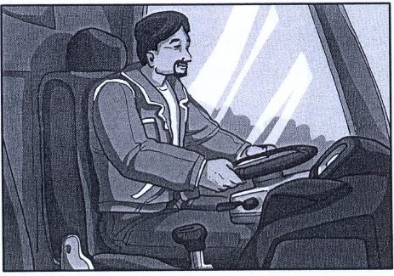
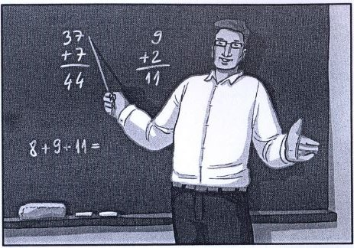
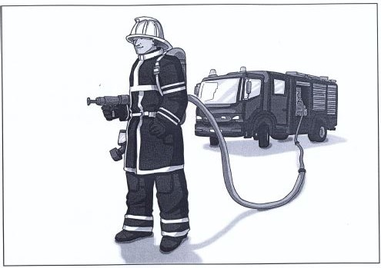
MOST NOTABLE INITIATIVES OF OMBUDSPERSON OVER THE YEARS
EDUCATION – EXAM-MATERIALS
‘Test of knowledge of the Croatian language for children who do not know or do not know enough Croatian language’
MEN

Slide 15
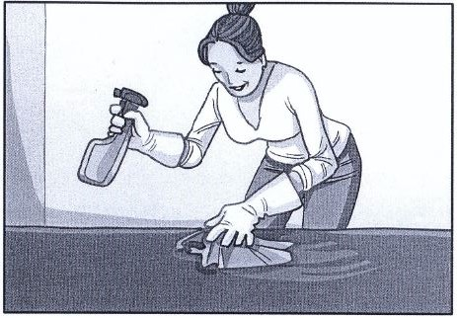
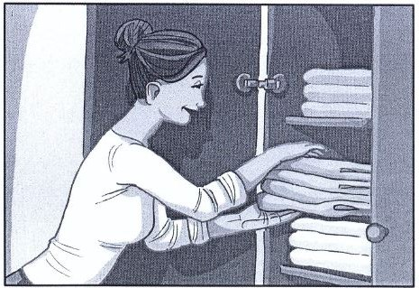
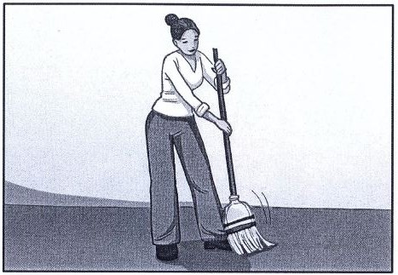
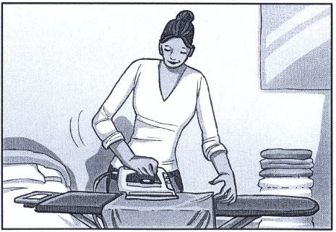
MOST NOTABLE INITIATIVES OF OMBUDSPERSON OVER THE YEARS
EDUCATION – EXAM-MATERIALS
‘Test of knowledge of the Croatian language for children who do not know or do not know enough Croatian language’
WOMEN
-Ombudsperson reacted and drawed attention on gender stereotypes → recommendation was adopted and a new version of exam is in the making

Slide 16
MOST NOTABLE INITIATIVES OF OMBUDSPERSON OVER THE YEARS
HEALTH EDUCATION
2012./13. – Health education inducted as mandatory subject in primary and secondary schools
Contents regarding gender equality implemented
Negative reactions of Catholic church in Croatia and NGO’s close to Catholic church’s teaching
Ombudsperson stated that the Health education programme is in accordance with relevant regulations and documents:
International Technical Guidance on Sexuality Education (UNESCO)
Standards for Sexuality Education in Europe (WHO)
International Guidlines on HIV/AIDS and Human Rights (UNAIDS)
Recommendation CM/Rec(2007)13 on gender mainstreaming in education (COE)
Recommendation CM/Rec(2010)5 on measures to combat discrimination on grounds of sexual orientation or gender identity (COE)

Slide 17
MOST NOTABLE INITIATIVES OF OMBUDSPERSON OVER THE YEARS
HEALTH EDUCATION
2013. – 3 Manuals for teachers (Ministry of science, education and sport)
Ombudsperson stated that the manuals are in accordance with anti-discrimination standards
One mistake: „right on the choice of sexual orientation” → „right on sexual orientation”
Ministry reacted quickly and changed the text

Slide 18
MOST NOTABLE INITIATIVES OF OMBUDSPERSON OVER THE YEARS
CIVIC EDUCATION
2012./13. - Civic education inducted as individual subject in experimental form in small number of primary and secondary schools
Civic education curriculum included many contents regarding human rights, including gender equality – Ombudsperson gave a few suggestions, part of which were accepted
It was planned to implement it as mandatory subject in 8th grade of primary and 1st and 2nd grade of secondary school after 3 years but the project was stopped

Slide 19
MOST NOTABLE INITIATIVES OF OMBUDSPERSON OVER THE YEARS
COMPLETE CURRICULAR REFORM
2015. – Ministry of science, education and sport started the work on new curricular documents for preschool, primary and secondary education
2016. – 52 curricular documents - much wider variety of contents regarding human rights, including gender equality, in comparison with curriculums currently in use
Expert debate: Ombudsperson gave a recommendation considering the topic of sexual orientation - that it should be implemented as a mandatory topic with emphasis on anti-discrimination message
Public debate is currently in the process

Slide 20
CONCLUSION
constant presence of gender stereotypes / discriminatory contents
education policy authorities are cooperative and respect opinions of the Ombudsperson
...…………………………………….

Slide 21
OMBUDSPERSON FOR GENDER EQUALITY OF THE REPUBLIC OF CROATIA
Preobraženska 4/I, 10000 Zagreb, +385 1 48 48 100, e-mail: ravnopravnost@prs.hr, web: http://www.prs.hr, facebook: Pravobraniteljica za ravnopravnost spolova RH
THANK YOU
FOR ATTENTION
Josip Grgić, education adviser
GENDER EQUALITY IN CROATIAN EDUCATION SYSTEM - EXPERIENCES OF THE OMBUDSPERSON FOR GENDER EQUALITY
SESSION ONE - Setting the Scene: Promoting Gender Equality in Education
Equinet Seminar – Gender Equality in Education
Prague, 19th of May, 2016.

