Slide 1
Challenges in ensuring gender equality in education
Equinet Seminar “Gender Equality in Education” Prague, 19 May2016
Irene Rosales Policy and campaigns officer

Slide 2
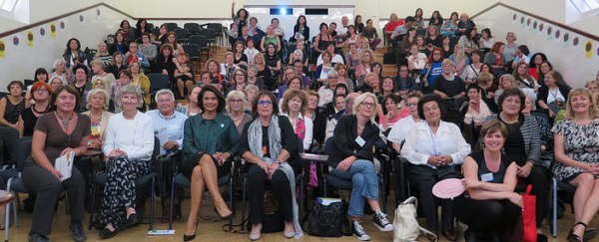

Slide 3
EWL STRATEGIC FRAMEWORK 2016-2020
To put an end to all forms of violence against women and girls and promote a society of peace, human security and dignity
To challenge and change the culture of sexism and stereotypes and promote positive roles for women and men
To promote the feminist transformation of a sustainable economy based on new economic models based on equality, well-being, care and social justice
To position women at the heart of political, social and economic participation and decision-making

Slide 4
Facts and figures
Key Facts and figures
Key Challenges
EWL Demands and opportunities for cooperation and involvement of women’s NGOs

Slide 5
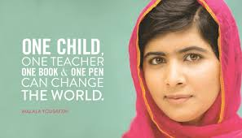
Facts and figures
Girls are less likely than boys to drop out of school: 9,5% of girls and 12,4% of boys (2014).
63.9% of women aged 15-24 are likely to participate in education compared to 59.3% of men
Women are more enrolled in tertiary education: 41%
While women far outnumber men in completing higher education, men prevail at the level of PhD graduates.

Slide 6
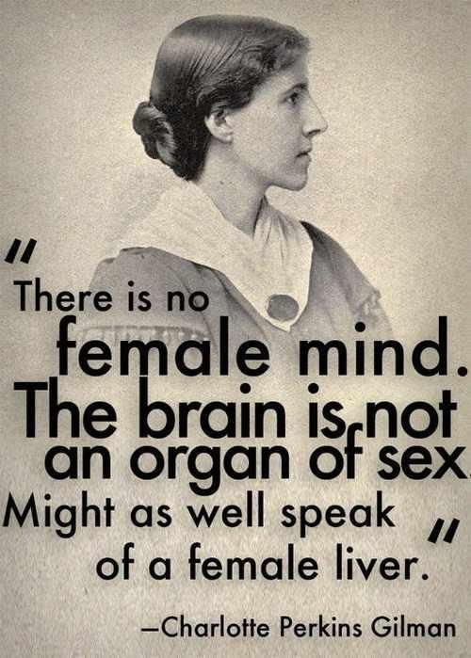
Facts and figures
Educational choices highly gendered: More male than female graduates in maths, science and technology in all EU MS

Slide 7
Facts and figures: Links to employment
Gender pay gap EU 28: 16,1% (2014) ranging from 2% in Slovenia to 28,3% in Estonia
Gender employment gap EU 28:
male employment rate : 70.1 %
female employment rate : 59.6 %
With the same level of education: men are 55.8% more likely to be employed.
Gender horizontal occupational segregation
Notes:
Females 43% Males 67% Difference 55,81395

Slide 8
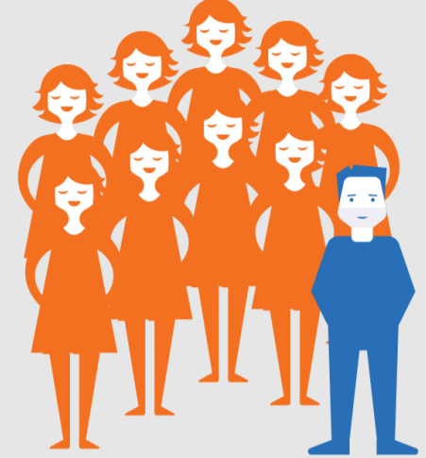
Facts and figures: Education professionals and GE in Educational institutions
Primary education: 9 in 10 teachers are women
Secondary education: 3 to 4 teachers in 10 are men
Tertiary education: 6 in 10 teachers are men
15.5% of institutions in the Higher Education Sector were headed by women and just 10% of universities had a female rector (2012)
Primary Education Tertiary education

Slide 9
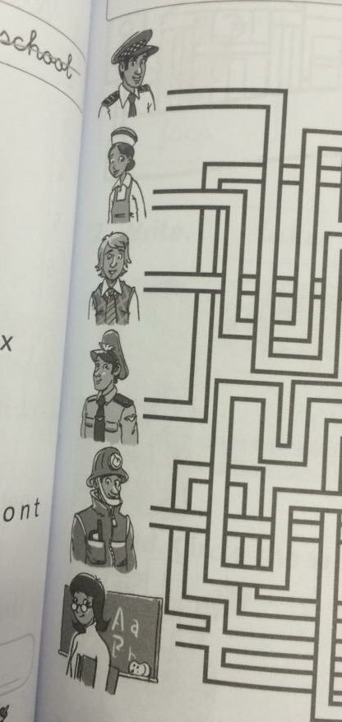
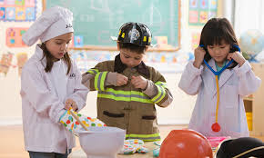
Challenges
Hidden curriculum
Gender stereotypes are still present in both values and attitudes and educational materials and methods
Educators play a crucial role in counteracting gender stereotypes.
However, unconscious gender bias reinforces stereotyping
Educative materials also reinforce gender stereotypes

Slide 10
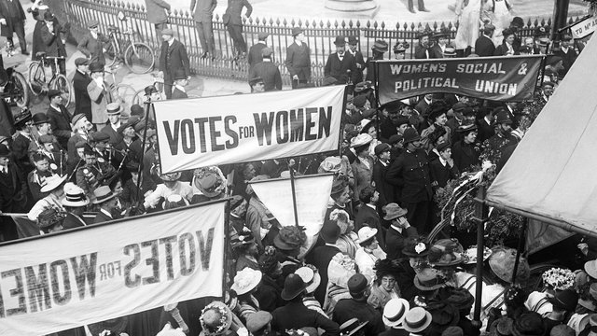
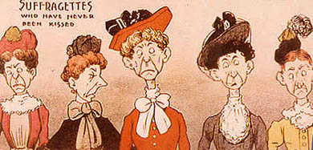
Challenges
Formal curriculum:
Androcentricity + Western-centricity
Role of women in history, science, maths, politics, literature missing in the different subjects

Slide 11
Challenges
Violence against women and girls
Girls and young women continue to experience sexism, sexual harassment and violence in schools and universities
Bullying often linked to gender identities and norms
Sexist remarks
Physical and sexual violence
Cyberviolence
Worrying trends on attitudes towards violence among young people

Slide 12
EWL Demands
Fight against gender stereotypes at every school age
Train all education professionals about gender stereotypes and gender equality and the identification of harassment and bullying.
Integrate gender equality in the curriculum.
Gender mainstreaming and gender budgeting in educational policies.
Include the prohibition of discrimination on the basis of sex and gender in education and media in the European Legislation.
Women’s rights organisations have a longstanding experience in raising awareness about sexism, gender stereotypes and gender inequalities.

Slide 13
THANK YOU FOR YOUR ATTENTION!
www.womenlobby.org
@Europeanwomen

