Slide 1
EQUINET SEMINAR
Gender Equality in Education
WORKSHOP
Gender sensitive teaching
19 May 2016

Slide 2
How to develop educational guides on gender and citizenship for school curricula?
Teresa Alvarez
Commission for Citizenship and Gender Equality - CIG
teresa.alvarez@cig.gov.pt

Slide 3
The Guides were designed to mainstream gender equality into the education system, in an effective and permanent way
The Project
Phases of the project
Production (conception and edition) of five Education Guides for Gender and Citizenship

Slide 4
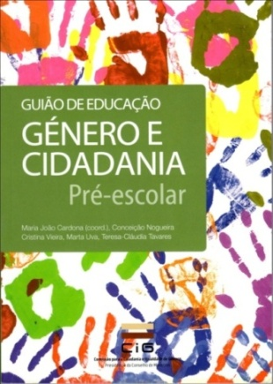
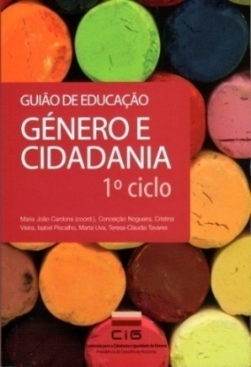

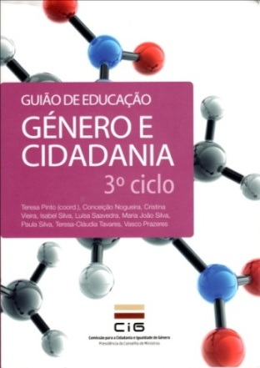
Education Guides Gender and Citizenship
In editing process
2008-2009
Pre-school
Age of 3 to 5
2008-2009
3rd basic cycle
Age of 12 to 14
2010-2011
1rst basic cycle
Age of 6 to 9
2010-2011
2nd basic cycle Age of 10 to 11
2014-2016
secondary
Age of 15 to 17
CIG : www.cig.gov.pt

Slide 5
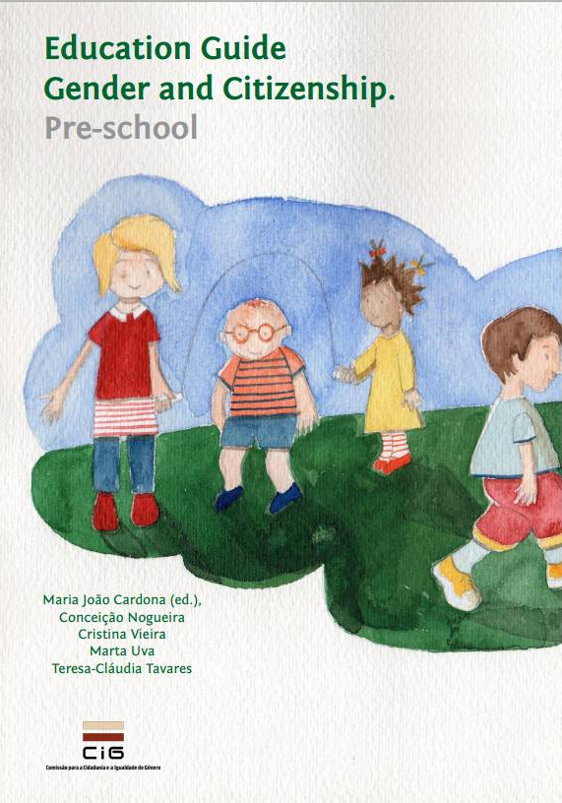
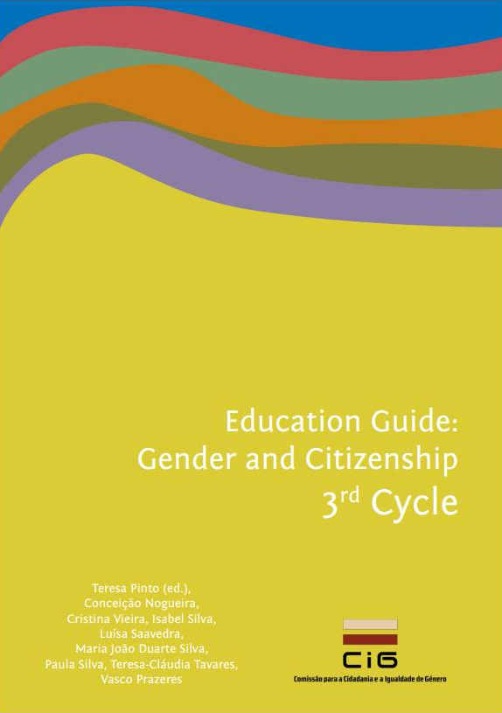
2011-2013
https://www.cig.gov.pt/documentacao-de-referencia/doc/cidadania-e-igualdade-de-genero/
https://www.cig.gov.pt/documentacao-de-referencia/doc/cidadania-e-igualdade-de-genero/

Slide 6
Phases of the project
Guides distribution by national school network libraries
Application of the Guides
In-service teacher training

Slide 7
What is the connection between the Guides Project and the Education System?

Slide 8
- 1 Guide for each school cycle
- Citizenship Education is a cross-curricular subject but it has no specific program.
- Gender equality was nearly absent in Recommendations for Citizenship Education.
The Guides

Slide 9
- In-service training is mandatory for teachers’ career progress and is provided by: universities and higher schools of education school’s teachers training centres teachers professional associations
- Teachers do not consider gender equality as an important or needed issue for formal education
Teacher training

Slide 10
The project:
- responds to a ME priority
- filles a gap in existing contents and materials
- and meets teachers’ needs

Slide 11
Who are CIG’s partners?

Slide 12
CIG coordinates the project
Higher Education Institutions
1 pilot-school
cluster
26 experts in Gender Studies, Women’s Studies, Education and Teacher Training produced the Guides
Production
80 teachers and educators tested several activities of the Guides and made suggestions
(4 teacher training courses)
Ministry of Education
Validation and distribution (800 school clusters)
CIG, ME and 10 Higher Education Institutions
Application of the Guides and teacher training

Slide 13
How do the Guides respond to the curricula and to educators and teachers’ needs?

Slide 14
Guides’ options
- Prescribe curricula » » » Curricula in action
- Easily applicable activities and in the existing teaching practices
- Gender issues: the added value of the Guides

Slide 15
1. To place gender perspective and equality between men and wemen at the center of “Education for Citizenship”
2. To integrate gender equality in the pedagogical practices and in schools’ projects
(changes in individual and collective teaching practices)
3. To integrate gender studies and women’s studies in the curricula
(providing scientific knowledge)
4. To introduce gender issues in schools’ organizational culture and making-decision
(sustaining individual and collective school changes)
The aims of the Guides

Slide 16
The Guides’ contents and structure
Theoretical framework
  Gender and Citizenship
  Gender and Curricula
  The Cross-sectional Nature of Gender
  Gender and Knowledge
Practical suggestions

Slide 17
Guides for Basic Education
The intersection of gender with some thematic areas has been identified as the main priority in order to overcome gender asymmetries:
    Leasure (children´s playful activities and generational change and continuitiy)
      Local Heritage (were are the women?)
        Characters (children´s books; old and new versions)
        Body (sport activities; (re)thinking the body)
          Health (risk behaviours; sexual health; drug addition)
            ICT (technology and spaces; internet safety; computer games)
              Decision-making (media; leadership, careers; time use)
                Vocational Choices

Slide 18
The Guide for Secondary Education
The integration of Women’s Studies and Gender Studies in disciplinary programs has been identified as the main priority:
    Portuguese Literature | English | Philosophy
      Biology/Natural Science
        History | Economy
          Art and Culture History | Physical Education
              Integration Area

Slide 19
Why these thematic areas? What its connection with the curricula?
National Reading Plan
ICT Education a ME priority for basic education
National Education for Health Program for basic education
Sexual education is mandatory in basic and secondary education
but it has no specific curricular area or disciplinary programme
School Psychology Service: Vocational Orientation
Secondary education:
  scientific/humanistic courses or profissional courses

Slide 20
Distribution of the Guides:
800 school network libraries
16 Higher Education Institutuions
Application of the Guides:
60 in-service teacher training courses nationwide provided by the CIG, the ME and 10 higher education institutions
(2116 hours; +150 school clusters; nearly 1.000 teachers)
Open University; Universities of Braga, Porto, Coimbra, Beira Interior and Évora; High Education Schools of Portalegre, Santarém, Setúbal and Lisbon

Slide 21
Guides
The Guides ensure the compulsory hours of sex education
They were applied
- in cross curricular areas
- in curricular subjects
- in multiannual school projects
- by other teachers of the same school: multiplier effect in the schools
They reinforce collaborative work between teachers (horizontal and vertical articulation)
Teachers:
Increase knowledge and critical awareness and realize the need for further training and follow-up actions

Slide 22
Mainstreaming gender equality in education
- has to answer the needs and priorities of the education system itself;
- must be part of a medium-term strategy
- needs partnerships in the long run, involving education stakeholders who are effectively engaged in promoting equality between women and men

Slide 23
How to develop educational guides on gender and citizenship for school curricula?
Teresa Alvarez
Commission for Citizenship and Gender Equality - CIG
teresa.alvarez@cig.gov.pt

Slide 24
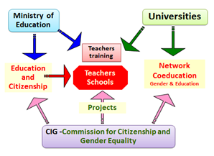
Education as a priority for the CIG
Notes:
sim

Slide 25
Preschool | 1rst cycle | 2nd cycle | 3rd cycle | Secondary
Educational environment and the relationships with families |  | A set of cross-cutting thematic areas |  | Scientific knowledge
Personal and Social Development ; Communication and expression; Knowledge of the world | Mathematic; Portuguese; Environmental Study; Artistic and Physical Expressions | Playful Activities in Free Time; History and Heritage; Characters in Children Literature | Body, and Movement; Education and Health; Leadership; ICT; Vocational Choices | Portuguese Literature; English; Philosofy; Biology/Natural Sciences; History; Economy; Art and Culture History; Sport/Phisical Education; ………………… Integration Area

Slide 26
Guides’ added value:
A theoretical approach about gender issues in both education for citizenship and in curricula
(teachers must understand what and why)
A practical approach: proposals of activities concerning some thematic areas, applicable in any school context
school subjects/disciplines; school projects; school and vocational guidance; school organisation
(to cross gender issues in the national curriculum)

