Slide 1
Equality and Human Rights Commission (GB)
Evaluating impact
29.01.2016
01

Slide 2
Who we are
Our mandate: To challenge discrimination, and to protect and promote human rights.
Our vision: We live in a country with a long history of upholding people’s rights, valuing diversity and challenging intolerance. The EHRC seeks to maintain and strengthen this heritage while identifying and tackling areas where there is still unfair discrimination or where human rights are not being respected.
Our roles:
Outcomes-focused strategic regulator
Promoter of standards and good practice
Authoritative centre of intelligence and innovation
Trusted partner
12.10.2015
02
Notes:
Optional slide – in case needed to clarify to the audience who the EHRC is

Slide 3
What I will cover
Why? (Need for evaluating impact)
Past and current approaches
Future considerations and lessons learning
12.10.2015
02
Notes:
Note: the agenda says you will be speaking on
Example of an evaluation carried out by the Equality and Human Rights Commission
Might be worth clarifying here that you are not concentrating on just one but need to cover the multitude of approaches as one size certainly does not fit all in regards to evaluation

Slide 4
Why?
Evaluating impact for an equality body
12.10.2015
03

Slide 5
EHRC and other equality bodies are often asked to show their impact…
EHRC: Evaluation & Impact
Need for Evaluation
Effective spending of public money
Public value – resulting social and economic benefit of work
Does what we do work?
Therefore any evaluation of work of the Commission is drawn up with some key considerations in mind:
Role and remit of the Commission on the issue
What approach has been taken (regulator, intervention, influence, guidance, explorative, legal...etc)
What is proportionate and will show meaningful change
Who is the work likely to impact (who do we want to work with on it)
04
Notes:
Challenge for all bodies in demonstrating public value as well as being assured that what they do is effective:
Need to be able to demonstrate that approaches work in order to justify further investments, transferability and future spending round settlements.
If unable to show how it has been effective and that existing budget has been spent with justifiable outcomes (ROI) then risk future budget cuts.
Also important to show what we do is different to other organisations working on equality and human rights in Great Britain. At times this is as far as reminding others of the particular role that EHRC plays:
Unlike some equality commissions, we are not an ombudsman service. We have a different relationship to particular legal cases and a number of different powers that we use appropriately and affordably and include supporting or taking on certain legal cases to clarify the law in areas where it needs clarification (e have quite a good success rate on those cases).
EHRC has unique statutory powers, which are not held by other organisations working in the area – such as Inquiry powers
EHRC are a regulator (but in the conventional sense). We do not issue regulations and we do not fine people if they fail to comply with regulations. We also do not, like many regulators, charge those who are meant to live by the regulations.
We are also the national human rights institution, so we do, as part of our core statutory function, a lot of monitoring of UK compliance with the international treaties to which the UK is a signatory. Subsequently forms the basis for the cross-examination of Government in Geneva.
We do a lot of direct human rights work. For example, we have a stream of work at present on the adequacy of the legal protection of the right to freedom of religion and belief, which, I have to say, is a muddled and tangled frontier with a lot of people very unclear on what is required and what is not required.

Slide 6
Challenges
EHRC: Evaluation & Impact
Need for Evaluation
EHRC is required by statute to encourage and support the development of a society in which:
People's ability to achieve their potential is not limited by prejudice or discrimination.
There is respect for and protection of each individual's human rights, and for the dignity and worth of all.
Each individual has an equal opportunity to participate in society.
There is mutual understanding between groups based on understanding and valuing of diversity and on shared respect for equality and human rights.
These are longer term goals where change and evaluation of impact can be difficult to measure:
Difficult to collect: Subjective/open to interpretation/multi-perspective (e.g. Hate crime – experience of, reported, recorded, prosecuted, impact of)
Rarely have regular management information or a contained environment to scientifically test – (correlation or causation? Many antecedal factors/noise in the data that can affect findings)

Slide 7
Past and current approaches
The good, the bad and the inconsistent
12.10.2015
03

Slide 8
Evaluation needs a LOGIC CHAIN
Presentation name
Past and current approaches
What is the problem or challenge to address?
What inputs, outputs or processes are needed?
What will the inputs need to deliver?
What are the immediate changes/gains expected?
What longer term impacts are expected?
Also; what is the sustainability?
Nature of Problem
Inputs
Outputs
Outcomes (short/medium term)
Impact (long term)
Includes numbers – such as how many.
Conducted at end or close to end of delivery
What are the available mechanisms and measures that continue to track change over time?
Defined problem is often missing
04
Notes:
Impact often considered at the end of project or programme inception, afterthought

Slide 9
On a regular basis EHRC looks at impact in terms of output and outtake
Presentation name
Past and current approaches
Achieving effective evaluation that has demonstrable causal impact and outcome is difficult, costly and often disproportionate to the activity undertaken.
EHRC regularly monitors impact in terms of output at an activity level across the Commission and reports monthly to a central project delivery board – for example:
Delivery of EHRC’s statutory duties: e.g. “Is Britain Fairer?”
Delivery of our Research Programme: Reports, briefings and evidence products are published, downloaded and cited (external) and used to inform decision making (internally and externally)
Strategic litigations and interventions – Number and nature and effectiveness: desired outcome achieved? from 2015:
Disability discrimination in housing (Supreme Court)
Ensuring Government complies with Art 19 UNCRPD in the implementation of the benefit cap insofar as it affects all carers of disabled people (High Court)
Gypsies and Travellers disadvantage from a Ministerial policy to "recover" traveller site appeals for the Minister to determine them himself. (High Court)
OUTTAKE: Impact through awareness of organisation, approach, agenda and issues – comms activity such as an increase in distribution, exposure and reach recorded through:
Coverage (sentiment, notoriety, network and volume),
Digital engagement - unique page visits, time spent and downloads
Across mediums - Media, Social media and digital
04
Notes:
More details strategic litigations settled in 2015:
Disability discrimination in housing (Supreme Court): The outcome maintained the distinction in the burden of proof that applies to defences under the EA as compared to the defences under HRA.
Government complying with Art 19 UNCRPD in the implementation of the benefit cap: Secretary of State for Work and Pensions indirectly discriminated against carers for disabled family members by failing to exempt them from the benefits cap, and carers' Article 14 rights under the ECHR had been contravened by not considering the impact on disabled people)
Gypsies and Travellers – and the “recover” site appeals policy: SSCLG indirectly discriminated against Gypsy and Traveller claimants and failed to have the necessary due regard to the PSED. This contravened both Section 19 and Section 149 of the Equality Act 2010 and also Article 6 of the ECHR, which provides the right to access to justice. The Court found that the Secretary of State’s recovery of all Gypsy and Traveller planning appeals was unlawful, disproportionate and led to an unreasonable delay in deciding such appeals. Gypsies and Travellers’ applications in the planning system will be considered by planning inspectors in a fair and reasonable manner, and not unreasonably delayed or singled out for scrutiny by the Secretary of State without a good reason.
However whether a desired outcome, or whether the Commission’s clear strategic objective established at the start of the process is met, is highly complex and may require multiple appeals and approaches to successfullky establish. Many examples of cases being dismissed or settled, or different outcomes resulting in further legal work required.
OECD ‘regulatory pyramid’,
Provides a helpful taxonomy of the ways in which a social regulator can intervene to induce change
Can be used to allocate organisations various regulatory (and other statutory) activities to some layer of the pyramid.

Slide 10
EHRC Evaluations (1)
EHRC: Evaluation & Impact
Past and current approaches
Product evaluation of projects and programmes
Outputs form grant programme
Compliance of public sector organizations with Public Sector Equality Duty
Outcome evaluation over time of Disability Harassment Inquiry (year 1,3,5)
Process evaluation of use of inquiry powers
In 2011 EHRC evaluated the design, conduct and impact of three Inquiries:
Race discrimination in the Construction Industry Inquiry Report (July, 2009)
Financial Services Inquiry: Sex discrimination and gender pay gap report (Sept, 2009)
Inquiry into recruitment and employment in the meat and poultry processing sector (March, 2010)
Notes:
Evaluation of Inquiry powers:
Looked at Initiation of Inquiries, evidence gathering and analysis, stakeholder engagement, aims and focus, findings and recommendations, follow up and impact and found excellent work undertaken by Inquiry teams, frequently working under significant pressures.
Key recommendations:
need to set a realistic timetable and employ clear resource planning
clearer strategic framework for selecting topics for Inquiry, setting aims and objectives, monitoring progress and impact, and for setting the scope and size of an Inquiry
greater clarity about the role of research and research quality standards in Inquiry investigations.

Slide 11
Impact at the EHRC
EHRC Evaluations (2)
Appointment practices on company boards: guidance and research has resounded with corporate boards where there is typically massive gender disparity.
Religion and belief project has reached a large stakeholder group due to the use of social media.
Disability harassment inquiry indicates that police have made improvements to the way they record disability hate crime so that it is recorded at the same level as other hate crimes.
Pregnancy and Maternity Discrimination project: Reached new audiences not traditionally engaged with EHRC through large scale stakeholder mapping and engagement
@CLEStweet @Jenny_Rouse
Notes:
Some results but not connected , scattergun, evaluation is like butterfly collecting…..(?)

Slide 12
Capturing EHRC’s public value….
EHRC: Evaluation & Impact
Past and current approaches
In 2012 commissioned study to develop a public value assessment framework to better evaluate the full social and economic impacts of the EHRC’s activities.
Designed to capture a wider range of outcomes than would be possible through conventional Cost-Benefit Analysis, evaluation and impact assessment
encapsulating both use and non-use values.
recognises impact may stem from ‘below the line’/less visible areas of activity (e.g. pre-enforcement actions that simply involve writing to individual employers but often lead to the instigation of behavioural changes )
PV provides a useful overall analytical framework. A disadvantage is ‘conflicting values’ i.e. different external stakeholders may perceive the value of the EHRC very differently.
Notes:
We started the bigger thinking but approached it from a technical viewpoint, got stuck with a gap between overarching concepts ( which were helpful in clarifying what we wanted to achieve over time) and current technical approaches ( which was a bit of a hotchpotch of all what was available in the main stream). Got stuck tryin got define unique contribution (and causation)

Slide 13
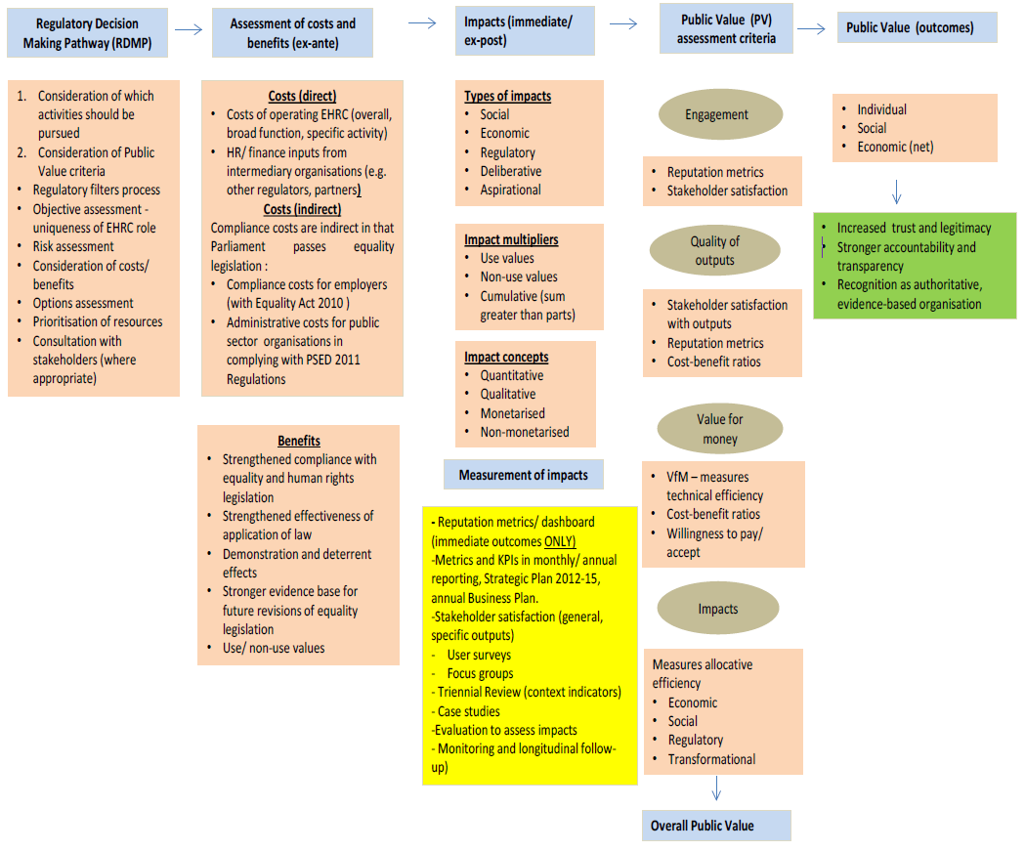
Notes:
Definition: Public value (PV) = total value to society generated by the EHRC through the effective fulfilment of:
Statutory responsibilities in strengthening compliance with, and improving enforcement of, UK equalities and human rights regulations.
Monitoring role as a National Human Rights Institution (NHRI) as part of the UK’s international commitments under the UN Convention on Human Rights.
Strengthening the evidence base and in providing knowledge, expertise and high-quality research in respect of equality and human rights and by being seen as an authoritative organisation in this context.
PV includes the monetary value to individuals, businesses and public sector organisations of activities undertaken by the Commission, but also their non-monetary value to people as individuals. PV generated by the EHRC will include both use and non-use values calculated on a Willingness to Accept (WTA) basis
PV needs to be incorporated from the outset i.e. become an integral part of the Commission’s decision-making processes and in evaluation and monitoring frameworks. Key stages in the performance measurement for assessing PV are outlined below:
• Step 1 - Ex-ante assessment of Public Value – build a strong PV dimension into the Regulatory Decision Making Pathway (RDMP) decision-making processes from the outset. Carry out an ex-ante assessment of costs and benefits, risks, options, consideration of the four overarching PV performance assessment criteria (see below).
• Step 2 - Assessment of impacts (immediate outcomes and ex-post) – assess the immediate outputs arising from the EHRC’s activities and track impacts on an ex-post basis e.g. social, economic, regulatory, deliberative and aspirational through longitudinal monitoring.
• Step 3 – Assessment of overall Public Value using the following criteria (i) focused engagement; (ii) quality of outputs; (iii) value for money and (iv) impacts (economic, regulatory, social).
Note: Need to explain this was 2012/13 and why in 2016/17 we still have not achieved what set out. Evaluation is important but needs to be PROPORTIONATE
I am assuming this hasn’t been adopted because it is too technical and resource intensive to apply wholesale across the Commission?

Slide 14
Key points:
Presentation name
Section name
1. Current measurement of impact can be insufficient and not very meaningful
2. Evaluation of projects, programmes or even the use of powers made no difference because they do not answer the bigger questions
3. Ask big questions first and not at the end
07

Slide 15
Future considerations and lessons learning
So how are we improving?...
12.10.2015
03

Slide 16
First steps: prove and improve
EHRC: Evaluation & Impact
Future considerations and lessons learning
Prove:
To Government (Treasury Green Book), the media, the general public, internally.
Improve:
To be even more effective next time.
Look forward at intended impact
Rather than backward at isolated outputs or outcomes
Use impact assessment to plan as well as to assess effectiveness
Don’t get stuck by technicalities or impossible asks
Perhaps direct causality is not that important, supposing it is achievable
Notes:
Public Interest needs to include assessment of effectiveness of powers, trends and plans of others. Also consideration of unique action by us v partnership

Slide 17
Unfair use of S&S powers by police towards Black and Asian population | Intended Impact on society | Policy/practice change required by institutions | Impact EHRC expected to have on institution | EHRC regulatory activity | EHRC resources and skills required
5 years | Significantly improved trust and/or sense of fair treatment by police from Black and Asian population (BCS data – static ally relevant) ↓ → | Majority of police (60-70%) forces’ S&S disprop is lowest average of their family (baseline MoJ 2010) Or have significantly increased S&S effectiveness ( higher conviction rate and crime reduction) ↓ → | S&S is standard item on political Home Office agenda and change programme is actively promoted and overseen by ACPO Effectiveness data are published along disprop. data ↓ → | monitoring progress and publicising outcomes with key agencies and general public Publication of revised Stop and Think setting out achievements and future expectations ↓ → | 0.2FT staff to monitor progress, 0.1 L5 oversight (Q1-Q4) Regular press releases and briefings small team (4x0.3 Q3) for preparation and publication ↓
3 years | Emerging national improvement in trust and/or sense of fair treatment by police from Black and Asian population (BCS data) ↓ → | 30% of police forces’ S&S disprop. is lowest average of their family (baseline MoJ 2010) Or have increased S&S effectiveness ( higher conviction rate and crime reduction evaluation and widespread distribution of promising approaches ↓ → | HO takes political leadership of S&S improvement Stop and search improvement programme is delivered by NPIA and ACPO to all remaining forces Effectiveness data are published along disprop. data ↓ → | monitoring progress and publicising outcomes with key agencies and general public Publication of revised Stop and Think setting out achievements and short term expectations ↓ → | 0.5FT staff to monitor progress, 0.1 L5 oversight (Q1-Q4) Regular press releases and briefings small team (4x0.3 Q3) for preparation and publication ↓
1 year | Indications of impact of adapted S&S policies by 5 police forces on Black , Asian and overall local populations’ sense of fairness and trust → | 5 police forces’ achieve lowest average of their family (baseline MoJ 2010) or have increased S&S effectiveness (higher conviction rate and crime reduction) Evaluation and Input of promising local approaches in Next Steps programme → | Senior leaders of 5 forces owe S&S change, publicise and communicate changes locally and with NPIA, ACPO and HO Identification of promising approaches HO secures long term budget for Next steps change programme → | monitoring progress and publicising outcomes with key agencies and general public Develop contacts with Next steps programme Lobby for long term provision of Next steps with HO and ministers → | 0.5FT staff to monitor progress, 0.1 L5 oversight (Q1-Q4) Regular press releases and briefings SMT/involvement for lobby work3 Q3) for preparation and publication
Notes:
Stop and Search:
Determine end goal over time,
Situate your organisations with and amongst other influencers
Set out critical components, actors and steps, clarify assumptions
First steps towards theory of change

Slide 18
Why evaluating impact is central
EHRC: Evaluation & Impact
Future considerations and lessons learning
Making an ‘Impact’ is the reason why an organisation, workstream or project exists.
Taking time to Plan→Monitor→ Evaluate impact is fundamental to maximising impact.
Start from where you want to be, and work backwards.
Measure outcomes, not outputs, to evidence impact.
Having a robust underpinning theory is crucial to understanding contribution to longer-term impacts.
Notes:
Public Interest needs to include assessment of effectiveness of powers, trends and plans of others. Also consideration of unique action by us v partnership

Slide 19
Impact cycle
Plan
for impact
Project
Delivery
Evaluate
impact
Monitor
impact
Thinking gets
stuck here

Slide 20
What do we plan, monitor and evaluate?
Two steps:
What is the ultimate impact you want to see?
Work backwards
@CLEStweet @Jenny_Rouse

Slide 21
What EHRC need
EHRC: Evaluation & Impact
Future considerations and lessons learning
A Theory of Impact: that works backwards from the EHRC vision/mission to understand the projects and approaches that are most impactful to guide planning about future projects. This theory needs to be well-evidenced- based on previous learning from EHRC on when work has/has not been impactful, and wider learning from the sector, academia etc.
Impact framework and measurement guidance: An approach for how to measure the impact of projects and the EHRC more widely.. Note:
It will be increasingly difficult to evidence and understand contribution to larger, more long-term impacts that are ‘further away’ from the projects it delivers
In these cases, ‘proxy’ indicators can be established
Concepts such as ‘attribution’ and the ‘counterfactual’ are also important and can aid thinking and approaches to unravelling contribution to larger outcomes.
Staff skills development: Training for relevant staff so that there is a meaningful legacy to the work: staff are able to undertake their own planning, monitoring and evaluation of impact.

Slide 22
Key points:
Presentation name
Section name
Measuring progress is a process, having impact is the goal
Use your organisation's vision to determine intended impact and work backwards
For evaluation and impact assessment to be meaningful, they need to be built into the culture of the organisation
07

Slide 23
Thank you
Presentation name
Section name
Marc Verlot
Research and Intelligence Director
marc.verlot@equalityhumanrights.com
07

