Slide 1
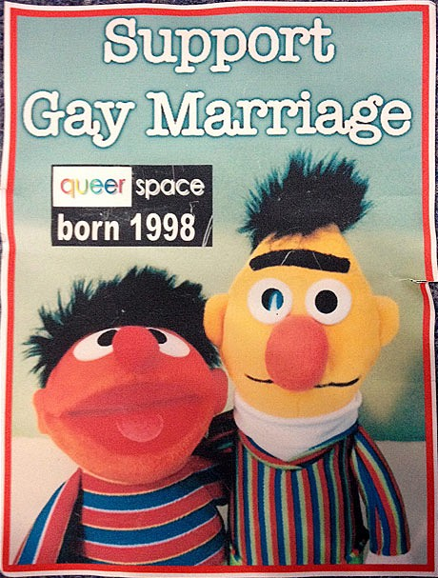
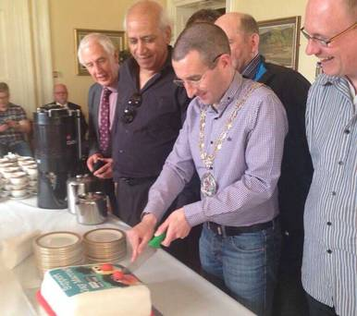
Lee v Ashers Baking Company
Notes:
Reactive work with the Media.
Big recent news story – Lee v Ashers Baking company.
A bakery owned by a family of very strong and fixed religious beliefs refused to fulfil an order for a cake with a “Support Gay Marriage” slogan. We supported the man who ordered the cake in his discrimination case against the bakery. The SO Regulations 2006 govern the supply of GFS to LGB people. FETO covers discrimination on the grounds of religious or political belief. The hearing was at the end of March and the decision in May.
The issues in the “cake” case involved the grounds of sexual orientation and religious belief and political opinion. The judge was satisfied from the evidence that the order for the cake was refused because the bakers took the view that the message on it conflicted with their views on sexual orientation and their religious and political views on a campaign to change the law on marriage. Accordingly she found that their decision was discriminatory under the laws covering these grounds.
The decision has not changed or expanded the law. The court’s judgement confirmed the legal position which the Equality Commission has always held and which it has always used as the basis for our advice to service providers and employers.
Businesses operating in the commercial sphere, providing services to the public, cannot discriminate against people on any of the grounds covered by anti-discrimination law in Northern Ireland governing the provision of goods, facilities and services to the public. Those grounds are disability, gender, race, religious belief and political opinion, and sexual orientation. Age will be added to this list, consultation this summer.
It is important to remember that the judgement spelt out clearly the limits of what the law requires. The judge found the bakery’s refusal to be unlawful, because they were contracted on a commercial basis to bake and ice a cake with entirely lawful graphics, and to be paid for it. She was clear that what the bakery was asked to do did not require them or their bakery company to support, promote or endorse any viewpoint.
For any business it will be a help for them to be clear and open about what goods facilities or services they offer to the public, just as they should have clear policies and procedures in employment matters. All business people make decisions on what they do or do not supply, usually on straightforward commercial grounds, but for example can choose not to open on a Sunday, which is not discriminatory. Their policy can make it clear if there are services or goods they do not supply, but these should not be defined in such a way as to be discriminatory on any of the protected grounds.
The Commission is happy to give guidance to any businesses concerned by the discussions and misleading interpretations which have arisen around this particular judgement. It has been appealed and we await developments.

Slide 3
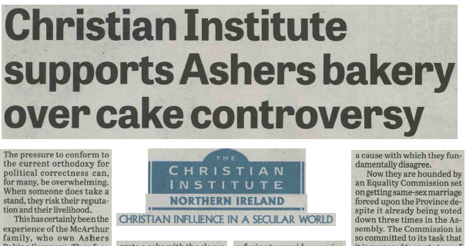
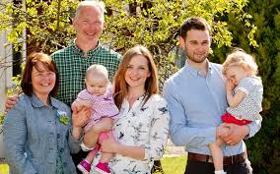
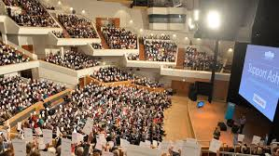
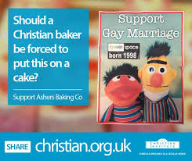
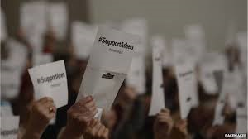
Notes:
The Christian Institute undertook a massive publicity campaign.
They appealed for funds to fight the case.
They filled the Waterfront Hall in Belfast with pro-Ashers Christians.
They pushed the image of the ‘normal’ happy family with babies and children.
They introduced and used a hashtage for Twitter and made their campaign easy to share on social media.

Slide 5
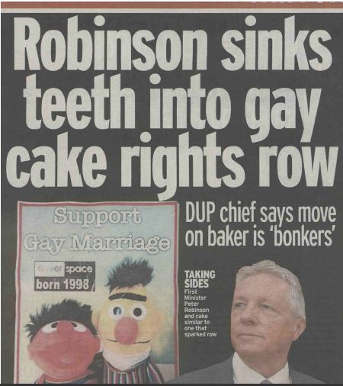

Slide 7
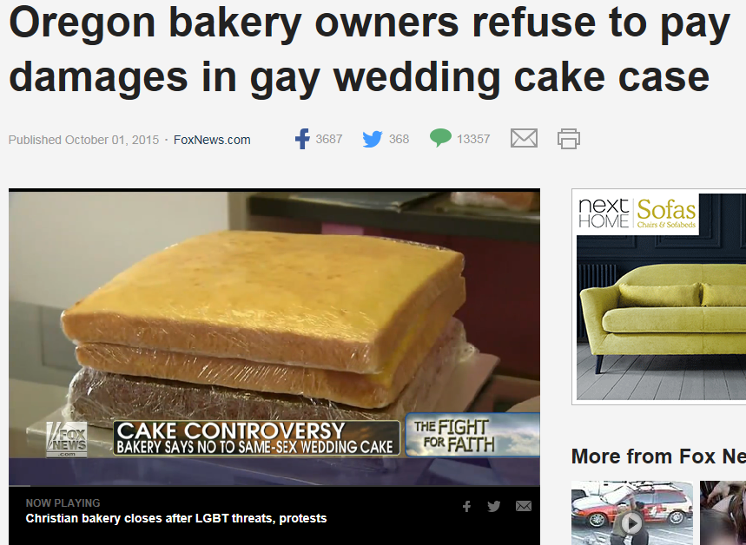
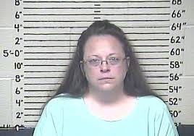
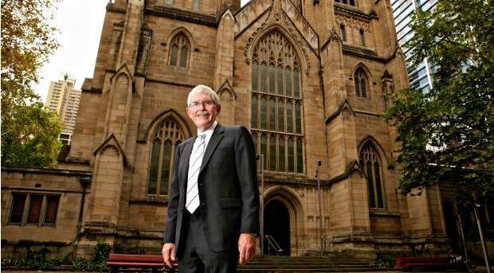
Notes:
A worldwide issue – not just Northern Ireland.
Bakers and florists across the US have fought for the right to refuse service to LGB people.
Kim Davis, the Kentucky clerk who refused to hand out marriage licences to LGB people was jailed for contempt of court.
Beulah Print in Co Louth, Ireland, refused to print gay wedding invitations.

Slide 9
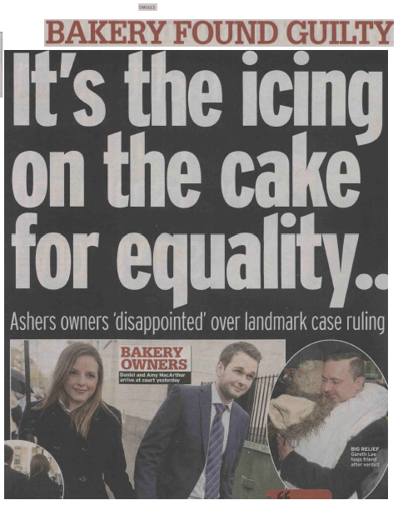
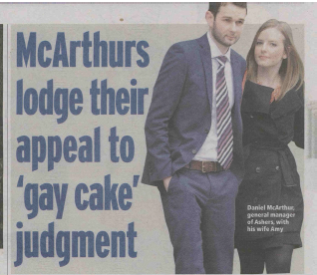
After the judge’s decision

