Slide 1
Communicating Religion - challenges, strategies & tools

Slide 2
Background
Challenges
Strategies and tools

Slide 3
Background

Slide 4
This is Norway
Becoming a multicultural society
Has a state church – but thinks religion should be kept private
Good laws – not so good practices
Polarized climate of debate

Slide 5
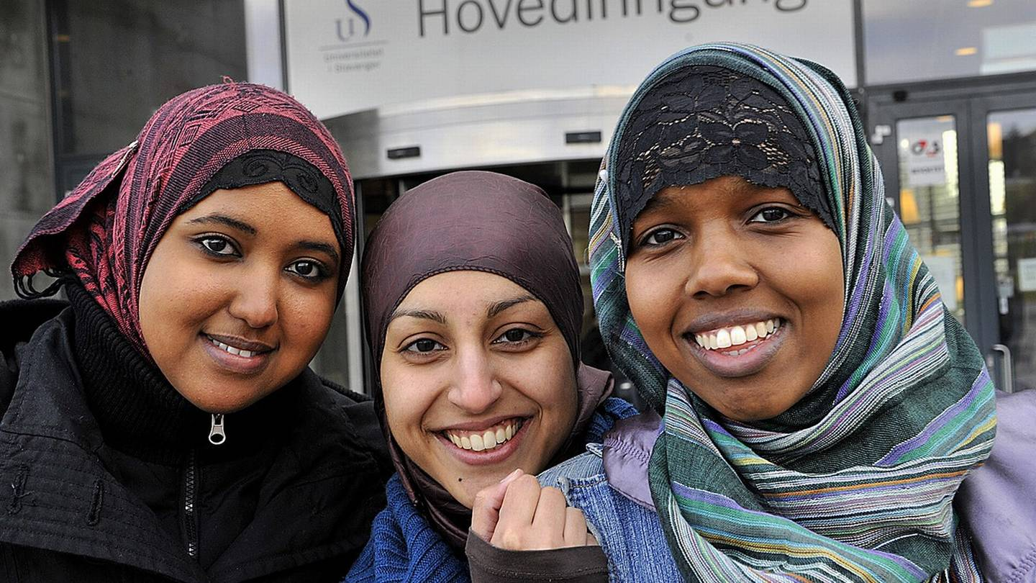
Equal?

Slide 6
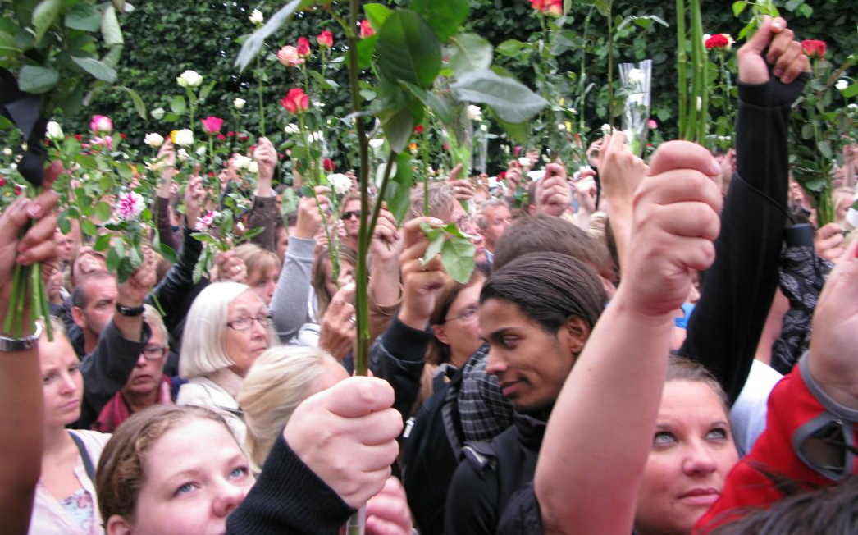
The sunny side

Slide 7
Challenges

Slide 8
It’s complicated. We don’t even agree with each other here at work.
The media wants simple answers. We don’t have any!
Human rights are competing with each other.

Slide 9
We must fight for gender equality. Religion is slowing us down.
The muslims are a minority. They need our support, not our criticism.
Stop! High risk of misunderstanding our balanced view.

Slide 10
Strategies and tools

Slide 11
#1 Be the expert!

Slide 12
#2 Handle the journalist
#2
Handle the journalist
- get the message across

Slide 13
Useful strategies
Take the opportunity
Set the terms
Use different spokespersons
Buy yourself time
Talk about more than the law
Promise further investigations

Slide 14
#3 Address conflicting interests

Slide 15
Pick up the phone!

