Slide 1
EQUINET SEMINAR A question of faith. Religion and belief in the work of equality bodies Engaging with policy-makers and producing policy recommendations
Nikolina Patalen
Office of the Ombudswoman, Croatia
November 2015, London

Slide 2
Broader context - General perception, attitudes and prejudices in Croatia
Survey 2012 - Attitudes towards and the level of awareness on discrimination
Religion – third most common ground, after national origin (29%) and social origin/property status (29%)
25% - religion is the most widespread ground
Measuring social distance- 22% of respondents comply with the claim:
„It would be unacceptable for me that a child of mine marries a person of other religion”

Slide 3
General perception, attitudes and prejudices in Croatia
Presence and the indicators of discriminatory and xenophobic attitudes in Croatia 2013 – NGO survey
Self perception - national and religious component very important for one’s identity
Xenophobic attitudes - 1/3 of citizens have negative attitudes toward people of Muslim religion
30% thinks that Muslim people are a threat to the security of Croatian citizens and their property
18% of respondents had xenophobic attitudes towards atheists or people that do not belong to any religion

Slide 4
Ombudsman’s mandate
Proceed upon received discrimination complaints - warnings, recommendations or opinions
Provide information to claimants
File criminal charges related to discrimination cases
Issue proposals for misdemeanour charges
Initiate joint legal action or intervene in a court proceeding
Inform the Parliament on discrimination occurrence as well as warn the public
Collect and analyse statistical data, conduct surveys concerning discrimination
Suggest legal and strategic solutions to the Government

Slide 5
Statistically monitoring the complaints
1385 discrimination complaints
79 on the ground of religion (5.5%)

Slide 6
Specificities
Small in number – point to discrimination of a larger number of people
Very often submitted by organizations, NGOs, religious communities, not natural persons
1/3 are multiple discrimination
In cases when natural persons claim religion based discrimination - most often connected to discrimination based on national origin or ethnic belonging
Areas - education science and sports, employment and work, public informing and media
…

Slide 7
…
Often fall within the authority of the Ombud for children
Point to:
discrimination of minority religious communities and people who are atheist or not belonging to any religion
formally and administratively established difference in access to formal entitlements
arrangements established in favour of the members of dominant religion

Slide 8
Discriminatory regulation – an example
In 2011 - three younger women of Muslim religion submitted complaints to the Ombudsman
MoI - police administration offices in different cities refused to issue them driving licenses because they wore head scarves in photographs
Regulation – photographs on driver's licenses should contain a photo of person without a head covering (hat, cap, scarf)
Exception – A photograph of a person with a head covering was permitted in case it was an older person that, according to folk customs, wore a scarf or hat as an integral part of the folk costume

Slide 9
…
The Ombudsman found that such provision leads to multiple discrimination on the grounds of religion and age
Anticipating possible answers by the MoI we argued:
„The ability to express religious belief or tradition by public display of religious symbols or dress which symbolizes belonging to a religious community may have become a security policy question in a part of public discussions and policies, but security arguments must be balanced with the fundamental right to express one’s religion and belief.”

Slide 10
…
Argumentation in favour of accepting photographs of people with head covering:
What is significant about human face for identification?
(a question for the MoI - how dress and head covering which does not
cover the face and is worn daily reduce the possibility of identification
and especially in what way is this related to a person’s age?)
Recent studies were referred to which have shown that eyebrows have a more important role in identification than for example eyes, as well as some internal features of the face (eyes, nose ...) and external (hair and jaw)

Slide 11
…
In fact…
Head covering which is constantly worn, although preventing the perception of hair, represents a crucial external characteristic!
If identification is perceiving one separate specific unit, then the photographs of people, who usually wear a head covering regardless of their age, without these coverings actually make identification more difficult or impossible!
The MoI in their reply did not provide any arguments to justify this practice

Slide 12
And in the end…
A recommendation was issued –photographs of persons with head covering should be permitted without any exception or age limit in cases when they are worn out of religious or medical reasons
The Minister of the Interior issued the new Regulations on driving licenses in April 2013
Regulation now includes the provisions which allow citizens´ photographs with head covering which is worn for religious or medical reasons

Slide 13
Raising the number of reported religion based discrimination cases
Regulation on driving licenses – info on the web page, Annual report
2013 brochure - state and public body officials
Cooperation with religious communities and CSOs (atheists, irreligious people) – consultations while preparing the Annual report

Slide 14
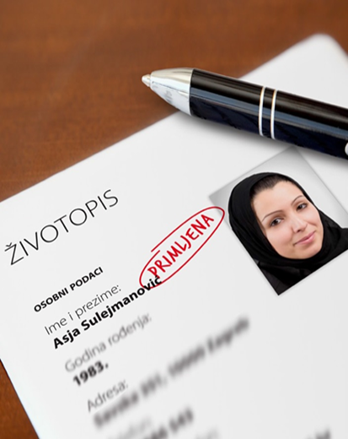
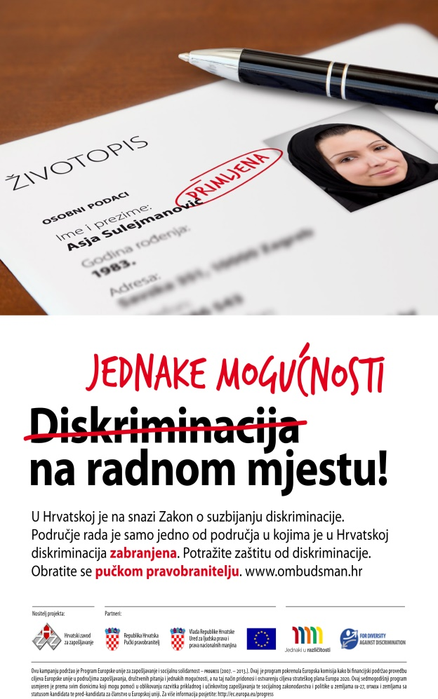
...
2012 campaign - discrimination in the field of employment and at work, discrimination based on national and ethnic origin, age and religion

Slide 15
Thank you!
www.ombudsman.hr

