Slide 1
Religion or belief work at the EHRC – engaging with employers
Sue Coe, Programme Head, Equality and Human Rights Commission
Sue.coe@equalityhumanrights.com

Slide 2
Pagan police win the right to take time off for festivals
Why I will fight to bear my cross: Four devout British Christians take their battle for religious freedom to human rights judges
Judges respect for the crucifix is paper thin
We are living in a post-Christian Britain and things will get worse claims Archbishop of Canterbury as Christians admit they are afraid to practice their faith
Hindu grandfather wins ‘human right’ to be cremated on open air funeral pyre
Christians ‘must choose between job or their faith’: Government lawyers claim at European Court
Secularists query decision to reinstate registrar who refused to conduct same sex weddings
What an insult to Christians! After crucifixes are allowed at work, human rights quango tells firms: give vegans and pagans special treatment too
BA had bullying lawyers but I had God on my side
02

Slide 3
Religion or belief in the workplace and service delivery – a call for evidence
02

Slide 4
Call for Evidence – key findings
Some workplaces inclusive. In others, religion seen as a private matter that should not be discussed at work
Perceived discrimination in recruitment, working conditions, promotion and progression, time off work
Beliefs mocked or dismissed; some employees felt unable to challenge discrimination and harassment
Concerns about the balance between freedom to express religious views and rights of others
Divergent views about when desirable and appropriate to discuss religious beliefs
Divergent views about opting out from work duties
03

Slide 5
Barriers for employers
04

Slide 6
Support for employers
Guidance
Online training
Simple checklists
Infographics
05

Slide 7
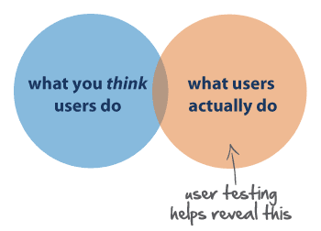
Employer user-testing of the guidance
06

Slide 8
Religion or Belief digital communications strategy
08

Slide 9
How to Guides
Religion or Belief digital communications strategy
09

Slide 10
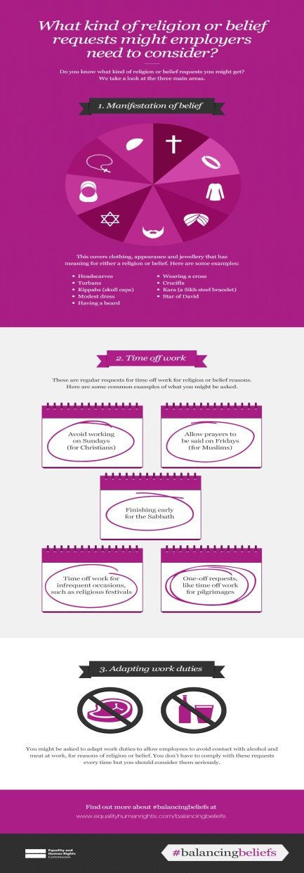
Infographics
Religion or Belief digital communications strategy
10

