Slide 1
www.philodroit.be

Slide 2
Legal challenges to frame religious discrimination
A question of faith. Religion and belief in the work of equality bodies (Equinet Seminar – 9 November 2015)
Isabelle Rorive
Prof. at the Law Faculty
Director of the Centre Perelman for Legal Philosophy
Université libre de Bruxelles (ULB)
European Equality Law Network (senior expert on religion or belief)
www.philodroit.be

Slide 3
Major challenges
Legal basis
Definition, boundaries and intersectionality
Neutrality and corporate image
Religious objection on discriminatory ground
www.philodroit.be

Slide 4
Legal basis – Two foundations
Freedom of religion and belief (+ non-discrimination clause)
Art. 9 ECHR (+ Art. 14 ECHR)
Contracting out doctrine (until Eweida and others v. the UK, 2013)
ECtHR (GC), Thlimmenos v. Greece (2000)
www.philodroit.be

Slide 5
Legal basis – Two foundations
Non-discrimination based on religion or belief:
Employment Equality Directive (2000/78/EC)
Direct discrimination (exceptions in Art. 4)
Indirect discrimination
+ the issue of reasonable accommodation
(Bribosia & Rorive, Reasonable Accommodation beyond disability in Europe, EU Commission, Sept. 2013)
Shift from freedom (tolerance) to non-discrimination
www.philodroit.be

Slide 6
Legal basis - Strategy
Freedom of religion / Non-discrimination
A strategic choice
Eg. ECtHR, Eweida and others v. the UK (2013)
Multilayered legal sources at the international level
Forum shopping and strategic litigation
Eg. “The Singh saga” before the ECtHR and the UN HRC
(Bribosia, Caceres & Rorive, “Les signes religieux au cœur d’un bras de fer: la saga Singh”, Revue trimestrielle des droits de l’homme, 2014, pp. 495-514)
www.philodroit.be

Slide 7
Definition – Religion or belief
Directive 2000/78/EC
Undefined
EU Commission
Political opinion not included
Member States
Guidance notes in some States
www.philodroit.be

Slide 8
Definition
ECtHR
Broad definition
Subjective and liberal approach
Eg. ECtHR (GC), Leyla Sahin v. Turkey (2005)
Eg. ECtHR, Eweida and others v. the UK (2013)
// Syndicat Northcrest v. Amselem, [2004] S.C.C. 47
www.philodroit.be

Slide 9
Boundaries and multiple identities
Religion/race
Mandla v Dowell-Lee [1983] UKHL 7
R (E) v Governing Body of JFS [2009] UKSC 15
Intersectionality
EU legal protection wider in Directive 2000/43
Material scope
Requirement of an equality body
www.philodroit.be

Slide 10
Neutrality and corporate image
The Baby Loup case (France)
The Ashbita case (Belgium) – request for a preliminary ruling lodged on 3 April 2015 (Case C-157/15)
The Bougnaoui case (France) – request for a preliminary ruling lodged on 24 April 2015 (Case C-188/15)
www.philodroit.be

Slide 11
Religious objection
Religious objection on discriminatory ground
Same-sex marriage:
Eg. ECtHR, Eweida and others v. the UK (2013)
Eg. French Constitutional Council, decision no. 2013-353 (QPC of 18 October 2013)
Eg. Legislation in the Netherlands (2014)
Goods and services:
Eg. Bull v. Hall and Preddy [2013] UKSC 73
Eg. Lee v. Ashers Baking Co ltd & Anor [2015] NICty 2
Debate not limited to Europe
www.philodroit.be

Slide 12
Some food for thought
Religion/belief raises distinct challenges for discrimination law
Highly political context cannot be overlooked
Minority and majority divide
www.philodroit.be

Slide 13
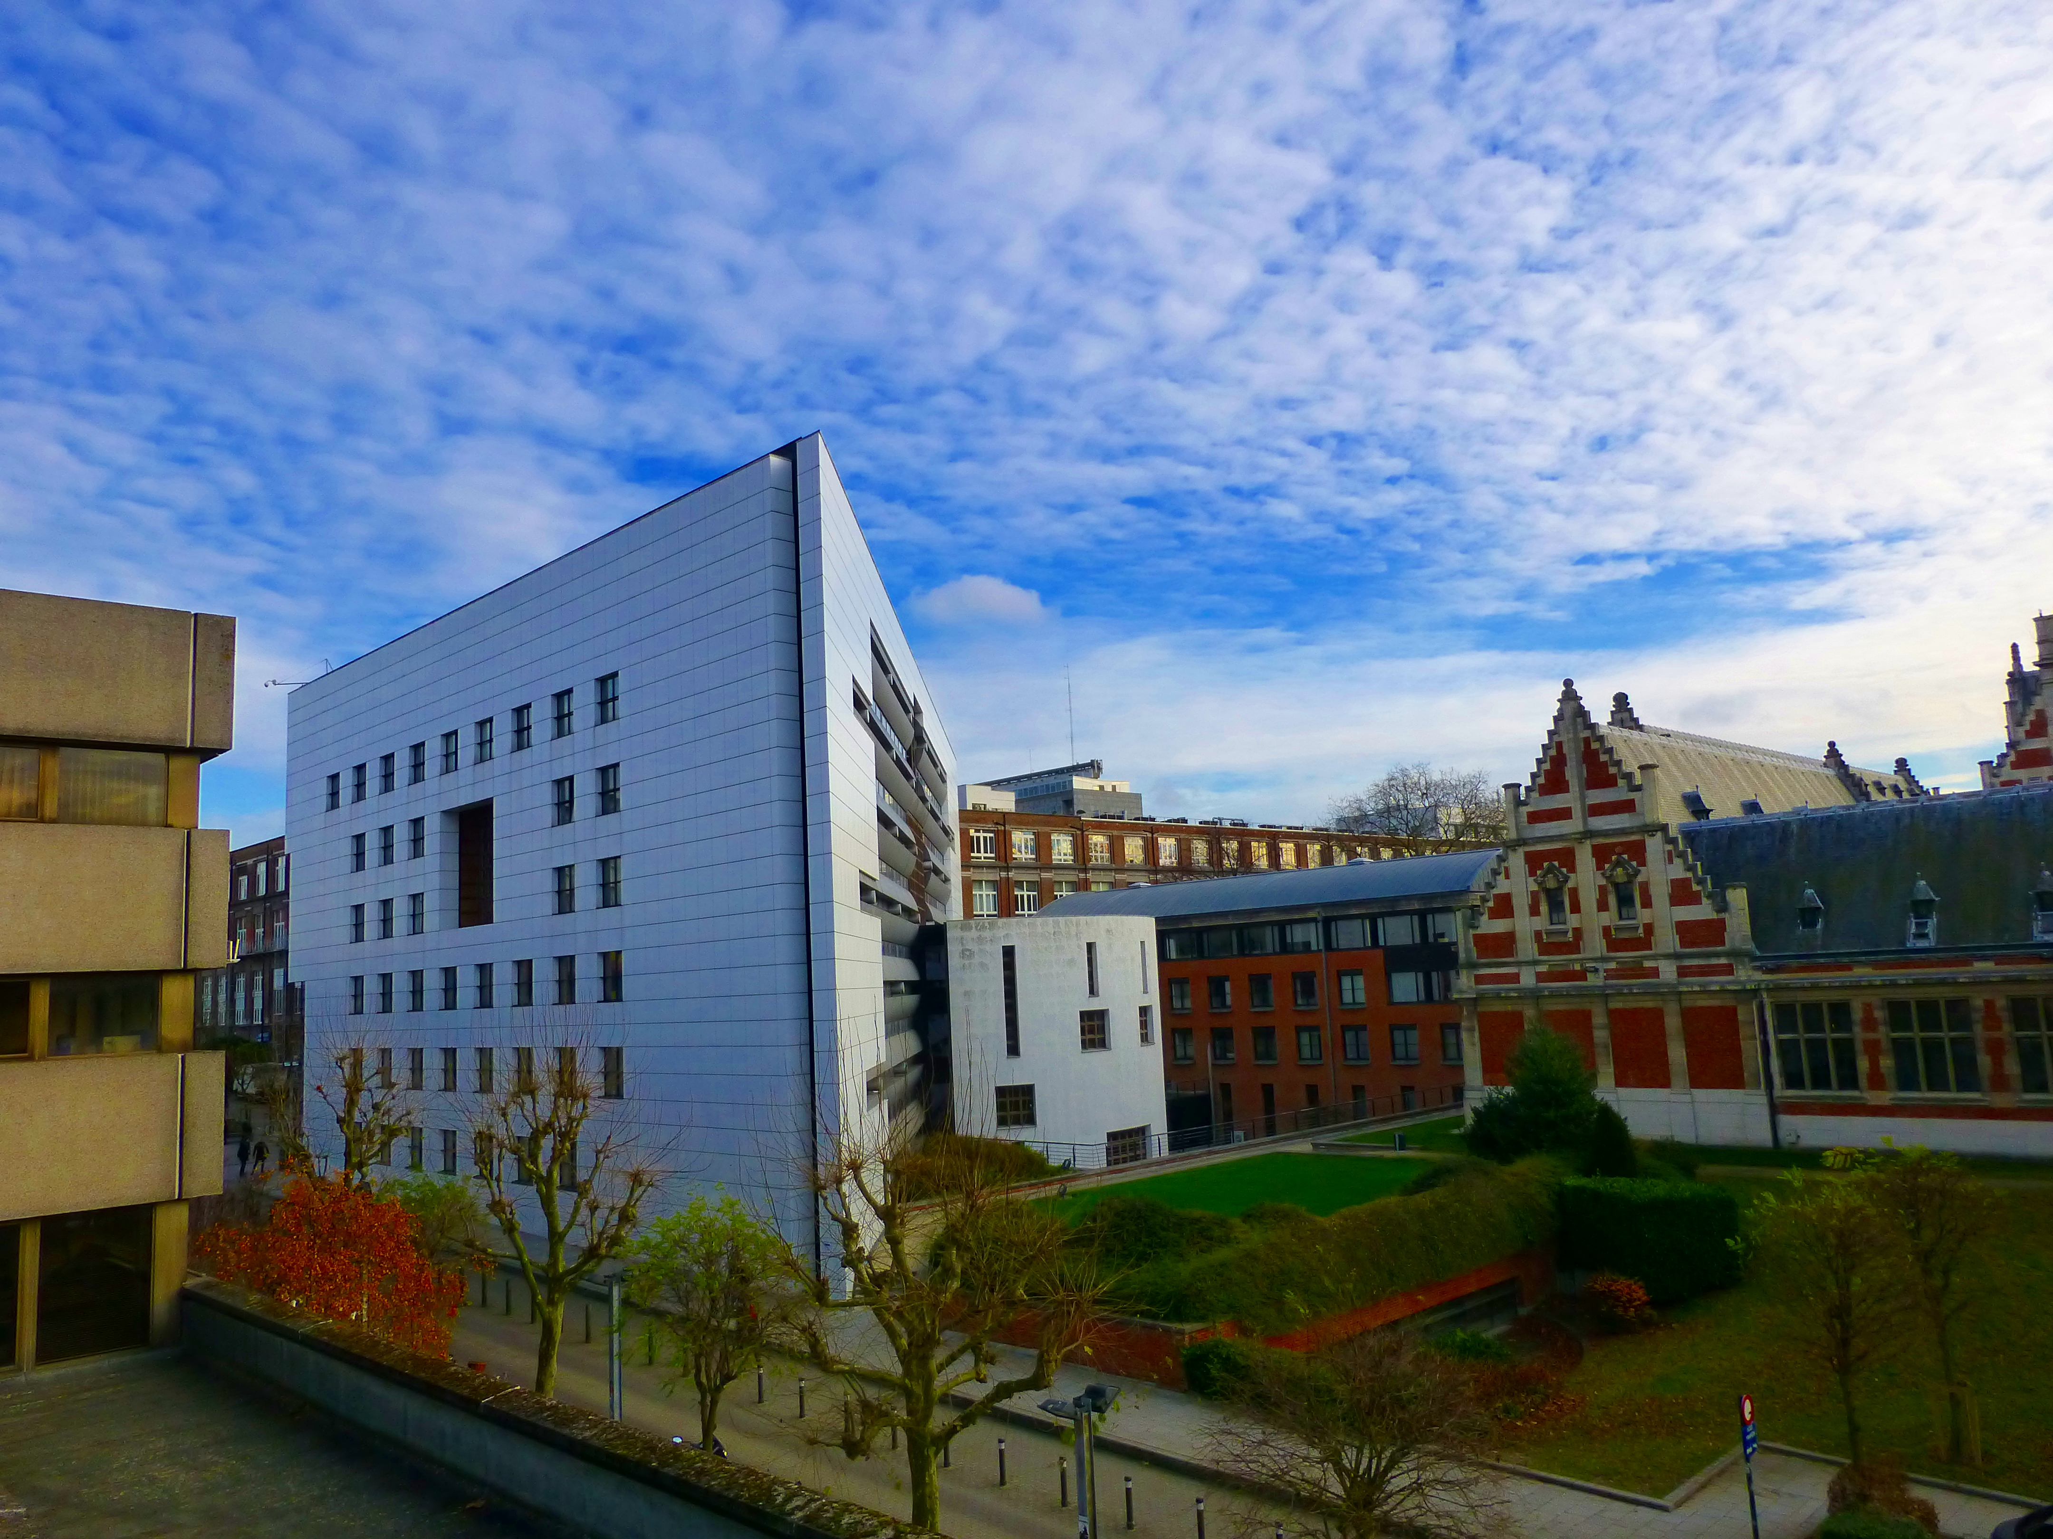
www.philodroit.be

