Slide 1
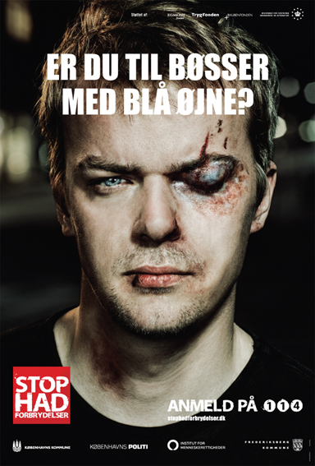
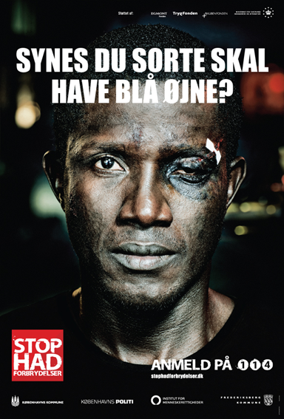
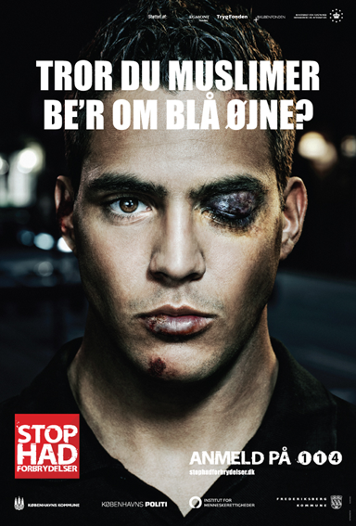
Posters of the hate crime campaign
The three posters focusing on hate crimes against minority groups. First one reading ”Are you into gays with blue eyes?”, second one ”Do you think black people should have blue eyes?”, third one “Do you think Muslims ask for blue eyes?” (a blue eye in Danish is a black eye), all of them stating “stop hate crimes” and “report on 114”.

Slide 2
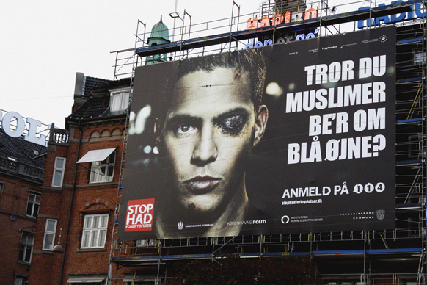
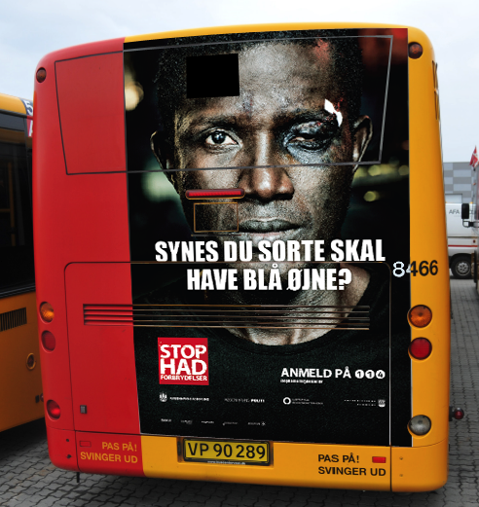
Outdoor banners and posters
Banner at the city hall square of Copenhagen, posters at the rear end of busses and in stands in downtown Copenhagen.

Slide 3
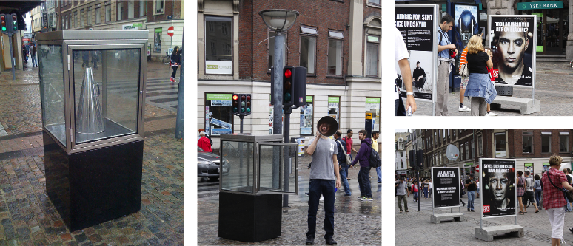
Art event at the main shopping street in Copenhagen
Every day at noon a man stopped by the glass case took out the megaphone and yelled: “It is never too late to say I’m sorry”. This was a loud comment on the way we treat each other and foreigners.

